Slide 1

Bayesian Spatial Clustering of
a Regression Coefficient
주건재
송현도
이재선

Slide 2

OVERVIEW
INTRODUCTION
DATA
MODEL
RESULT

Slide 3
1. INTRODUCTION

Slide 4
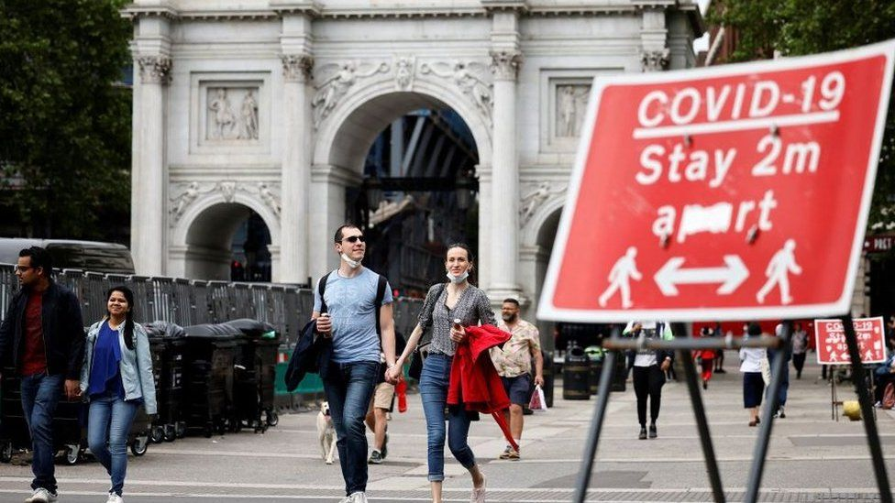
1. INTRODUCTION
1.1 TOPIC
Source: Getty Images
“Infectious diseases diffuse over space”
“The regression coefficient may have spatial dependency structures”

Slide 5
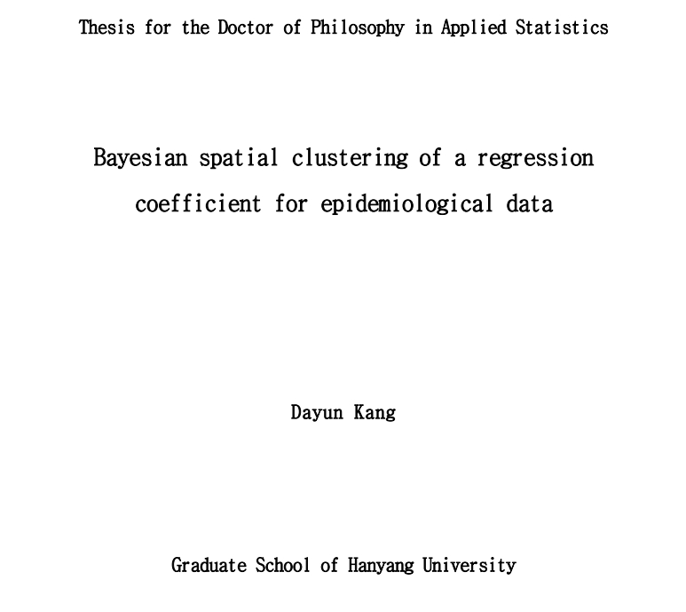
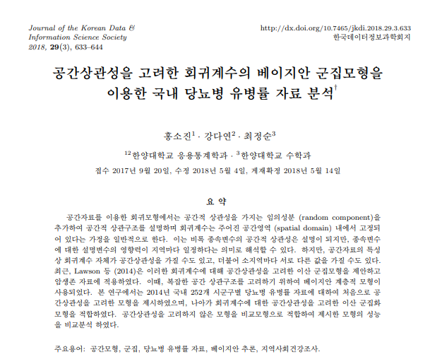
1. INTRODUCTION
1.2 BIBIOGRAPHY

Slide 6
2. DATA

Slide 7
2. DATA
2.1 MOTIVATING DATA
COVID-19 cases in Seoul
Si/Gun/Gu-level counts of COVID-19
January 1, 2021 ~ September 4, 2021
Number of areas: 25 (based on the map of the 2018 year)
Data from 서울 열린 데이터 광장

Slide 8
2. DATA
2.1 MOTIVATING DATA
Covariates
Proportion of old population in January 1, 2021 ~ August 31, 2021
Proportion of foreigner in 2021
Population density (people per km) in 2021
Data from 서울 열린 데이터 광장

Slide 9
2. DATA
2.2 EDA
Data description
Variable | Mean | sd | Median | Q1 | Q3 | Min | Max
COVID-19 cases | 2345 | 886.251 | 2331 | 1904 | 2714 | 861 | 5036
Proportion of old population | 0.163 | 0.017 | 0.162 | 0.150 | 0.174 | 0.141 | 0.207
Proportion of foreigner | 0.009 | 0.007 | 0.007 | 0.003 | 0.014 | 0.002 | 0.023
Population density (people per km) | 16921 | 4701 | 16890 | 13987 | 19598 | 6432 | 25875

Slide 10
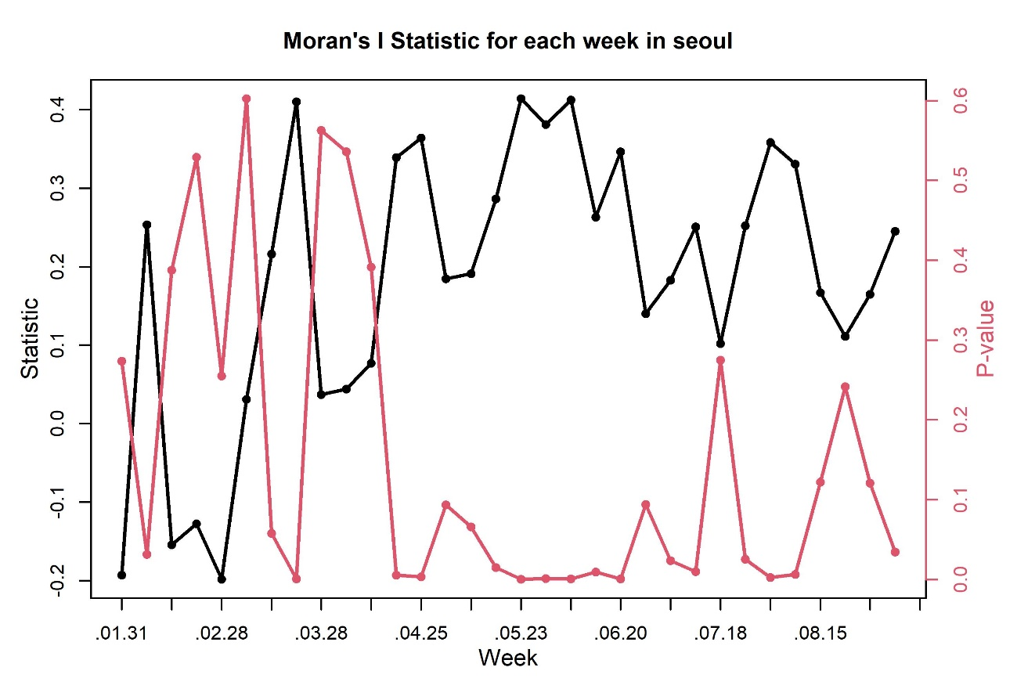
2. DATA
2.2 EDA
Moran’s I: a measure of spatial association among areal units

Slide 11
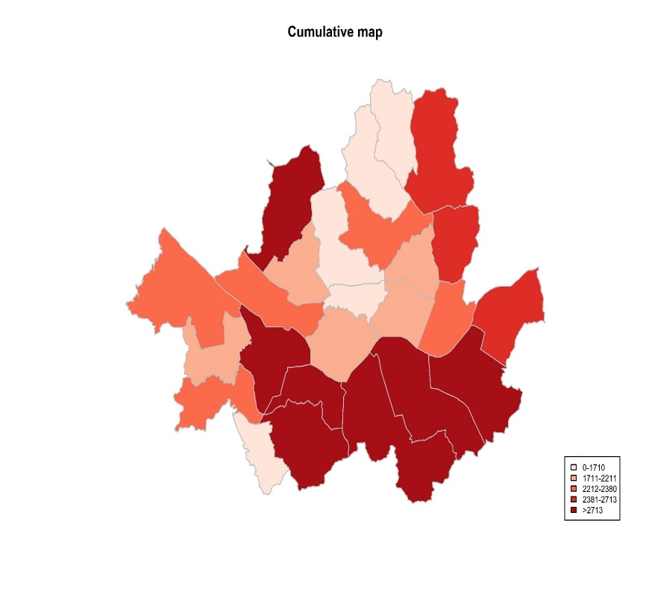
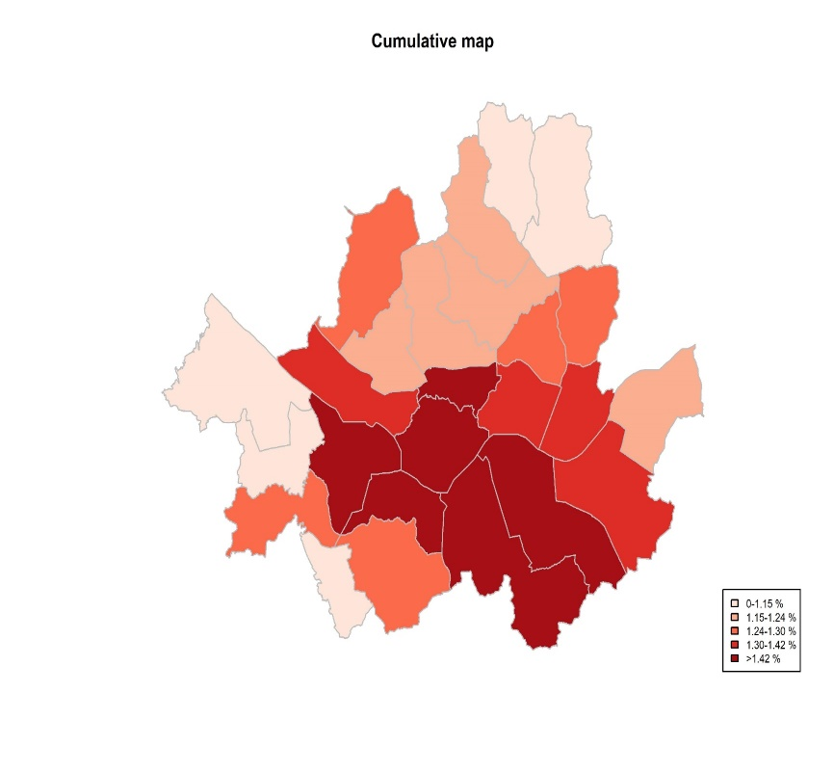
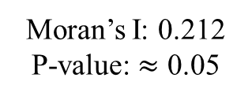
2. DATA
2.2 EDA
Considering population
of each district (gu)
Moran’s I: 0.212
P-value: $≈$ 0.05
Moran’s I: 0.385
P-value: < 0.001

Slide 12
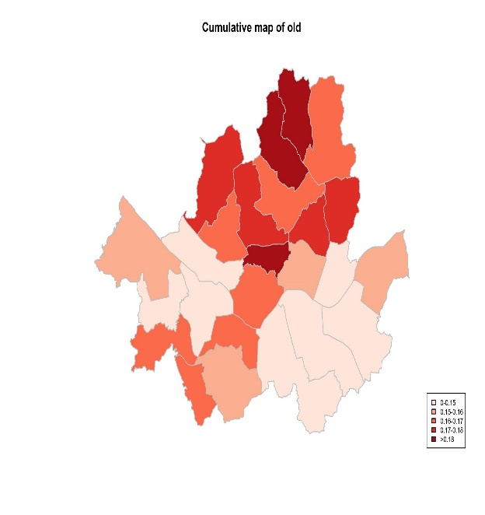
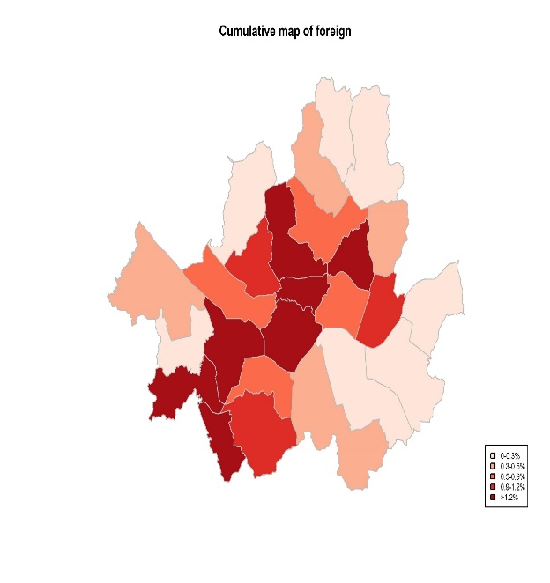
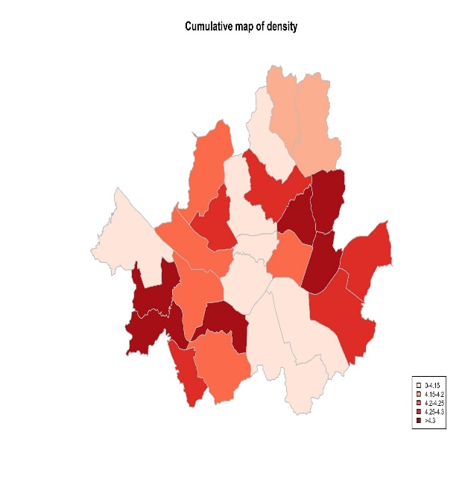
2. DATA
2.2 EDA
There may exist spatial clusters for each variable
The regression coefficient may have spatial dependency structures

Slide 13
3. MODEL

Slide 14
3. MODEL
3.1 MODEL
Count data
Overdispersion
Excess of zero counts
Negative Binomial OR Poisson-lognormal model
Poisson model
Zero-inflated Poisson model
with clustering

Slide 15
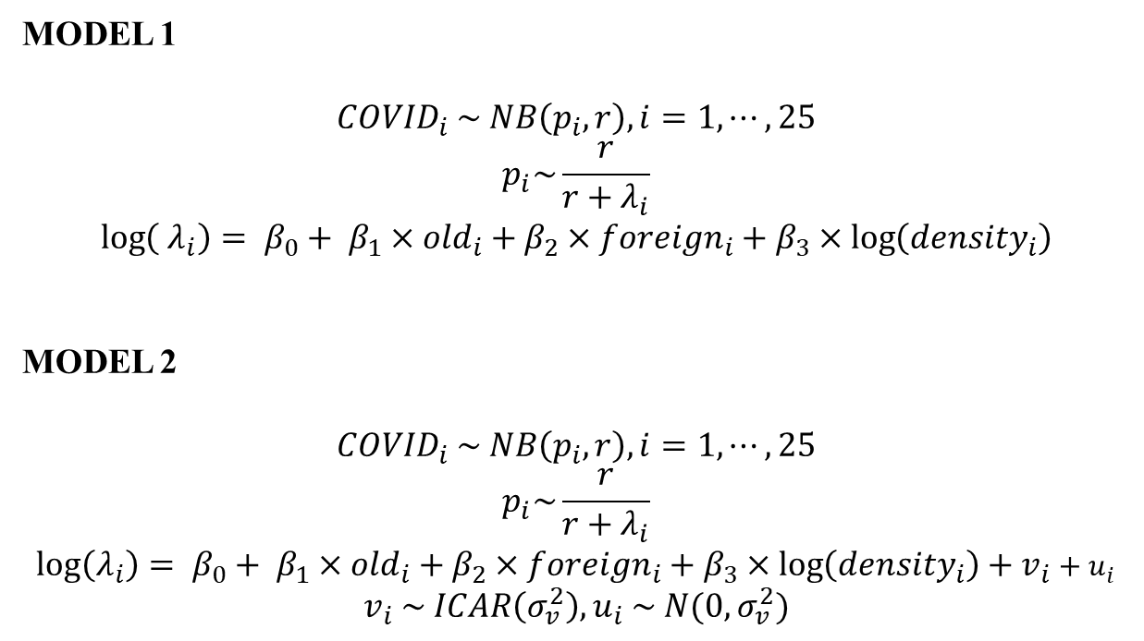
3. MODEL
3.1 MODEL
MODEL 1
$${COVID}_{i} \sim NB\left(p_{i},r\right), i=1,⋯,25$$
$$p_{i}\sim \frac{r}{r+λ_{i}}$$
$$\log\left({ λ}_{i}\right)= β_{0}+ β_{1}×{old}_{i}+β_{2}×{foreign}_{i}+β_{3}×\log\left({density}_{i}\right)$$
MODEL 2
$${COVID}_{i} \sim NB\left(p_{i},r\right), i=1,⋯,25$$
$$p_{i}\sim \frac{r}{r+λ_{i}}$$
$$\log\left(λ_{i}\right)= β_{0}+ β_{1}×{old}_{i}+β_{2}×{foreign}_{i}+β_{3}×\log\left({density}_{i}\right)+v_{i}+u_{i}$$
$$v_{i} \sim ICAR\left(σ_{v}^{2}\right), u_{i} \sim N(0,σ_{v}^{2})$$

Slide 16
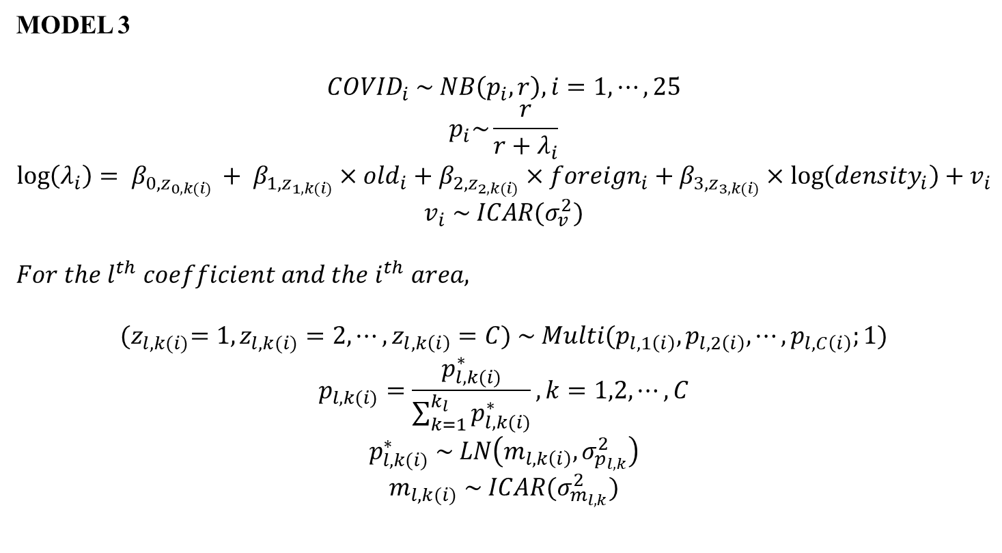
3. MODEL
3.1 MODEL
MODEL 3
$${COVID}_{i} \sim NB\left(p_{i},r\right), i=1,⋯,25$$
$$p_{i}\sim \frac{r}{r+λ_{i}}$$
$$\log\left(λ_{i}\right)= β_{0,z_{0,k(i)} }+ β_{1,z_{1,k(i)}}×{old}_{i}+β_{2,z_{2,k(i)}}×{foreign}_{i}+β_{3,z_{3,k(i)}}×\log\left({density}_{i}\right)+v_{i}$$
$$v_{i} \sim ICAR(σ_{v}^{2})$$
$$For the l^{th} coefficient and the i^{th} area,$$
$${(z}_{l,k(i)}=1, z_{l,k(i)}=2,⋯,z_{l,k\left(i\right)}=C) \sim Multi(p_{l,1\left(i\right)},p_{l,2\left(i\right)},⋯,p_{l,C\left(i\right)};1)$$
$$p_{l,k(i)}=\frac{p_{l,k(i)}^{∗}}{\sum_{k=1}^{k_{l}}{p_{l,k(i)}^{∗}}}, k=1,2,⋯,C$$
$$p_{l,k(i)}^{∗} \sim LN\left(m_{l,k\left(i\right)}, σ_{p_{l,k}}^{2}\right)$$
$$m_{l,k(i)} \sim ICAR(σ_{m_{l,k}}^{2})$$

Slide 17
4. RESULT

Slide 18
4. RESULT
4.1 PERFORMANCE
Model performance
 | DIC
MODEL 1 | 5702.54
MODEL 2 | 3891.73
MODEL 3

Slide 19
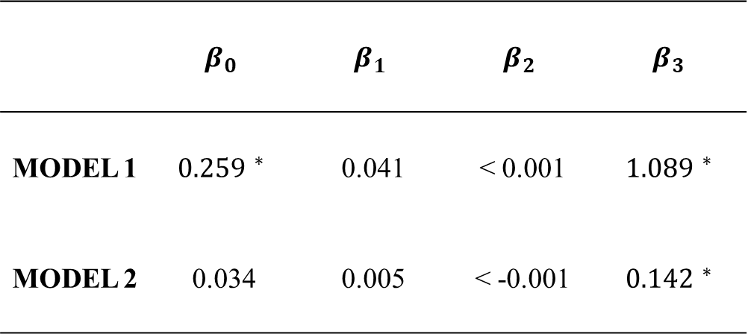
4. RESULT
4.2 ESTIMATE
Parameter estimates (posterior mean)
 | $$β_{0}$$ | $$β_{1}$$ | $$β_{2}$$ | $$β_{3}$$
MODEL 1 | $${0.259 }^{∗}$$ | 0.041 | < 0.001 | $${1.\text{089} }^{∗}$$
MODEL 2 | 0.034 | 0.005 | < -0.001 | $${0.142 }^{∗}$$
* represents statistically significant values

Slide 20
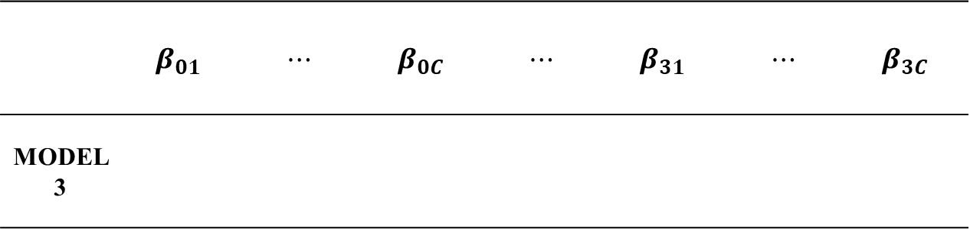
4. RESULT
4.2 ESTIMATE
Parameter estimates (posterior mean)
 | $$β_{01}$$ | $$⋯$$ | $$β_{0C}$$ | $$⋯$$ | $$β_{31}$$ | $$⋯$$ | $$β_{3C}$$
MODEL 3
* represents statistically significant values

Slide 21
Q&A

Slide 22
REFERENCE
홍종환. (2022). 베이지안 시공간 모형을 이용한 서울시 COVID-19 자료 분석 (Doctoral dissertation, 한양대학교).
Besag, J. (1974). Spatial interaction and the statistical analysis of lattice systems. Journal of the Royal Statistical Society: Series B (Methodological), 36(2), 192-225.
Brook, D. (1964). On the distinction between the conditional probability and the joint probability approaches in the specification of nearest-neighbor systems. Biometrika, 51(3/4), 481-483.
Clifford, P. (1990). Markov random fields in statistics. Disorder in physical systems: A volume in honour of John M. Hammersley, 19-32.
Hong, S., Kang, D., & Choi, J. (2018). Analysis of domestic diabetes prevalence data using Bayesian spatially- dependent clustering models in regression coefficients. The Korean Data & Information Science Society, 29(3), 633-644.
Lawson, A. B., Choi, J., & Zhang, J. (2014). Prior choice in discrete latent modeling of spatially referenced cancer survival. Statistical methods in medical research, 23(2), 183-200.
Kang, D. (2021). Bayesian spatial clustering of a regression coefficient for epidemiological data (Doctoral dissertation, 한양대학교).
Hong, S., Kang, D., & Choi, J. (2018). Analysis of domestic diabetes prevalence data using Bayesian spatially- dependent clustering models in regression coefficients. The Korean Data & Information Science Society, 29(3), 633-644.

