Slide 1
Best Practice
FME 2016 Training

Slide 2
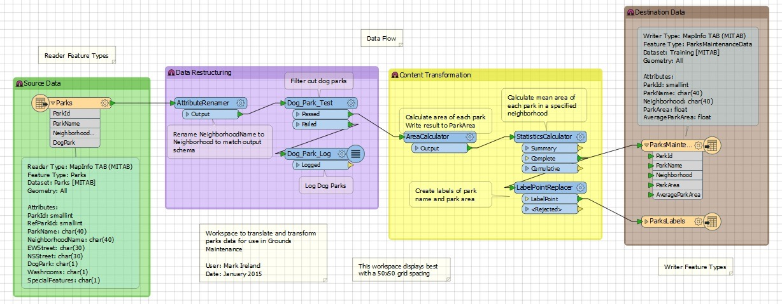
Best Practice
In this Section
What is Best Practice?
Style
Methodology
Debugging
Organization

Slide 3
Best Practice
What is Best Practice?
Why use Best Practice?

Slide 4
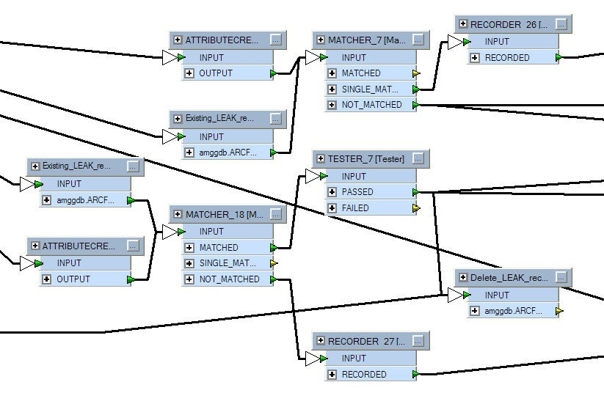
FME Workspace Design
Examples of Poor Design

Slide 5
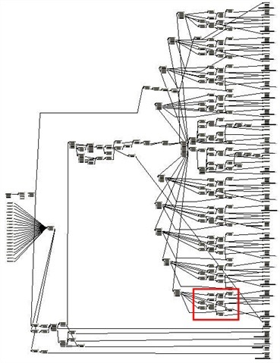
FME Workspace Design
Examples of Poor Design

Slide 6
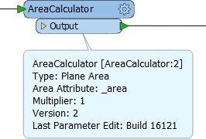
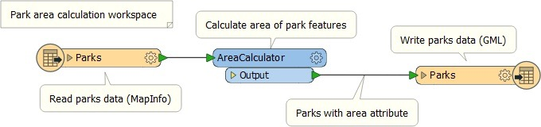
Annotating Workspace
Header Annotation
Summary Annotation
User Annotation
Annotation Options

Slide 7
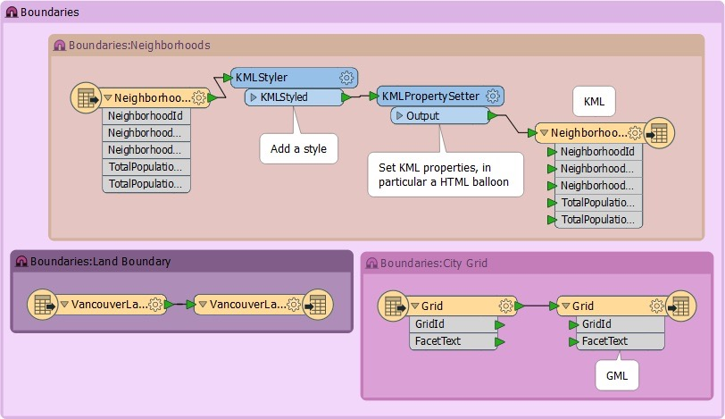
Bookmarks
Adding, Resizing, and Editing
Bookmark Options
The Magnet Icon
Bookmarks for Sectioning
Bookmarks for Quick Access
Bookmarks for Editing
?

Slide 8
General Style Suggestions
Transformer Layout
Grid and Guides
Non-overlapping Connections
Renamed Transformers
Workspace Properties
Applying the Style Guide
E

Slide 9
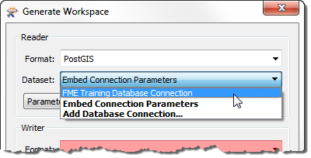
Format Methodology
Minimizing Feature Type Objects
Database Connections

Slide 10
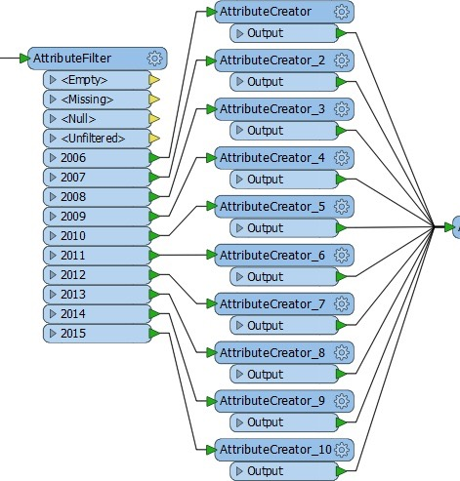
Transformer Methodology
Duplicated Transformers
Error Trapping
Complexity
Design Patterns
E

Slide 11
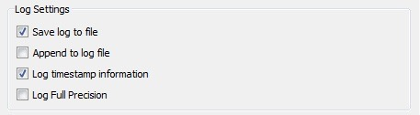
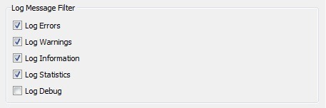
Debugging - Logging
Message Types
Log Options
Log Timings
Logger Transformer
Spatial Log File

Slide 12
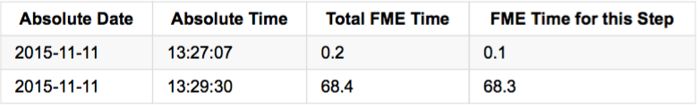
Debugging - Logging
Interpreting the Log Window
Check for Errors
Check for Warnings
Check for Timestamps
Sequence

Slide 13
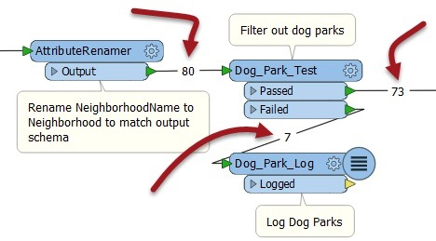
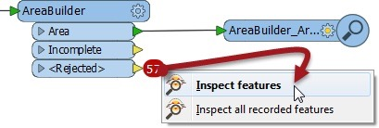
Deugging
Feature Counts
Rejected Features

Slide 14
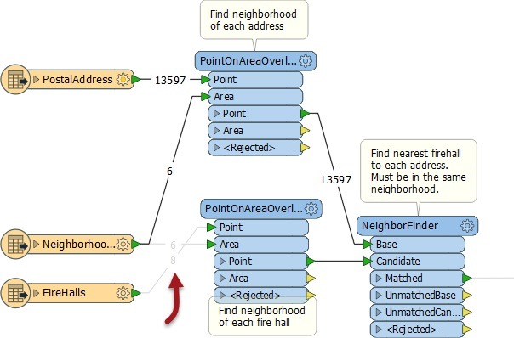
Debugging
Workspace Searching
Testing Isolated Sections
?
Debugging
E

Slide 15
Organization
Sharing Resources
Shared Resource Folder
Templates
?

Slide 16
Organization
FME Projects
Folder Structure
File Renaming
Relative Paths

Slide 17
Exercise
Exercise | FME Hackathon
Data | Roads (Autodesk AutoCAD DWG, Esri Shape, and/or PostGIS)
Overall Goal | Find the shortest route from the hackathon to an Italian Cafe
Demonstrates | Data Translation, Transformation, and Best Practice
Start Workspace | None
End Workspace | C:\FMEData2016\Workspaces\DesktopBasic\BestPractice-Ex4-Complete.fmwt

Slide 18
Questions
Which of the following is NOT a method to create a bookmark?
Click the Insert Bookmark button on the toolbar
Select a transformer, right click, choose Create Bookmark
Select multiple transformers, right click, choose Create Bookmark
Use the Ctrl+B shortcut
Which of these is NOT a type of annotation in Workbench?
Header Annotation
Parameter Annotation
User Annotation
Summary Annotation

Slide 19
Question
It’s possible to disable other objects besides connections. Can you pick out which of these objects (there may be more than one) can be disabled in Workbench?
Transformers
Annotation
Feature Types
Bookmarks

Slide 20
Question
Which ways can a template be opened for use in FME Workbench (there might be more than one correct answer)?
Open it using File > Open
Open it using File > Open Recent Template
Double-click the fmwt file in Windows Explorer
Use Create Workspace from Template in the Getting Started part of the start tab

