Slide 1
Advanced Parameter Use
FME 2017

Slide 2

Performance
In this Section
Performance and FME and 64-Bit
Log File Interpretation
Reader and Writer Optimization
Transformation Optimization
Database Optimization
Parallel Processing
FME Server and FME Cloud

Slide 3

Performance and FME
What do we mean by performance?
What can impair performance?
What is 64-bit FME?

Slide 4
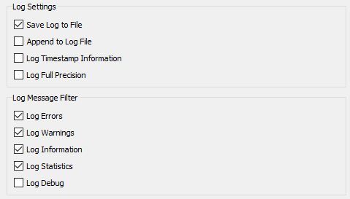
Log File Interpretation
Log Messages
Configuring the Log Window

Slide 5
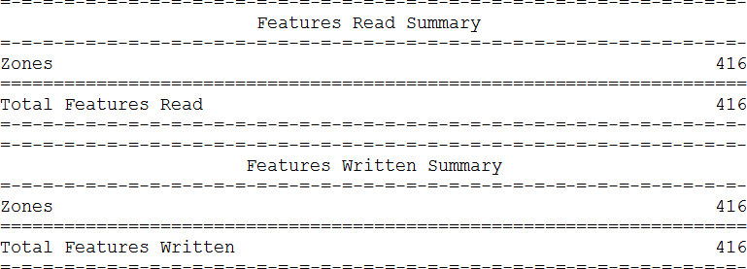
Log File Interpretation
Command Line Statement
Configuration and Setup Information
Translation and Transformation
Log Summary
Log Timings

Slide 6
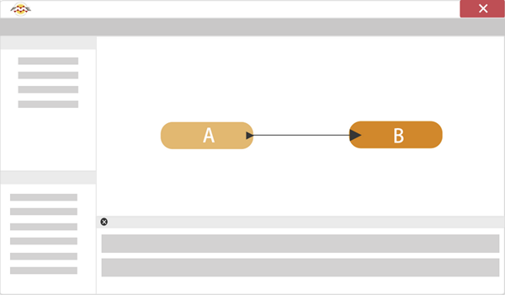
Reader/Writer Optimization
Reader and Writer Optimization
Assessing Reader Performance
Improving Reader Performance
Assessing Writer Performance
Improving Writer Performance

Slide 7
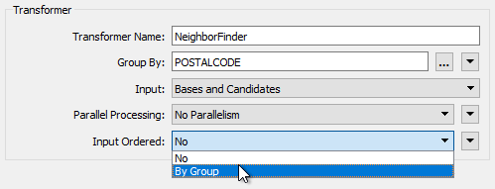
Transformation Optimization
Transformation Length
Transformation Memory Use
Improving Transformation Performance

Slide 8
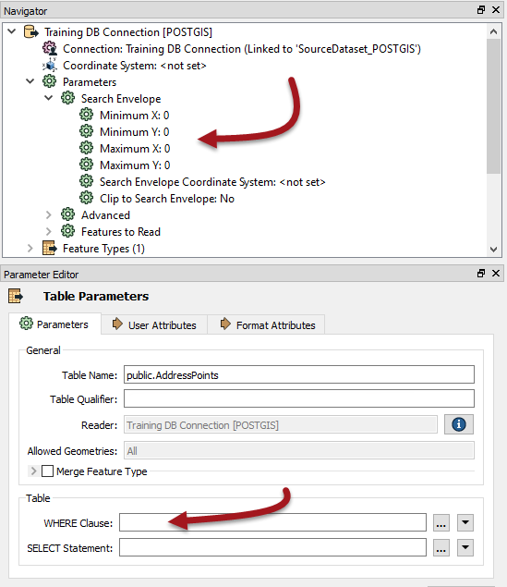
Database Optimization
Database Reading
Database Writing

Slide 9
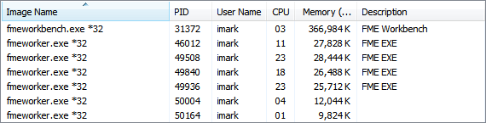
Parallel Processing
What is Parallel Processing?
Transformers and Parallel Processing
Parallel Processing Groups

Slide 10
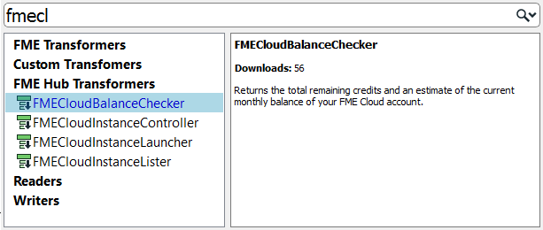
FME Cloud and Server
Bulk Translations on FME Server
FME Cloud

