Slide 1
Custom Transformers
FME 2017

Slide 2

Custom Transformers
In this Section
Creating Custom Transformers
Using Custom Transformers
Schema Handling
Custom Transformer Types
Custom Transformer Versioning
Parallel Processing
Custom Transformer Loops

Slide 3
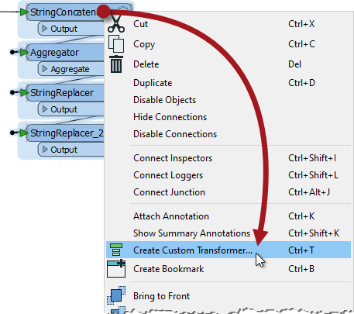
Custom Transformers
What is a Custom Transformer?
Creating a Custom Transformer

Slide 4
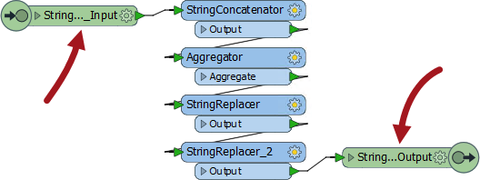
Using Custom Transformers
Using a Custom Transformer
Editing a Re-Used Custom Transformer
Custom Transformer Input/Output Ports

Slide 5
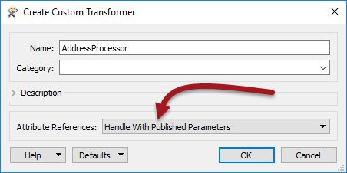
Custom Transformers and Schema
Handling Attribute Schema
Handling User Parameters
Automatic Schema Handling
Post-Creation Schema Handling

Slide 6
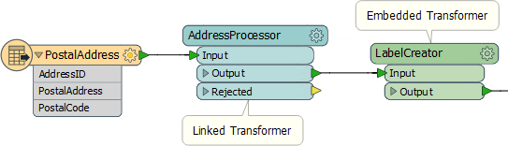
Custom Transformer Types
Linked vs Embedded
Creating a Linked Custom Transformer
Switching Custom Transformer Types

Slide 7
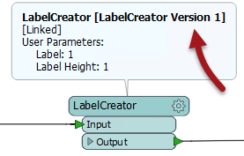
Custom Transformer Versioning
Custom Transformer Versioning
Why Use Versioning?
Creating/Editing Versions
Updating Versions

Slide 8
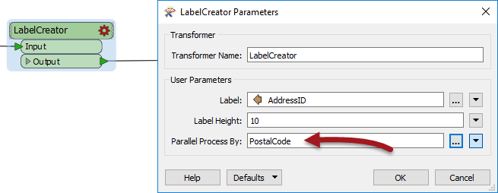
Parallel Processing
Activating Parallel Processing
Defining a Group

Slide 9
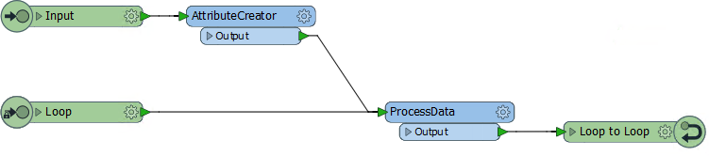
Loops
Custom Transformers and Loops
What is a Loop?
Why use a Loop?
Setting up a Loop
Loops and Custom Transformer Types

