Slide 1
Advanced Reading/Writing
FME 2017

Slide 2

Advanced Reading and Writing
In this Section
Zip File Handling
Web Based Datasets
Fanouts
Generic Read/Write
Dynamic Read/Write
Dynamic Schema Handling
Advanced Dynamic Schemas

Slide 3
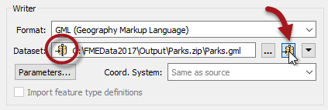
Zip File Handling
Zip File Reading
Zip File Writing

Slide 4
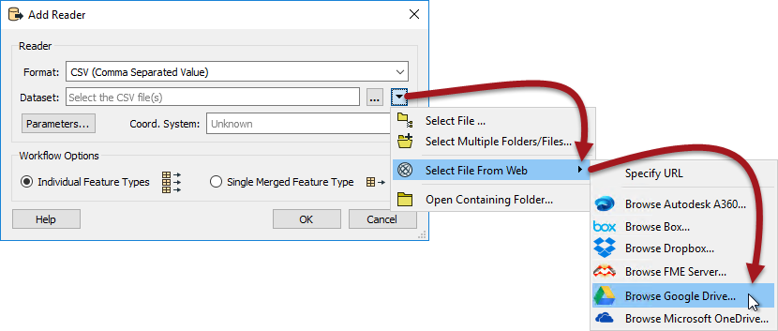
Web-Based Datasets
Simple URL Selection
Web Services
Connector Transformers

Slide 5
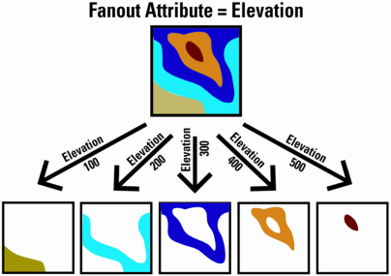
Fanouts
What is a Fanout?
Feature Type Fanout
Dataset Fanout

Slide 6


Generic Read/Write
The Generic Reader
The Generic Writer

Slide 7
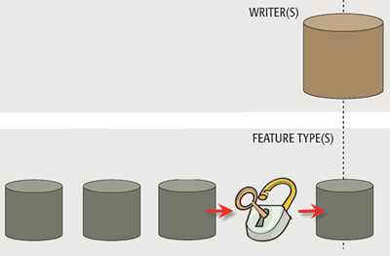
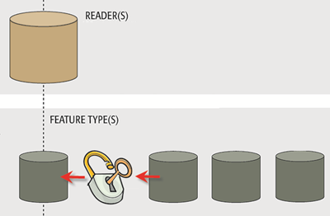
Dynamic Translations
What are Dynamic Translations?
Creating a Dynamic Translation
How does a Dynamic Translation Look?

Slide 8
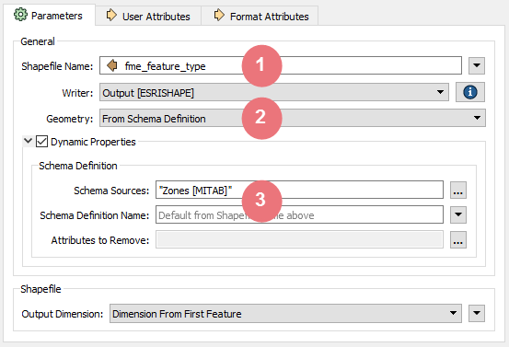
Dynamic Schema Handling
Schema Sources
Dynamic Feature Types
Dynamic Attribute Handling
Dynamic Geometry Handling

Slide 9
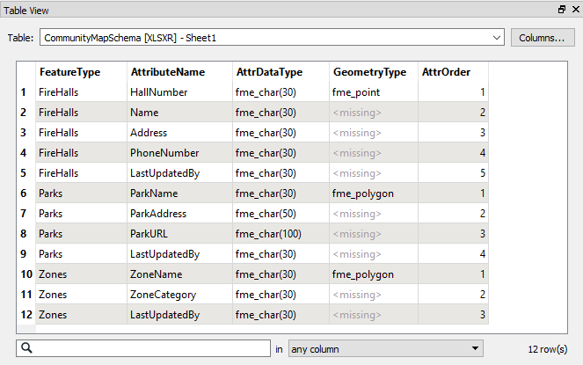
Advanced Dynamic Schemas
Table-Based Schemas
Constructed Attribute Schemas

