Slide 1
Advanced Attributes
FME 2017

Slide 2

Advanced Attribute Handling
In this Section
Constructing Values
Editor Dialogs
Conditional Values
Multiple Feature Attributes
Null Attributes

Slide 3
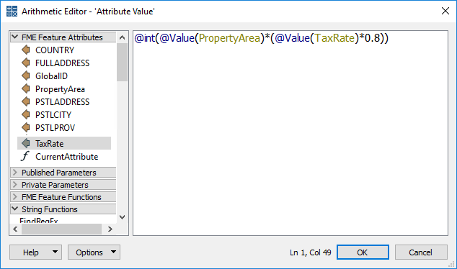
Constructing Values
Text Editor
Arithmetic Editor
FME Feature Functions

Slide 4
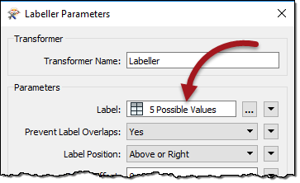
Conditional Values
What are Conditional Values?
When to use Conditional Values

Slide 5
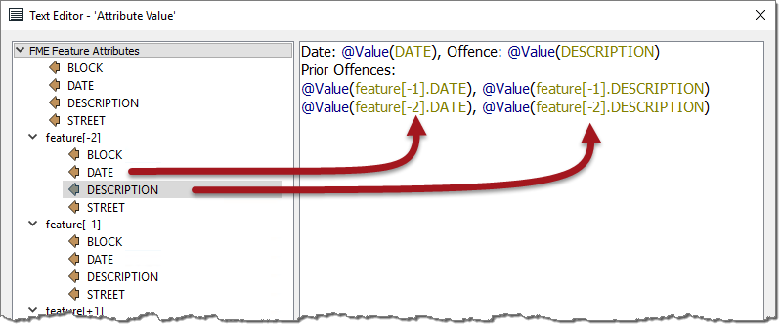
Multiple Feature Attributes
Adjacent Feature Functionality
Using Multiple Feature Attributes

Slide 6
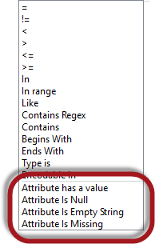
Null Attribute Values
What is a Null Value?
How does FME Represent “Nothing”?
Handling “Nothing”
Recognizing and Writing Nulls
Setting Nulls and Bulk Setting

