Slide 1
Data Transformation
FME 2016 Training

Slide 2

Data Transformation
In this Section
What is Data Transformation?
Structural Transformation
Transformation with Transformers
Content Transformation
Transformers in Series
Transformers in Parallel
Coordinate System Transformation

Slide 3
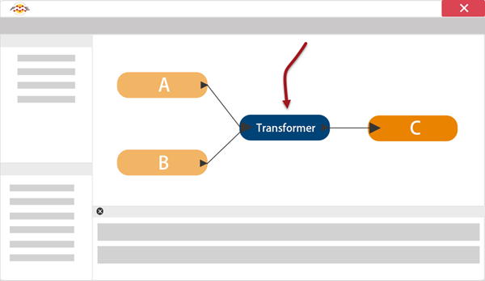
Data Transformation
What is Data Transformation?

Slide 4
Data Transformation Types
Structural (reorganization)
Content (revision)

Slide 5
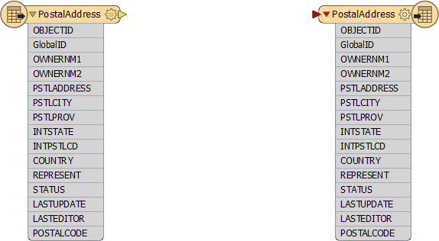
Structural Transformation
What is a schema?
Schema Representation in FME

Slide 6
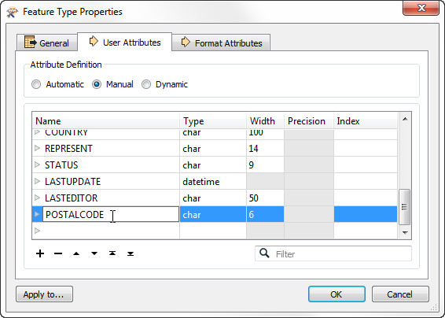
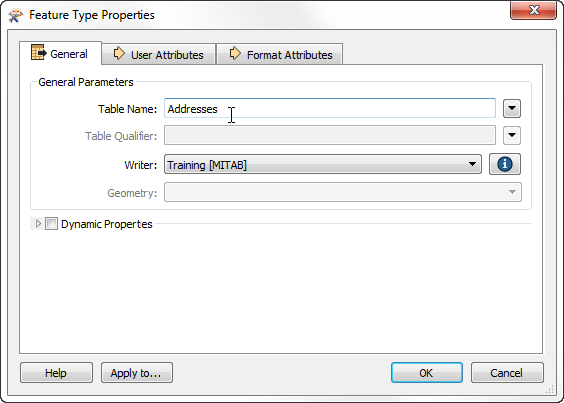
Schema Editing
Attribute Renaming
Attribute Type Changes
Feature Type Renaming
Geometry Type Changes
Schema Editing
E

Slide 7

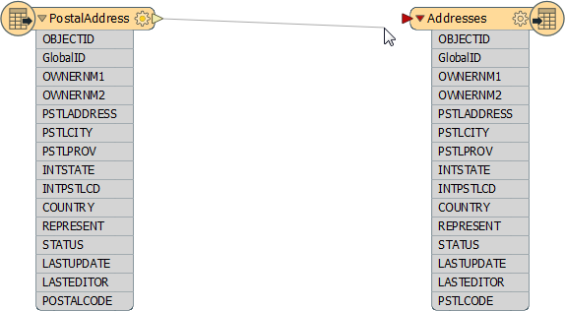
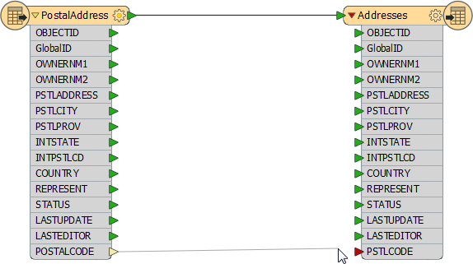
Schema Mapping
What is Schema Mapping?
Feature Mapping
Attribute Mapping

Slide 8


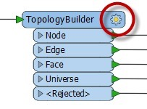
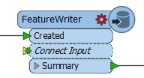
Transformation with Transformers
What is a Transformer?
Transformer Parameters
Color-Coded Properties Button
Transformer Ports
Structural Transformation
E

Slide 9
Content Transformation
What is a Feature?
Geometric Transformation
Attribute Transformation
?

Slide 10

Transformers Used in Series
Chaining Transformers
Calculating Statistics
E

Slide 11
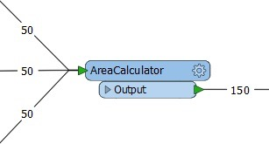

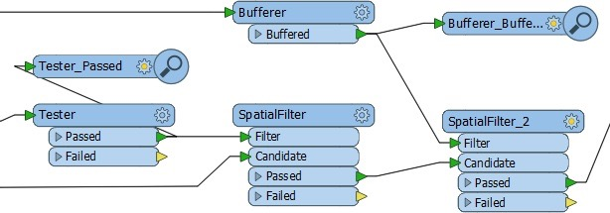
Transformers Used in Parallel
Multiple Streams
Labelling Features
E

Slide 12
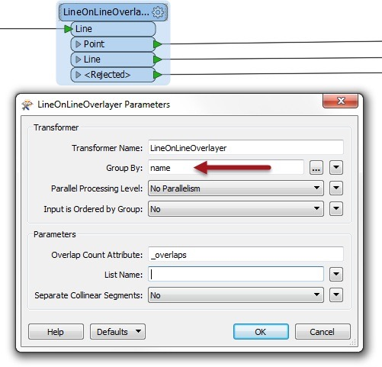
Group-By Processing
What is a Group?
Creating Groups
?
Neighborhood Averages
E

Slide 13
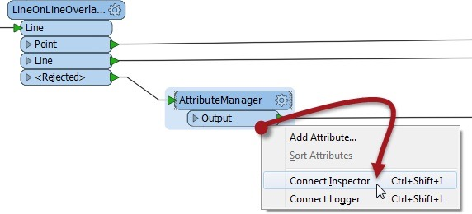
Data Inspection Using Workbench
Using and Placing Inspector Transformer

Slide 14
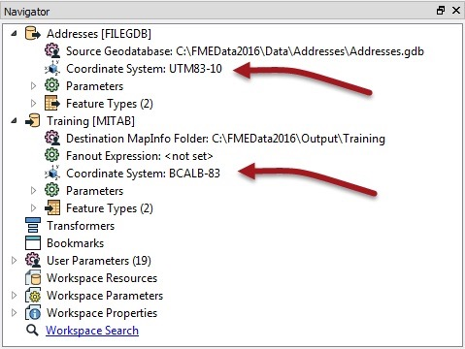
Coordinate System Transformation
Coordinate System Basics
Coordinate System Settings
Automatic Detection of Coordinate Systems
Data Reprojection
E

Slide 15
Exercise
Exercise | Voting Analysis Project
Data | Election Mapping (GML) Election Statistics (Microsoft Excel)
Overall Goal | Map statistics of voting patterns
Demonstrates | Data Transformation
Start Workspace | C:\FMEData2016\Workspaces\DesktopBasic\Transformation-Ex7-Begin.fmw
End Workspace | C:\FMEData2016\Workspaces\DesktopBasic\Transformation-Ex7-Complete.fmw

Slide 16
Questions
Which three colors represent checked, need checking, and unset parameters on transformer objects?
blue, yellow, red
green, yellow, red
red, green, blue
green, blue hellow
If I use a transformer to remove irregularities (like self-intersecting loops) in the boundary of a polygon, what type of transformation is it?
Structural Transformation of Attributes
Structural Transformation of Geometry
Content Transformation of Attributes
Content Transformation of Geometry

Slide 17
Questions
Which of the following transformers do you think is group-based? Feel free to use Workbench to help answer this question.
StringFormatter
Clipper
Rotator
AttributeRounder

