Slide 1
Data Translation Basics
FME 2017

Slide 2
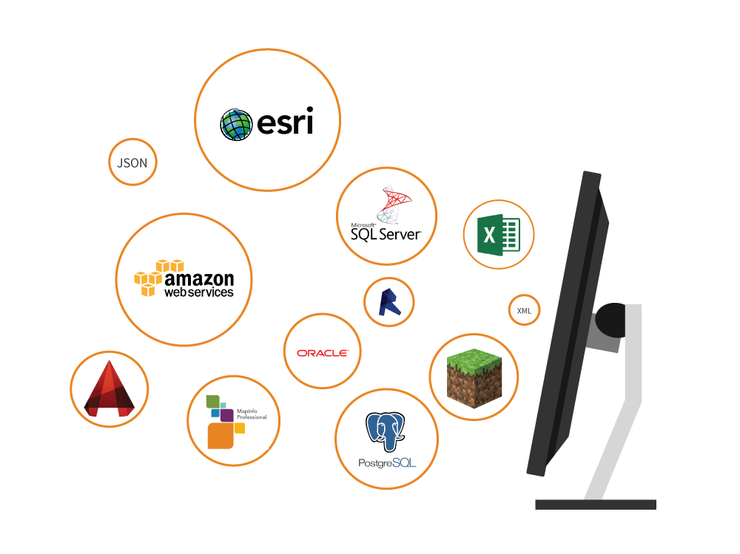
Data Translation Basics
In this Section
What is FME?
FME Desktop Components
Introduction to FME Workbench
Creating a Translation
Introduction to FME Data Inspector
Basic Data Inspection

Slide 3
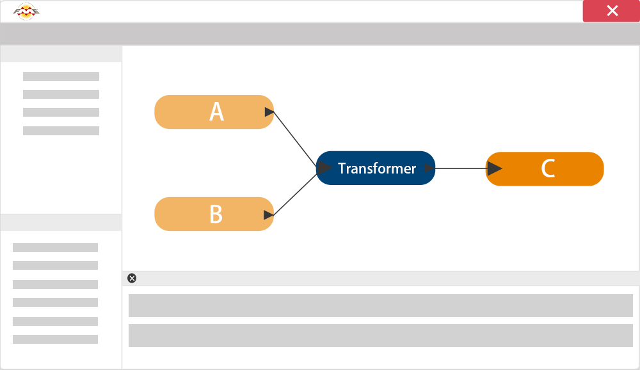
What is FME?
Data Interoperability Solution
Extract, Transform and Load

Slide 4
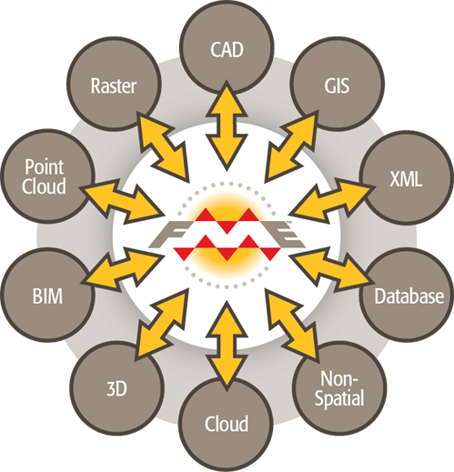
How FME Works
Rich Data Model
?

Slide 5
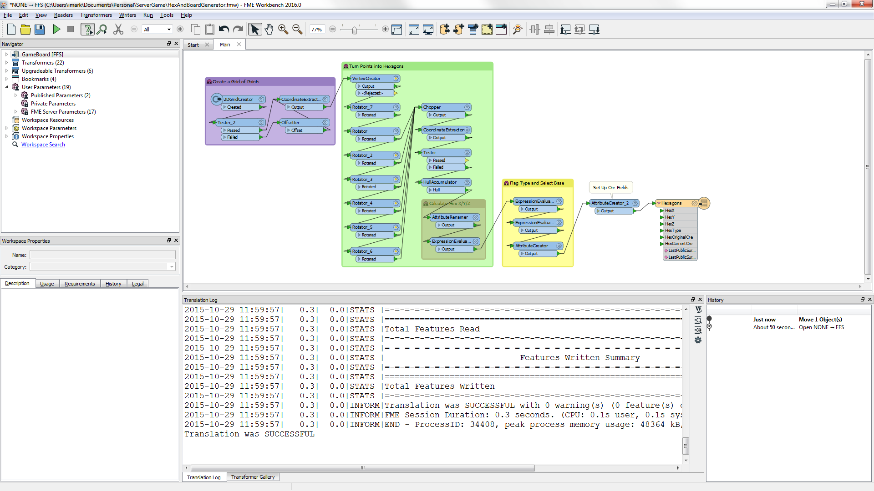
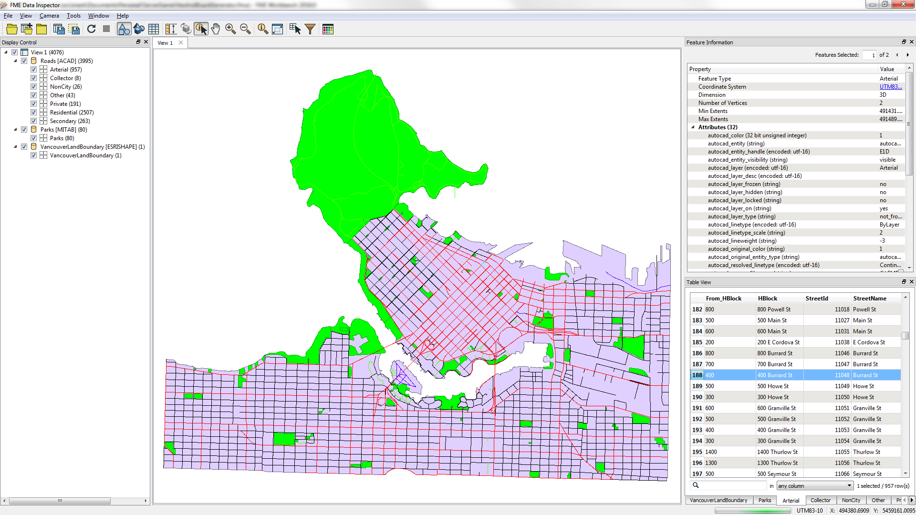
FME Desktop Applications
FME Workbench
FME Data Inspector

Slide 6
Other FME Desktop Applications
FME Utilities
Help
FME Quick Translator
FME Integration Console
FME Licensing Assistant
Other FME Components
FME Command Line
FME Plug-in SDK

Slide 7

Introduction to FME Workbench
What is FME Workbench?
Starting FME Workbench
?

Slide 8
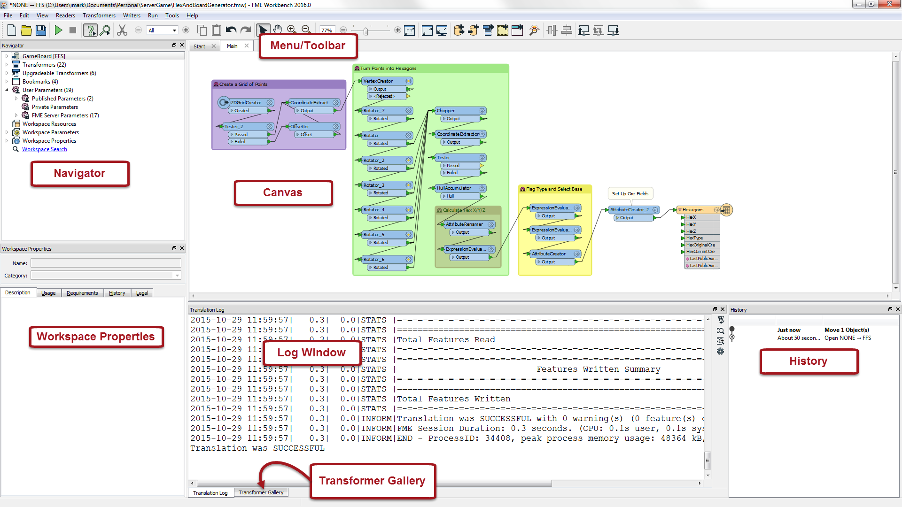
FME Workbench Components

Slide 9
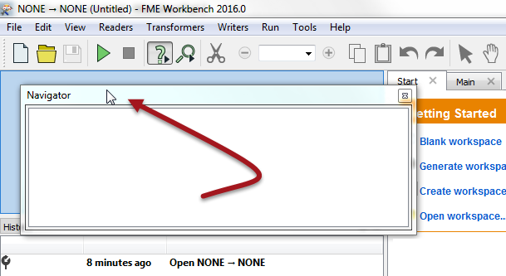
Window Control in FME Workbench
Detach and Deposit in Custom Location
?

Slide 10
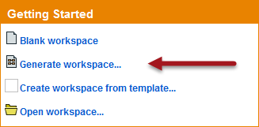
Creating a Translation
The Start Tab
Generate Workspace Dialog
Format Selection
Feature Types Dialog
?

Slide 11
The New Workspace
Saving the Workspace
Workspace Results
Running the Workspace
Basic Workspace Creation
E

Slide 12

Introduction to FME Data Inspector
What is Data Inspection?
What can be Inspected?
What is the FME Data Inspector?
Starting the FME Data Inspector
?

Slide 13
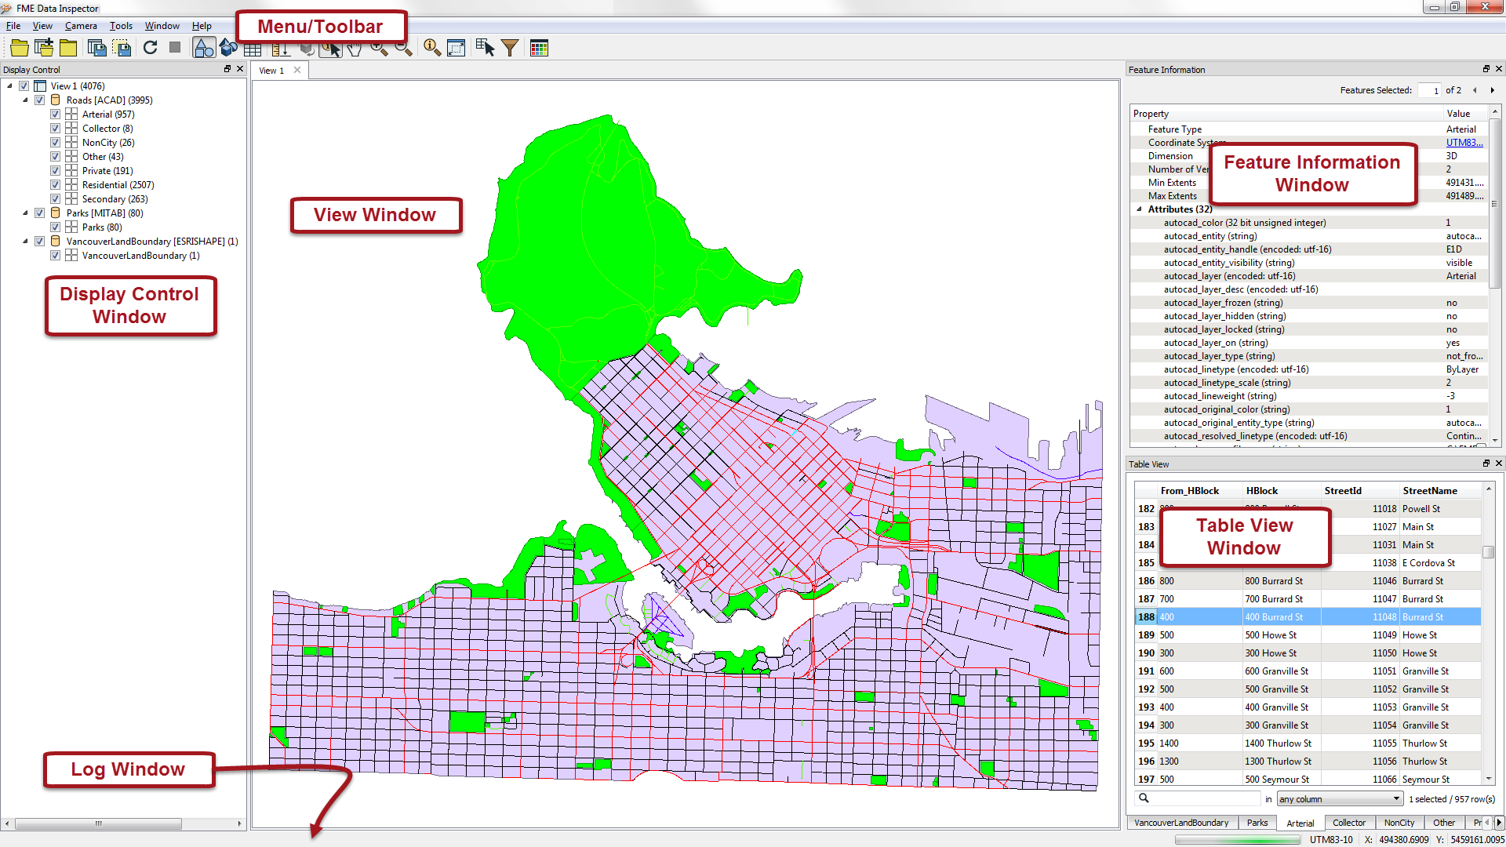
FME Data Inspector Components

Slide 14
Viewing Data in the Data Inspector
Opening a Dataset
Adding a Dataset
Windowing Tools
Background Maps

Slide 15

Querying Data in the Data Inspector
Query Tool
Measure Tool
Basic Data Inspection
Feature Information Window
Table View Window
E

Slide 16
Data Inspector Style Functionality
Display Control
Display Status
Style

Slide 17
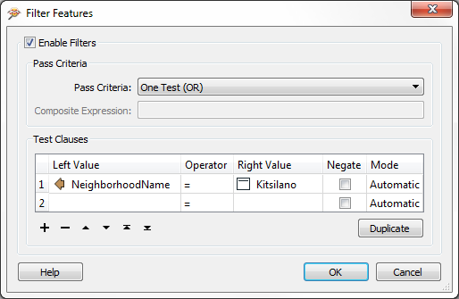
Misc. Data Inspector Functionality
Shift + Ctrl Keys
Save Tools
Data Filtering
The FME Data Inspector
E

Slide 18
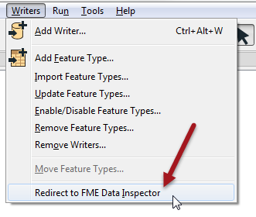
Data Translation Previews
Redirect to FME Data Inspector

Slide 19
Exercise
Exercise | Tourist Bureau Project
Data | Community Mapping/Food Vendors (Esri Geodatabase)
Overall Goal | Create a GPS-compatible dataset of food vendors for the local tourist bureau
Demonstrates | Basic Data Translation and Data Inspection
Start Workspace | None
End Workspace | C:\FMEData2016\Workspaces\DesktopBasic\Basics-Ex4-Complete.fmw

Slide 20
Questions
ETL is an acronym for…?
Extra-Terrestrial Lifeform
Extract, Transform, Load
Express Toll Lane
Eat, Transform, Love
FME can seamlessly translate between so many formats because it has…
A sentient data dictionary
A retro-encabulator
A rich data model
A core of unicorn hairs

Slide 21
Questions
Which of the following applications is NOT part of FME Desktop?
FME Workbench
FME Integration Console
FME Server Console
FME Data Inspector
FME Workbench allows you to define flows of data in which way?
Graphically
Telepathically
Problematically
By writing lots of code in C++ or Java

Slide 22
Questions
Which of these is a window in FME Workbench?
The Maths Window
The Geography Window
The English Literature Window
The History Window
Which of these is NOT an arrangement of windows in FME Workbench?
Stacked
Floating
Double-Glazed
Tabbed

Slide 23
Questions
Which of these is NOT a way to set the format of a translation?
Typing the format name
Selecting the format from a drop-down list
Browsing for a format in the formats gallery
By selecting a dataset with a known file extension
None of the above (they are all valid ways to set the format)

Slide 24
Questions
When you are inspecting *schema*, what are you trying to verify?
The color and linestyle of features
The number of features
The layers (classes, tables, types)
Where the nearest coffee shop is

