Slide 1
Translation Components
FME 2017

Slide 2
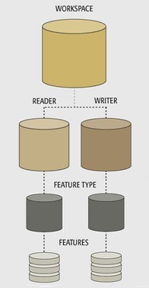
Translation Components
In this Section
Key Components
Workspaces
Readers and Writers
Feature Types
Features

Slide 3
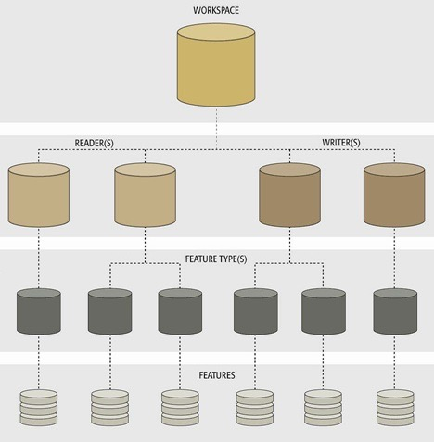
Translation Components
Component Hierarchy
One-to-Many Relationships
?

Slide 4
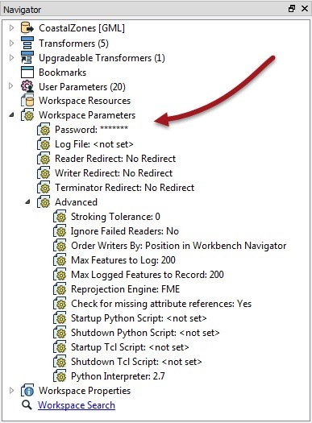
Workspaces
Creating a Workspace
Controlling a Workspace
Creating a Workspace
E

Slide 5
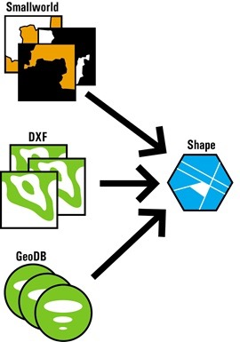
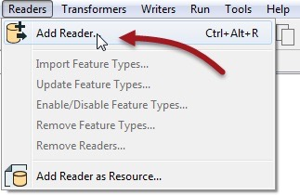
Readers
Adding a Reader
Removing a Reader

Slide 6
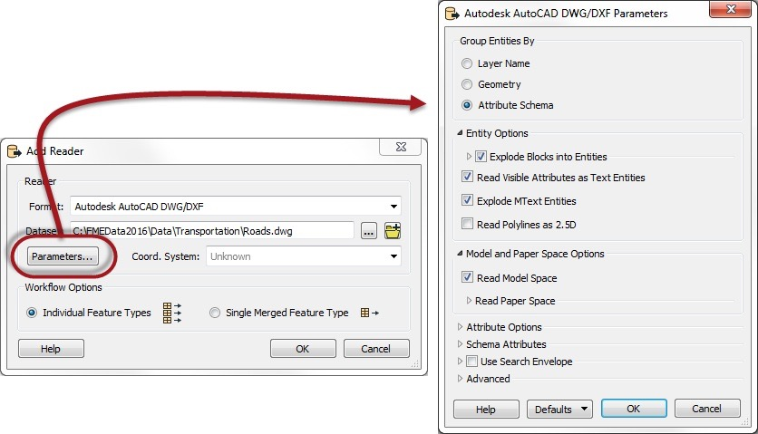
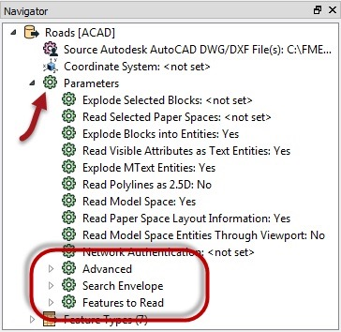
Controlling Readers
Reader Parameters

Slide 7
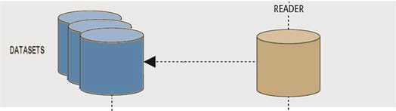
Reader Dataset Parameter
Multiple Dataset Selection
File-Based vs. Folder-Based Datasets
Adding Readers
E

Slide 8
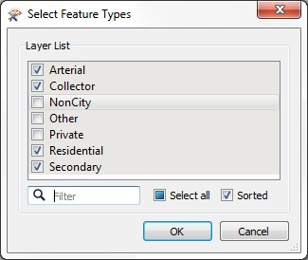
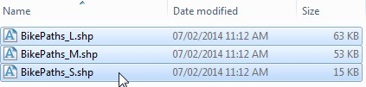
Reader Feature Types
Adding Reader Feature Types
Removing Reader Feature Types

Slide 9
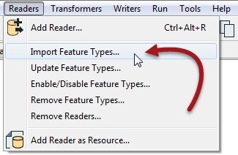
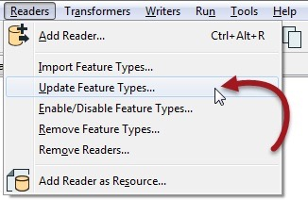
Reader Feature Types
Importing Reader Feature Types
Updating Reader Feature Types
?

Slide 10
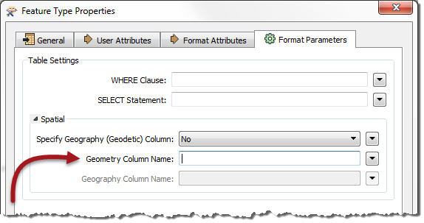
Reader Feature Types
Reader Feature Type Parameters
Reader Feature Types
E

Slide 11
Managing Datasets and Feature Types
Limiting Source Data
Changing Source Dataset Parameters
Consequences
Unexpected Input Remover
Unexpected Input and Dataset Type
Unexpected Input
E

Slide 12
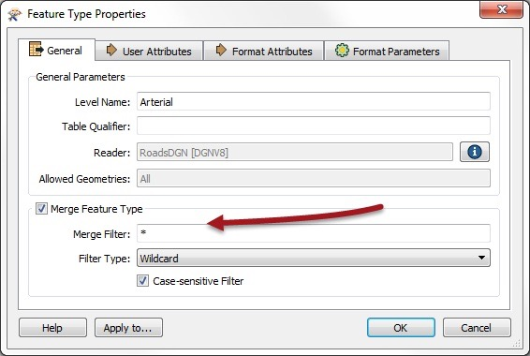

Dealing with Source Feature Types
Import Feature Type
Merge Parameter
Dealing with Unexpected Input
E

Slide 13
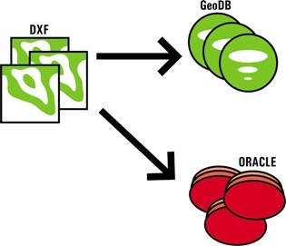
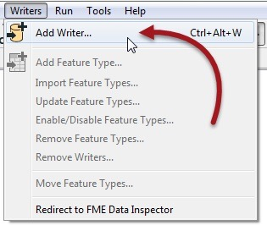
Writers
Adding a Writer
Removing a Writer

Slide 14
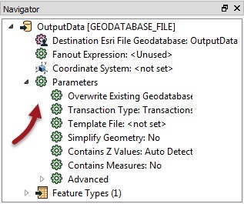
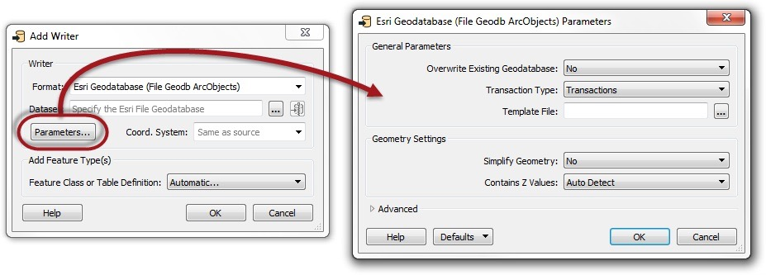
Controlling Writers
Writer Parameters
Adding Writers
E

Slide 15
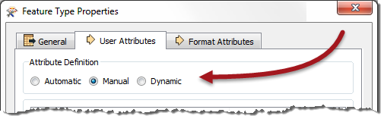
Writer Feature Types
Writer Feature Type Attributes
Manual Attribute Definitions
Automatic Attribute Definitions
Dynamic Attribute Definitions

Slide 16
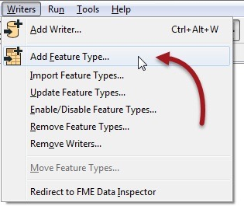
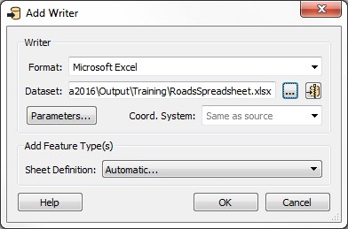

Writer Feature Types
Adding Writer Feature Types
Adding Feature Types to an Existing Writer
Adding Feature Types to a New Writer
Managing Writer Feature Types
E

Slide 17
Writer Feature Types
Copying Feature Types to a Writer
Removing Writer Feature Types
Importing Writer Feature Types
?

Slide 18
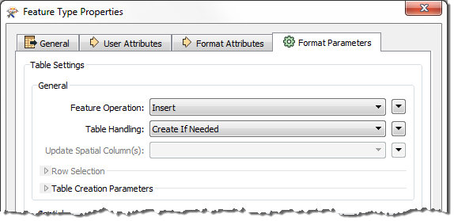
Writer Feature Types
Writer Feature Type Parameters

Slide 19
Exercise
Exercise | Elevation Model Updates
Data | Contours (Esri Shapefile) Raster Orthophotos (GeoTIFF)
Overall Goal | Generate a 3D surface model using updated information
Demonstrates | Workspace components and parameters
Start Workspace | C:\FMEData2016\Workspaces\DesktopBasic\Components-Ex8-Begin.fmw
End Workspace | C:\FMEData2016\Workspaces\DesktopBasic\Components-Ex8-Complete.fmw

Slide 20
Question
Here are four different formats and four different terms for “feature type”. Connect the format to the correct terminology.
Format | Feature Type Terminology
Oracle Spatial | Level
MicroStation Design | Layer
Esri Geodatabase | Table
Adobe PDF | Feature Class

Slide 21
Question
Here are four scenarios and four tools or settings. Connect the scenario to the correct tool/setting.
Scenario | Tool
Source filename changes | Add Reader
Attribute type changes in database | Import Feature Type
Additional database table needs reading | Update Feature Type
New file dataset needs reading | Source Dataset Parameter

Slide 22
Question
Here's an interesting question for you to consider. I want to convert some data from Esri Shapefile to GML format, with the GML having the same schema as an existing PostGIS database. How can I do this?
1. Create a workspace to convert the Shapefile to PostGIS. Create a second workspace to convert the PostGIS to GML.
2. Create a workspace to convert the PostGIS to GML. Create a second workspace to convert the Shapefile to GML, overwriting the previously created GML file.
3. Create a workspace with PostGIS and Shapefile Readers, and a GML Writer. Copy the PostGIS Reader feature types to the GML Writer and connect the Shapefile Reader feature types to them. Delete the PostGIS Reader and run the workspace.
4. Create a workspace with a Shapefile Reader and a GML Writer. Import feature type schemas from the PostGIS database into the GML Writer.

