Slide 1
Practical Transformer Use
FME 2017

Slide 2
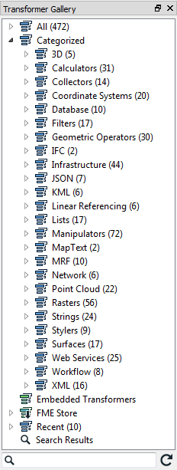
Practical Transformer Use
In this Section
Transformer Gallery
Transformer Searching
Most Valuable Transformers
Managing Attributes
Conditional Filtering
Data Joins

Slide 3
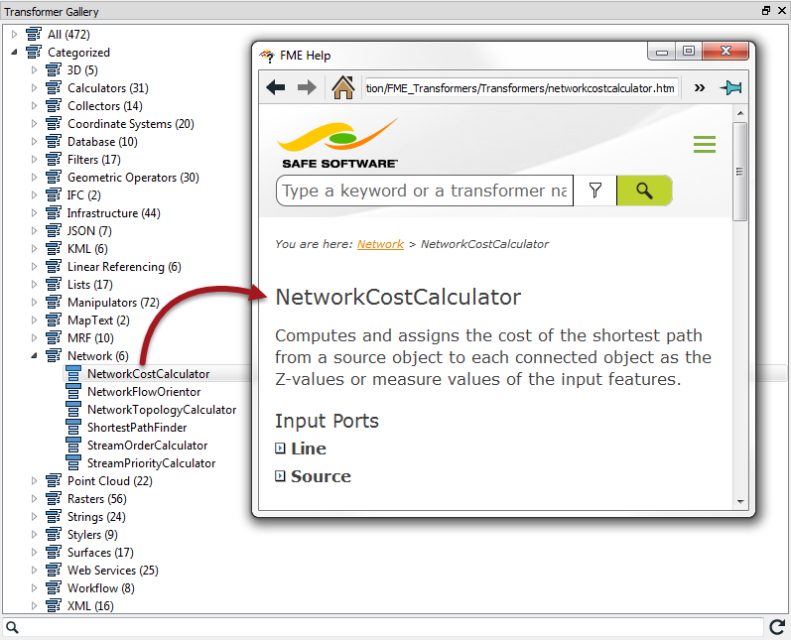
Transformer Gallery
Transformer Gallery
Transformer Categories
Transformer Help

Slide 4
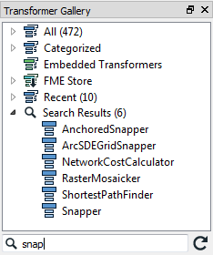
Transformer Searching
Transformer Gallery Search
Quick Add Search
CamelCase
?

Slide 5
Most Valuable Transformers
The Top 25

Slide 6
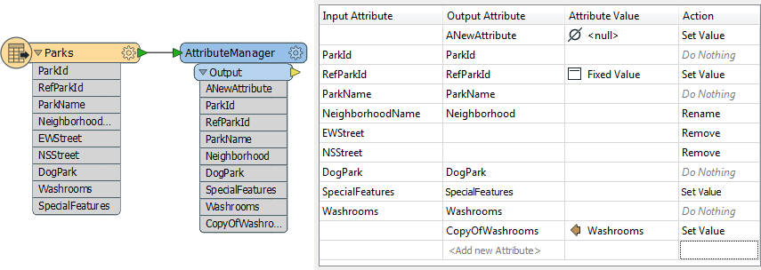
Managing Attributes
Attribute Managing Transformers
AttributeManager
Address Open Data Project
E

Slide 7
Managing Attributes
Constructing Attributes
Text Editor
Arithmetic Editor
FME Feature Functions
Replacing Other Transformers
?

Slide 8
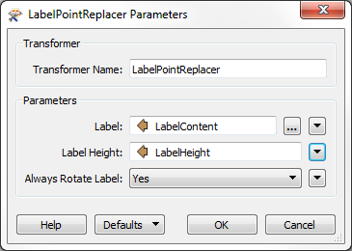
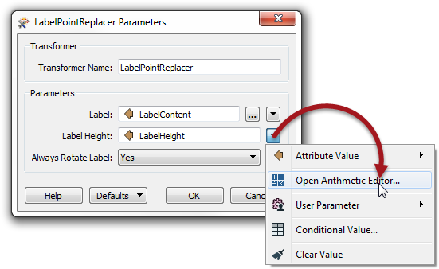
Managing Attributes
Constructing Parameters
Using Attributes for Parameters
Constructing Parameter Values

Slide 9
Managing Attributes
Renaming and Copying Attributes
Bulk Attribute Renaming
Removing Attributes

Slide 10
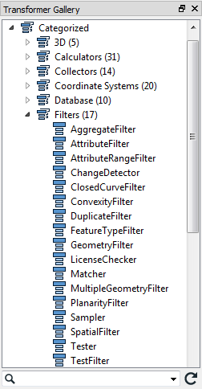
Conditional Filtering
What is Filtering?
Transformers that Filter
?

Slide 11
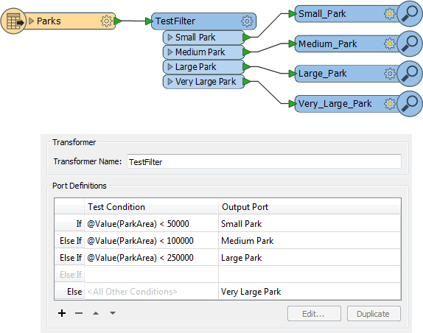
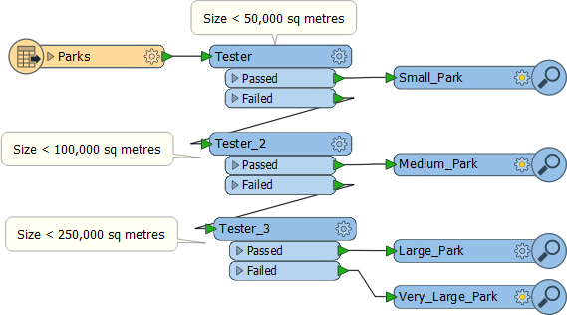
Conditional Filtering
Tester
TestFilter

Slide 12
Conditional Filtering
Other Key Filter Transformers
AttributeFilter
AttributeRangeFilter
GeometryFilter
Noise Control Laws Project
E

Slide 13
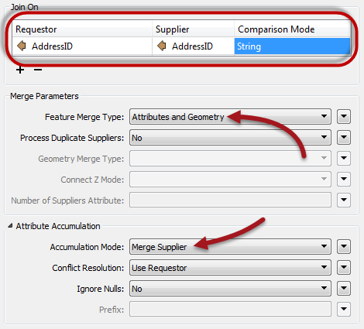
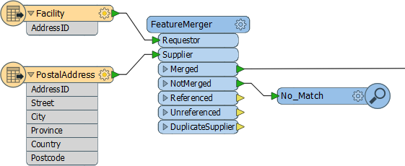
Data Joins
What is a Data Join?
Attribute Join Transformers
FeatureMerger
Joiner

Slide 14
Data Joins
Spatial Join Transformers
Overlayers
NeighborFinder
FeatureReader
SpatialFilter
?

Slide 15
Exercise
Exercise | Crime Mapping Data Request
Data | Roads (AutoCAD DWG) Crime Statistics (CSV)
Overall Goal | Carry out a join between crime statistics and city block
Demonstrates | Attribute-Based Joins
Start Workspace | None
End Workspace | C:\FMEData2016\Workspaces\DesktopBasic\Transformers-Ex3-Complete.fmw

Slide 16
Question
Which of the following is NOT a category of transformers?
Database
Formats
Linear Referencing
Surfaces
Here are four transformers and four categories. Match the transformer to the correct category.
Scenario | Tool
Chopper | Infrastructure
Terminator | Calculators
Matcher | Manipulators
DateFormatter | Filters

Slide 17
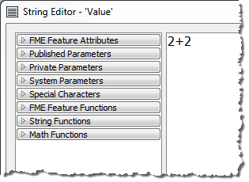
Question
Look at this screenshot of an editing dialog and tell me what the value returned to the attribute will be:
2 + 2
4
4.0
Error!

Slide 18
Question
How many transformers in the Filter category appear in the Top 25 Most Valuable Transformers list?
Three (3)
Four (4)
Five (5)
Six (6)

Slide 19
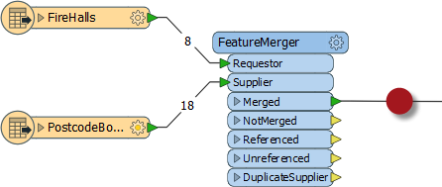
Question
Look at the following screenshot, then answer how many features will appear in the output connection...
Eight (8)
Eighteen (18)
Twenty-six (26)
Can’t tell

