Slide 1
How to approach semantic modelling – overview of tools and methods

Slide 2
01
05
Title Here
Title Here
Text box
Text box
02
Title Here
06
Title Here
Text box
Text box
Table of contents
03
Title Here
07
Title Here
Text box
Text box
04
Title Here
08
Title Here
Text box
Text box

Slide 3
Semantic alignment of modelling techniques - a layered approach
Marco Brattinga (Sopra Steria)
Tanja Ronzhina (Geonovum)

Slide 4
Overview
Introduction
Problem statement
MIM as an effective modelling approach

Slide 5



Introduction
Marco Brattinga
Tanja Ronzhina

Slide 6

Problem statement
Successful data exchange between (and within) organizations is essential for business operations.
  Public services must be able to reuse data created elsewhere — provided its meaning
  matches our needs and reuse is permitted.
To make meaning explicit, we use data-modelling techniques.
  Different organizations use different modelling approaches: UML, ER, FBM, LD
  No law prescribes a specific modelling technique — it cannot be enforced.
Even when using the same technique, meaning is not always unambiguous.
  Meaning is a linguistic property; data models typically formalise only logical properties

Slide 7

How we have addressed these problems
Problem: The meaning of the model is ambiguous
Solution:
  Acknowledge that data describes reality — it is not reality itself.
  Recognize that any model lacking this distinction becomes meaningless.
  Recognize that any model that fails to make the connection to reality becomes useless.
  Develop a metamodel that clearly separates the two and supports making the connection.

Slide 8


MIM framework
Model of terminology & concepts
What are we talking about?
Level 1
model of the
Universe of discourse
Conceptual information model
What kind of the information is relevant?
Level 2
Universe of discourse
(“reality”)
Logical datamodel
How is the data used?
Level 3
model of the
Data domain
Technical datamodel
How to store or exchange?
(data) -administration
-processing
Level 4
-exchange

Slide 9

Object
-type
dataobject-type
characterizes (describes) similar
characterizes (describes) similar
Jan’s personal information
[Jan] has red hair
[Jan] is born on 25 feb 2008
[Jan] has full name “Jan Janssen”
[Jan] lives in [Amersfoort]
Domain object (“Jan”)
Data-object about Jan
Jan is the main subject of this data-object.

Slide 10
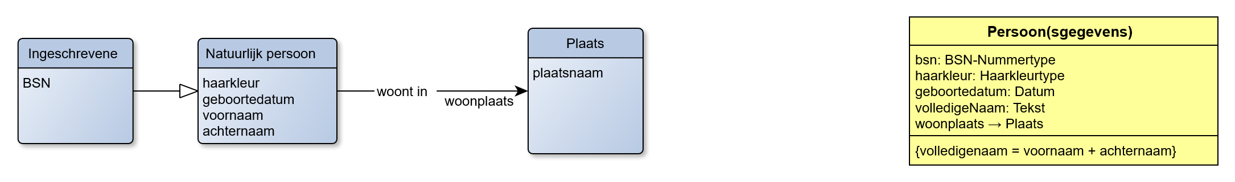

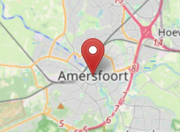
3 objecttypes
Dataobjecttype (with 5 elements)
characterizes (describes) similar
characterizes (describes) similar
characterizes (describes) similar
[Jan] heeft BSN 12345678
[Jan] heeft rood haar
[Jan] is geboren op 25-2-2008
[Jan] heeft volledige naam “Jan Janssen”
Domain object
(“Jan”)
[Jan] woont in [Amersfoort]
Domain object
(“Amersfoort”)
A data-object
(containing 5 statements about Jan)

Slide 11
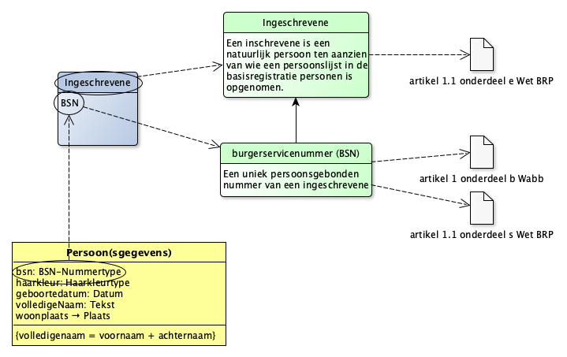
Core metamodel & example
MIM-2
MIM-1
Objecttype
Concept
uses terminology
as defined by
has main subjects of type
Data-object
type
MIM-3

Slide 12
How we have addressed these problems
Problem: Different modelling techniques are used
Solution:
  Accept that multiple modelling techniques exist, and each has its own value.
  Develop a metamodel (a “model of models”) that defines a shared exchange language.
  Specify how models in each notation can be translated to the common exchange language — and back again.

Slide 13
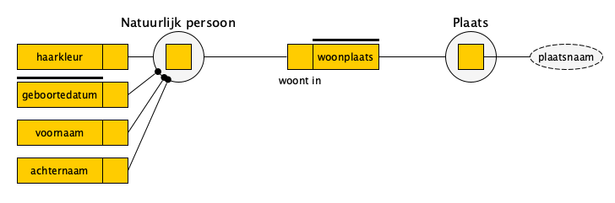
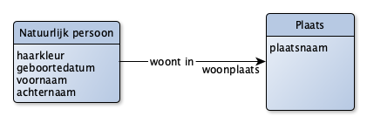
MIM in UML, FBM, ER and Linked Data
exo:NatuurlijkPersoon a owl:Class;
mim:equivalent ex:NatuurlijkPersoon;
.
exo:voornaam a owl:DatatypeProperty;
mim:equivalent ex:haarkleur;
.
exo:woonplaats a owl:ObjectProperty;
mim:equivalent ex:woonplaats;
.
exm:NatuurlijkPersoon a mim:Objecttype;
mim:kenmerk ex:voornaam, ex:haarkleur; #etc
mim:kenmerk ex:woonplaats
.
exm:woontIn a mim:Relatietype;
mim:member ex:NatuurlijkPersoon, ex:Plaats;
mim:role ex:woonplaats;
.
ex:Jan a exo:NatuurlijkPersoon;
exo:voornaam “Jan”;
exo:woonplaats ex:Amersfoort;
.

Slide 14

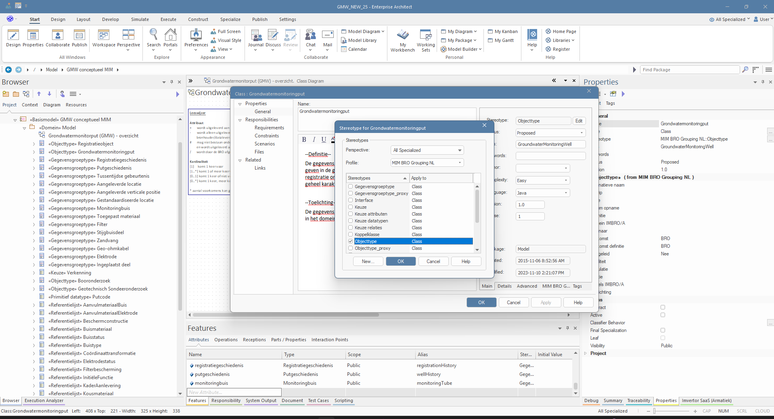
How we have addressed these problems
Problem: Organizations may be reluctant to adopt the solutions
Solution:
  Don’t dictate — develop solutions collaboratively with users.
  Ensure strong governance and demonstrate that it is effective.
  Provide tools and guidance that work in real-life situations.
  Apply Pas-Toe-Of-Leg-Uit (“Do it — or explain why not”).
    Exceptions may be valid, but they also offer opportunities to improve the solution.

Slide 16
Marco Brattinga
Tanja Ronzhina
MIM standard

