Slide 1
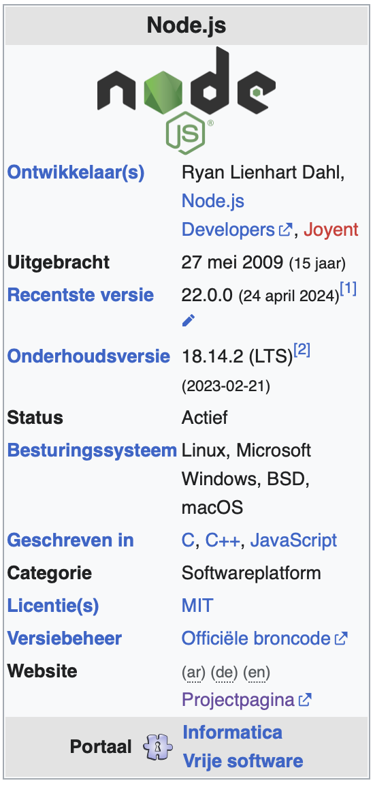
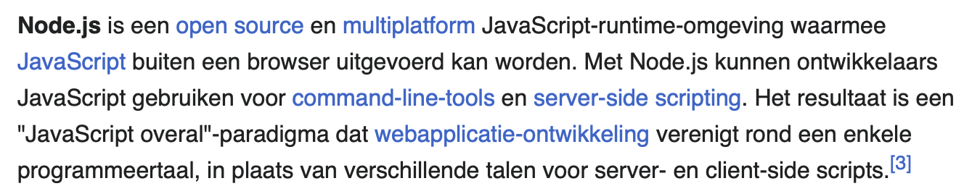
nodejs, expressjs - javascript
Javascript:

Slide 2
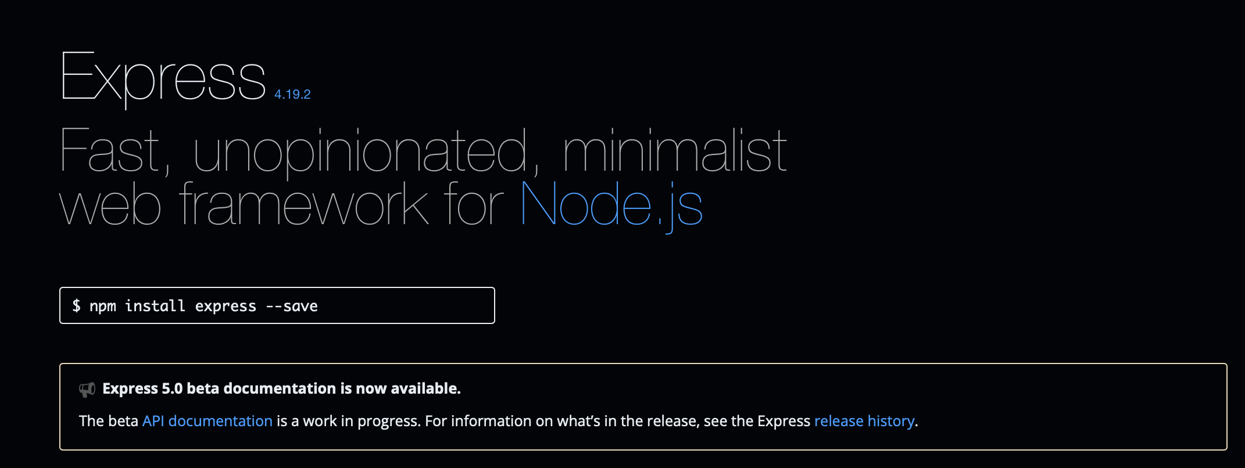
expressjs

Slide 3
‘Architecture’
OAPIF YAML
Insomnia
nodejs / expressjs
socket
WebBrowser
No code gen
QGIS, Esri, …
geojson
curl, …

Slide 4
‘Architecture’
OAPIF YAML
json/html
Insomnia
nodejs / expressjs
socket
WebBrowser
html
No code gen
QGIS, Esri, …
json
geojson
curl, …

Slide 5

‘Architecture’
nodejs / expressjs
req
Insomnia
socket
GET /kontich/collections/g2020/items?f=json HTTP/1.1
res
WebBrowser
HTTP/1.1 200 OK
X-Powered-By: Express
Content-Crs: urn:ogc:def:crs:OGC:1.3:CRS84
Content-Type: application/json; charset=utf-8
Content-Length: 233117
ETag: W/"38e9d-smcmFErKAg9bqFT/m2hZSI2J7pA"
Date: Mon, 22 Jul 2024 07:47:04 GMT
Connection: keep-alive
Keep-Alive: timeout=5
{"type":"FeatureCollection","features":[{"type":"Feature","geometry":{"type":"Polygon","coordinates":[[[4.836904719830233,51.71261186219708],[4.842367931828861,51.67965404535827],[4.781071321809747,51.66390211812952],[4.787505939028108,51.63704801116956],[4.731388847030403,51.64299386821649],[4.699059657817242,51.638073190658574],[4.684902977273319,51.666366490887185],[4.64513658535018,51.71906732347356],[4.676304223904792,51.724923649009945],[4.698553145800539,51.72199204842582],[4.733650891305746,51.73650736658969],[4.764199375929489,51.759857403256646],[4.853126170313312,51
geojson
QGIS, Esri, …
curl, …

Slide 6
‘Architecture’
nodejs / expressjs
req
Insomnia
socket
GET /kontich/collections/g2020/items?f=html HTTP/1.1
res
WebBrowser
<!DOCTYPE html>
<html>
<head>
<link rel="stylesheet" href="https://unpkg.com/leaflet@1.9.4/dist/leaflet.css"
integrity="sha256-p4NxAoJBhIIN+hmNHrzRCf9tD/miZyoHS5obTRR9BMY="
crossorigin=""/>
<script src="https://unpkg.com/leaflet@1.9.4/dist/leaflet.js"
integrity="sha256-20nQCchB9co0qIjJZRGuk2/Z9VM+kNiyxNV1lvTlZBo="
crossorigin=""></script>
</head>
<body>
<h1>Data from collection</h1>
<h2>Features</h2>9235
geojson
QGIS, Esri, …
curl, …

