Slide 1

25 Sept 2013
Aberdeen Tech Challenge
Kickoff Meeting

Slide 2

Our Objective
Gain exposure for Geon in a new customer base: Army EW and ISR at Aberdeen Proving Ground (I2WD, CECOM, RDECOM, …)
Demonstrate REDHAWK utility as a flexible sensor platform

Slide 3
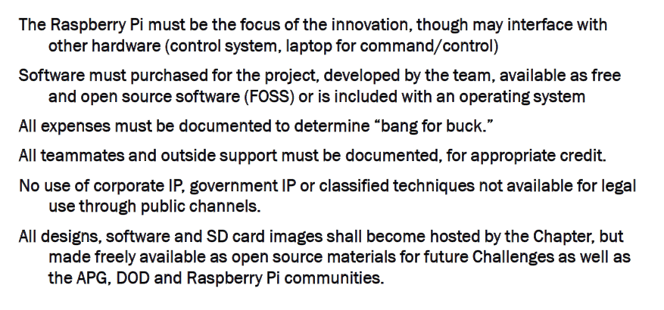
Rules

Slide 4
Our Submission
EM situational awareness is critical for spectrum dominance and force protection. Deployment of ubiquitous RF sensors on the battlefield is often limited by the cost of current equipment. For Tech Challenge 2013, Team REDHAWK will develop a low cost RF sensor node based on the open source REDHAWK Software Defined Radio framework (redhawksdr.org). The Raspberry Pi will host the REDHAWK framework and serve as an integration platform for a low-cost USB receiver covering (roughly 24 to 1850MHz) along with USB GPS and WiFi dongles.
The project will demonstrate an inexpensive distributed RF sensor grid based on Raspberry Pi nodes to perform spectrum operations missions such as spectrum monitoring, threat detection and (as a stretch goal) coarse emitter location. The project will also serve as a well documented, freely available reference design for groups within the ISR and EW communities who are interested in learning more about the REDHAWK SDR framework and how it might benefit their missions.

Slide 5
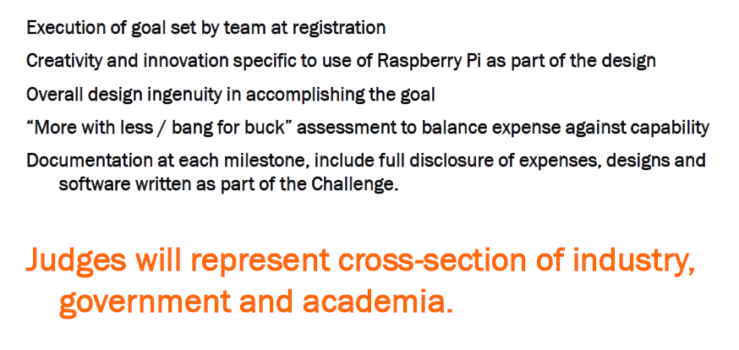
Judging Criteria

Slide 6
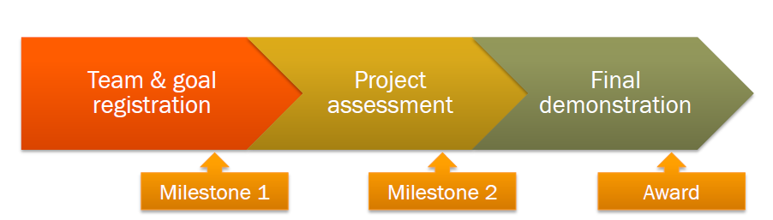
Milestones
Early Sept
(done)
Late Nov
Late Jan

Slide 7

RTL USB Dongle

Slide 8
Current RTL USB Dongle + REDHAWK
LAPTOP
Domain & Device Manager
Control
RTLTcpSource
(AXIOS)
BulkIO Packets
To waveform
Raw Samples
RTL_TCP
USB
RTL SDR

Slide 9
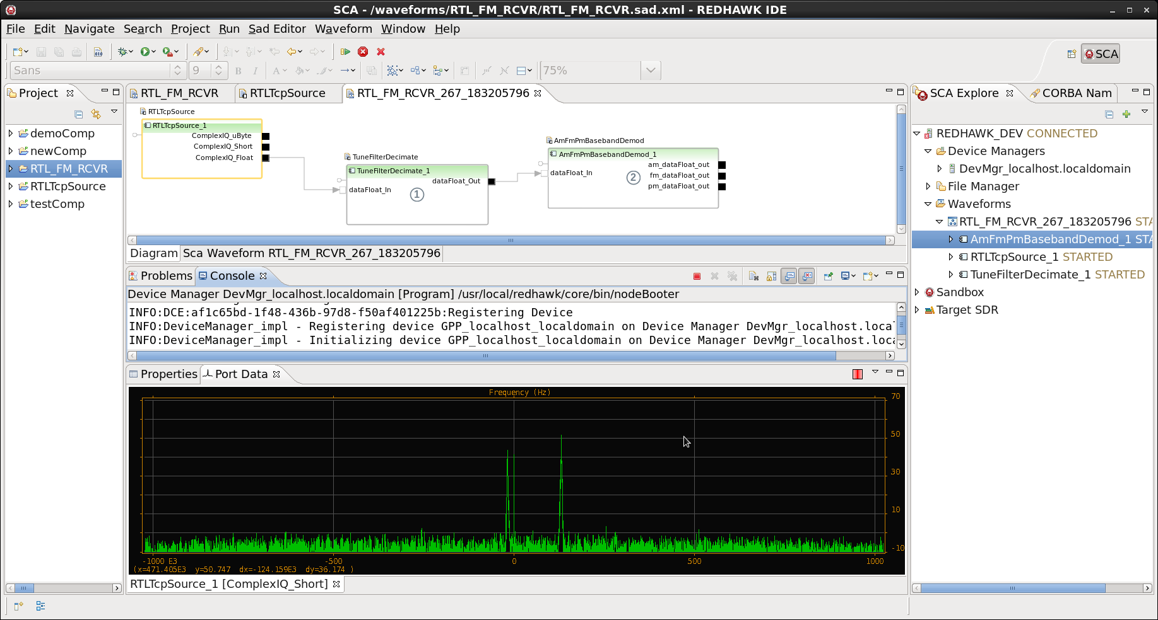
REDHAWK Spectral Display

Slide 10
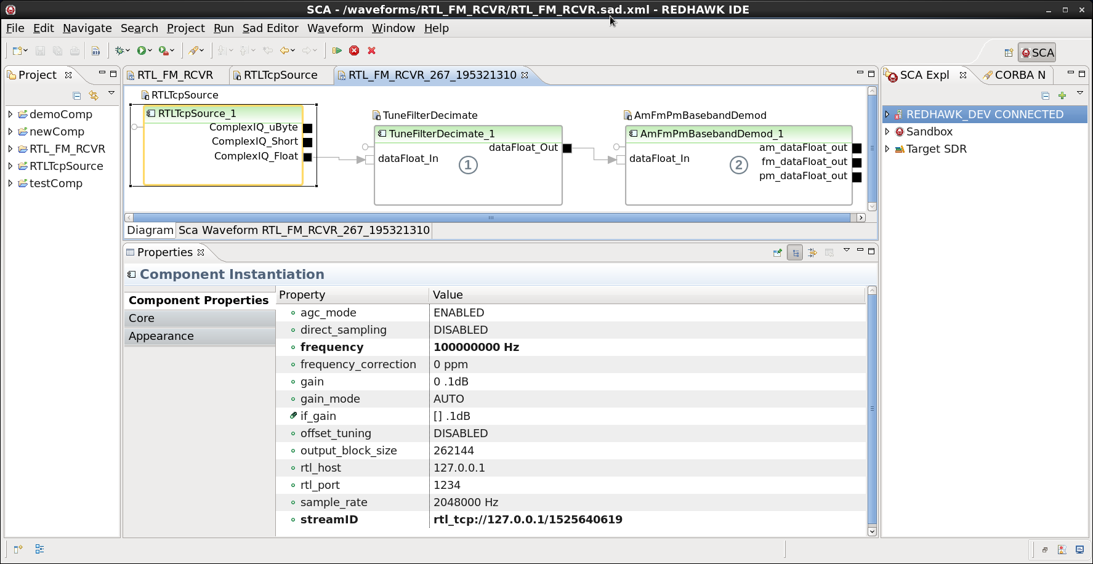
REDHAWK RTLTcpSource Properties

Slide 11
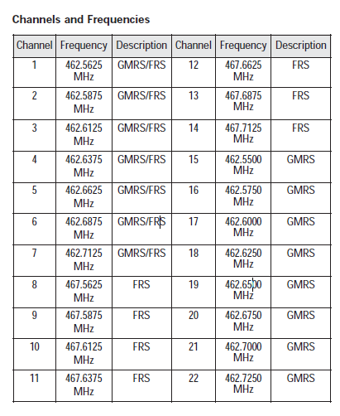
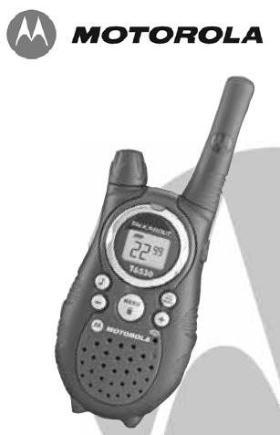
FRS Radio

Slide 12
Phase 0 Capability
Sensor
Domain Manager
Device Manager
RasPi
LAPTOP
RTLTcpSource(?)
Ingest and Display
RTL_TCP
ENET
ENET
USB Hub
RTL SDR
WIFI
GPS

Slide 13
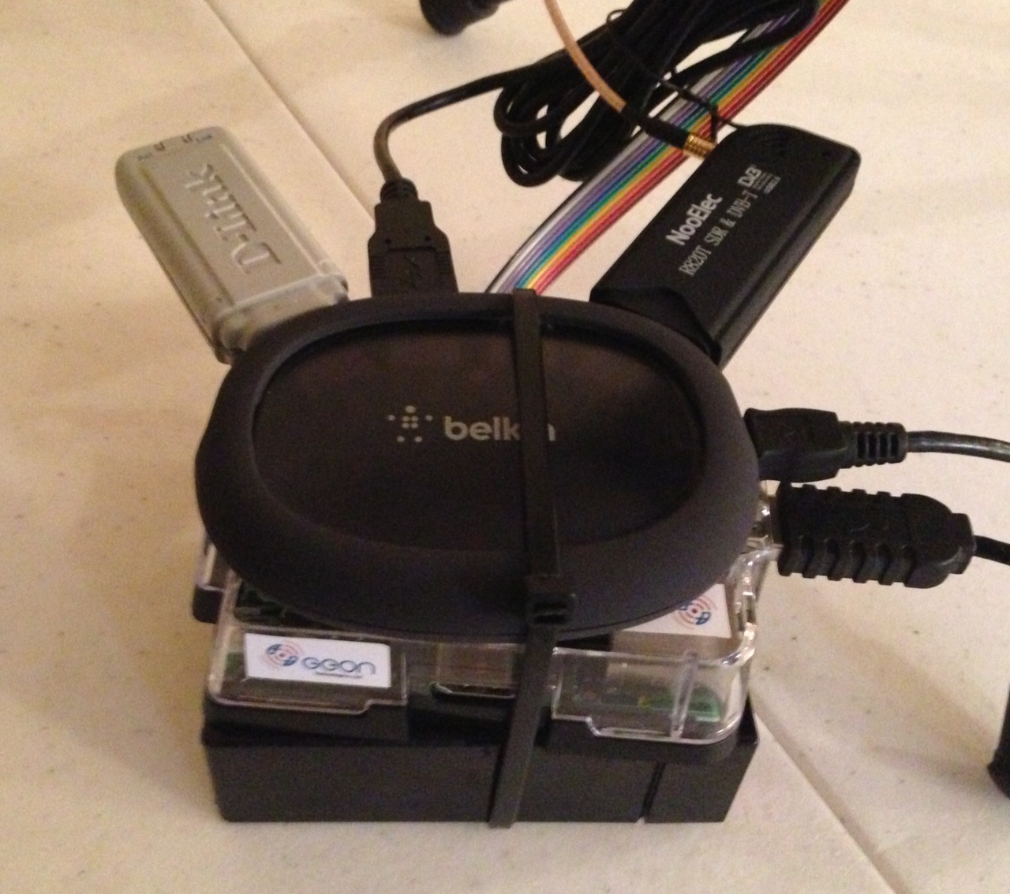
Sensor Configuration

Slide 14
Phase 1
Add WIFI and GPS
Add Frontend IDL?
Standard RH GPS Device?
Custom Control Panel
Channel Activity Detection & Reporting?
Battery status

Slide 15
Phase 2
Multiple Sensors via WIFI (up to 4)
Multi Spectral Display Control Panel
Google map position of sensors

Slide 16
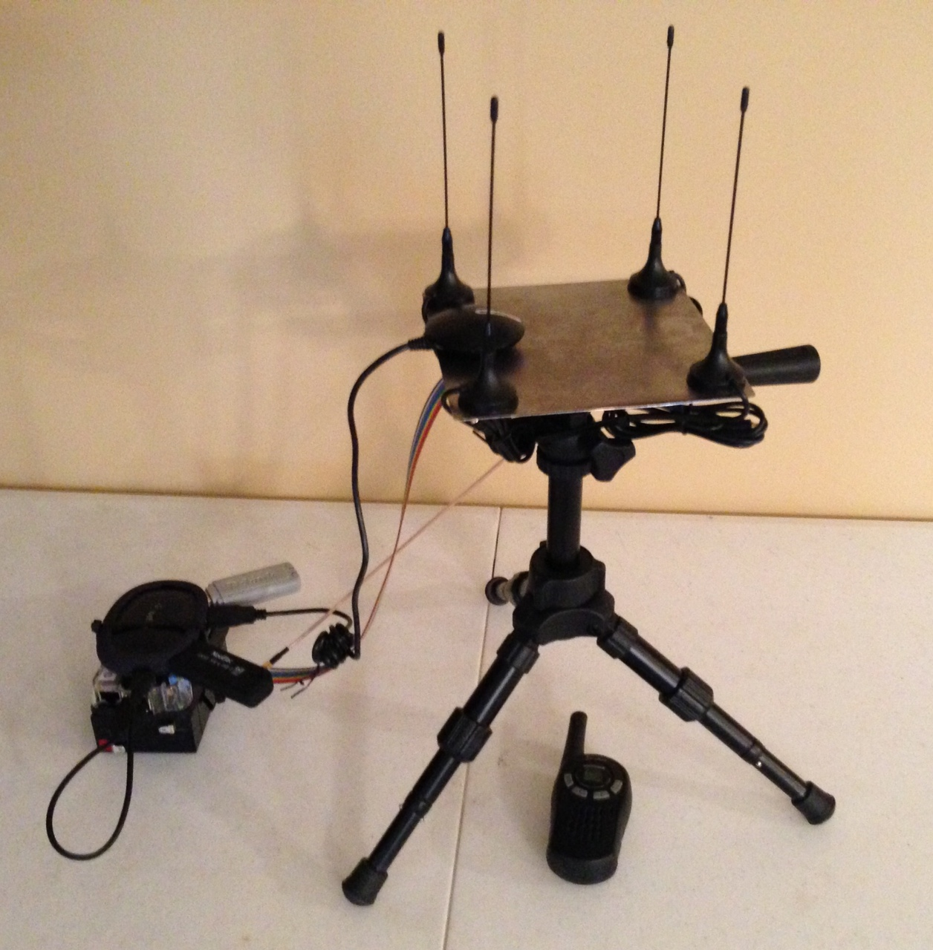
Phase 3 (stretch goal)
Coarse Emitter location using pseudo-doppler DF

Slide 17
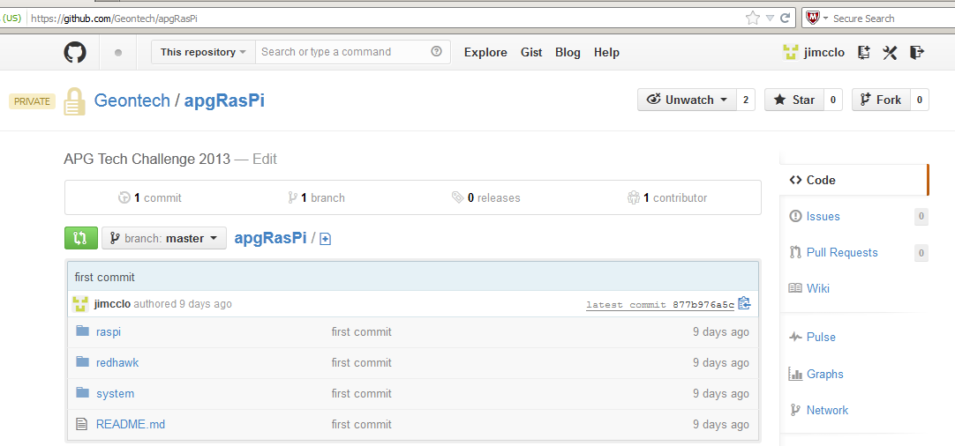
Geon Github

Slide 18
Final Thoughts
Think about where you might fit if interested
Will develop task lists & schedule
Regular meetings
Get github account
liquidDSP: public repo in Github
jgaeddert/liquid-dsp
Keep this within Geon circles

