Slide 1
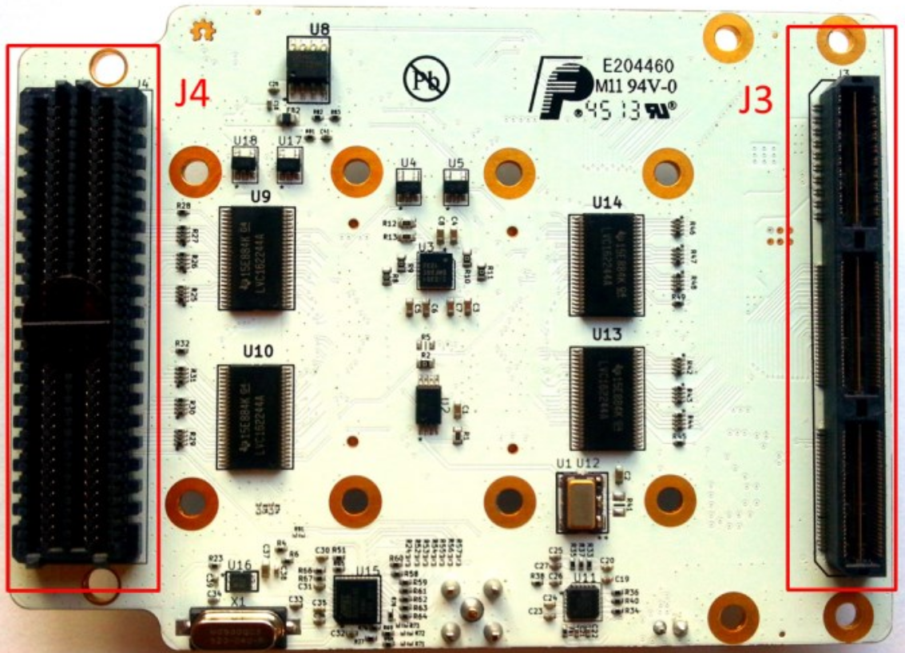
To support 2.5 V operation, this
resistor (R82) needs to be changed

