Slide 1
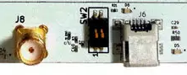
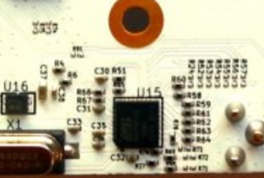
 | Resistor to remove
 | Resistor to Place
FRONT
R80
R90
BACK
R75
R74
R60
R24
R54
R55
R56
R57
R61
R62
R70
R63
R64
R76
R73
R77
R69
R72
R68
R71

