Slide 1
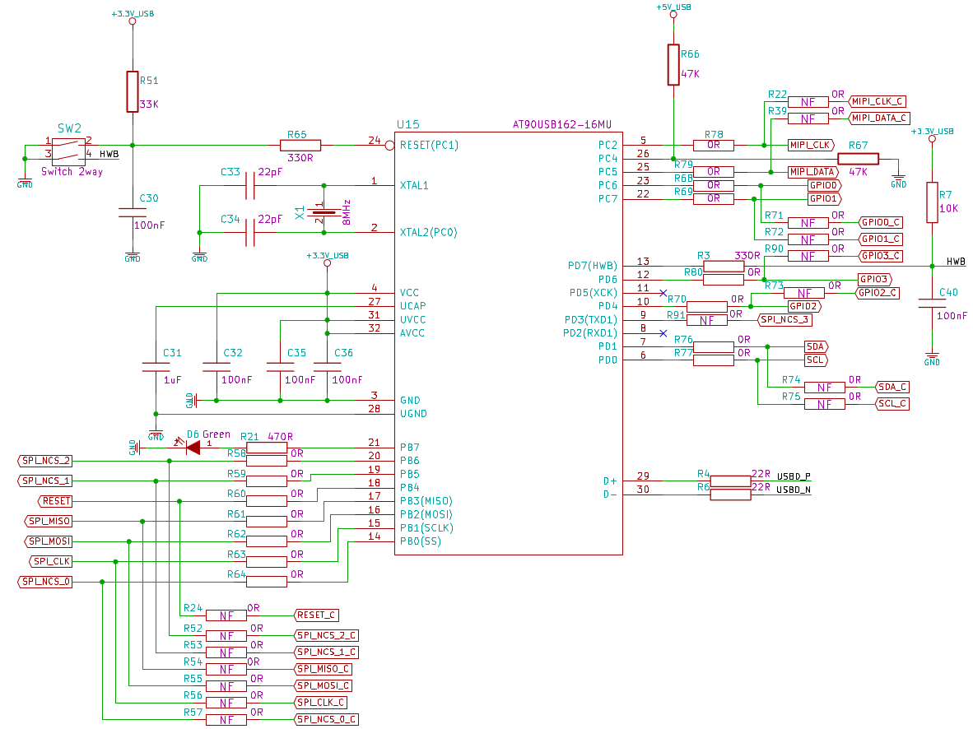
 | Resistor to remove
 | Resistor to Place

