Slide 1
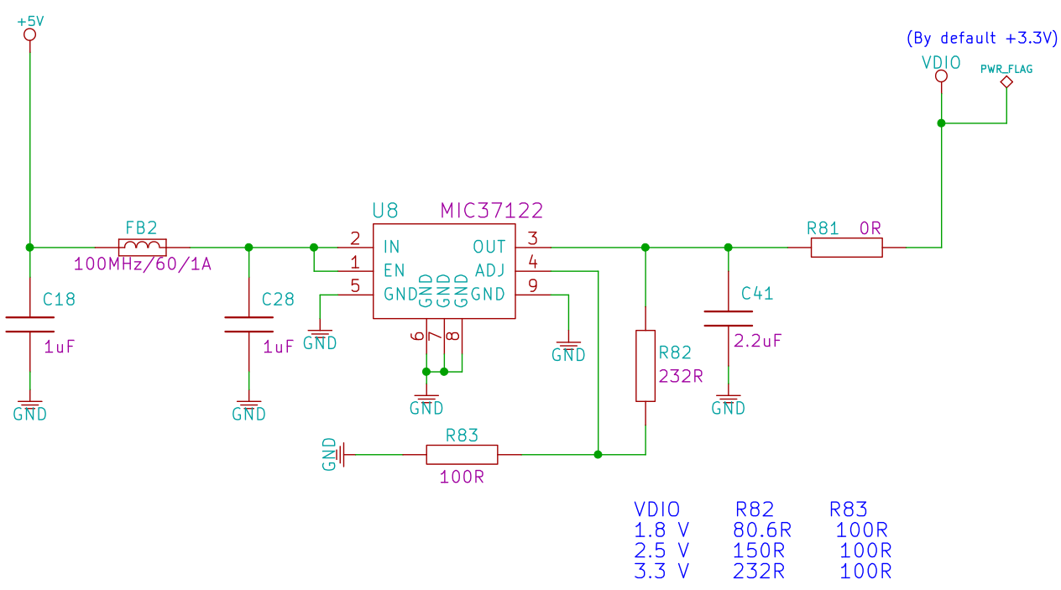
To support 2.5 V operation, this resistor needs to be changed
Voltage Divider Configurations

