Slide 1
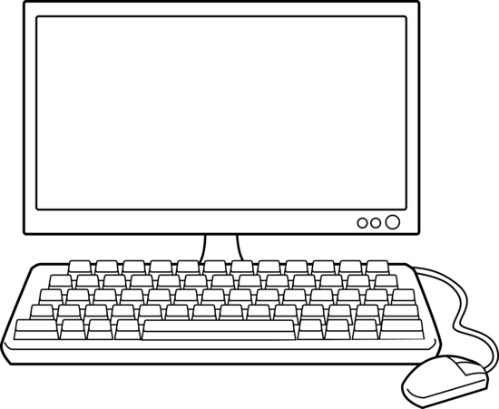

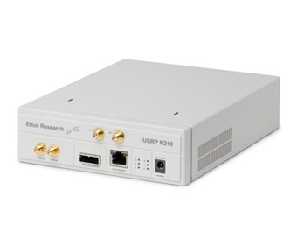
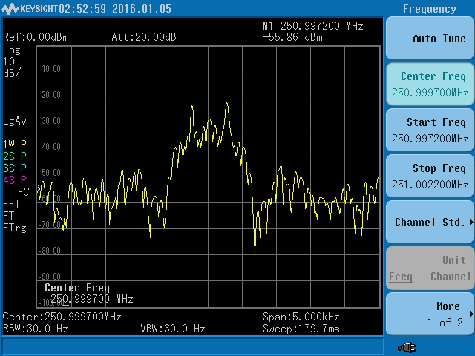
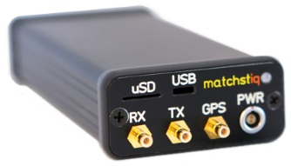
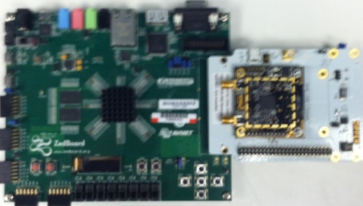
Development Host Machine
OS: CENTOS 7 with OpenCPI and GNUradio installed
Ettus N210 SDR
With WBX daughtercard installed
Ethernet for control
via GNUradio
Ethernet for NFS mount between Platform Under Test and Host
USB for serial port access
Spectrum Analyzer
Splitter
OpenCPI enabled platform under test:
Epiq Matchstiq-Z1 or Zedboard with Zipper
(other platforms are supported)
 | Command/Control connections |  | RF connections

