Slide 1


Ideas - Web Application – Part 2
Berufsakademie Sachsen
Staatliche Studienakademie Leipzig
Module: System Implementation
Lecturer: Prof. Dr.-Ing. Christian Heller
Seminar Group: CS14
30.11.2016
A presentation by:
Georg Andrássy
Roland Knobloch
Angela Stöckert

Slide 2
Outline
1 Frontend Example
2 WebAPI Example
3 DataManager
4 Project Organisation
5 Conclusion
Ideas Web Application – Part 2
Georg Andrássy
Roland Knobloch
Angela Stöckert

Slide 3

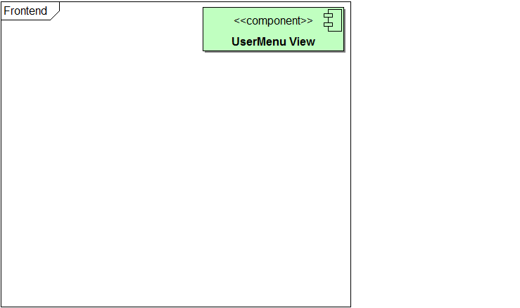
1 Frontend Example
2 WebAPI Example
3 DataManager
4 Organisation
5 Conclusion
Ideas Web Application – Part 2
Georg Andrássy
Roland Knobloch
Angela Stöckert

Slide 4
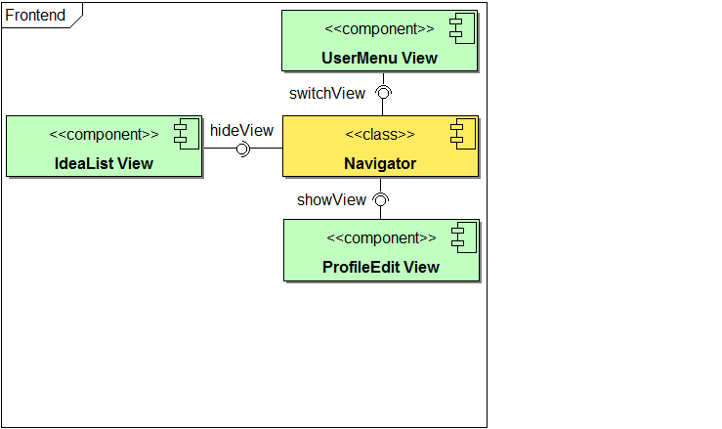
1 Frontend Example
2 WebAPI Example
3 DataManager
4 Organisation
5 Conclusion
Ideas Web Application – Part 2
Georg Andrássy
Roland Knobloch
Angela Stöckert

Slide 5
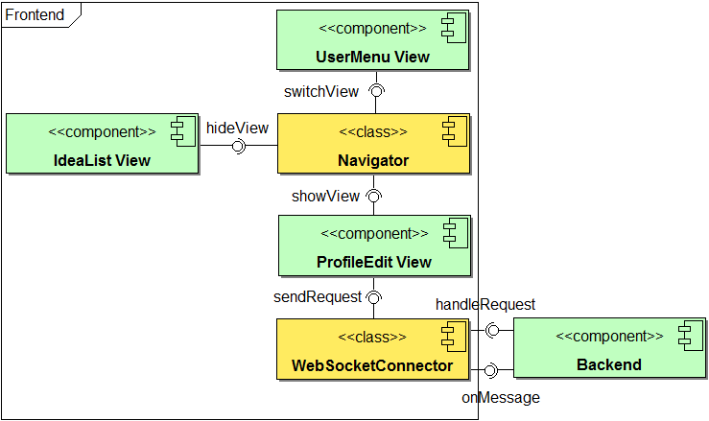
1 Frontend Example
2 WebAPI Example
3 DataManager
4 Organisation
5 Conclusion
request-key:
“getProfileRequest“
response-key:
“getProfileRequest-response“
Ideas Web Application – Part 2
Georg Andrássy
Roland Knobloch
Angela Stöckert

Slide 6
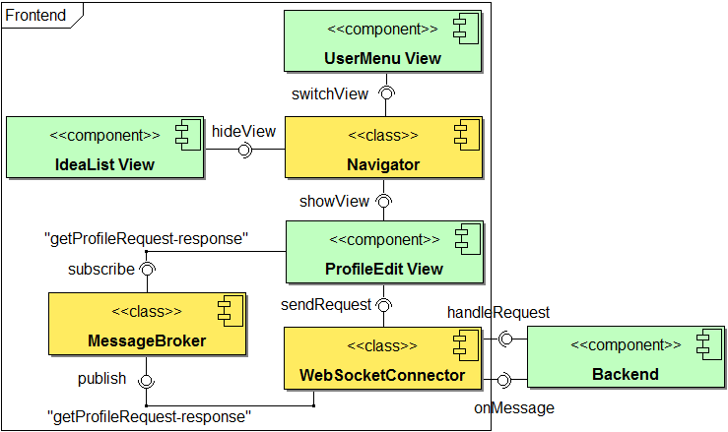
1 Frontend Example
2 WebAPI Example
3 DataManager
4 Organisation
5 Conclusion
response-key:
“getProfileRequest-response“
Ideas Web Application – Part 2
Georg Andrássy
Roland Knobloch
Angela Stöckert

Slide 7
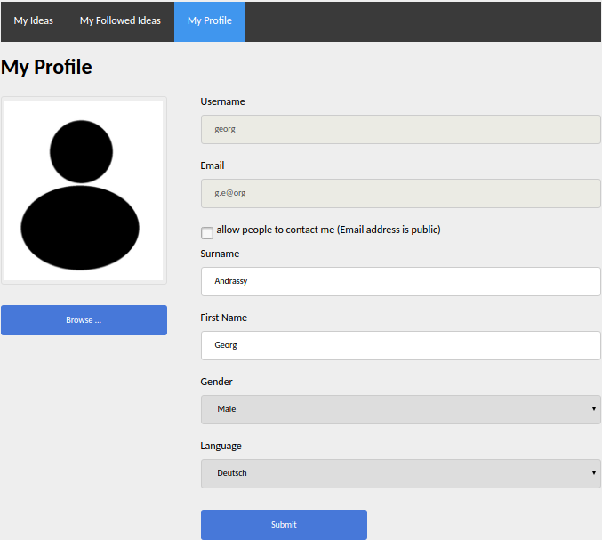
1 Frontend Example
2 WebAPI Example
3 DataManager
4 Organisation
5 Conclusion
Ideas Web Application – Part 2
Georg Andrássy
Roland Knobloch
Angela Stöckert

Slide 8
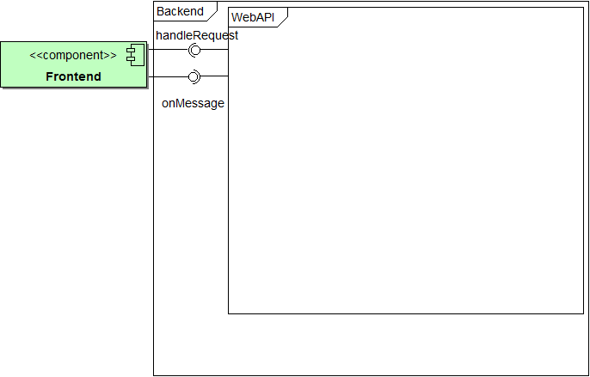
1 Frontend Example
2 WebAPI Example
3 DataManager
4 Organisation
5 Conclusion
Ideas Web Application – Part 2
Georg Andrássy
Roland Knobloch
Angela Stöckert

Slide 9
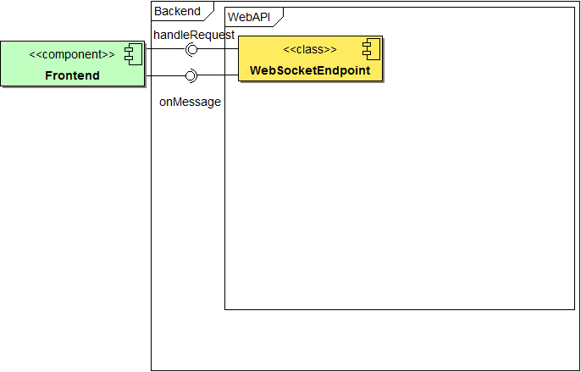
1 Frontend Example
2 WebAPI Example
3 DataManager
4 Organisation
5 Conclusion
Ideas Web Application – Part 2
Georg Andrássy
Roland Knobloch
Angela Stöckert

Slide 10
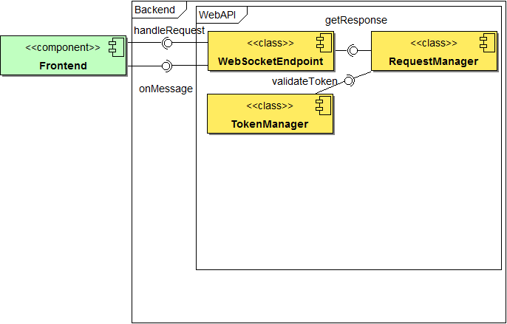
1 Frontend Example
2 WebAPI Example
3 DataManager
4 Organisation
5 Conclusion
JSON-String Java-Object
Ideas Web Application – Part 2
Georg Andrássy
Roland Knobloch
Angela Stöckert

Slide 11
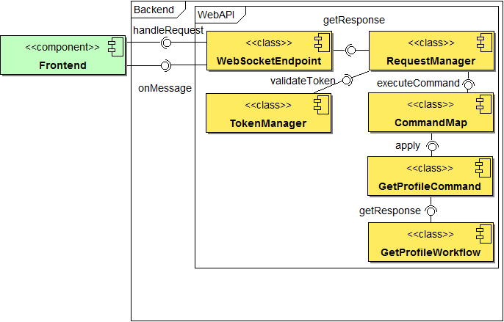
1 Frontend Example
2 WebAPI Example
3 DataManager
4 Organisation
5 Conclusion
request-key:
“getProfileRequest“
Command Pattern
Ideas Web Application – Part 2
Georg Andrássy
Roland Knobloch
Angela Stöckert

Slide 12
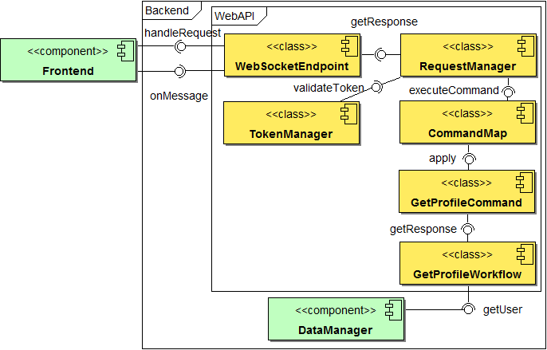
1 Frontend Example
2 WebAPI Example
3 DataManager
4 Organisation
5 Conclusion
Ideas Web Application – Part 2
Georg Andrássy
Roland Knobloch
Angela Stöckert

Slide 13
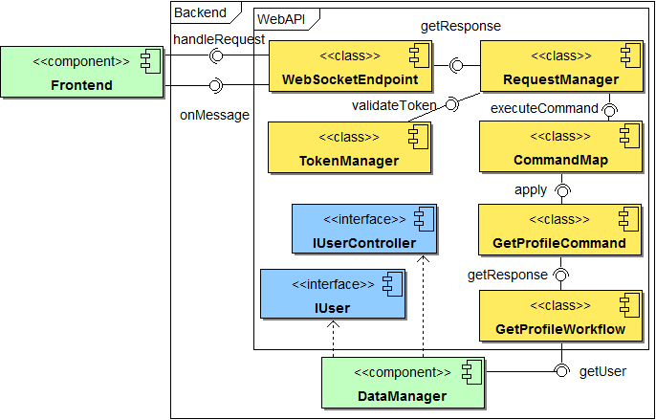
1 Frontend Example
2 WebAPI Example
3 DataManager
4 Organisation
5 Conclusion
Ideas Web Application – Part 2
Georg Andrássy
Roland Knobloch
Angela Stöckert

