Slide 1
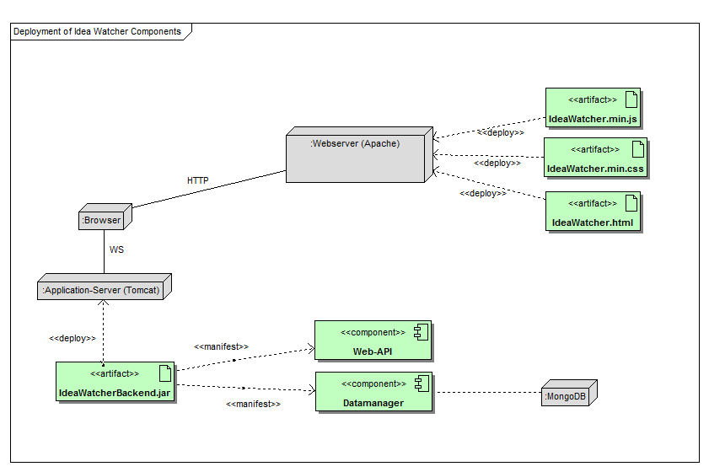
3. Architecture
1 Introduction
2 Ranking Algorithm
3 Architecture
4 User Features
5 Localisation
Ideas Web Application – Part 1
Stefan Lerm
Florian Aurich
André Noldin

Slide 2
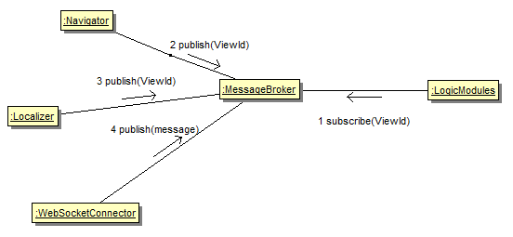
3.1 Message Broker
1 Introduction
2 Ranking Algorithm
3 Architecture
4 User Features
5 Localisation
Publish / Subscribe Pattern
Promote Loose
coupling
Backend
communication
(UML Dia anpassen)
Ideas Web Application – Part 1
Stefan Lerm
Florian Aurich
André Noldin

Slide 3
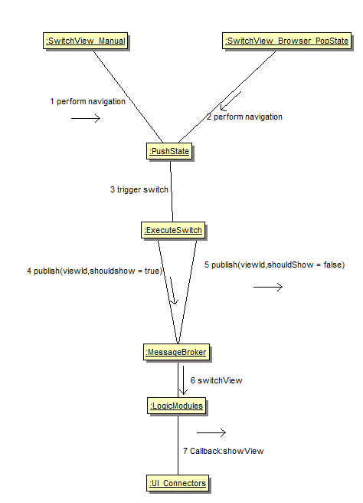
3.2 Navigator
1 Introduction
2 Ranking Algorithm
3 Architecture
4 User Features
5 Localisation
HTML5 History API
Native Navigation
Complete URL support
Bookmarking in SPA
Utilizes Message broker
CSS: display:none;
Ideas Web Application – Part 1
Stefan Lerm
Florian Aurich
André Noldin

