Slide 1

IdeaWatcher - Presentation
Part 1 - Frontend
Part 2 - Backend
Notes:
- hello and welcome to the presentation of our software-project
- my name is stefan an my team members are …
- because we are a group of 6 people, our presentation is devided into 2 parts

Slide 2
Outline
Thema 1
Thema 2
Thema 3
1 Introduction
1.1 Ranking-Algorithm
2 Flo
<Foliennummer>
Notes:
- in the first part i will give you an introduction
- than flo willl this and andre that
- in the secand part georg tells about this, roland about that and angela sums it up

Slide 3

Thema 1
Thema 2
Thema 3
Quelle: https://pixabay.com/de/idee-gl%C3%BChbirne-beleuchtet-hell-1651681/
<Foliennummer>
Notes:
- first, let me ask you a rethorical question:
- I think everyone had at least once a brilliant idea for a product or a smartphone app or something.
- For example a friend of mine and me, we had an idea of a football with integrated cameras so you can see a goal from the perspective of the ball
- but which of these ideas realy came to live?
- the most of us have neither the time, nor the money nor the energy to work on such an idea.
- some may don't want money or fame for theyr idea
- they just want to see their idea get to live
- so every day millions of brilliant ideas stay in the heads of people and get forgotton while big companys invest a lot in market research to figure out which new product the people could need

Slide 4

Thema 1
Thema 2
Thema 3
<Foliennummer>
Notes:
- at this point we bring both of them together: with ideas for the world
=> website aufrufen
---
- ideas for the world is a web application that allows you to share your ideas with the whole world
- it is a single-page-application that was programmed without the help of any framework
- every logic was programmed by ouerselfes
- our main target was to use technologies that are new to us and learn as much as possible, aspecially about the mechanisms inside of a web-appllication
3 Minuten bis hier

Slide 5
1.1 Ranking-Algorithm
Thema 1
Thema 2
Thema 3
Hot-ratings:
  likes: 50%
  followers: 30%
  age: 20%
Trending-ratings:
  likes: 30%
  followers: 10%
  age: 60%
Fresh-ratings:
  likes: 0%
  followers: 0%
  age: 100%
<Foliennummer>
Notes:
- the order of the ideas for the pages hot, trending and fresh are based on a special ranking-algorithm
- based on the 3 criterias: number likes, number followers and age of the idea - a ranking valua gets calculated
- the 3 criterias get a different weight for all 3 views
- this algorithm and these 3 views are solving the problem, that there could be always the same view ideas on the top of the list
- so the age gets a factor - the younger the better
=> and a newer idea with less likes could beat an older idea

Slide 6
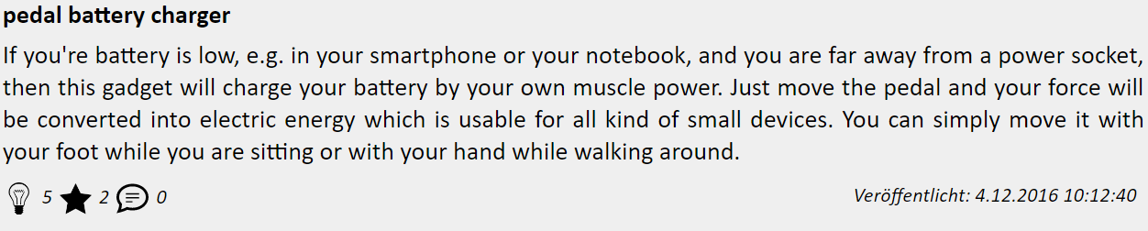
1.1 Ranking-Algorithm
Thema 1
Thema 2
Thema 3
max likes = 14
max followers = 5
max age = 1814400
Hot-ratings:
likes = 0.5
followers = 0.3
age = 0.2
≈ 1036800 seconds
5 / 14 = 0.357
2 / 5 = 0.4
(1814400 - 1036800) / 1814400 = 0.429
0.5 * 0.357
+ 0.3 * 0.4
+ 0.2 * 0.429
=> hot-rank = 0,3843
<Foliennummer>
Notes:
- lets take a look at an example
- this idea has 5 likes, 2 followers and a age of about 1 mio seconds
- first the algorithm searches for the best idea in each criteria
=> so the idea with the most likes has 14 of it, the idea with the most followers has 5 and the oldest idea is 1.8 mio seconds old
=> now each value of our idea gets divided with the top value and we always get value between 0 and 1 for each criteria
=> these values are independant of each other but completely comparable
=> each value now gets multiplicated with it's weight and summed up => so we get the ranking-value of this idea
3 Minuten für Ranking

Slide 7

1 Test Überschrift
Thema 1
Thema 2
Thema 3
Test Text Test Text Test Text Test Text Test Text Test Text Test Text Test Text Test Text Test Text
Eins
  Eins Eins
Zwei
Drei
Quelle: www.englische-flagge.com
<Foliennummer>

Slide 8
IdeaWatcher - Presentation
Part 1 - Frontend
Part 2 - Backend

Slide 9
1 Test Überschrift
Thema 1
Thema 2
Thema 3
Test Text Test Text Test Text Test Text Test Text Test Text Test Text Test Text Test Text Test Text
Eins
  Eins Eins
Zwei
Drei
Quelle: www.englische-flagge.com
<Foliennummer>

