Slide 1

IdeaWatcher - Presentation
Part 1 - Frontend
Part 2 - Backend

Slide 2
IdeaWatcher - Presentation
Part 1 - Frontend
Part 2 - Backend

Slide 3

1 Test Überschrift
Thema 1
Thema 2
Thema 3
Test Text Test Text Test Text Test Text Test Text Test Text Test Text Test Text Test Text Test Text
Eins
  Eins Eins
Zwei
Drei
Quelle: www.englische-flagge.com

Slide 4



General project conditions
Version management
Goal
Quelle: http://git-scm.com/downloads/logos
Quelle: https://github.com/logos
HTML5
CSS
Component
communiation
NoSQL
Javascript
Single-page application
Knowledge
Notes:
http://www.pixelero.de/blog/trend-frameworks/
Möglichst ohne Frameworks und stattdessen Konzentration auf Grundlegendes (HTML, CSS, Javascript, Java)
Ziel:
Basiswissen erlangen
Struktur selbst vorgeben
Version management with git using github
No frameworks
Goal: Gain basic knowledge about:
Single page applications
Structured communication between components
HTML5, CSS, Javascript, NoSQL
Development as a team

Slide 5


Project management
Based on scrum
Direct or team messaging
Orgware for task planning
Notes:
Weekly meetings for sprint review and planning
Product owner: Stefan Lerm
Scrum master: Georg Andrássy

Slide 6


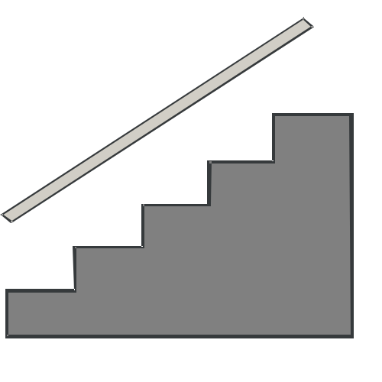






Problems
Notes:
Different knowledge levels
Different IDE‘s and operating systems
Team communication
Dependencies between tasks
Growing structures
No time for automated testing

Slide 7
Lessons learned
Structure of a web application
Knowledge about technology
Team work
Version management and project management

Slide 8
Conclusion
Goal achieved
Prototype working
Team ready for new project

