Slide 1


Ideas - Web Application – Part 1
Berufsakademie Sachsen
Staatliche Studienakademie Leipzig
Module: System Implementation
Lecturer: Prof. Dr.-Ing. Christian Heller
Seminar Group: CS14
16.12.2016
A presentation by:
Stefan Lerm
Florian Aurich
André Noldin

Slide 2
Outline
1 Introduction
2 Ranking-Algorithm
3 Architecture
4 User Features
5 Localisation
Ideas Web Application – Part 1
Stefan Lerm
Florian Aurich
André Noldin

Slide 3

1 Introduction
2 Ranking Algorithm
3 Architecture
4 User Features
5 Localisation
Source: https://pixabay.com/de/idee-gl%C3%BChbirne-beleuchtet-hell-1651681/
Ideas Web Application – Part 1
Stefan Lerm
Florian Aurich
André Noldin

Slide 4
1 Introduction
2 Ranking Algorithm
3 Architecture
4 User Features
5 Localisation
Ideas Web Application – Part 1
Stefan Lerm
Florian Aurich
André Noldin

Slide 5
2. Ranking-Algorithm
1 Introduction
2 Ranking Algorithm
3 Architecture
4 User Features
5 Localisation
Hot-ratings:
  likes: 50%
  followers: 30%
  age: 20%
Trending-ratings:
  likes: 30%
  followers: 10%
  age: 60%
Fresh-ratings:
  likes: 0%
  followers: 0%
  age: 100%
Ideas Web Application – Part 1
Stefan Lerm
Florian Aurich
André Noldin

Slide 6
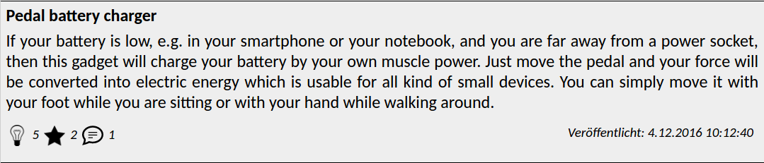
2. Ranking-Algorithm
1 Introduction
2 Ranking Algorithm
3 Architecture
4 User Features
5 Localisation
max likes = 14
max followers = 5
max age = 1814400
Hot-ratings:
likes = 0.5
followers = 0.3
age = 0.2
≈ 1036800 seconds
5 / 14 = 0.357
2 / 5 = 0.4
(1814400 - 1036800) / 1814400 = 0.429
0.5 * 0.357
+ 0.3 * 0.4
+ 0.2 * 0.429
=> hot-rank = 0,3843
Ideas Web Application – Part 1
Stefan Lerm
Florian Aurich
André Noldin

Slide 7
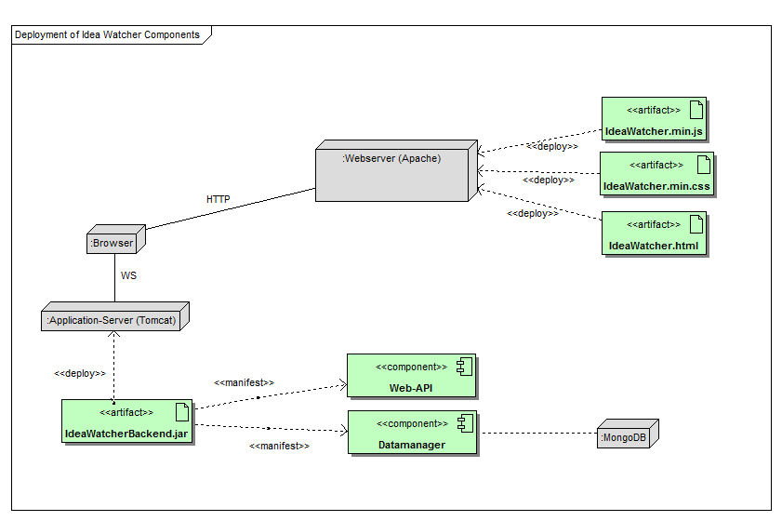
3. Architecture
1 Introduction
2 Ranking Algorithm
3 Architecture
4 User Features
5 Localisation
Ideas Web Application – Part 1
Stefan Lerm
Florian Aurich
André Noldin

Slide 8
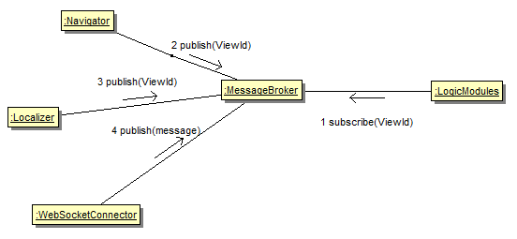
3.1 Message Broker
1 Introduction
2 Ranking Algorithm
3 Architecture
4 User Features
5 Localisation
Publish / Subscribe Pattern
Promote Loose
coupling
Backend
communication
(UML Dia anpassen)
Ideas Web Application – Part 1
Stefan Lerm
Florian Aurich
André Noldin

Slide 9
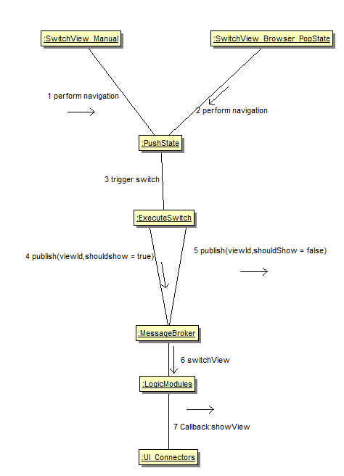
3.2 Navigator
1 Introduction
2 Ranking Algorithm
3 Architecture
4 User Features
5 Localisation
HTML5 History API
Native Navigation
Complete URL support
Bookmarking in SPA
Utilizes Message broker
CSS: display:none;
Ideas Web Application – Part 1
Stefan Lerm
Florian Aurich
André Noldin

Slide 10
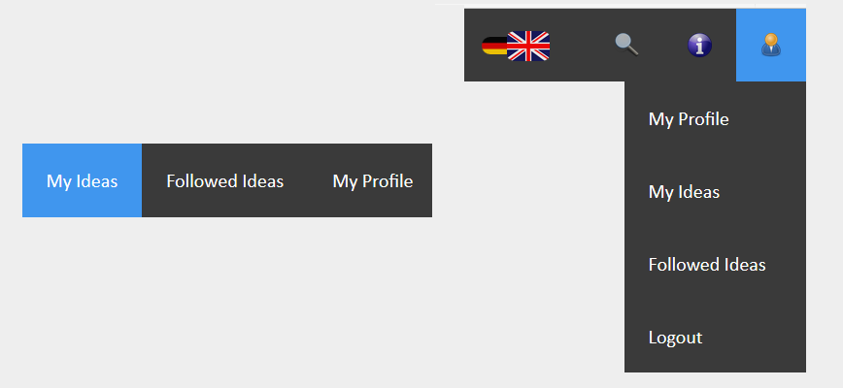
4. User Features
1 Introduction
2 Ranking Algorithm
3 Architecture
4 User Features
5 Localisation
User Sub-Sidebar
Dropdown Menu ->
Ideas Web Application – Part 1
Stefan Lerm
Florian Aurich
André Noldin

Slide 11

5. Localisation
1 Introduction
2 Ranking Algorithm
3 Architecture
4 User Features
5 Localisation
German to English
Quelle: http://www.peterjockisch.de/images/500px-Flag_of_Germany.svg.png
Quelle:http://www.englisch-hilfen.de/images/flags/230.gif
Ideas Web Application – Part 1
Stefan Lerm
Florian Aurich
André Noldin

Slide 12
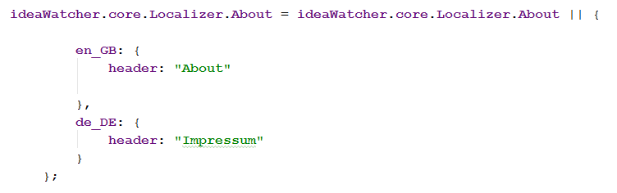
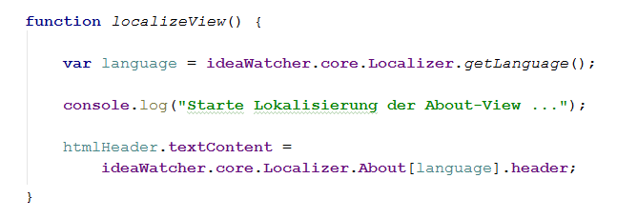
5. Localisation
1 Introduction
2 Ranking Algorithm
3 Architecture
4 User Features
5 Localisation
localizer.js
ui-Connector
Ideas Web Application – Part 1
Stefan Lerm
Florian Aurich
André Noldin

