Slide 1



4.1 General project conditions
1 Frontend Example
2 WebAPI Example
3 DataManager
4 Organisation
5 Conclusion
Version management
source: http://git-scm.com/downloads/logos
source: https://github.com/logos
source: http://edtechfutures.com/wp-content/uploads/
2016/04/online-product-knowledge-training-kit.jpg
HTML5
CSS
Java
NoSQL
Component
communication
WebSocket
Single page application
Javascript
Knowledge
Ideas Web Application – Part 2
Georg Andrássy
Roland Knobloch
Angela Stöckert

Slide 2


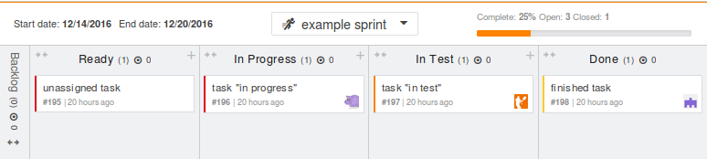
4.2 Project Management
1 Frontend Example
2 WebAPI Example
3 DataManager
4 Organisation
5 Conclusion
Based on scrum
Orgware for task planning
Direct or team messaging
source: https://www.scrum.org/
source: https://zube.io/blog
source: https://slack.com/
Ideas Web Application – Part 2
Georg Andrássy
Roland Knobloch
Angela Stöckert

Slide 3
4.2 Project Management
1 Frontend Example
2 WebAPI Example
3 DataManager
4 Organisation
5 Conclusion
Based on scrum
Orgware for task planning
Direct or team messaging
source: https://www.scrum.org/
source: https://zube.io/blog
source: https://slack.com/
Ideas Web Application – Part 2
Georg Andrássy
Roland Knobloch
Angela Stöckert

Slide 4
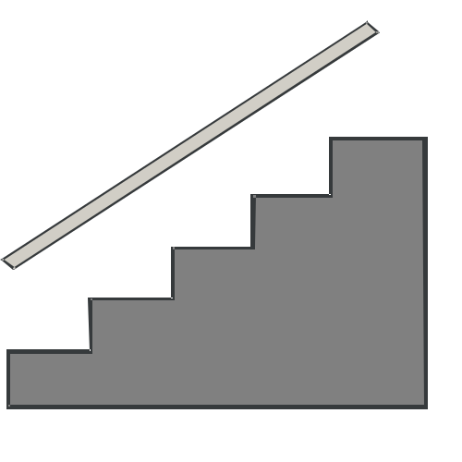
4.3 Problems
1 Frontend Example
2 WebAPI Example
3 DataManager
4 Organisation
5 Conclusion
Ideas Web Application – Part 2
Georg Andrássy
Roland Knobloch
Angela Stöckert

Slide 5





4.3 Problems
1 Frontend Example
2 WebAPI Example
3 DataManager
4 Organisation
5 Conclusion
Ideas Web Application – Part 2
Georg Andrássy
Roland Knobloch
Angela Stöckert

Slide 6


4.3 Problems
1 Frontend Example
2 WebAPI Example
3 DataManager
4 Organisation
5 Conclusion
Ideas Web Application – Part 2
Georg Andrássy
Roland Knobloch
Angela Stöckert

Slide 7

4.3 Problems
1 Frontend Example
2 WebAPI Example
3 DataManager
4 Organisation
5 Conclusion
Ideas Web Application – Part 2
Georg Andrássy
Roland Knobloch
Angela Stöckert

Slide 8

4.3 Problems
1 Frontend Example
2 WebAPI Example
3 DataManager
4 Organisation
5 Conclusion
Sources:
http://www.point-project.net/piktogramme/
https://www.jetbrains.com/company/press/
https://eclipse.org/artwork/
http://design.ubuntu.com/brand/ubuntu-logo
http://design.ubuntu.com/brand/ubuntu-logo
https://pixabay.com/en/monument-valley-arizona-usa-road-50966/https://pixabay.com/en/clouds-landscape-mountain-range-1837129/
https://pixabay.com/en/puzzle-kreispuzzel-platform-1713170/
Ideas Web Application – Part 2
Georg Andrássy
Roland Knobloch
Angela Stöckert

Slide 9

5. Conclusion
1 Frontend Example
2 WebAPI Example
3 DataManager
4 Organisation
5 Conclusion
Working prototype
Meets technical specification
Goal
source: https://pixabay.com/en/check-mark-tick-mark-check-correct-1292787/
Ideas Web Application – Part 2
Georg Andrássy
Roland Knobloch
Angela Stöckert

Slide 10
Feature list
/F00100/ Idee anzeigen
/F00110/ Anzeige der Ideen mit der besten Bewertung (Hot)
/F00120/ Anzeige der aufstrebenden Ideen (Trending)
/F00130/ Anzeige der neuesten Ideen (Fresh)
/F00140/ Anzeige der Ideen nach Kategorie
/F00200/ Impressum anschauen
/F00600/ Login
/F00700/ Logout
/F00800/ Idee anlegen
/F00900/ Idee veröffentlichen
/F01000/ Idee ändern
/F01100/ Idee löschen
/F01200/ Idee bewerten
/F01300/ Bewertung zurücknehmen
/F01400/ Idee folgen
/F01500/ Idee nicht mehr folgen
/F01600/ Idee kommentieren
/F01700/ Kommentar löschen
/F01800/ Anzeige des eigenen Profils
/F01900/ Bearbeiten eigener Benutzerdaten
Registrierung
Stichwortsuche im Ideentitel
Anzeigen von Benachrichtigungen

