Slide 1


Ideas - Web Application – Part 2
Berufsakademie Sachsen
Staatliche Studienakademie Leipzig
Module: System Implementation
Lecturer: Prof. Dr.-Ing. Christian Heller
Seminar Group: CS14
30.11.2016
A presentation by:
Georg Andrássy
Roland Knobloch
Angela Stöckert

Slide 2
Outline
1 Frontend Example
2 WebAPI Example
3 DataManager
4 Project Organisation
5 Conclusion
Ideas Web Application – Part 2
Georg Andrássy
Roland Knobloch
Angela Stöckert

Slide 3

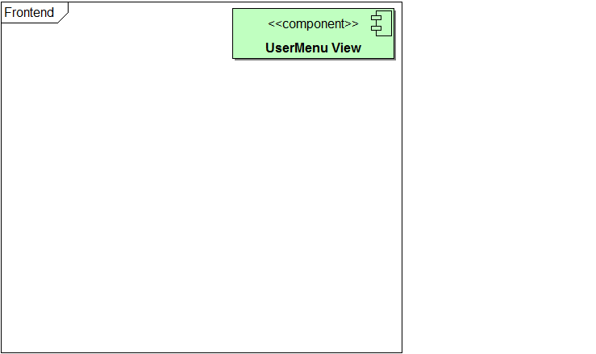
1 Frontend Example
2 WebAPI Example
3 DataManager
4 Organisation
5 Conclusion
Ideas Web Application – Part 2
Georg Andrássy
Roland Knobloch
Angela Stöckert

Slide 4
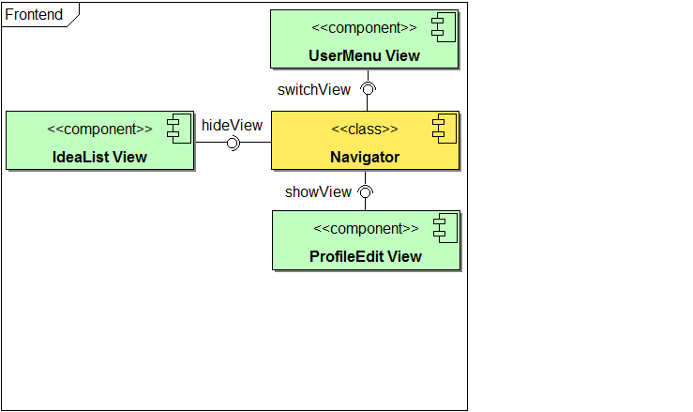
1 Frontend Example
2 WebAPI Example
3 DataManager
4 Organisation
5 Conclusion
Ideas Web Application – Part 2
Georg Andrássy
Roland Knobloch
Angela Stöckert

Slide 5
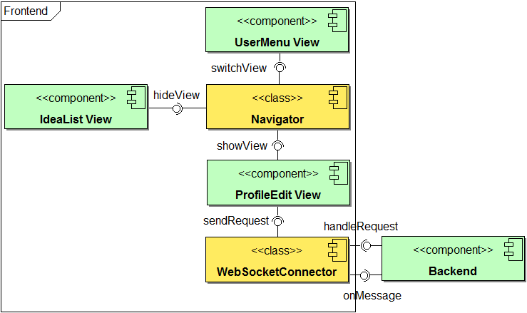
1 Frontend Example
2 WebAPI Example
3 DataManager
4 Organisation
5 Conclusion
request-key:
“getProfileRequest“
response-key:
“getProfileRequest-response“
Ideas Web Application – Part 2
Georg Andrássy
Roland Knobloch
Angela Stöckert

Slide 6
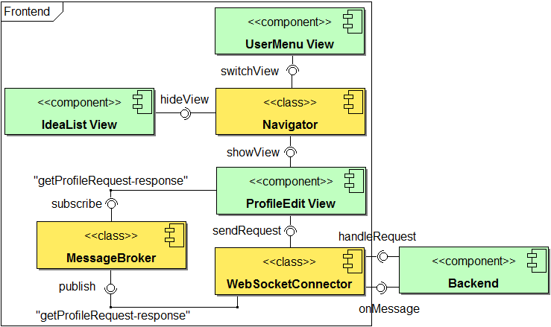
1 Frontend Example
2 WebAPI Example
3 DataManager
4 Organisation
5 Conclusion
response-key:
“getProfileRequest-response“
Ideas Web Application – Part 2
Georg Andrássy
Roland Knobloch
Angela Stöckert

Slide 7
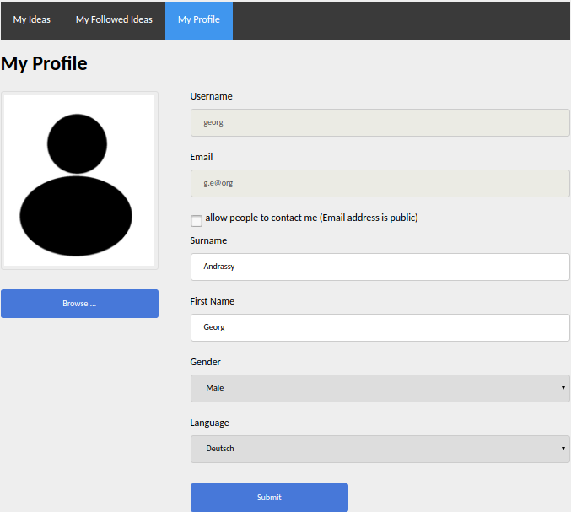
1 Frontend Example
2 WebAPI Example
3 DataManager
4 Organisation
5 Conclusion
Ideas Web Application – Part 2
Georg Andrássy
Roland Knobloch
Angela Stöckert

Slide 8
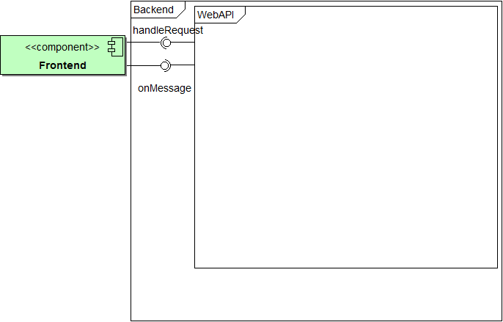
1 Frontend Example
2 WebAPI Example
3 DataManager
4 Organisation
5 Conclusion
Ideas Web Application – Part 2
Georg Andrássy
Roland Knobloch
Angela Stöckert

Slide 9
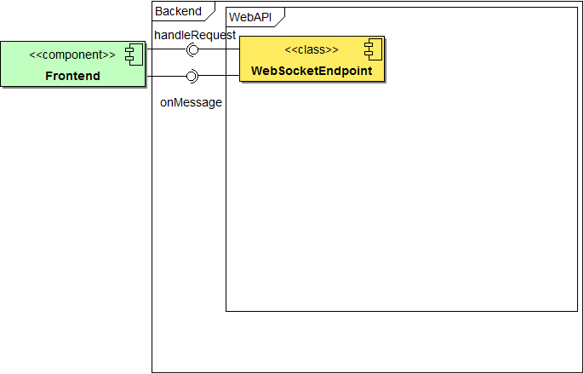
1 Frontend Example
2 WebAPI Example
3 DataManager
4 Organisation
5 Conclusion
Ideas Web Application – Part 2
Georg Andrássy
Roland Knobloch
Angela Stöckert

Slide 10
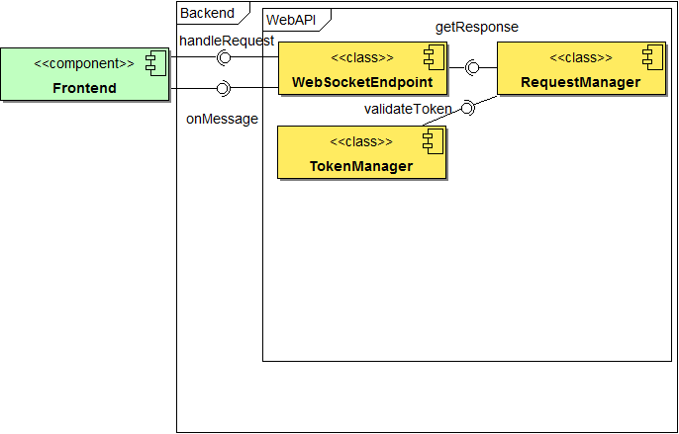
1 Frontend Example
2 WebAPI Example
3 DataManager
4 Organisation
5 Conclusion
JSON-String Java-Object
Ideas Web Application – Part 2
Georg Andrássy
Roland Knobloch
Angela Stöckert

Slide 11
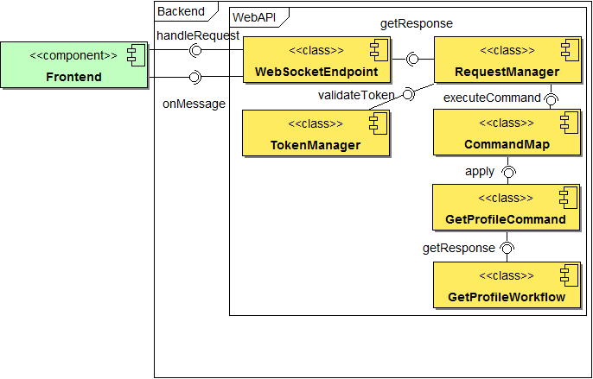
1 Frontend Example
2 WebAPI Example
3 DataManager
4 Organisation
5 Conclusion
request-key:
“getProfileRequest“
Command Pattern
Ideas Web Application – Part 2
Georg Andrássy
Roland Knobloch
Angela Stöckert

Slide 12
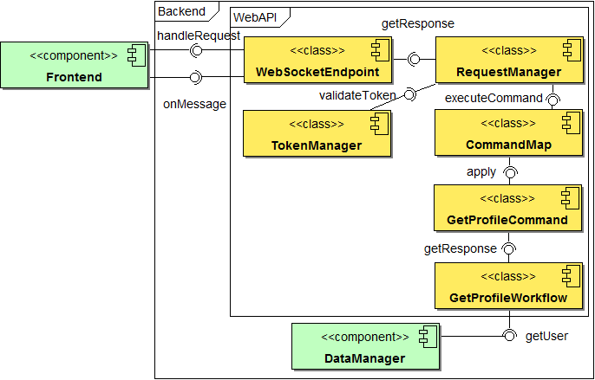
1 Frontend Example
2 WebAPI Example
3 DataManager
4 Organisation
5 Conclusion
Ideas Web Application – Part 2
Georg Andrássy
Roland Knobloch
Angela Stöckert

Slide 13
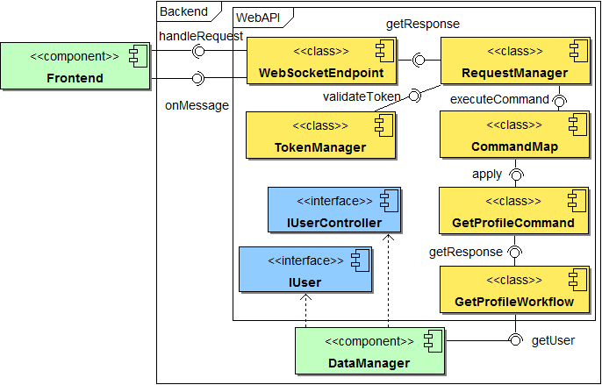
1 Frontend Example
2 WebAPI Example
3 DataManager
4 Organisation
5 Conclusion
Ideas Web Application – Part 2
Georg Andrássy
Roland Knobloch
Angela Stöckert

Slide 14
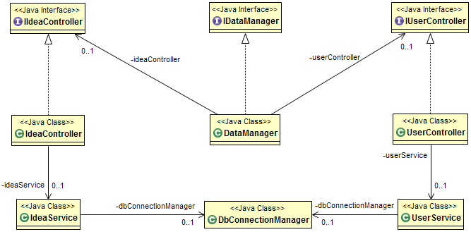
3. DataManager
1 Frontend Example
2 WebAPI Example
3 DataManager
4 Organisation
5 Conclusion
WebAPI
DataManager
Ideas Web Application – Part 2
Georg Andrássy
Roland Knobloch
Angela Stöckert

Slide 15
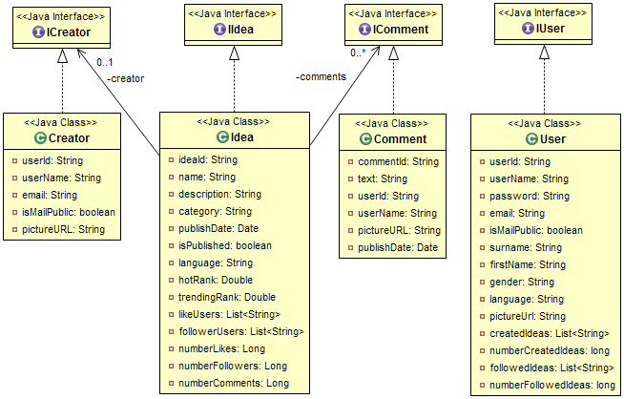
3.1 Plain Old Java Object (POJO)
1 Frontend Example
2 WebAPI Example
3 DataManager
4 Organisation
5 Conclusion
WebAPI
DataManager
Ideas Web Application – Part 2
Georg Andrássy
Roland Knobloch
Angela Stöckert

Slide 16
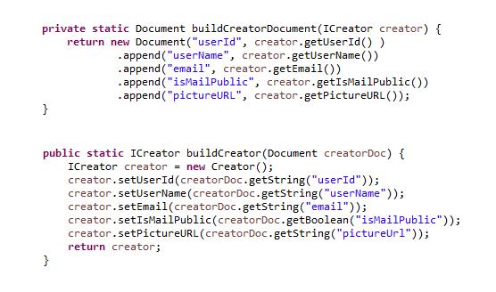
Conversion between POJO and Document

Slide 17
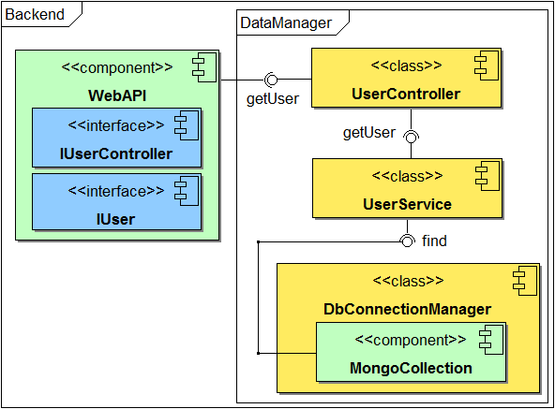
1 Frontend Example
2 WebAPI Example
3 DataManager
4 Organisation
5 Conclusion
Ideas Web Application – Part 2
Georg Andrássy
Roland Knobloch
Angela Stöckert

Slide 18
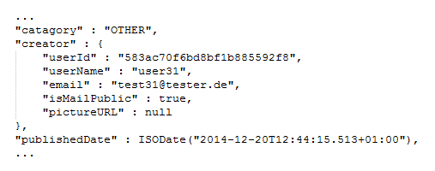
Sub-document „creator“

Slide 19



4.1 General Project Conditions
1 Frontend Example
2 WebAPI Example
3 DataManager
4 Organisation
5 Conclusion
source: http://git-scm.com/downloads/logos
source: https://github.com/logos
source: http://edtechfutures.com/wp-content/uploads/
2016/04/online-product-knowledge-training-kit.jpg
HTML5
CSS
Component
communiation
NoSQL
Javascript
Knowledge
Ideas Web Application – Part 2
Georg Andrássy
Roland Knobloch
Angela Stöckert

Slide 20


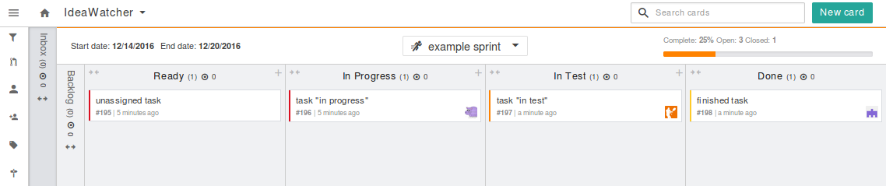
4.2 Project Management
1 Frontend Example
2 WebAPI Example
3 DataManager
4 Organisation
5 Conclusion
Based on scrum
Orgware for task planning
Direct or team messaging
source: https://www.scrum.org/
source: https://zube.io/blog
source: https://slack.com/
Ideas Web Application – Part 2
Georg Andrássy
Roland Knobloch
Angela Stöckert

Slide 21
4.2 Project Management
1 Frontend Example
2 WebAPI Example
3 DataManager
4 Organisation
5 Conclusion
Based on scrum
Orgware for task planning
Direct or team messaging
source: https://www.scrum.org/
source: https://zube.io/blog
source: https://slack.com/
Ideas Web Application – Part 2
Georg Andrássy
Roland Knobloch
Angela Stöckert

Slide 22
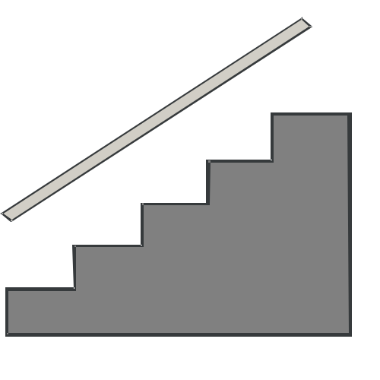
4.3 Problems
1 Frontend Example
2 WebAPI Example
3 DataManager
4 Organisation
5 Conclusion
Ideas Web Application – Part 2
Georg Andrássy
Roland Knobloch
Angela Stöckert

Slide 23





4.3 Problems
1 Frontend Example
2 WebAPI Example
3 DataManager
4 Organisation
5 Conclusion
Ideas Web Application – Part 2
Georg Andrássy
Roland Knobloch
Angela Stöckert

Slide 24
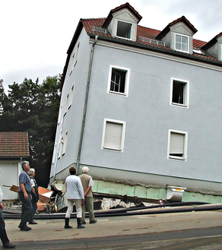
4.3 Problems
1 Frontend Example
2 WebAPI Example
3 DataManager
4 Organisation
5 Conclusion
Ideas Web Application – Part 2
Georg Andrássy
Roland Knobloch
Angela Stöckert

Slide 25

4.3 Problems
1 Frontend Example
2 WebAPI Example
3 DataManager
4 Organisation
5 Conclusion
Ideas Web Application – Part 2
Georg Andrássy
Roland Knobloch
Angela Stöckert

Slide 26

4.3 Problems
1 Frontend Example
2 WebAPI Example
3 DataManager
4 Organisation
5 Conclusion
Sources:
http://www.point-project.net/piktogramme/
https://www.jetbrains.com/company/press/
https://eclipse.org/artwork/
http://design.ubuntu.com/brand/ubuntu-logo
http://design.ubuntu.com/brand/ubuntu-logo
https://www.strassenkatalog.de/panoramio/hochwasser_das_schiefe_haus_von_freital,10093778.html
https://pixabay.com/en/puzzle-kreispuzzel-platform-1713170/
Ideas Web Application – Part 2
Georg Andrássy
Roland Knobloch
Angela Stöckert

Slide 27

5. Conclusion
1 Frontend Example
2 WebAPI Example
3 DataManager
4 Organisation
5 Conclusion
Working prototype
Meets technical specification
Goal
source: https://pixabay.com/en/check-mark-tick-mark-check-correct-1292787/
Ideas Web Application – Part 2
Georg Andrássy
Roland Knobloch
Angela Stöckert

