Slide 1
Nonlinear controller analysis
George Zogopoulos
Kaga 2024

Slide 2
Part 1: Dawdling

Slide 3
Presentation goals
Don’t get too rusty in writing papers.
Keep alive a streak of IEEE conference presentations.
Take advantage of my post-graduate controls courses.
Contribute proofs for the ArduPilot Controllers

Slide 4
A lot of disappointment
Don’t get too rusty in writing papers.
Keep alive a streak of IEEE conference presentations.
Take advantage of my post-graduate controls courses.
Contribute proofs for the ArduPilot Controllers
This isn’t a peer reviewed paper.

Slide 5
A lot of disappointment
Don’t get too rusty in writing papers.
Keep alive a streak of IEEE conference presentations.
Take advantage of my post-graduate controls courses.
Contribute proofs for the ArduPilot Controllers
This isn’t a peer reviewed paper.
This isn’t an IEEE conference.

Slide 6
A lot of disappointment
Don’t get too rusty in writing papers.
Keep alive a streak of IEEE conference presentations.
Take advantage of my post-graduate controls courses.
Contribute proofs for the ArduPilot Controllers
This isn’t a peer reviewed paper.
This isn’t an IEEE conference.
I didn’t remember half as much as I thought.

Slide 7
A lot of disappointment
Don’t get too rusty in writing papers.
Keep alive a streak of IEEE conference presentations.
Take advantage of my post-graduate controls courses.
Contribute proofs for the ArduPilot Controllers
This isn’t a peer reviewed paper.
This isn’t an IEEE conference.
I didn’t remember half as much as I thought.
Didn’t manage half as much as I hoped.

Slide 8
Key takeaways
Have fun!
Research is heavy on the body.

Slide 9
Part 2: Meat and potatoes

Slide 10
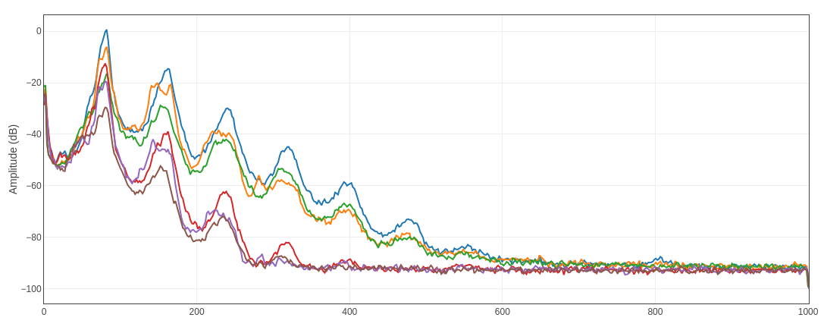

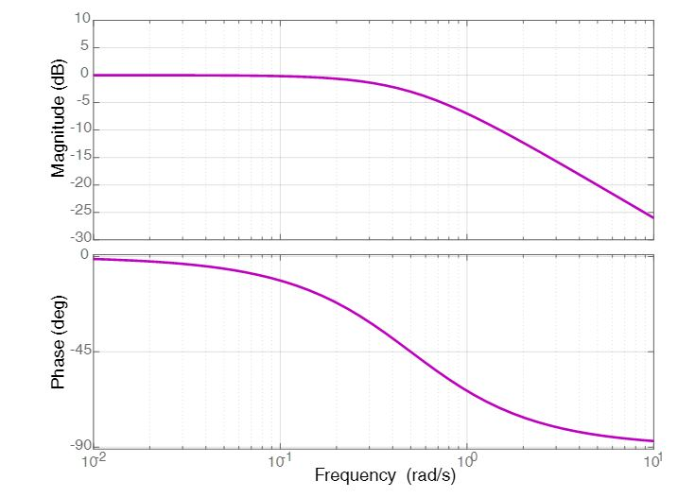

Nonlinear analysis
We use plenty of FFT and Bode diagrams
Not applicable to nonlinear systems:
Plant is nonlinear
Controller is nonlinear

Slide 11
Nonlinear analysis
We use plenty of FFT and Bode diagrams
Not applicable to nonlinear systems:
Plant is nonlinear
Controller is nonlinear
TECS!

Slide 12
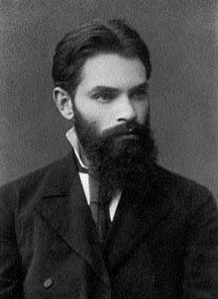
Bearded guy
Aleksandr Lyapunov
19th century Russia
Father of stability theory in dynamic systems

Slide 13
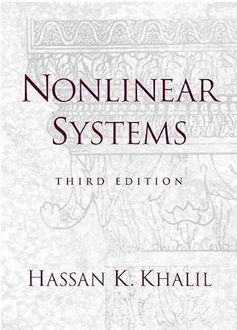
Bibliography
Khalil, H. K. (2002). Nonlinear Systems (3rd ed.). Prentice-Hall, Inc.

Slide 14
Literature review
General nonlinear stability: Literally thousands
ArduPilot controllers: None that I could find.
Pointers very welcome!

Slide 15
Goals: revised
Study if TECS closes a stable loop (spoiler: it usually does).
Uncover any hints on tuning.

Slide 16
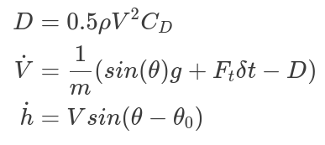
Modelling
Longitudinal airplane dynamics
Assume perfect pitch tracking
Simplified thruster model
Simplified drag
Limited to constant altitude/velocity tracking

Slide 17
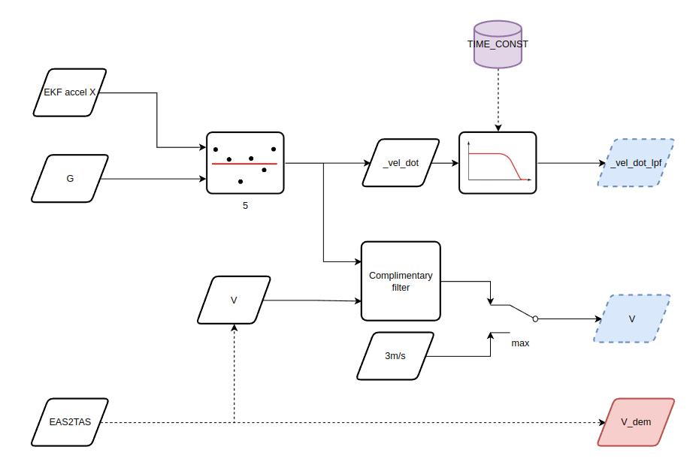
Autonomous system
Condense the controller into a digestible form.

Slide 18
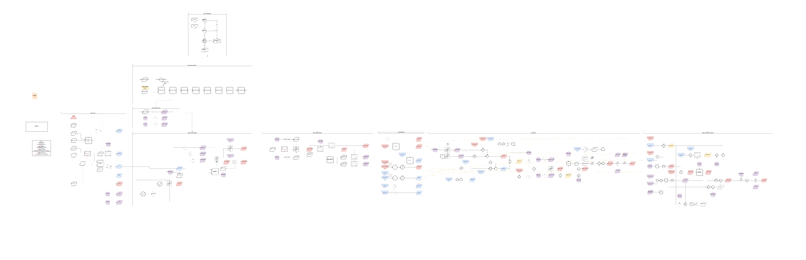
Autonomous system
“Digestible”

Slide 19
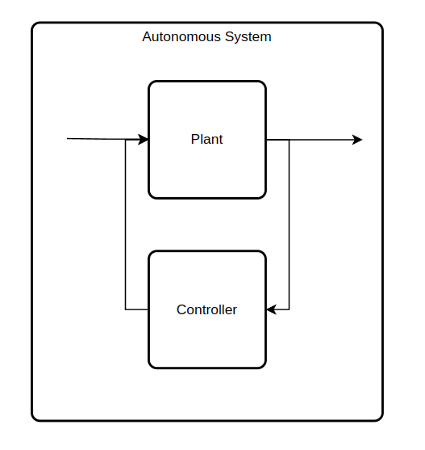
Autonomous system
Construct the autonomous system:
Replace the plant inputs with the controller outputs.
Its state dynamics are a mere function of themselves.

Slide 20
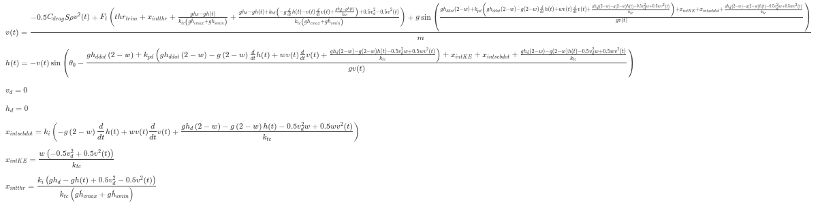
Autonomous system
Construct the autonomous system… easy

Slide 21
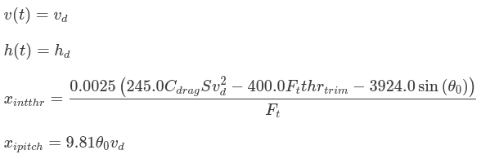
Equilibrium points
Find the equilibrium points of the system:
It is basically the height and altitude setpoint.
The integrators state capture the trim.

Slide 22
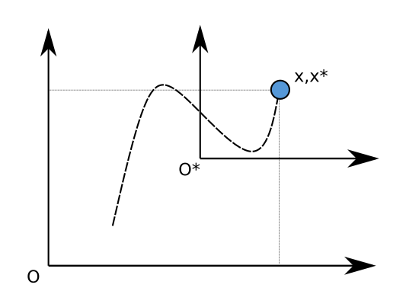
Translated system
Translate the system so that the new origin is placed onto the trim point.
Most stability analysis techniques assume that the desired stability is for the origin.

Slide 23
Linear analysis
Linear analysis
Linearization of the autonomous system
Performed at the trim point.
Gives an accurate stability assessment.

Slide 24
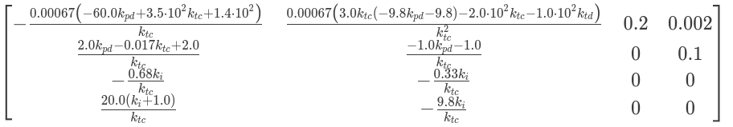
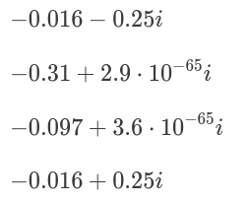
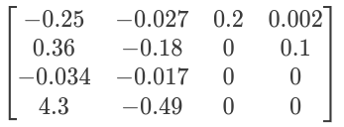
Linear analysis
eigenvalues

Slide 25
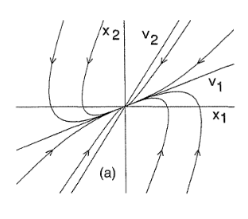
Intermission
Qualitative behaviour of linear systems
Stable node

Slide 26
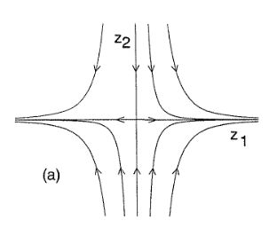
Intermission
Qualitative behaviour of linear systems
Stable node
Saddle point

Slide 27
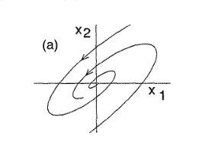
Intermission
Qualitative behaviour of linear systems
Stable node
Saddle point
Focus point

Slide 28
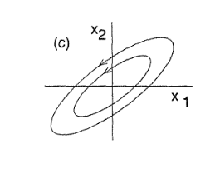
Intermission
Qualitative behaviour of linear systems
Stable node
Saddle point
Focus point
Center
… and some more

Slide 29
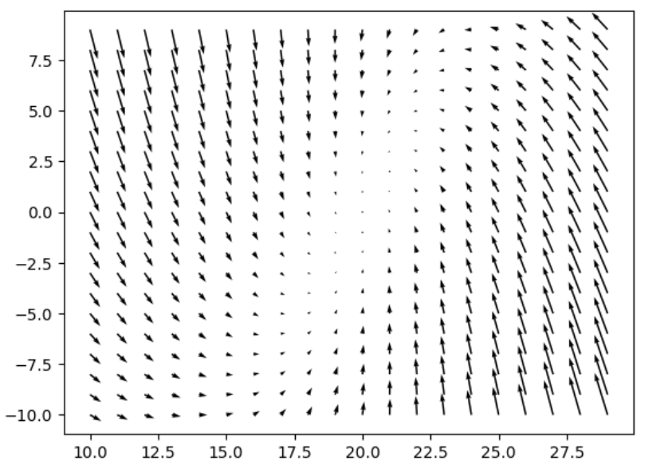
Phase portrait
It captures the trajectory of the system via propagation.
Numerical values needed.
It is expected to reflect what the linear analysis pointed.
Blaha afaefaaaaafjafja jafkejafa
h
v

Slide 30
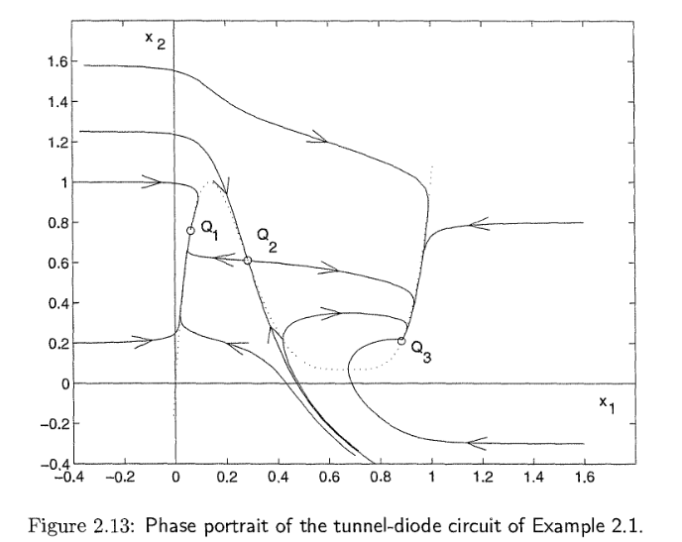
Phase portrait
It captures the trajectory of the system via propagation.
Numerical values needed.
It is expected to reflect what the linear analysis pointed.
It is not the same as a linear portrait
h
v

Slide 31

Lyapunov’s theorem
It is a sufficient proof that the autonomous system is stable.
It is the common source to derive conditions for stability.
Finding a suitable and handy Lyapunov function is the hardest part.
Let:
If:
then f(x) is stable.

Slide 32

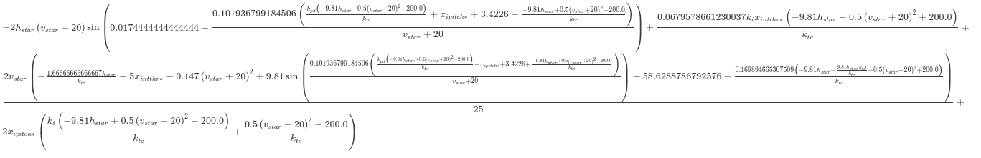
Nonlinear stability
A naive attempt at a Lyapunov function is often doomed:
Let V(x) =
This yields dV(x)/dt =
or equivalently

Slide 33
Nonlinear stability
A naive attempt at a Lyapunov function is often doomed:
Let V(x) =
This yields dV(x)/dt =
or equivalently
Yeah… no.

Slide 34
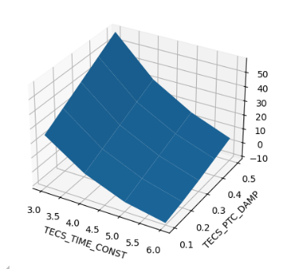
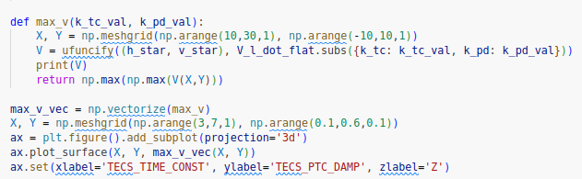
Numerical approximations
If you can’t solve them… calculate them.

Slide 35
Results
TECS is proven to be stable with the given assumptions.
That’s a good initial verification for the proposed methodology.

Slide 36
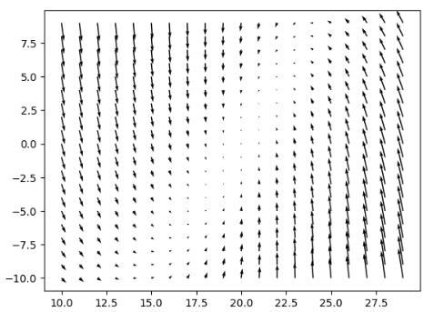
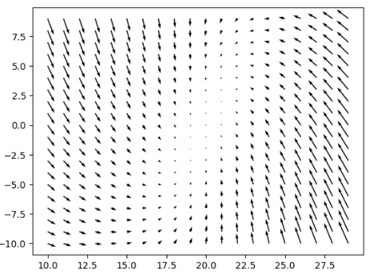
Results
TECS is proven to be stable with the given assumptions.
Too many variables to keep track of and reconcile.
We had to use numerical values to progress on this analysis.
TECS_TIME_CONST=3
TECS_PTC_DAMP=0.5
TECS_TIME_CONST=6
TECS_PTC_DAMP=0.3

Slide 37
Results
TECS is proven to be stable with the given assumptions.
Too many variables to keep track of and reconcile.
Some parameter identification is necessary.
It probably doesn’t need to be very accurate, so it might be applicable to whole vehicle classes.

Slide 38
Results
TECS is proven to be stable with the given assumptions.
Too many variables to keep track of and reconcile.
Some parameter identification is necessary.
Sympy!
All of the mathematics presented were carried out with the computer algebra Python package sympy.
The Jupyter notebook can be found at https://github.com/Georacer/ap_controller_analysis

Slide 39
Future work
Study more!
Employ useful theorems that facilitate analysis.
Employ passivity theory in systems with independent components.

Slide 40
Thank you!
If you indulged me this far, you have my sincere thanks!
Questions?

