Slide 1
Flights Dataset

Slide 2
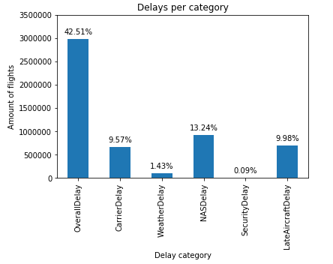
What is the share of delayed flights? How does it split amongst different categories?
The overall delay quota is 42.5 % which seems quite high. However any delay bigger than 0 minutes is considered here. The delay categories do not sum up to the total quota, as not for all delays the delay of these categories have been provided.

Slide 3
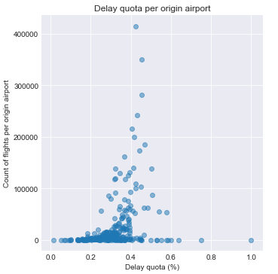
Do different airports have different delay quotas considering the amount of flights they handled?
As for the airports with a low number of flights the delay quota is spread out. For the airports with a higher amount of flights the delay quota is between 30% to 60%. The higher the flight frequency the less the spread of the delay quota.

Slide 4
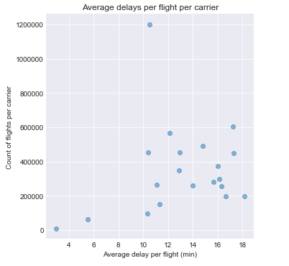
Are certain carriers sticking out regarding overall delays?
Apart from the two carriers with the lowest frequency on the left all the other carriers have an average delay ranging from 10 min per flight to 19 min per flight. There seems to be no relationship with regards to amount of flights per carrier and average delay per flight.

