Slide 1


6-site Hubbard model
Large Fock space: dim 2¹²
Use conservation of Sz : (s1, s2) sectors of dim
For example a basis function from (1,2) sector:
in binary code (10000|101000)

Slide 2
6-site Hubbard model
Matrix elements of the interaction part (diagonal in present basis):
Sector (3,3)
0
U
2U
3U
implementation of
(101000|100000) -> (101000).(100000) = 1
implementation of
(101000|100000) -> (101000)-(100000) = (001000)
i=2

Slide 3
6-site Hubbard model
Matrix elements of the hopping part:
in binary code (10100|100000)
-> -(01100|100000)
(11000|000000)
Signs:
X

Slide 4
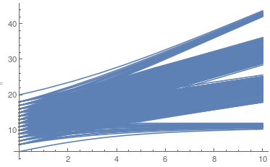
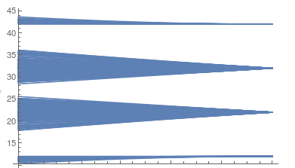
6-site Hubbard model
Spectrum of eigenenergies:
Sector (3,3)
U=10
t=1
Ei
1
t
0
U

Slide 5
6-site Hubbard model
Spectrum of eigenenergies:
Sector (3,3)
atomic limit
U=10
t=1
Ei
1
t
0
U
Non-interacting limit
(weak-coupling expansion)
(strong-coupling expansion)

Slide 6



6-site Hubbard model
Non-interacting (canonical) bosons or fermions
=> We can find all eigenstates by diagonalizing the 1-p Hamiltonian (= hopping matrix)
Canonical commutation relations!

Slide 7



6-site Hubbard model
Large U >> t limit:
Sector (3,3)
0
U
2U
3U
Degeneracy:
180
180

Slide 8


6-site Hubbard model
Expectation values/correlation functions:
Simple form for operator diagonal in a given basis
The average value one gets when many measurement on site i are performed. Possible result of each individual
measurement is 0, 1 and -1.
At half filling (N=6)
Fluctuations of Sz
Total moment (occupation number):
Conserved quantities (corresponding operators commute with
Hamiltonian)

Slide 9
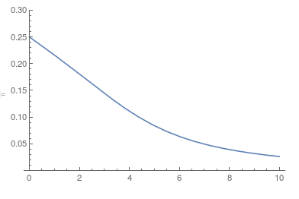
6-site Hubbard model
Expectation values/correlation functions:
Double occupancy: (probability to find two electrons in a given site)
?
U

Slide 10
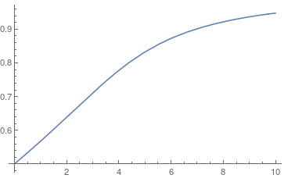
6-site Hubbard model
Expectation values/correlation functions:
(Fluctuating) local moment
?
U

Slide 11
6-site Hubbard model
Expectation values/correlation functions:
Non-local spin-spin correlation function
Weighted sum over configurations like
0
1
-1
Which one has the largest weight?

Slide 12
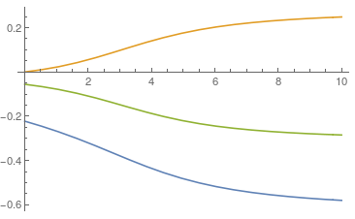
6-site Hubbard model
Expectation values/correlation functions:
13
1
14
0
12
U
-1

Slide 13

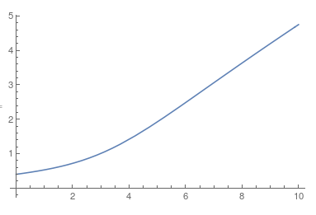
6-site Hubbard model
Why correlation functions?
Contributions to interaction energy of the system
Response to small perturbations
Correction: Factor 2 missing in the recorded
presentation
external local field
U

Slide 14
6-site Hubbard model
What about symmetry?
We have used conservation of N and Sz when constructing the basis
We did not use translation symmetry
This would require a bit more 'brain' input

Slide 15

6-site Hubbard model
Translation symmetry is reflected in the correlation functions:
13
1
14
0
12
U
-1

Slide 16
6-site Hubbard model
Translation symmetry is reflected in the correlation functions:
}
invariant
invariant: (k''=0)
Correction:
k+k'+(k"-k")=0 (mod 2𝝅)
k''=𝝅
The ground state is dominated by the states
of the type
=>
The ground state phase does not matter as pointed out correctly.

Slide 17
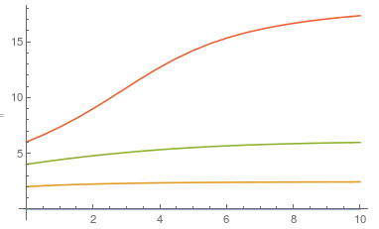
6-site Hubbard model
Translation symmetry is reflected in the correlation functions:
1
0
U
U
-1

