Slide 1


6-site Hubbard model
Large Fock space: dim 2¹²
Use conservation of Sz : (s1, s2) sectors of dim
We study all sectors with N=6 simultaneously (6,0), (5, 1), (4,2), (3,3), (2,4), (1,5), (0,6)

Slide 2
Thermal equilibrium
Thermal averages (finite temperature):
reservoir
energy and/or
particles
system
Coupling is very weak !

Slide 3
Thermal equilibrium
Thermal averages (finite temperature):
reservoir
Coupling is very weak !
energy and/or
particles
system

Slide 4

Thermal equilibrium
ensemble averaging:
Measurement involves different (weakly coupled)
parts of the system,
e.g., total moment is a sum of local moments
Measurement involves averaging over (long) time (=duration
of measurement)
p1
p2
p3
p4
t1
t2
t3
t4
...
Ergodic hypothesis
p1
p2
p3
p4
Averaging over various realizations of the system

Slide 5
Thermal equilibrium
ensemble averaging:
Measurement involves averaging over (long) time (=duration
of measurement)
reservoir
system
t1
t2
t3
t4
Coupling is very weak !
Ergodic hypothesis
p1
p2
p3
p4
Averaging over various realizations of the system
The slow dynamics due to system-reservoir
interaction is replaced by ensemble averaging
(the fast dynamics of the system itself is retained)

Slide 6


Thermal equilibrium
ensemble averaging:
p1
p2
p3
p4
Averaging over various realizations of the system
How do we get the probabilities?
Statistical considerations => in thermal equilibrium:
avg. at temperature T
Boltzmann weight/factor
Partition function
sum over eigenstates l

Slide 7



Thermal equilibrium
ensemble averaging:
p1
p2
p3
p4
Averaging over various realizations of the system
How do we get the probabilities?
Statistical considerations => in thermal equilibrium:
density matrix
(statistical operator)
Hamiltonian (operator)
(number)
inverse temperature

Slide 8
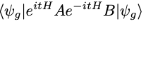
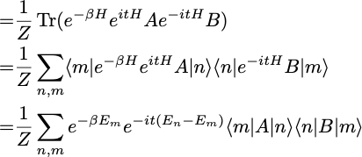
Thermal equilibrium
ensemble averaging:
p1
p2
p3
p4
Averaging over various realizations of the system
Ground state:
Finite temperature:

Slide 9
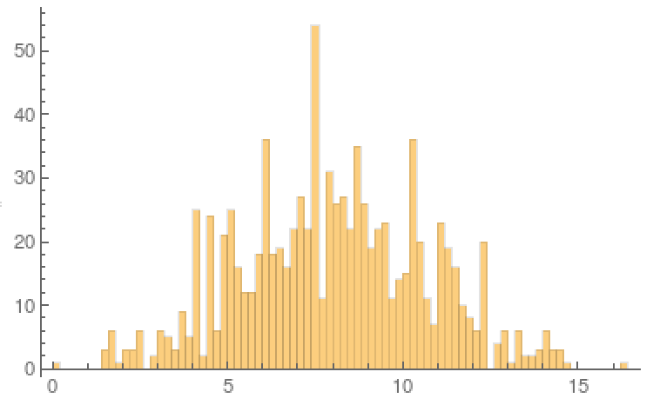

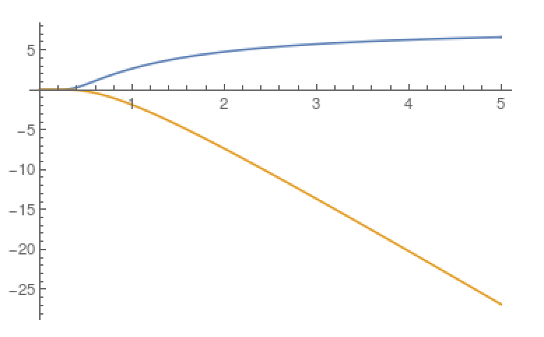
Thermodynamic observables
Energy spectrum (N=6)
Thermodynamic observables:
U=1.23
internal energy
# of states
free energy
entropy S
specific heat (heat capacity)
E
U
T
F

Slide 10
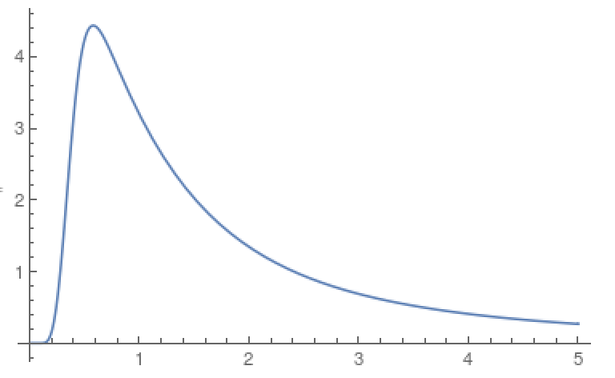
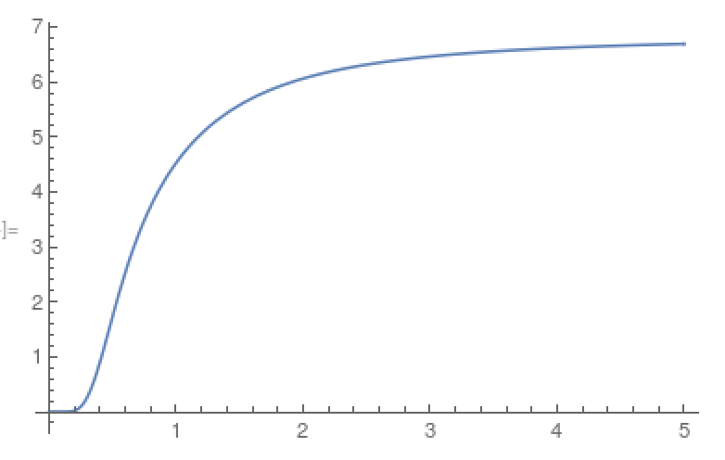
Thermodynamic observables
Energy spectrum (N=6)
Thermodynamic observables:
U=1.23
internal energy
# of states
free energy
entropy S
specific heat (heat capacity)
E
c
S
T
T

Slide 11
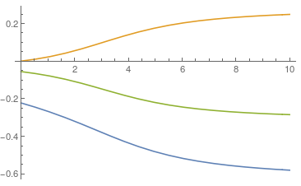
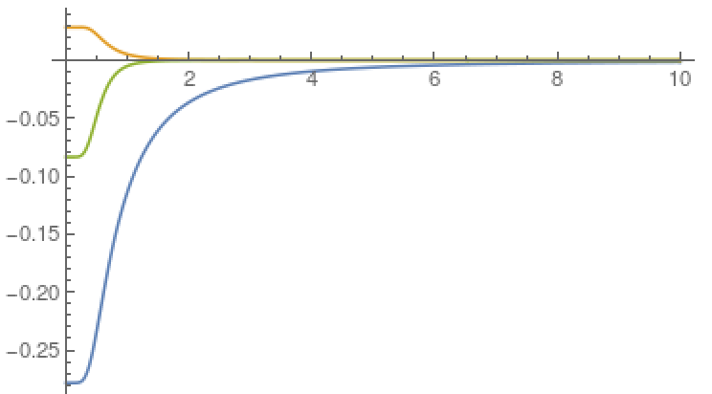
Correlation functions
Expectation values/correlation functions:
T=0
U=1.23
13
14
12
T
U

Slide 12


Linear response
Why correlation functions?
Contributions to interaction energy of the system
Response to small perturbations
external uniform field

Slide 13
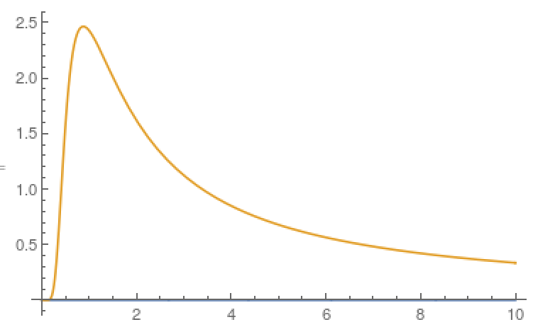
Linear response
Why correlation functions?
Contributions to interaction energy of the system
Response to small perturbations
external uniform field
T

Slide 14
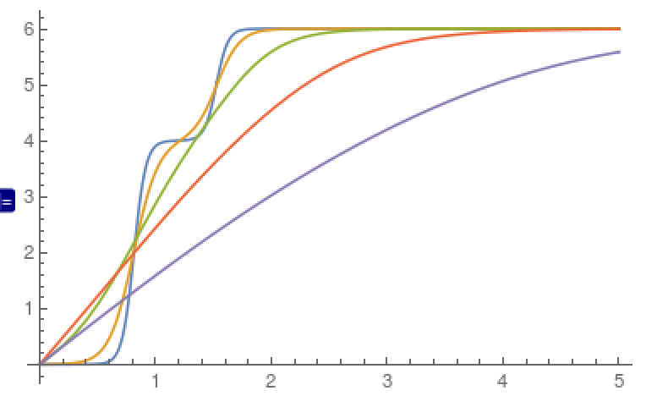
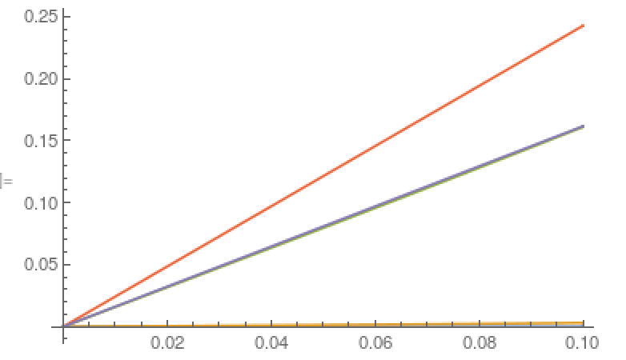
Linear response
Does it work?
Let's calculate a response to finite h.
T
Sz
Sz
h
h

Slide 15
Linear response
Why correlation functions?
Contributions to interaction energy of the system
Response to small perturbations
Uniform susceptibility is a special case because
external uniform field
General case (e.g. local susceptibility):

Slide 16
Linear response (perturbative) regime
Kubo formula
External time-dependent field (el.-mag. field, photon)
Initial state (ground state)
Evolution operator
H0 and V do not commute and thus is it not possible to split the exponential even if V did not depend on time!
Standard trick: discretise the time into small steps and use the fact that ,
i.e., we can split the exponential on each time (the error can be made arbitrarily small):
Next we expand the exponentials containing the external field:

Slide 17
Linear response (perturbative) regime
Kubo formula
External time-dependent field (el.-mag. field, photon)
Initial state (ground state)
Evolution operator
H0 and V do not commute and thus is it not possible to split the exponential even if V did not depend on time!
Standard trick: discretise the time into small steps and use the fact that ,
i.e., we can split the exponential on each time (the error can be made arbitrarily small):
Next we expand the exponentials containing the external field:
Now we arrange the terms in powers of V:
+
+
+
+
….
+
+
….
….
+
+
….

Slide 18
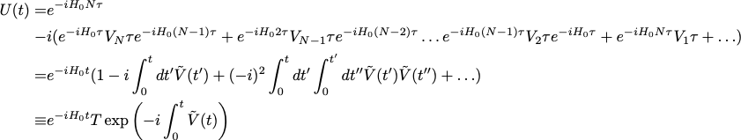
Linear response (perturbative) regime
Kubo formula
External time-dependent field (el.-mag. field, photon)
Initial state (ground state)
Evolution operator
H0 and V do not commute and thus is it not possible to split the exponential even if V did not depend on time!
Standard trick: discretise the time into small steps and use the fact that ,
i.e., we can split the exponential on each time (the error can be made arbitrarily small):
Next we expand the exponentials containing the external field:

Slide 19
Linear response (perturbative) regime
Kubo formula
External time-dependent field (el.-mag. field, photon)
Initial state (ground state)
Evolution operator
H0 and V do not commute and thus is it not possible to split the exponential even if V did not depend on time!
T is so called time ordering symbol (sometimes called an time-ordering operator). Note that it is not an operator! The meaning of T is the expansion on the line above.
You cannot interpret this expression as “evaluate the integral in the bracket -> exponentiate the result -> apply T on the result”!
Standard trick: discretise the time into small steps and use the fact that ,
i.e., we can split the exponential on each time (the error can be made arbitrarily small):
Next we expand the exponentials containing the external field:

Slide 20




Linear response (perturbative) regime
Kubo formula
External time-dependent field (el.-mag. field, photon)
Initial state (ground state)
Evolution operator
H0 and V do not commute and thus is it not possible to split the exponential even if V did not depend on time!
Standard trick: discretise the time into small steps and use the fact that ,
i.e., we can split the exponential on each time (the error can be made arbitrarily small):
Next we expand the exponentials containing the external field:

Slide 21
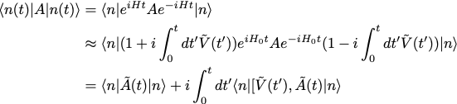

Linear response (perturbative) regime
Kubo formula
Now we can evaluate the expectation value of operator A in the system evolving with time
We keep only terms linear in V.
In compact form. Note that operators are in so called interaction representation with respect to H0 (This is indicated by <>0)
We have shifted origin of time integral to infinity, assuming that the perturbation is adiabatically (slowly) turned on (this excludes the transient states that takes place after sudden turning of finite external field)
The formula can be used in thermal equilibrium, in which case <>0 refers to thermal average -
trace with .

Slide 22

Linear response (perturbative) regime
Kubo formula
A typical external field has the form of a (classical) function (electric field, Zeeman field, vector
potential, …) coupled to a typically (semilocal) operator (charge-, spin-, current-density):
In the linear response regime the amplitude of the response is linearly proportional to the amplitude of the external field. We want to investigate the trivial temporal (or frequency) relationship.
Note, that the expectation value of the commutator depends only on the difference t-t’,
because H0 does not depend on time.

