Slide 1
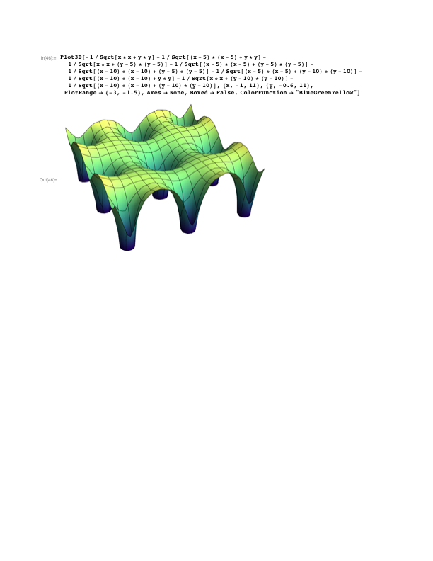
Hubbard model
t
U
Hubbard model
Electrons in crystal

Slide 2





How do we describe materials?
probe
perturbation
sample
photoemission
transport
magnetism
2-particle properties
Weakly correlated electrons:
Strongly correlated electrons:
‘small_correction’ is not small !

Slide 3
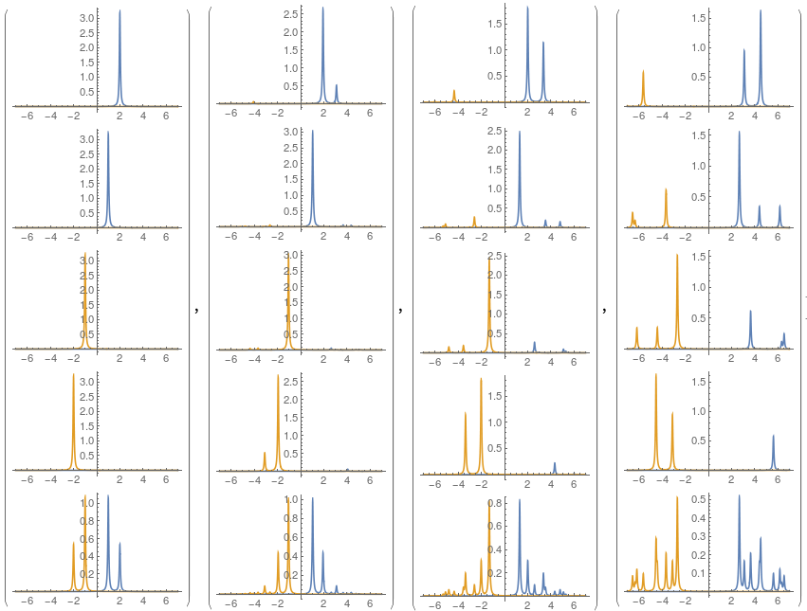
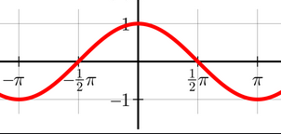
How do we describe materials?
probe
perturbation
sample
photoemission
transport
magnetism
𝜔
2-particle properties
k
Weakly correlated electrons:
Strongly correlated electrons:
‘small_correction’ is not small !

Slide 4
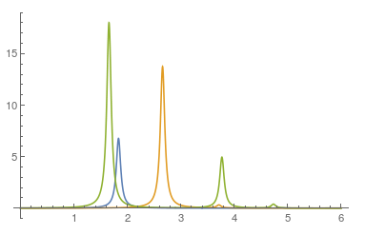
How do we describe materials?
probe
perturbation
sample
photoemission
transport
magnetism
Im
2-particle properties
Weakly correlated electrons:
𝜔
Strongly correlated electrons:
‘small_correction’ is not small !

Slide 5
How do we calculate correlation functions?
probe
perturbation
sample
photoemission
transport
magnetism
2-particle properties
Weakly correlated electrons:
Strongly correlated electrons:
‘small_correction’ is not small !

Slide 6



Electron self-energy
How does coupling to phonons affect electrons?
Electron propagator:
t
t
t=0
t=0
In a non-interacting system:
k

Slide 7
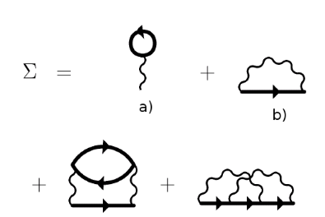

Self-energy and Dyson equation
perturbation theory (diagrams)
effective potential
Quasiparticle construction:
Non-interacting particle is a pole of G(𝜔).
equation for approx. pole 𝜔* with a linewidth

Slide 8
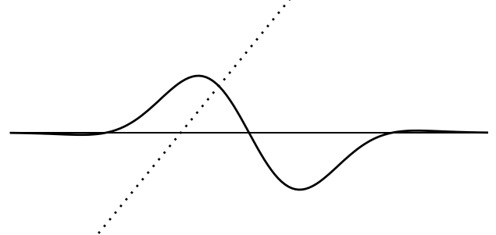

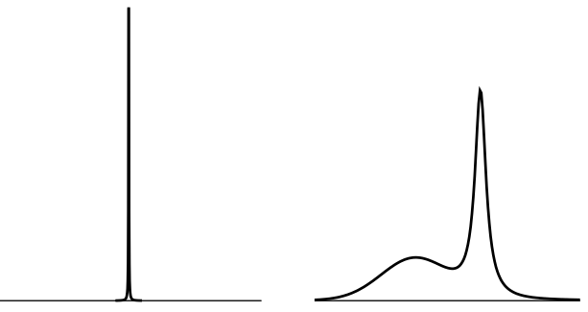
Self-energy and Dyson equation
Quasiparticle construction:
Non-interacting particle is a pole of G(𝜔).
equation for approx. pole 𝜔* with a linewidth
interacting (dressed)
non-interacting (bare)

Slide 9


Self-energy and Dyson equation
Quasiparticle construction:
Non-interacting particle is a pole of G(𝜔).
equation for approx. pole 𝜔* with a linewidth
For 𝜔 close to 0: Re𝜮(𝜔) is linear (in FL, not in general)
Quasi-particles are Z⁻¹ heavier than bare particles.
Quasi-particle residuum

Slide 10
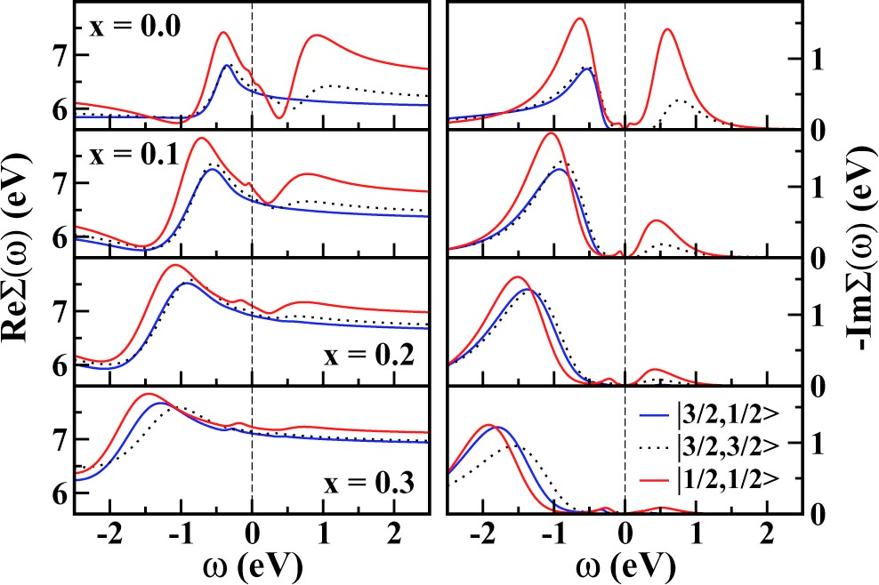
Re𝝨
Self-energy and Dyson equation
Quasiparticle construction:
Non-interacting particle is a pole of G(𝜔).
equation for approx. pole 𝜔* with a linewidth
-Im𝝨
interacting (dressed)
non-interacting (bare)

Slide 11
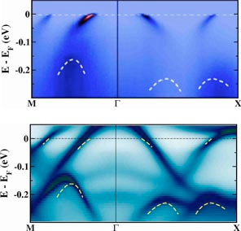
Re𝝨
Self-energy and Dyson equation
exp:
the:
FL regime
Quasiparticle construction:
Non-interacting particle is a pole of G(𝜔).
equation for approx. pole 𝜔* with a linewidth
-Im𝝨
interacting (dressed)
non-interacting (bare)

Slide 12

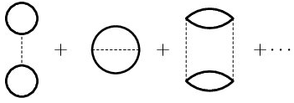
2nd order perturbation theory (small U)
2nd order
0th order (non-interacting)
k
i
U
ΔE^{N}:
EF
EF
j
l
U
U
k
x
i
x
ΔE^{N+1}:
EF
EF
j
l
U

Slide 13

2nd order perturbation theory (small U)
k
i
ΔE^{N}:
EF
j
l
x
x
x
x
ΔE^{N+1}-ΔE^{N}: - + + +
0

Slide 14
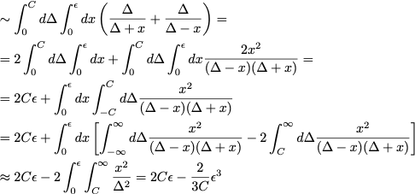
2nd order perturbation theory (small U)
x
x
x
x
ΔE^{N+1}-ΔE^{N}: - + + +
0

Slide 15
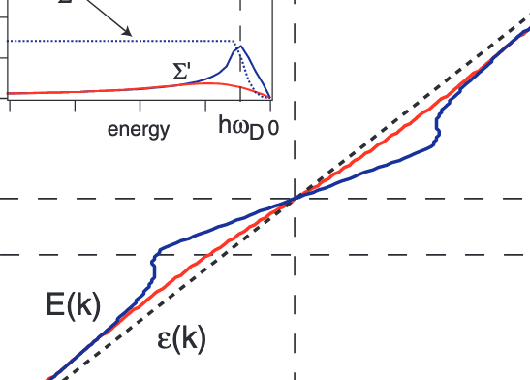
Electron mass enhancement
Electronic energies further from the Fermi level are renormalized (reduced) more than the ones close to it:
Why does the self-energy change sign at EF?
Why is there a mass enhancement (and not reduction)?
Re𝝨

Slide 16
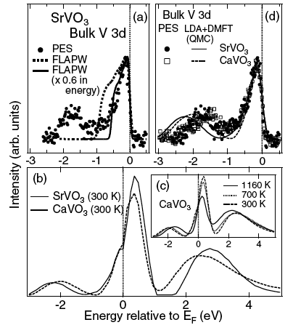
Comparison to experiment
Photoemission spectroscopy vs LDA+DMFT
intensity
E (eV)
Sekiyama, PRL 93, 156402 (2004)

Slide 17



Atomic limit n=1 (large U)
-Im G
-U/2
U/2
-Im G0
-U/2
U/2
-Im 𝛴
-U/2
U/2

Slide 18
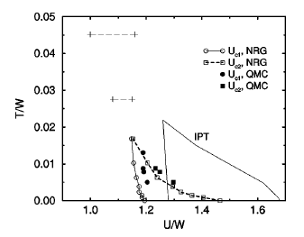
Hubbard model: DMFT results
crossover
I
critical point
M
1st order transition
Bulla et al. PRB 64, 045103 (2001)

Slide 19
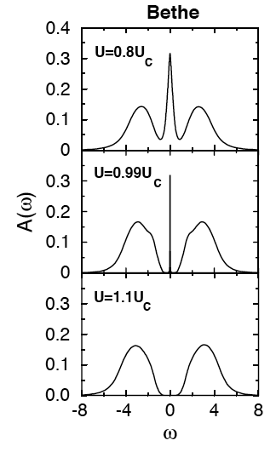
Hubbard model: DMFT results
I
M
Bulla et al. PRB 64, 045103 (2001)

Slide 20
Hubbard model: DMFT results
I
M
Bulla et al. PRB 64, 045103 (2001)

Slide 21
Single-band Hubbard model D=∞
T=0 (NRG solver)
Increasing U/W
Bulla, PRL 83, 136 (1999)

Slide 22

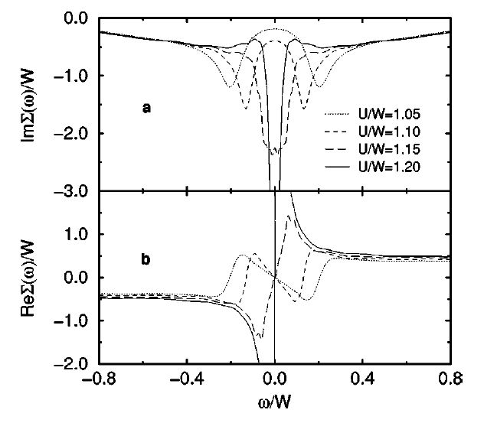
Hubbard model: metal-insulator transition
self-energy:
with increasing U quasiparticles
become heavier (m* → ∞)
in Mott insulator Σ(ω) develops
pole inside the band
in DMFT the gaps opens due to
self-consistency
Bulla et al. PRB 64, 045103 (2001)

Slide 23
Hubbard model: metal-insulator transition
self-energy:
with increasing U quasiparticles
become heavier (m* → ∞)
in Mott insulator Σ(ω) develops
pole inside the band
in DMFT the gaps opens due to
self-consistency
Bulla et al. PRB 64, 045103 (2001)

Slide 24
Hubbard model: metal-insulator transition
self-energy:
with increasing U quasiparticles
become heavier (m* → ∞)
in Mott insulator Σ(ω) develops
pole inside the band
in DMFT the gaps opens due to
self-consistency
Bulla et al. PRB 64, 045103 (2001)

Slide 25
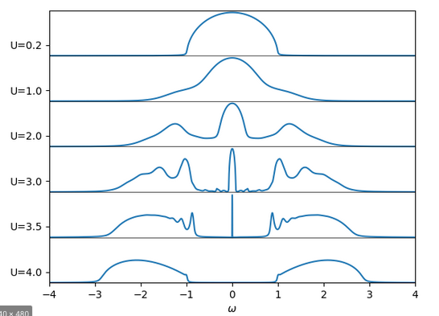
Hubbard model: metal-insulator transition
non-interacting limit
atomic limit
-U/2
U/2
Georges et al., RMP 1996

Slide 26
Band insulator
Charge gap
=Δ
add electron
Spin
gap
=Δ
flip spin
create particle-hole
pair
Optical gap
=Δ

Slide 27
Mott insulator
Charge gap
= U
add electron
Spin
gap
≃0
flip spin
create particle-hole
pair
Optical gap
=Δ

Slide 28
Mott insulator
Charge gap
= U
add electron
Spin
gap
≃0
flip spin
create particle-hole
pair
Optical gap
=Δ

