Slide 1

Dynamics:
Classical dynamics:
State of a system:
?
Quantum dynamics?
?
Gedanken experiment:
?
The outcome is not deterministic
The system has no memory (it does not matter how I prepare the initial state)
The statistical distribution of the results does not change with time P(𝜑,t,t’)=P(𝜑,t-t’)
The particle does not disappear

Slide 2
Examples of dynamical models
?
?
Gedanken experiment:
?
Markov process (Brownian motion)
Quantum mechanics: unitary evolution + measurement

Slide 3
Simpler Example: 1D N-chain with nn hopping
Discrete time - for convenience
Markov process (Brownian motion)
Particle is always at a definite site
At each time-step it can choose randomly between
hopping left (x²), hopping right (x²), staying put (1-2x²)
We use a N-vector to describe the probability of finding
the particle at any given site
Quantum mechanics: unitary evolution + measurement
We use a complex N-vector (WF) to describe the state of the particle
At each time-step the WF undergoes a unitary transformation reflecting hopping of the particle
At time t we perform a measurement (compute the amplitude of WF at any given site)

Slide 4
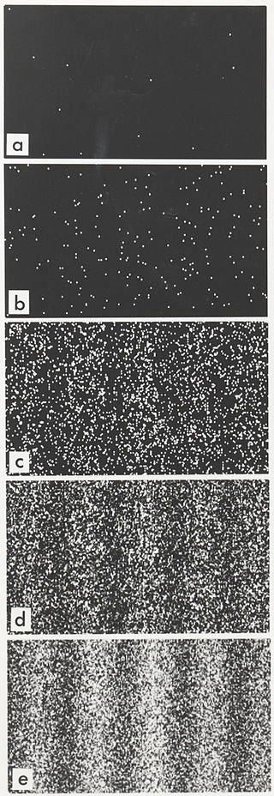


Double slit experiment with electrons
(Wikipedia)
d
𝜑
Electron has a wavelength
Impuls
Wellenlänge

Slide 5
Wave function collapse
Complicated (chemical, physical, biological)
process
d
No interference
𝜑
Measurement in QM:
Results of measurement are randomly distributed
The possible outcomes are the eigenvalues of a corresponding hermitian operator
Probability of an outcome is given by the weight of the corresponding eigenvector in the probed wave function
In the process of measurement the system becomes entangled with the wave function of the macroscopic apparatus, which leads to collapse of the wave function system (is reduced to the eigenfunction of the measured eigenvalue).

Slide 6
Wave function collapse
Complicated (chemical, physical, biological)
process
d
No interference
No interference=>No stripes
Measurement in QM:
Results of measurement are randomly distributed
The possible outcomes are the eigenvalues of a corresponding hermitian operator
Probability of an outcome is given by the weight of the corresponding eigenvector in the probed wave function
In the process of measurement the system becomes entangled with the wave function of the macroscopic apparatus, which leads to collapse of the wave function system (is reduced to the eigenfunction of the measured eigenvalue).

Slide 7

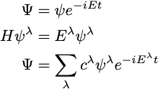
Schrodinger equation
Making time-step infinitely small
H is constant in time

Slide 8



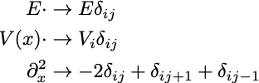
Schrodinger equation in continuum
Fi-1
Fi
F(x)
Discretisation
Fi+1
x
Derivatives replaced with differences
Identity matrix
Diagonal matrix
Irrelevant constant shift
Nearest-neighbour hopping

Slide 9
Wave functions and expectation values
Wave function is not observable: The same dynamical system can be described by a different wave function (similar gauge freedom as with electromagnetic potentials)
Operators are also not unique:
Observables - unique:

