Slide 1






Linear response
Kubo formula
Response of a system to small external perturbations is described by ground state (equilibrium)
correlation functions (fluctuation-dissipation theorem).
perturbation
probe
photoemission
conductivity, optical absorption
magnetic susceptibility
superconductivity
sample
(semi-local) density-like quantities

Slide 2




Linear response
Kubo formula
Response of a system to small external perturbations is described by ground state (equilibrium)
correlation functions (fluctuation-dissipation theorem).
spin
perturbation
probe
photoemission
conductivity, optical absorption
magnetic susceptibility
superconductivity
sample
charge
(semi-local) density-like quantities

Slide 3
Linear response
Kubo formula
Response of a system to small external perturbations is described by ground state (equilibrium)
correlation functions (fluctuation-dissipation theorem).
perturbation
probe
photoemission
conductivity, optical absorption
magnetic susceptibility
superconductivity
sample
charge current
(semi-local) density-like quantities

Slide 4
Linear response
Kubo formula
Response of a system to small external perturbations is described by ground state (equilibrium)
correlation functions (fluctuation-dissipation theorem).
R <-> q
perturbation
probe
photoemission
conductivity, optical absorption
magnetic susceptibility
superconductivity
sample
(semi-local) density-like quantities

Slide 5
Linear response
Kubo formula
q=(0,0)
Response of a system to small external perturbations is described by ground state (equilibrium)
correlation functions (fluctuation-dissipation theorem).
q=(𝜋,𝜋)
perturbation
probe
photoemission
conductivity, optical absorption
magnetic susceptibility
superconductivity
sample
(semi-local) density-like quantities

Slide 6
Linear response
Kubo formula
Response of a system to small external perturbations is described by ground state (equilibrium)
correlation functions (fluctuation-dissipation theorem).
perturbation
probe
photoemission
conductivity, optical absorption
magnetic susceptibility
superconductivity
sample
(semi-local) density-like quantities
Let us consider the response to static perturbations

Slide 7


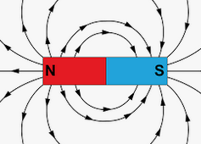
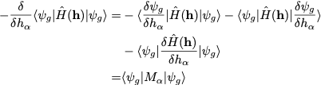


Susceptibility
Thermodynamic definition of susceptibility
@T=0
=0 (by minimum property of the ground state)
@T>0
<- free energy

Slide 8
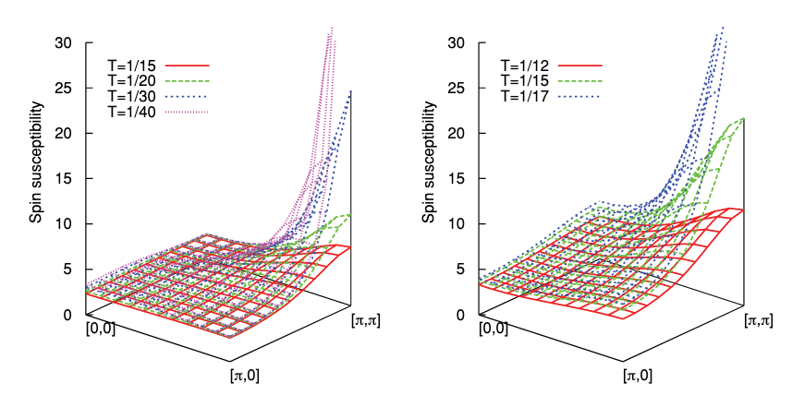
Susceptibility
What if the susceptibility diverges?
2D Hubbard model (DMFT solution)
U=0.4
U=1

Slide 9

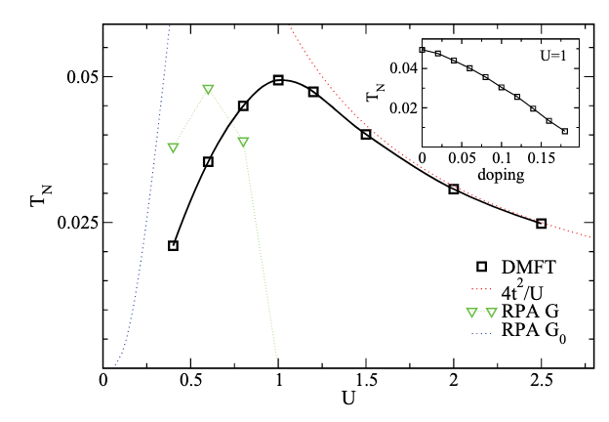


Susceptibility
What if the susceptibility diverges?
2D Hubbard model (DMFT solution)

Slide 10
Susceptibility
What if the susceptibility diverges?
2D Hubbard model (DMFT solution)

Slide 11

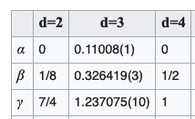


Critical phenomena
How does susceptibility and other quantities (e.g. M) as a function of control parameter (e.g. temperature) approach the critical point?
Example: Ising model
Dimension is crucial!
Correlation length
The static susceptibility "collects" temporal correlations over all time-scales.
Can we detect a symmetry breaking "instantaneously"? Yes
In the normal state for large distances.
When the transition is approached the correlation length 𝜆 diverges, i.e., the correlation function
does not diverges exponentially at the transition.

Slide 12
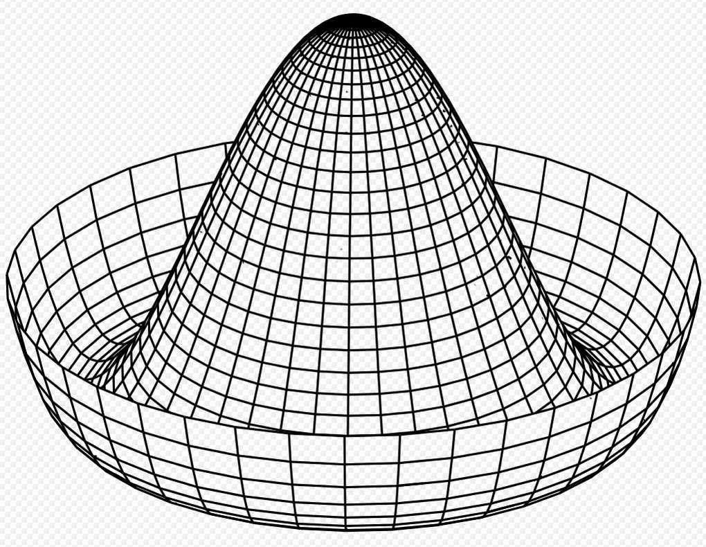
Spontaneous breaking of continuous symmetry
Continuous symmetries: space isotropy (orbital or spin rotations),
space homogeneity (translation), gauge symmetries (charge conservation)
Transition:
Broken symmetry
liquid, gas -> solid
paramagnet -> ferromagnet
paramagnet-> antiferromagnet
metal -> superconductor
normal gas -> Bose-Einstein condensate
translation (homogeneity of space)
spin rotation (isotropy of spin space)
spin rotation (isotropy of spin space)
gauge symmetry (charge conservation)
gauge symmetry (particle number conservation)

Slide 13
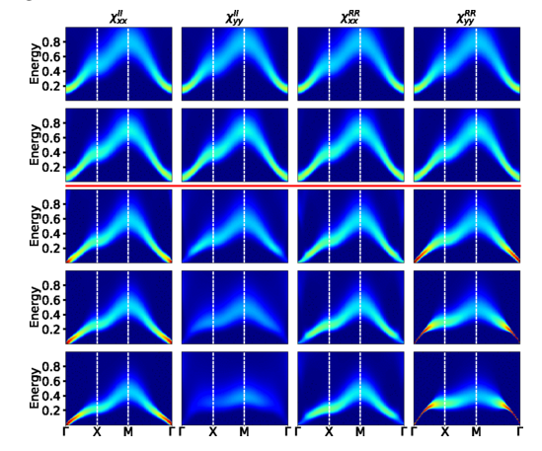

Spontaneous breaking of continuous symmetry
Continuous symmetries: space isotropy (orbital or spin rotations),
space isotropy (translation), gauge symmetries (charge conservation)
Goldstone mode (in systems with short-range interaction):
Long-wave length rotations of the order parameter
cost vanishingly low energy.
2 linear modes in 2-orbital Hubbard model (exciton condensate phase)
Transition:
Goldstone mode
liquid, gas -> solid
paramagnet -> ferromagnet
paramagnet-> antiferromagnet
metal -> superconductor
normal gas -> Bose-Einstein condensate
acoustic phonons
(quadratic) magnons
(linear) magnons
massive (due to long-range Coulomb interaction)
'sound' waves

Slide 14
Not all transitions are associated with divergent susceptibility
First order transitions (distinct states are locally stable,
while their energies cross):
The transition does not have to break any symmetry
(e.g. vapor <-> liquid transition)
Topological transitions (no local order parameter), the phases are distinguished by (discrete) topological invariants

Slide 15









Spontaneous symmetry breaking (mean-field theory)
Hubbard model (simplest model that have all the ingredients) at half filling n=1
t
U
Mean-field decoupling (T=0)
Minimize

Slide 16
Spontaneous symmetry breaking (mean-field theory)
Hubbard model (simplest model that have all the ingredients) at half filling n=1
t
U
Mean-field decoupling (T=0)
Minimize

Slide 17
Spontaneous symmetry breaking (mean-field theory)
Hubbard model (simplest model that have all the ingredients) at half filling n=1
t
U
Mean-field decoupling (T=0)
Intuitive picture:
Write the operator a expectation value plus 'fluctuations'
Keep only linear terms in the 'fluctuations'
Minimize

Slide 18
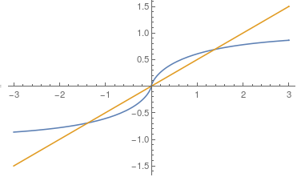
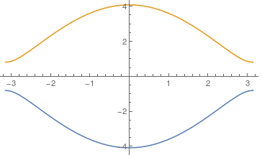
Spontaneous symmetry breaking (mean-field theory)
Hubbard model (simplest model that have all the ingredients)
Assuming staggered order:
gap

Slide 19
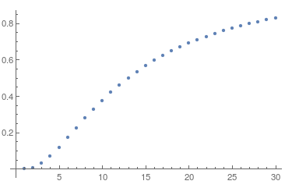
Spontaneous symmetry breaking (mean-field theory)
Hubbard model (simplest model that have all the ingredients)
Assuming staggered order:
1
2
3

Slide 20
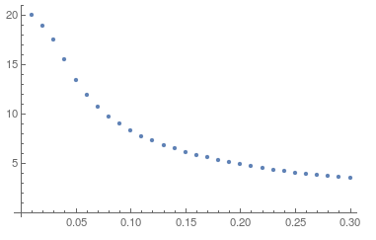
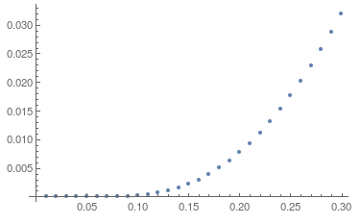

Spontaneous symmetry breaking (mean-field theory)
Hubbard model (simplest model that have all the ingredients)
Assuming staggered order:
1
2
3

Slide 21
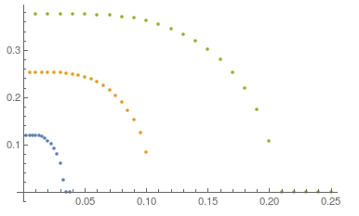
Spontaneous symmetry breaking (mean-field theory)
The ground state breaks symmetries of the Hamiltonian:
spin isotropy (z-direction is special)
periodicity (two sublattices)
time-reversal
=> ground state is degenerate
=> if continuous symmetries are broken Goldstone modes
exist: magnons (FM, AFM), acoustic phonons (solids),
sound waves (BEC), ...
=> spontaneous symmetry breaking (second order phase transition) can exist only in infinite (macroscopic) systems
=> ordered phase is destroyed by temperature
U=1
U=0.75
U=0.5
Examples:
magnetic order (spin rotation symmetry)
crystalline order (translational symmetry)
superconductivity (particle conservation, gauge symmetry)
Bose-Einstein condensation (particle conservation, gauge symmetry)
charge/spin density waves (translational symmetry)
MF theory can be generalized to finite temperatures - it provides an accurate description
of spontaneous symmetry breaking in weak coupling limit, e.g. superconductivy

Slide 22
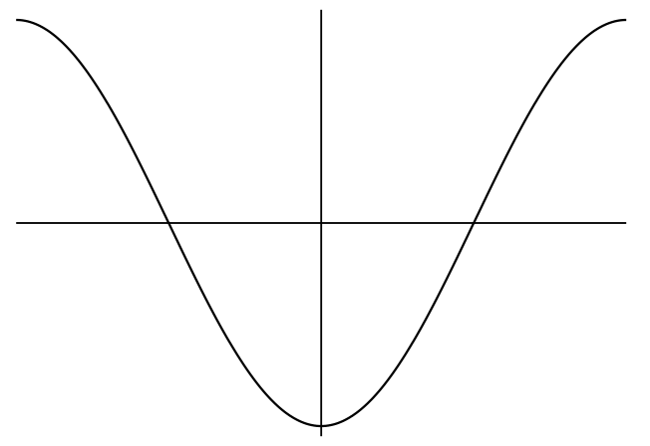
Spontaneous symmetry breaking (mean-field theory)
Why AFM and why the T=0 order exists for any U?
This is a special property of square lattice and half-filling!
(in generic case one gets an order at finite U if at all)
Perfect nesting of the Fermi surface:
-𝜋
𝜋
𝜋
Note the similarity with Peierls instability!
(However, perfect nesting is generic in 1D, but very special in 2D)

