Slide 1
Embedding
Quantum impurity problem
U
Σ(ω)
Σ(ω)
Σ(ω)
Σ(ω)
Σ(ω)
Σ(ω)

Slide 2






Large dimension limit - classical Heisenberg model
Cavity construction:
Expansion in ‘hybridization’:
Cumulant expansion:
Scaling:

Slide 3
Large dimension limit - classical Heisenberg model
Cavity construction:
Expansion in ‘hybridization’:
Cumulant expansion:
Scaling:

Slide 4
Large dimension limit - classical Heisenberg model
Cavity construction:
Expansion in ‘hybridization’:
Cumulant expansion:
Scaling:

Slide 5
Large dimension limit - classical Heisenberg model
Cavity construction:
Expansion in ‘hybridization’:
Cumulant expansion:
Scaling:

Slide 6
Large dimension limit - classical Heisenberg model
Cavity construction:
Expansion in ‘hybridization’:
Cumulant expansion:
Scaling:

Slide 7
Large dimension limit - classical Heisenberg model
Cavity construction:
Expansion in ‘hybridization’:
Cumulant expansion:
Scaling:

Slide 8
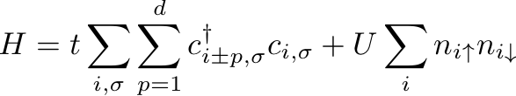


Hubbard model in d=∞
How to construct non-trivial d=∞ limit?
⟨E_{kin}⟩ ≈ ⟨E_{int}⟩
How to scale hopping?
Metzner and Vollhardt,
PRL 62, 324 (1998)

Slide 9
Dynamical mean-field theory (DMFT)
t
U
U
Σ(ω)
Σ(ω)
Σ(ω)
A. Georges et al. RMP 68, 13 (1996)
t
Σ(ω)
Σ(ω)
Σ(ω)
Physics Today (March 2004) Kotliar, Vollhardt

Slide 10







DMFT Weiss molecular field
Anderson impurity model

Slide 11


Local moments in metals
What is the fate of a local moment (=interacting atom) submerged into a Fermi sea?
Anderson impurity model
Impurity states:
n=0
n=1
n=2

Slide 12


Mean-field theory
What is the fate of a local moment (=interacting atom) submerged into a Fermi sea?
Anderson impurity model
Impurity states:
Anderson's solution (special case)
n=0
n=1
n=2

Slide 13
Mean-field theory
What is the fate of a local moment (=interacting atom) submerged into a Fermi sea?
Anderson impurity model
Impurity states:
Anderson's solution (special case)
n=0
U=𝜋𝛥
n=2

Slide 14
Mean-field theory
Impurity spectral function:
What is the fate of a local moment (=interacting atom) submerged into a Fermi sea?
Anderson model
Anderson's solution (special case)
n=0
U=𝜋𝛥
n=2

Slide 15
Mean-field theory
Impurity spectral function:
What is the fate of a local moment (=interacting atom) submerged into a Fermi sea?
Anderson model
Anderson's solution (special case)
n=0
U=𝜋𝛥
n=2

Slide 16



Anderson to Kondo model
Let us look at the hard case of large U
Let us eliminate the state of the impurity
Kondo model
https://tube1.it.tuwien.ac.at/my-account/video-playlists/89ea4708-f4f7-490e-8458-02e0267bb648

Slide 17
Kondo model
states:
processes:
J/2
-J/2
J

Slide 18


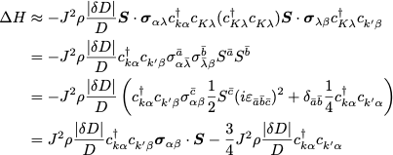
Poor man's scaling (renormalization)
https://tube1.it.tuwien.ac.at/my-account/video-playlists/89ea4708-f4f7-490e-8458-02e0267bb648

Slide 19
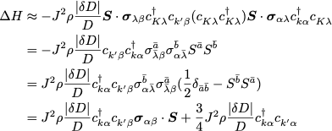
Poor man's scaling (renormalization)

Slide 20
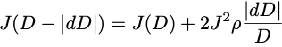
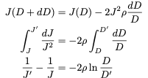


Poor man's scaling (renormalization)
Kondo temperature
The perturbative procedure breaks down at the energy scale:
Accurate numerical calculations can be performed at any temperature
analytic (IPT, NCA) - diagrammatic expansions
diagonalization (ED, NRG, DMRG) - Hamiltonian based
QMC (Hirsch-Fye, CT-QMC) - action based
Numerical renormalization group (K. G. Wilson - Nobel prize)
The basic idea is similar to poor man's scaling -> create a sequence of Hamiltonians that describe progressively lower energy scale
renormalization is one of the key concepts in physics, which allows to describe phenomena where perturbative methods fail (e.g. critical points - phase transitions)

Slide 21



Universality
Impurity observables = 'system with impurity' - 'system without impurity'
Magnetic susceptibility:
}
Universal function
Universality:
Many different systems have the same behavior
Several (infinite number of ) microscopic parameters
combine in a single number
Krishnamurthy,Wilkins and Wilson, PRB 1980

Slide 22

Anderson/Kondo model 'phase diagram'
Krishnamurthy,Wilkins and Wilson, PRB 1980

Slide 23

Anderson/Kondo model 'phase diagram'
Kondo regime
Krishnamurthy,Wilkins and Wilson, PRB 1980

Slide 24
Anderson/Kondo model 'phase diagram'
Non-interacting regime
Krishnamurthy,Wilkins and Wilson, PRB 1980

Slide 25
Anderson/Kondo model 'phase diagram'
Free impurity
Krishnamurthy,Wilkins and Wilson, PRB 1980

Slide 26
Anderson/Kondo model 'phase diagram'
Free impurity
Local moment regime
Krishnamurthy,Wilkins and Wilson, PRB 1980

Slide 27
Anderson/Kondo model 'phase diagram'
Free impurity
Free orbital regime
Krishnamurthy,Wilkins and Wilson, PRB 1980

Slide 28
Anderson/Kondo model 'phase diagram'
Impurity states:
Non-interacting regime
Krishnamurthy,Wilkins and Wilson, PRB 1980

Slide 29
Anderson/Kondo model 'phase diagram'
Impurity states:
Non-interacting regime
Krishnamurthy,Wilkins and Wilson, PRB 1980

Slide 30
Anderson/Kondo model 'phase diagram'
Kondo regime
Universal regime
Krishnamurthy,Wilkins and Wilson, PRB 1980

Slide 31

Anderson/Kondo model 'phase diagram'
Kondo regime
non-universal regime
Kondo effect - resistivity minimum
Krishnamurthy,Wilkins and Wilson, PRB 1980

Slide 32
Anderson/Kondo model 'phase diagram'
Andeson regime
universal regime
SC
LM
FO
Krishnamurthy,Wilkins and Wilson, PRB 1980

Slide 33
Anderson/Kondo model 'phase diagram'
Andeson regime
universal regime
Local moment regime is gone!
SC
FO
Krishnamurthy,Wilkins and Wilson, PRB 1980

Slide 34
Anderson model impurity spectral function
Krishnamurthy,Wilkins and Wilson, PRB 1980

Slide 35
Anderson model impurity spectral function
Peters et al., PRB 2006
Krishnamurthy,Wilkins and Wilson, PRB 1980

Slide 36
Anderson model impurity spectral function
Peters et al., PRB 2006

Slide 37
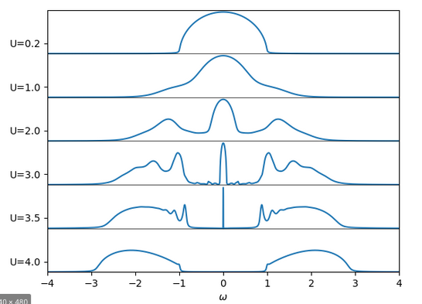
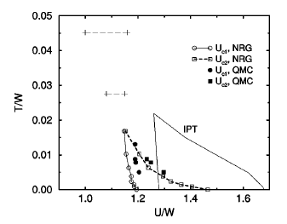
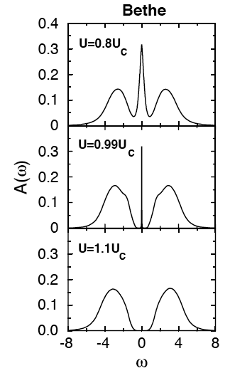
Hubbard model @ n=1: DMFT results
Georges et al., RMP 1996
Mott transition
I
M
Bulla, PRB 2001

