Slide 1



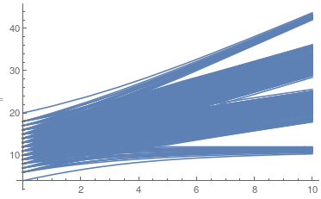
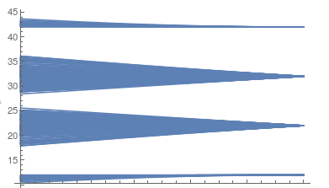
Formation of local moments
BCS-BEC crossover
Spectrum of eigenenergies (6-site Hubbard model):
Sector (3,3)
U=10
t=1
Ei
1
t
0
(strong-coupling expansion)
U
for more info:
https://tube1.it.tuwien.ac.at/my-account/video-playlists/1faaf358-0774-48c2-aa27-8be8dd3440f3
Beekman, Rademaker and van Wezel, SciPost Phys. Lect. Notes 11 (2019)

Slide 2
Formation of local moments
Pauli susceptibility:
𝜒
T
Spectrum of eigenenergies (6-site Hubbard model):
Sector (3,3)
U=10
t=1
Ei
1
t
0
U
(strong-coupling expansion)

Slide 3
Formation of local moments
Curie-Weiss susceptibility:
𝜒
~1/(T-C)
T
Spectrum of eigenenergies (6-site Hubbard model):
Sector (3,3)
U=10
t=1
Ei
1
t
0
U
(strong-coupling expansion)

Slide 4


Formation of local moments
U is large (U>>t)

Slide 5

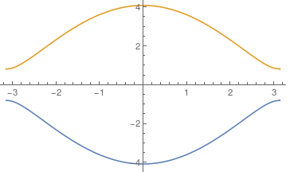
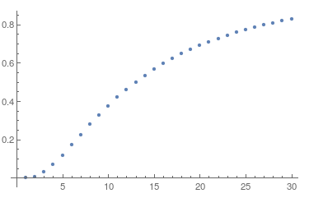


BCS-BEC crossover
weak-coupling limit:
strong-coupling limit:
gap
1
2
3
1
2
3

Slide 6
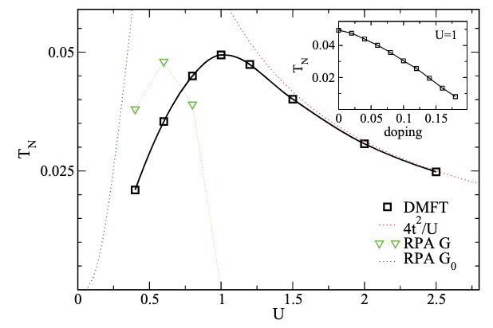


BCS-BEC crossover
weak-coupling limit:
strong-coupling limit:
gap

Slide 7
BCS-BEC crossover
weak-coupling limit:
strong-coupling limit:
gap
Bethe-Salpeter equation:

Slide 8

BCS-BEC crossover
weak-coupling limit:
strong-coupling limit:
physical susceptibility:
'bubble'
gap
frequency & momentum
static response
Bethe-Salpeter equation:
electron
hole
e-h interaction

Slide 9
BCS-BEC crossover
weak-coupling limit:
strong-coupling limit:
gap
Bethe-Salpeter equation:
RPA (random phase approximation)
Atomic vertex
Transition is driven by the T-dependence of the 'bubble'
Transition is driven by the T-dependence of the vertex

Slide 10
BCS-BEC crossover
weak-coupling limit:
strong-coupling limit:
gap
Normal phase: excitation - almost independent quasiparticles
=> broad peaks, dispersion apparent only close
to the transition
excitation - strongly bound pairs of QP
=> exist well above Tc, the formation T
and transition T are very different
Curie susceptibility 1/T
Ordered phase: only 1P states close to FL affected
=> large spatial extent of the 'condensed
particles'
excitations condense = become coherent
(local moments point in fixed direction)
Superconductivity: Cooper pairs absent in normal phase
CPs have large spatial extent
(many CPs overlap)
Mott antiferromagnetism, exciton condensation

Slide 11
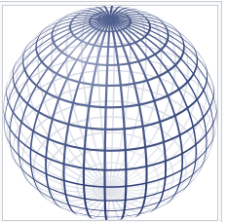
Spontaneous symmetry breaking
3D magnet
planar magnet
Symmetry group G of the Hamiltonian:
SO(3)~SU(2)
SO(2)=U(1)
Order parameter and residual symmetry (symmetry of the ground state) H:
U(1)
{I}
Set of all possible order parameters G/H (coset of G not necessarily a group):
S2
U(1)=S1

Slide 12

Spontaneous symmetry breaking
S=1

Slide 13
Spontaneous symmetry breaking
S=1
The same order (a different ground state obtained by an operation from G/H - orthogonal and degenerate with the above state).
Can we get a different ordered state (assuming uniform order)?

Slide 14



Spontaneous symmetry breaking
S=1
Yes!
There is no SU(2) rotation that takes |1> to |0>

Slide 15
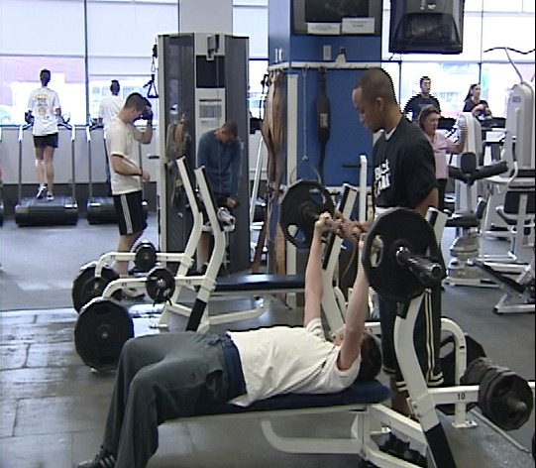
Dimensionality
Examples: correlations in everyday life
any D - Coulomb blockade: “in a crowded gym you are stuck
at one station”

Slide 16
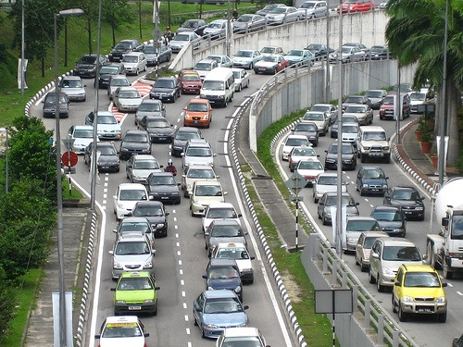
Dimensionality
Examples: correlations in everyday life
1D - complete loss of individual identity

Slide 17
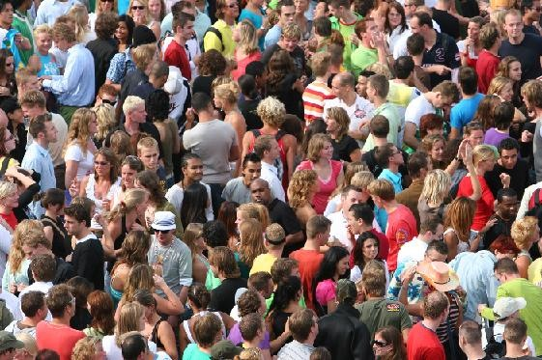
Dimensionality
Examples: correlations in everyday life
2D - fading through a crowd “you become heavy”

Slide 18
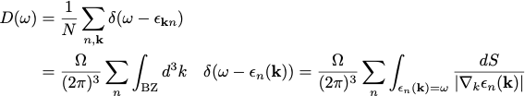

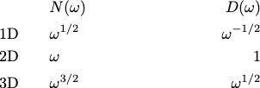
Density of states
Definition:
Calculation:
histogram (brute force summation over discrete k-mesh)
‘trick’: use and perform the calculation for small finite 𝛤 .
analytic calculation - band edges (van Hove singularities)
The states with and live in a k-sphere of radius
This gives rise to characteristic behavior close to the band edge:

Slide 19
Density of states
Definition:
Calculation:
histogram (brute force summation over discrete k-mesh)
‘trick’: use and perform the calculation for small finite 𝛤 .
analytic calculation - band edges (van Hove singularities)
The states with and live in a k-sphere of radius
This gives rise to characteristic behavior close to the band edge:

Slide 20
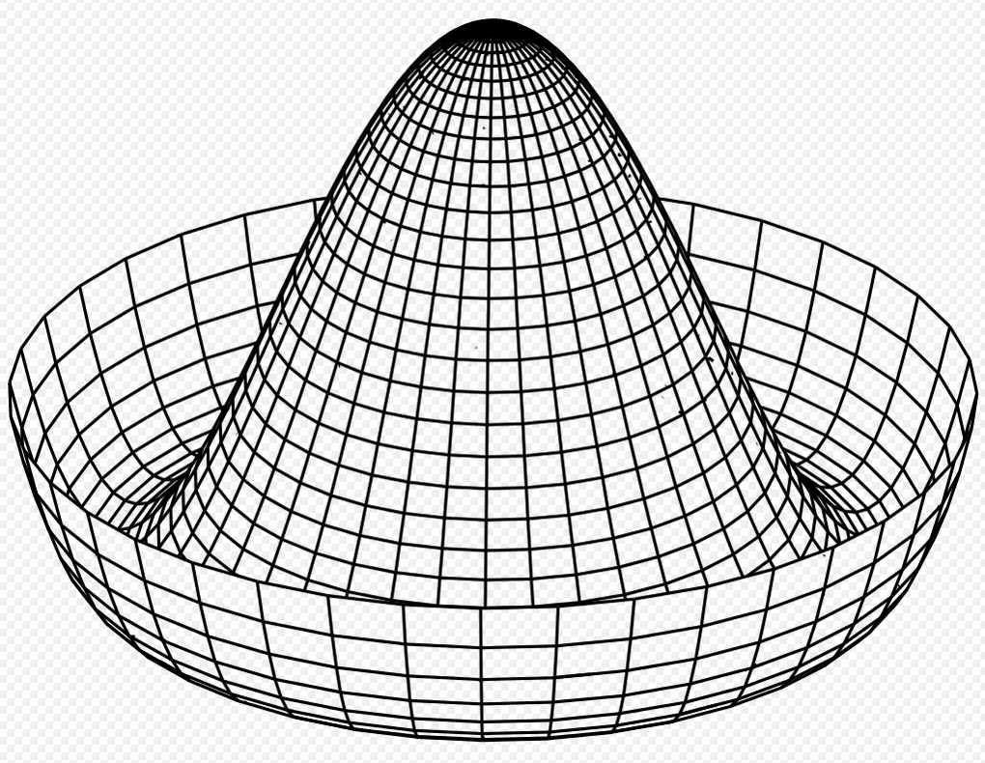
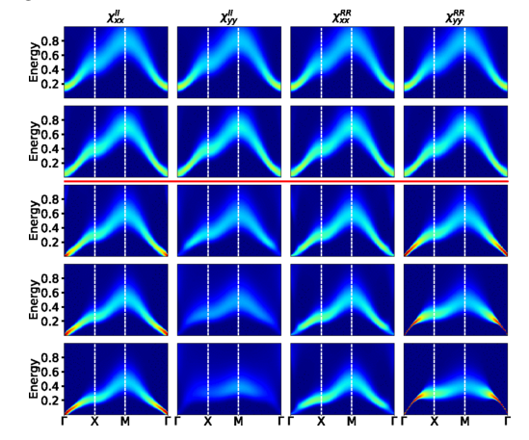

Spontaneous breaking of continuous symmetry
Continuous symmetries: space isotropy (orbital or spin rotations),
space isotropy (translation), gauge symmetries (charge conservation)
Goldstone mode (in systems with short-range interaction):
Long-wave length rotations of the order parameter
cost vanishingly low energy.
2 linear modes in 2-orbital Hubbard model (exciton condensate phase)
Transition:
Goldstone mode
liquid, gas -> solid
paramagnet -> ferromagnet
paramagnet-> antiferromagnet
metal -> superconductor
normal gas -> Bose-Einstein condensate
acoustic phonons
(quadratic) magnons
(linear) magnons
massive (due to long-range Coulomb interaction)
'sound' waves

Slide 21
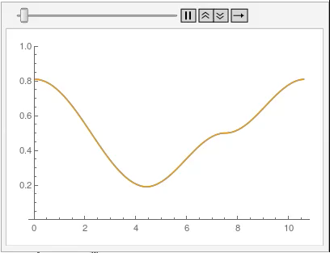
Spontaneous breaking of continuous symmetry
Continuous symmetries: space isotropy (orbital or spin rotations),
space isotropy (translation), gauge symmetries (charge conservation)
Goldstone mode (in systems with short-range interaction):
Long-wave length rotations of the order parameter
cost vanishingly low energy.
2 linear modes in 2-orbital Hubbard model (exciton condensate phase)
Transition:
Goldstone mode
liquid, gas -> solid
paramagnet -> ferromagnet
paramagnet-> antiferromagnet
metal -> superconductor
normal gas -> Bose-Einstein condensate
acoustic phonons
(quadratic) magnons
(linear) magnons
massive (due to long-range Coulomb interaction)
'sound' waves

Slide 22
Absence of order in low dimensions
Ferromagnet:
exact groundstate
excitations:
magnon
Thermal population of magnons reduced the ordered moment M.
If 'many' magnons are populated M can completely vanish. How many magnons are
populated depends on the density of states (dispersion + dimension).
Antiferromagnet:
quantum fluctuations (T=0)
The Neel state is only approximate ground state. Can the quantum fluctuations destroy it?
The answer is yes in 1D. In D=2 or 3 quantum corrections are finite and only reduce the ordered
moment.
AFM magnons destroy the Neel order in 2D for T>0.

Slide 23
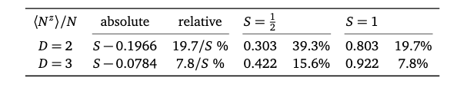
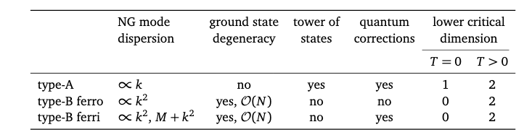
Absence of order in low dimensions
Antiferromagnet - quantum correction:
Antiferro-, ferro- and ferrimagnet at T=0 and T>0
Beekman, Rademaker and van Wezel, SciPost Phys. Lect. Notes 11 (2019)

Slide 24
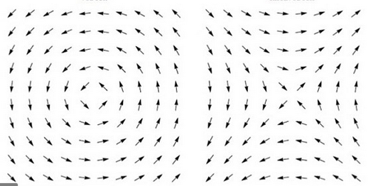
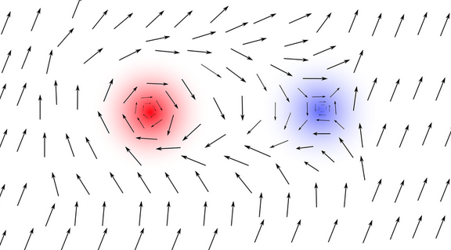
Topological excitations
base space (lattice)
+1
order parameter space
0
-1
Homotopy
vortex: +1
antivortex: -1
vortex-antivortex pair:
Kosterlitz–Thouless transition
2D xy-model
no local order parameter
normal phase (exp correlations), ordered phase (power law correlations)
unbinding of vortex-anti-vortex pairs

Slide 25

Lack of order in 1D, T>0
Ising model
T=0, exact ground state:
or
excitations:
(gapped) E=2J
excitations:
(gapped) E=J
T>0, typical state (<S>=0 no order):
What makes 1D different?
The surface does not depend on the volume.
=> growing a domain with 'opposite' order costs finite energy independent of the domain size
=>@T>0 there is always a finite probability do find the domain wall(s)
=> correlation length depends on the concentration of domain walls, finite concentration of domain walls implies a finite correlation length

