Slide 1
Example: 1D N-ladder
How to construct basis of an irreducible representation?

Slide 2
Example: 1D N-ladder
How to construct basis of an irreducible representation?

Slide 3
Example: 1D N-ladder
How to construct basis of an irreducible representation?

Slide 4
Example: 1D N-ladder
How to construct basis of an irreducible representation?

Slide 5
Example: 1D N-ladder
How to construct basis of an irreducible representation?

Slide 6

Example: 1D N-ladder
How to construct basis of an irreducible representation?
Represent group elements (symmetry operations) by linear operators (matrices) in a given Hilbert space
Select a random vector (seed)
Apply all symmetry operations on the seed to obtain N vectors (not necessarily linearly independent)
Form a linear combination with coefficients given by representation theory (tabulated)

Slide 7
Example: 1D N-ladder
How to construct basis of an irreducible representation?
Represent group elements (symmetry operations) by linear operators (matrices) in a given Hilbert space
Select a random vector (seed)
Apply all symmetry operations on the seed to obtain N vectors (not necessarily linearly independent)
Form a linear combination with coefficients given by representation theory (tabulated)

Slide 8

Example: 1D N-ladder
General index (chain, principal quantum number)
Random seed vector (orthogonal to the space we have already covered)
Operator representing group element g (rotation, translation)
Symmetry group
Irreducible representation (k index, orbital quantum number l)
Coefficients (do not depend on the studied system); tabulated
Column index - only for multi-dimensional
representations (non-abelian groups)
(magnetic quantum number m)

Slide 9



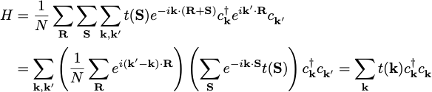
Bloch theorem for lattice models
periodicity
lattice site coincides with the unit cell
(not the most general case)
Unitary transformation (very common trick for periodic systems):

Slide 10

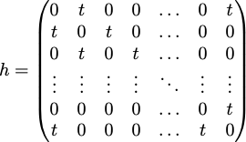

Example: 1D chain with nn hopping
Hopping matrix (Hamiltonian):
Dispersion:
Diagonalize h directly for N=3. What eigenstates do you get?
Generalize the problem for square and cubic lattices.

Slide 11
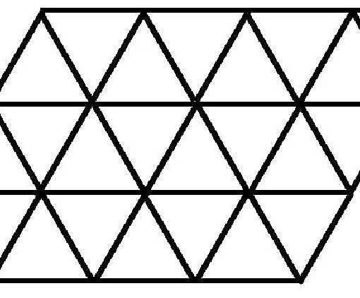
Example: Triangular lattice
(0,1)
(1,1)
Type to enter text
(0,0)
(1,0)
b
a
After FT:

Slide 12
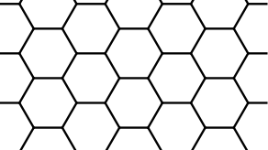

Example: Honeycomb lattice
(-1,0)
b
(0,1)
Type to enter text
(0,0)
(0,-1)
(1,0)
a
After FT:

Slide 13

Example: Honeycomb lattice
After FT:
At each k-point k=(ka,kb) we have a 2x2 matrix to diagonalize:
Finally we get the dispersion relation:

Slide 14
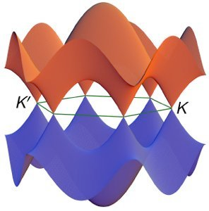
Example: Honeycomb lattice
After FT:
At each k-point k=(ka,kb) we have a 2x2 matrix to diagonalize:
Finally we get the dispersion relation:

Slide 15



Geometrical meaning of k-vector
Observation:
The parameters k=(ka,kb,…) look like a vector, k.R looks like a scalar
product, but we did not specify any angles.
The relationship of k-space and R-space
is that of duality.
The R-lattice defines a reciprocal G-lattice.
The k-vectors studied so far span a unit cell of the G-lattice.
Unit cell volume:
G-basis vectors:
Remarks:
Ga is perpendicular to all basis vector except a and scales as 1/|a|
For orthogonal basis Ga is parallel to a and has the length 2π/|a|
=

Slide 16
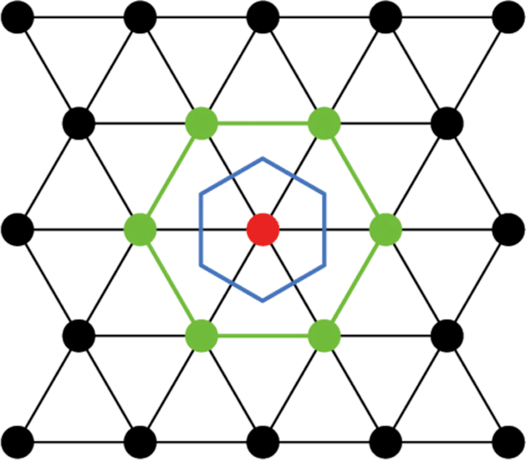
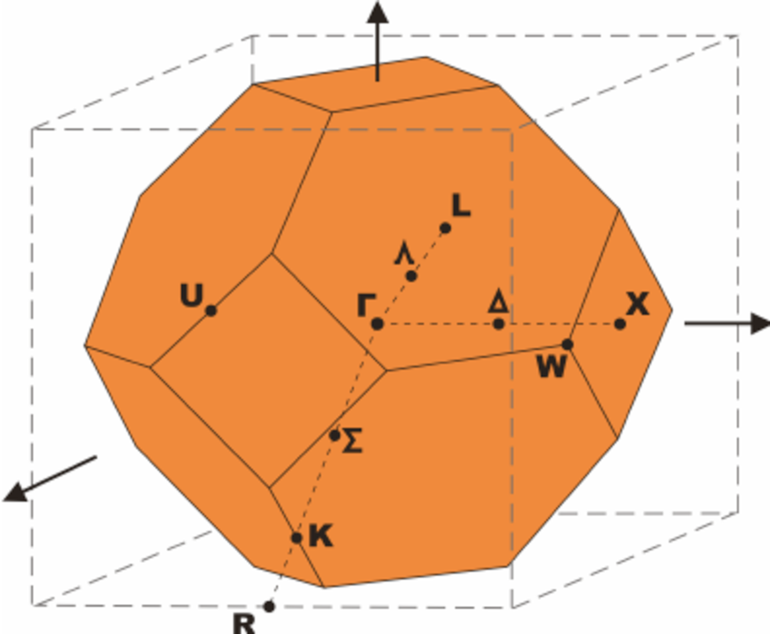
1st Brillouin zone
Observation:
The vectors k and k+G are equivalent (give the same Bloch state)
=> we do not have to use the primitive cell in the k-space (as long as we span the same set of inequivalent k-vectors)
Woronoi cell of the G-lattice
one-to-one mapping to primitive cell
respects point symmetry of the lattice
standard notation for special points
(solid state codes usually have automated
routines, e.g. xcrysden)
Example:
fcc Brillouin zone

