Slide 1
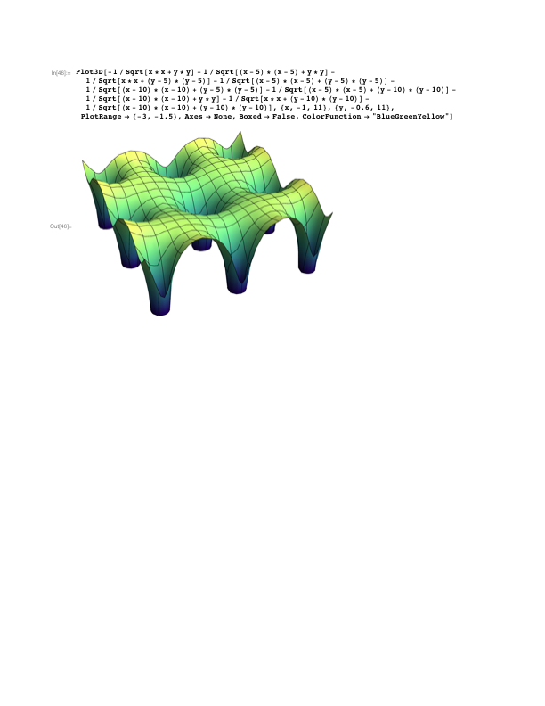



Continuum vs lattice model description
t
U
Electrons live in continuum space
r-representation
ab-initio methods (density functional theory)
incomprehensible
Electrons live on discrete lattice
(lattice site = atom or orbital)
Wannier basis (transition amplitudes)
quantum field theory (many-body)
chemical intuition

Slide 2

Continuum vs lattice model description
t
U
Take a left turn!
Electrons live in continuum space
r-representation
ab-initio methods (density functional theory)
incomprehensible
Electrons live on discrete lattice
(lattice site = atom or orbital)
Wannier basis (transition amplitudes)
quantum field theory (many-body)
chemical intuition

Slide 3

Continuum vs lattice model description
t
U
Electrons live in continuum space
r-representation
ab-initio methods (density functional theory)
incomprehensible
Electrons live on discrete lattice
(lattice site = atom or orbital)
Wannier basis (transition amplitudes)
quantum field theory (many-body)
chemical intuition

Slide 4
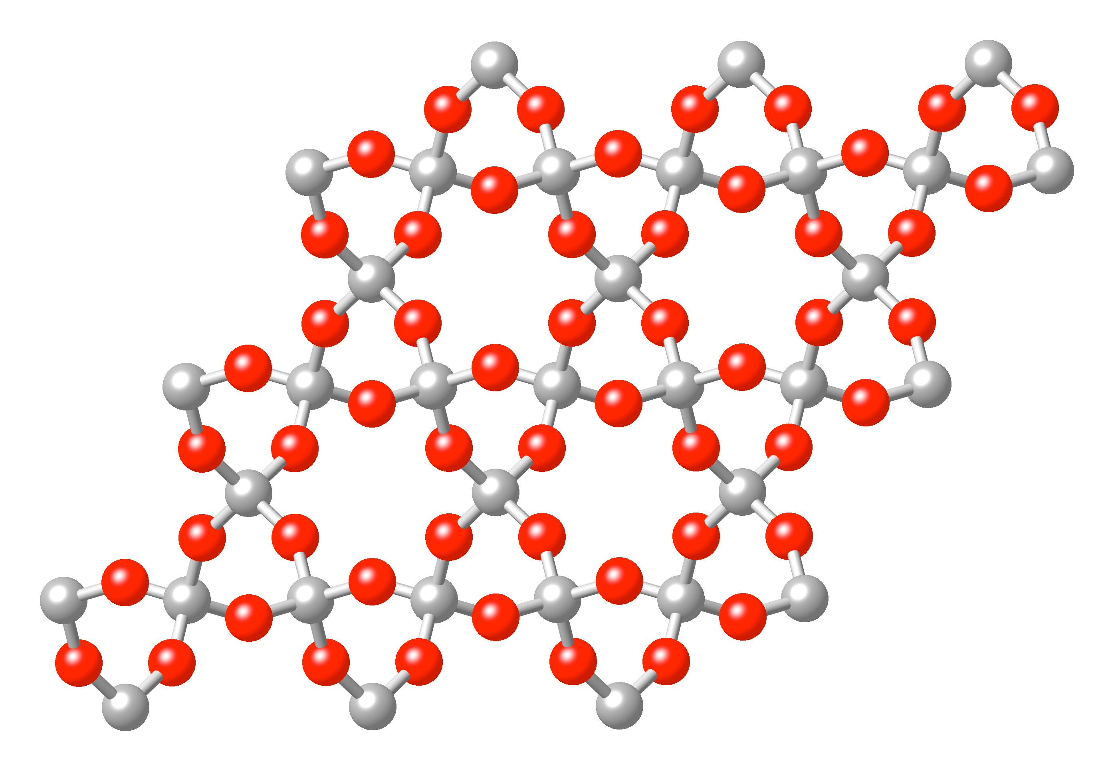
Periodic lattice
Crystallographic unit (elementary) cell:
Lattice vectors a and b are defined by translational symmetry of the crystal
(=> the origin is arbitrary)
The space is filled with unit cells indexed with

Slide 5
Periodic lattice
Crystallographic unit (elementary) cell:
Lattice vectors a and b are defined by translational symmetry of the crystal
(=> the origin is arbitrary)
The space is filled with unit cells indexed with

Slide 6
Periodic lattice
Crystallographic unit (elementary) cell:
Lattice vectors a and b are defined by translational symmetry of the crystal
(=> the origin is arbitrary)
The space is filled with unit cells indexed with

Slide 7
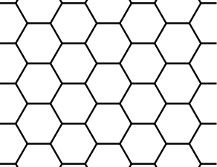
Periodic lattice
Crystallographic unit (elementary) cell:
Lattice vectors a and b are defined by translational symmetry of the crystal
(=> the origin is arbitrary)
The space is filled with unit cells indexed with

Slide 8

Bloch theorem (continuum formulation)
Action of the translation operator:
Different translations commute: (*)
Let us construct common eigenstates of all translation operators (one-dimensional representations of the translation group)
(*) implies and thus
What are the admissible values of k?
Periodic boundary conditions:
Interpretation: k=0 functions that are invariant under any translation
k=𝜋/a function that change sign under elementary translation

Slide 9
Bloch theorem (continuum formulation)
Action of the translation operator:
Different translations commute: (*)
Let us construct common eigenstates of all translation operators (one-dimensional representations of the translation group)
(*) implies and thus
What are the admissible values of k?
Periodic boundary conditions:
Interpretation: k=0 functions that are invariant under any translation
k=𝜋/a function that change sign under elementary translation

Slide 10
Bloch theorem (continuum formulation)
Action of the translation operator:
Different translations commute: (*)
Let us construct common eigenstates of all translation operators (one-dimensional representations of the translation group)
(*) implies and thus
What are the admissible values of k?
Periodic boundary conditions:
Interpretation: k=0 functions that are invariant under any translation
k=𝜋/a function that change sign under elementary translation

Slide 11
Bloch theorem (continuum formulation)
Bloch function:
(*)
Bloch functions are orthogonal:
What is it good for?
We have reduced the computational effort immensely!
from the entire (infinite) crystal to a single unit cell
from continuum to discrete spectrum
periodic function
(*)

Slide 12
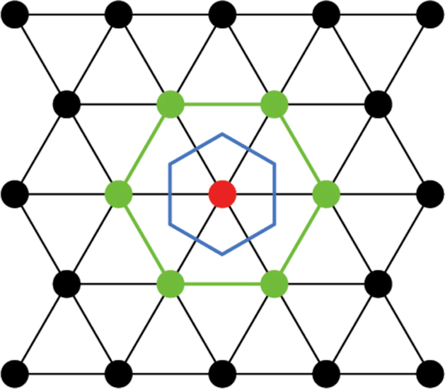
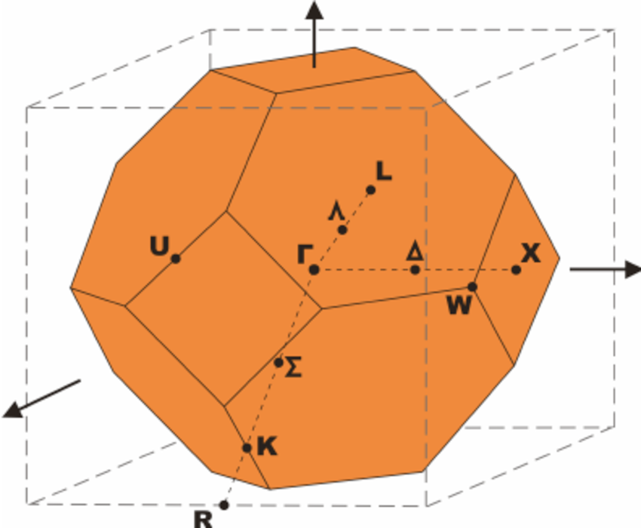
1st Brillouin zone
Observation:
The vectors k and k+G are equivalent (give the same Bloch state)
=> we do not have to use the primitive cell in the k-space (as long as we span the same set of inequivalent k-vectors)
Woronoi cell of the G-lattice
one-to-one mapping to primitive cell
respects point symmetry of the lattice
standard notation for special points
(solid state codes usually have automated
routines, e.g. xcrysden)
Example:
fcc Brillouin zone

Slide 13
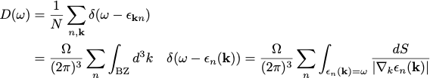


Density of states
Definition:
Remarks:
Histogram - how many states there are with energies between ω and ω+dω
Allows to calculate quantities that depend only on band energy
total charge (per unit cell)
(band) energy (per unit cell)
Calculation:
histogram (brute force summation over discrete k-mesh
tetrahedron method (used in standard codes) - linearization of dispersion
analytic calculation

Slide 14

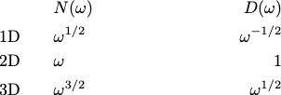
Density of states
Definition:
Calculation:
histogram (brute force summation over discrete k-mesh)
‘trick’: use and perform the calculation for
small finite 𝛤 .
analytic calculation - band edges (van Hove singularities)
The states with live in a k-sphere of radius
This gives rise to characteristic
behavior close to the band edge:

Slide 15
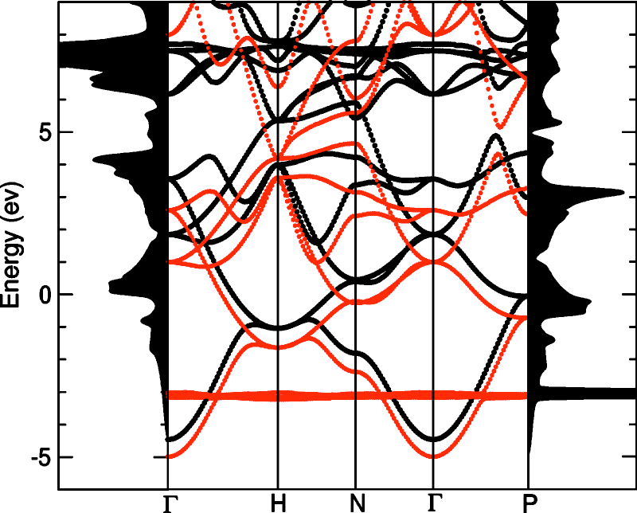
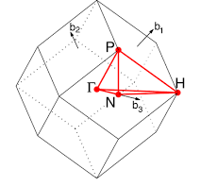
Example bcc Eu
Band structure
(spin polarized)
DoS
DoS
Brillouin zone
bcc (body centred cubic) structure
k

Slide 16
Use of symmetry
Typical symmetries in solids:
Translation k-vector (continuous index) band structure
Spin SU(2) S, Sz magnetic ordering
Space group irr. classification of bands. symmetry protected band crossings
Time reversal
All lead to various selection rules.
Local symmetries:
Spin SU(2) S, Sz atomic multiplets (open shells)
Point group irr. classification local degeneracy, crystal field splitting
Bond symmetries selection rules for hopping

Slide 17
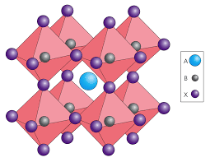
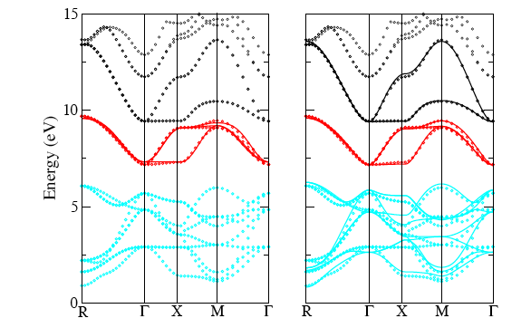
Example: cubic crystal field
d-orbitals on
the B site
Objective: Construct a lattice model with d-orbitals sitting on the B sites.

Slide 18
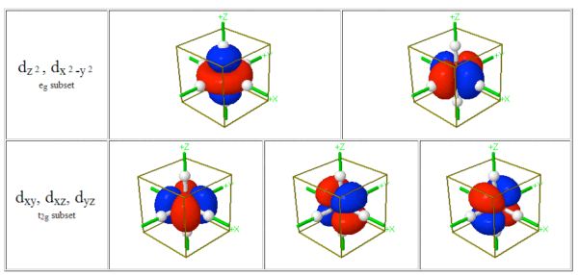
On-site Hamiltonian (crystal field)
The B site has a cubic symmetry
The d-orbitals transform like quadratic polynomials x², y², z², xy, xz, yz
(there are only 5 functions because x²+y²+z² is an s-function)
There two irreducible representations:
Eg
cubic symmetry
spherical symmetry
Eg
T2g
Energy levels
T2g

Slide 19

Nearest neighbor hopping
What is the hopping amplitude between these two orbital on neighbor sites?

Slide 20
Nearest neighbor hopping
What is the hopping amplitude between these two orbital on neighbor sites?

Slide 21

Nearest neighbor hopping
What is the hopping amplitude between these two orbital on neighbor sites?

Slide 22
Nearest neighbor hopping
Examples of allowed hopping processes:

Slide 23
Approximate symmetry
Let’s us stretch the structure along z-axis a bit
=> no cubic symmetry (Oh->D4v)
tetragonal symmetry
cubic symmetry
spherical symmetry
Eg
B1g
A1g
B1g
A1g
Energy levels
B2g
Eg
T2g
B2g
Eg

Slide 24
Approximate symmetry
Let’s us stretch the structure along z-axis a bit
=> no cubic symmetry (Oh->D3d)
tetrahedral distortion
cubic symmetry
spherical symmetry
Eg
Eg
Eg
Energy levels
T2g
Eg
A1g
Eg
A1g
I cannot draw (find) these

