Slide 1

Second quantization and lattice QFT
Quantum mechanics:
Quantum field theory:
vector graphics (.ps)
we follow each particle (r is dynamical variable)
impractical for many electrons
Pauli statistics causes complications (Slater det.)
cannot capture states with fractional occupation
Fock space is artificial construct
‘product’ of Hilbert spaces of each particle
bitmap (.bmp)
we follow the state of space points (lattice sites)
r (=site index) is a parameter
general approach
Pauli statistics is simple (commutation rules)
no problem with fractional occupation
Fock space is very natural
‘product’ of Hilbert spaces of lattice sites

Slide 2


Fock space in lattice QFT
Hubbard model
lattice Fock space
t
U
local Fock space for fermions

Slide 3
Fock space in lattice QFT
Hubbard model
lattice Fock space
t
U
local Fock space
for bosons

Slide 4
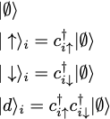

Fock space in lattice QFT
Hubbard model
2-flavors per site and
local Fock space:
Pauli statistics:
Fock space can be constructed by acting with creation operators on vacuum
One can use binary code to index the states
Order of operators is crucial
t
U
Definition:
Flavor = (orbital, spin)
Hilbert space of each flavor is

Slide 5

Fock space in lattice QFT
Hubbard model
2-flavors per site and
local Fock space:
Pauli statistics:
Fock space can be constructed by acting with creation operators on vacuum
One can use binary code to index the states
Order of operators is crucial
Density (number) operator:
t
U
Definition:
Flavor = (orbital, spin)
Hilbert space of each flavor is

Slide 6


Example of wave functions
3
4
1
2
5
6
2
3
4
2
3
4
2
3
4
1
1
1
5
6
5
6
5
6
2
3
4
1
5
6
Total size of fermionic Fock space is 4^{N.} (bosonic is infinite)
Any state can be written as a linear combination of the states in occupation number basis

Slide 7

Action of an operator
3
4
1
2
5
6
Move annihilation operators to the right ->calculate number of (anti)commutators
Put creations operators to standard order (for fermions only)-> determine signs
4
4
2
3
4
1
2
3
1
2
3
1
6
6
5
6
5
5
2
3
4
3
4
2
3
4
1
1
2
1
5
6
5
6
5
6

Slide 8

Hubbard molecule
A
B
Remarks:
number of 1-p states N=4
dimension of the Fock space
dimension of an M-particle sector
density/particle number operator

Slide 9
Hubbard molecule
A
B
Construction of the Hamiltonian (in occupation number basis):
sign convention, e.g.
order the 1-p states:
Two options: Construct the matrices of the elementary creation/anihilation
operators. (computer - sparse matrices)
Construct the basis states and compute the matrix elements of
H using commutation relations. (pen&paper)

Slide 10
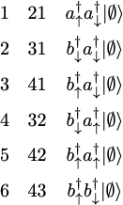
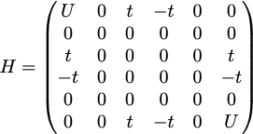
Hubbard molecule
Construction of the Hamiltonian (in occupation number basis):
sign convention, e.g.
order the 1-p states:
Let us focus on the 2 electron sector (the rest is trivial)
The basis: index i2i1 state Hamiltonian:

Slide 11
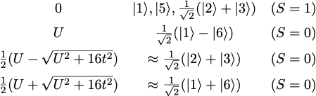
Hubbard molecule
The basis: index i2i1 state Hamiltonian:
Spectrum: Energy Eigenfunctions Total spin
Ground state:

Slide 12
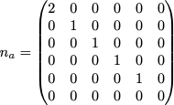

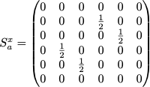
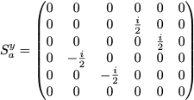
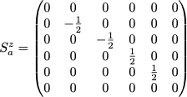



Hubbard molecule
Various operators:

Slide 13
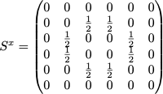
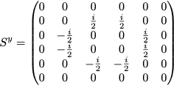
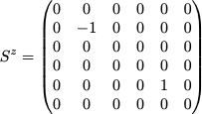
Hubbard molecule
Various operators:

Slide 14
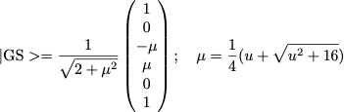


Some expectation values
Ground state:
Lowest excitation energy:
Total spin (conserved):
Spin per atom (non-conserved):
large u=U/t

Slide 15

Some physics
Ground state:
Non-interacting limit (μ=1):
Bonding—anti-bonding picture:
atom A
atom B
2t

Slide 16
Some physics
Ground state:
Non-interacting limit (μ=1):
Bonding—anti-bonding picture:
atom A
atom B
2t

