Slide 1


6-site Hubbard model
Large Fock space: dim 2¹²
Use conservation of Sz : (s1, s2) sectors of dim
For example a basis function from (1,2) sector:
in binary code (10000|101000)

Slide 2
Time-dependent (dynamical) correlations
Why correlation functions?
Contributions to interaction energy of the system
Response to small perturbations

Slide 3

Time-dependent (dynamical) correlations
Why correlation functions?
Contributions to interaction energy of the system
Response to small perturbations
due to spin SU(2) symmetry is equivalent
Meaning?
time:
0
t
time
space

Slide 4
Time-dependent (dynamical) correlations
Why correlation functions?
Contributions to interaction energy of the system
Response to small perturbations
due to spin SU(2) symmetry is equivalent
Meaning?
time:
0
t
time
space

Slide 5

Time-dependent (dynamical) correlations
Why correlation functions?
Contributions to interaction energy of the system
Response to small perturbations
Note that operators taken at equal time fulfil the canonical commutation relations, but not at different times.

Slide 6

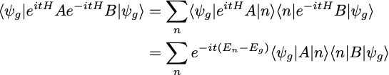
Time-dependent (dynamical) correlations
Why correlation functions?
Contributions to interaction energy of the system
Response to small perturbations
Spectral representation

Slide 7


Time-dependent (dynamical) correlations
Why correlation functions?
Contributions to interaction energy of the system
Response to small perturbations
Spectral representation
Fourier transform:

Slide 8
Time-dependent (dynamical) correlations
Why correlation functions?
Contributions to interaction energy of the system
Response to small perturbations
Spectral representation
Fourier transform:
Problem
time
time
Retarded (causal) Green's function:
space
space
Treat omega as a complex variable:

Slide 9
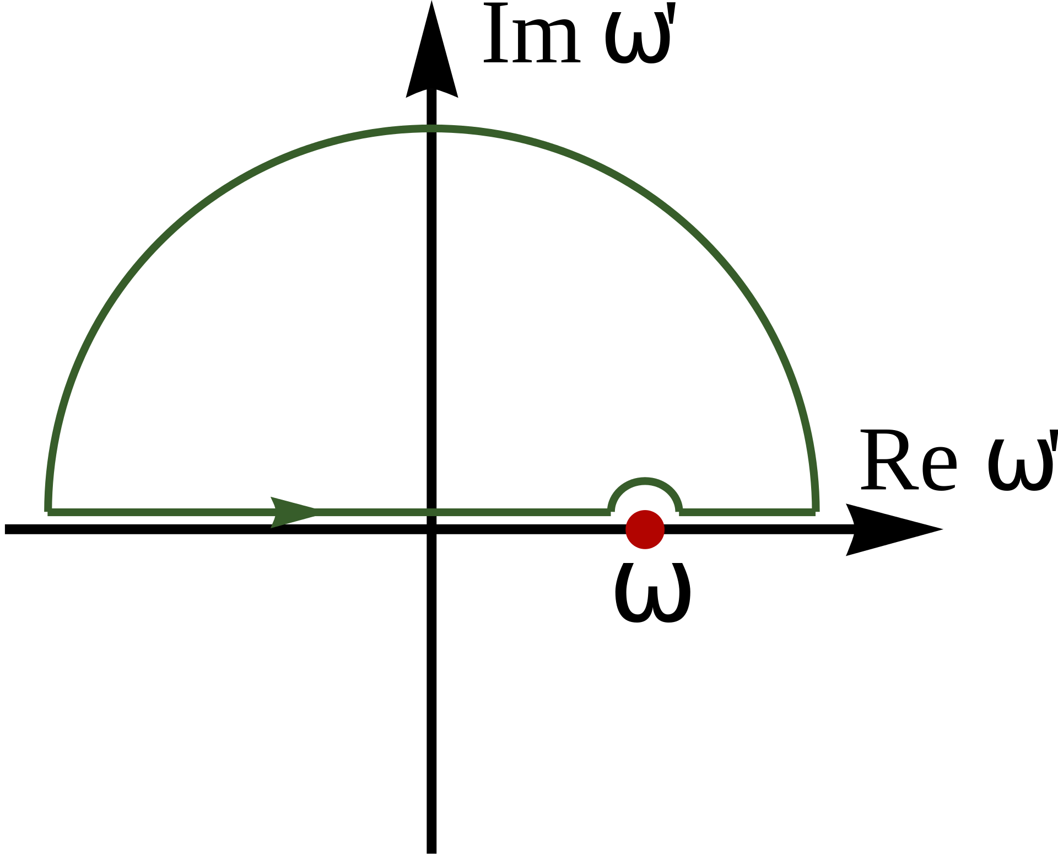
Time-dependent (dynamical) correlations
Spectral representation
Fourier transform:
Problem
time
time
Retarded (causal) Green's function:
space
space
Treat omega as a complex variable:

Slide 10

Time-dependent (dynamical) correlations
Spectral representation
Fourier transform:
Problem
time
time
Retarded (causal) Green's function:
space
space
Treat omega as a complex variable:

Slide 11

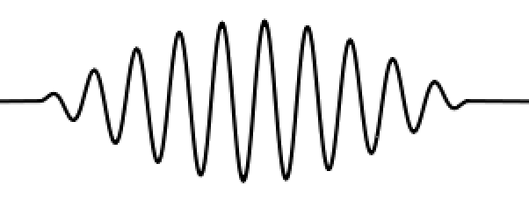
Time-dependent (dynamical) correlations
Spectral representation
Retarded (causal) Green's function:
Physical meaning
long 𝜔-pulse
exited states
ground state

Slide 12




Time-dependent (dynamical) correlations
Physical meaning
long 𝜔-pulse
exited states
ground state
Examples:
perturbation
probe
sample
photoemission
transport, optics
magnetism, neutron scattering

Slide 13
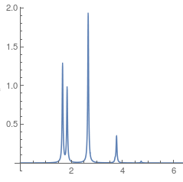
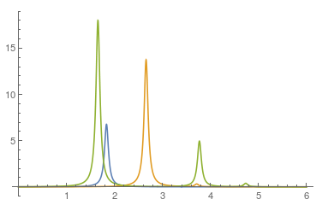

6-site Hubbard model
Why correlation functions?
Contributions to interaction energy of the system
Response to small perturbations
Im
Im
𝜔
𝜔

Slide 14
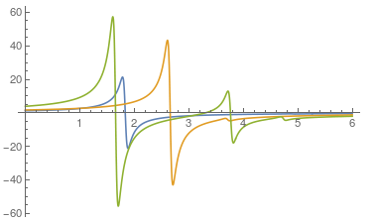
6-site Hubbard model
Why correlation functions?
Contributions to interaction energy of the system
Response to small perturbations
Re
Im
Im
𝜔
𝜔

Slide 15

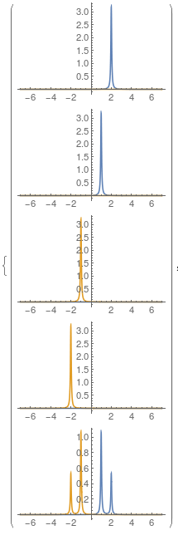

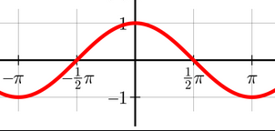
6-site Hubbard model
1-particle propagator
1-particle spectral function
Non-interacting case (U=0) - relationship to 1P eigenenergies
𝜔
local
k

Slide 16
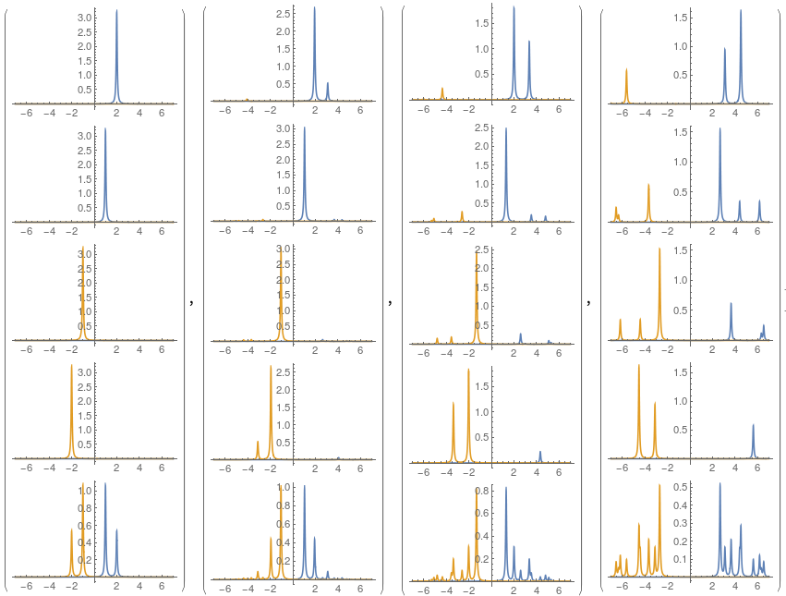
6-site Hubbard model
𝜔
1-particle spectral function
k
U=0
U=2
U=4
U=8
local

Slide 17



6-site Hubbard model
𝜔
1-particle spectral function
k
U=0
U=2
U=4
U=8
Canonical commutation relations!
local

Slide 18

6-site Hubbard model
𝜔
1-particle spectral function
k
U=0
U=2
U=4
U=8
Large U (atomic problem, t=0)
Ak(𝜔)
-𝜇
U-𝜇
𝜔
local

Slide 19
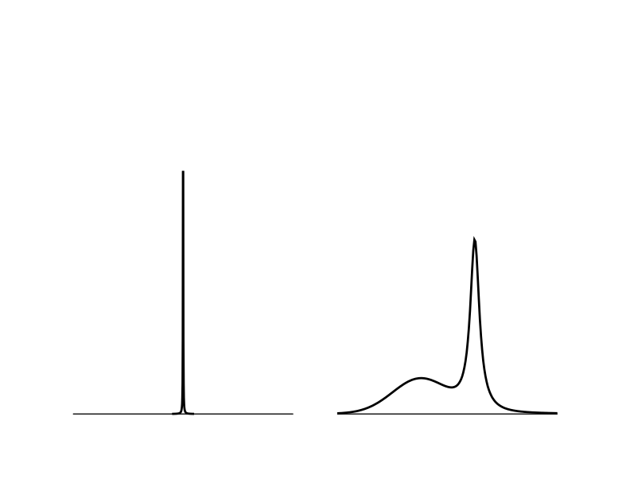

Infinite system
𝜔
1-particle spectral function
k
U=0
U=2
U=4
U=8
non-interacting (bare)
interacting (dressed)

Slide 20
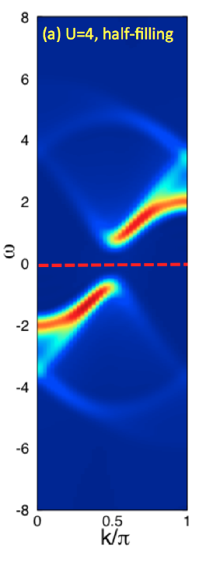
Infinite system
𝜔
1-particle spectral function
k
U=4
Nocera et al. 2017

