Slide 1
Presentation: Go or GoLang, Date: 10/23/2019
Presenter: Georg Hertzsch, Team Stats-Screening
Time needed: 10 minutes
Do It Yourself (Online Compiler): https://tour.golang.org/welcome/1
Notes:
Here you can see the gropher mascot!
Preparing your presentation:
1. Open CMD
Cd C:\Go\src\presentation
For executing code: use the command: go run filename.go

Slide 2
Content
Background information
Short introduction to GoLang
Datastructures
GoLang and Multithreading/Concurrency (introduction, not extensive)
GoLang and Webengineering (introduction, not extensive)

Slide 3
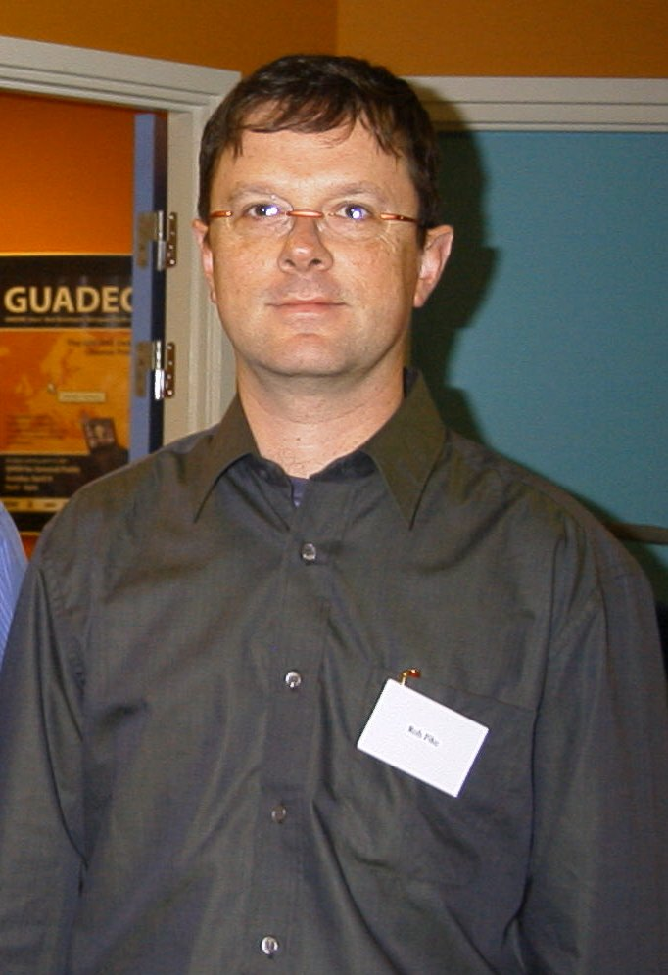

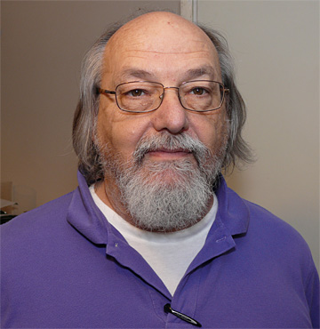
Faces behind Go
Ken Thompson
Rob Pike
Robert Griesemer
Notes:
All Google-employees
From right to left:
Griesemer: Swiss Computer Scientist from ETH Zurich
Rob Pike: Canadian Software Engineer, Took part in developing OS Plan 9, and Inferno + programming language Limbo (former Bell Labs employee)
Ken Thompson: main-contributor to UNIX-System and Programming languages B and C (former Bell Labs employee)

Slide 4
General
First stable version: 2012, current version (Oct. 17th 19): 1.13.3
License: BSD (University of California Berkley),
Typing discipline: strong
Runs on DragonFly BSD, FreeBSD, Linux, macOS, NetBSD, OpenBSD, Plan 9, Solaris, Windows
Used by: https://github.com/golang/go/wiki/GoUsers
1. Open-Source: Docker, Caddy (web server), CockroachDB (scale-out SQL-DB), Ethereum, Kubernetes, Lightning Network (bitcoin network), Mattermost,
2. partly commercial: Uber (for handling high volumes of geofence-based queries), MongoDB (administering MongoDB instances), Netflix (two portions of their server architecture), Dropbox (just migrated from Python to Go),
Developed by Google
Notes:
Typing discipline: not Duck (If it walks like a duck and it quacks like a duck, then it must be a duck) or dynamic as in Python
But there are some simplifications to it

Slide 5
First Few Features
Fast compilation times
A toolchain that, by default, produces statically linked native binaries without external dependencies
This is like C, right?
Notes:
Go is influenced by C, but with an emphasis on greater simplicity and safety. The language consists of:
Fast compilation times.^{[45]}
Remote package management (go get)^{[46]} and online package documentation.^{[47]}
Distinctive approaches to particular problems:
Built-in concurrency primitives: light-weight processes (goroutines), channels, and the select statement.
An interface system in place of virtual inheritance, and type embedding instead of non-virtual inheritance.
A toolchain that, by default, produces statically linked native binaries without external dependencies.
A desire to keep the language specification simple enough to hold in a programmer's head,^{[48]} in part by omitting features which are common in similar languages.

Slide 6
Was C/C++ „upgraded“ to Go?
Yes (main contributor: C)
Simplistic language specifications: easier to recall
compilation is highly efficient
No:
Further Input from Pascal/Modula/Oberon
declarations, packages
Further Input from Newsqueak/Limbo
Concurrency (Tony Hoare's CSP)
It‘s a completely new language
Notes:
Compilation is highly efficient: as already mentioned

Slide 7
Main reason for the new language
Issues with servers at Google
Java and C++ took too much repetition to write code
Python: too slow and type safety became an issue
Go provides efficient compilation, efficient execution and ease of programming in one language
Fun fact: D Language (official ancestor of C) being started developed by Google-team in 2015
https://dlang.org/
Notes:
No we know why there is a need for this new language. Now let‘s check out the differences between C++/C
https://golang.org/doc/faq#ancestors

Slide 8
Conceptional Differences C++ and Go
Go does not have classes with constructors or destructors
No class methods, No class inheritance hierarchy, and No virtual functions
Go provides interfaces
go provides automatic garbage collection of allocated memory
Go is "safe" by default. Pointers cannot point to arbitrary memory
Hash-Tables are provided: maps
operations that mix different types require casts#
there is no structural exception handling (Try-Catch-block)
Notes:
https://github.com/golang/go/wiki/GoForCPPProgrammers
Garbage collection: no need to worry about heap-allocated vs. stack-allocated storage, new vs. malloc, or delete vs. delete[] vs. free
Casts in go are called conversions!
https://golang.org/doc/faq#ancestors
Exception Handling: (but see later!)
We believe that coupling exceptions to a control structure, as in the try-catch-finally idiom, results in convoluted code

Slide 9
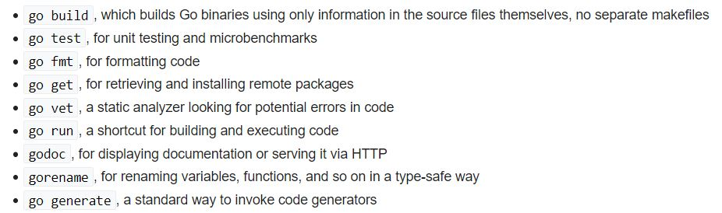
Few Go Tools
Notes:
Most importantly: go run!

Slide 10
Types in Go
Built-in string type: string.
Built-in boolean type: bool.
Built-in numeric types:
int8, uint8 (byte), int16, uint16, int32 (rune), uint32, int64, uint64,
int, uint, uintptr.
float32, float64.
complex64, complex128.

Slide 11
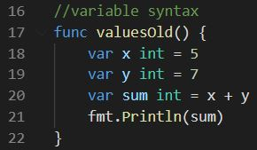
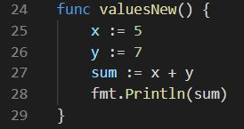
Syntax 1
combined declaration/initialization operator was introduced
Below see a declaration of variables with no types specified (even though typing discipline is static/strong)
Semicolon at end of line possible but not required
=
Notes:
The second piece of code reminds me of Delphi/Pascal!

Slide 12
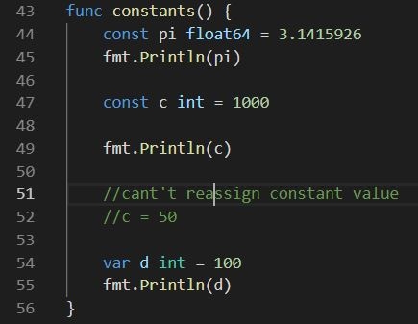
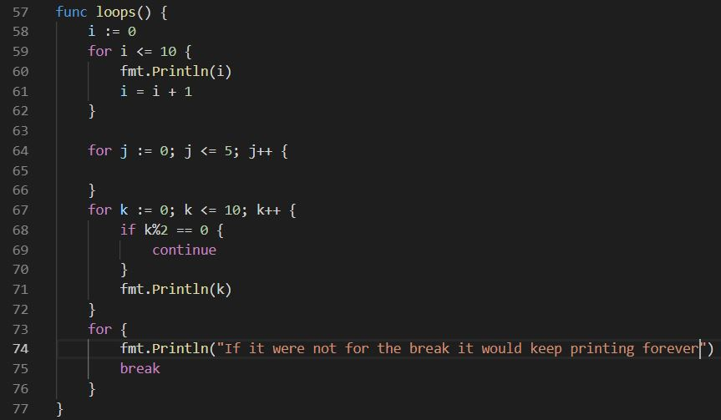
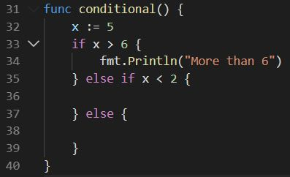
Syntax 2
Notes:
Check out the loops: there are no brackets around conditions
Below: you can see conditionals: you don‘t need any type of brackets around the conditionals

Slide 13
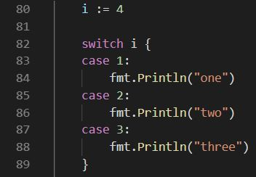
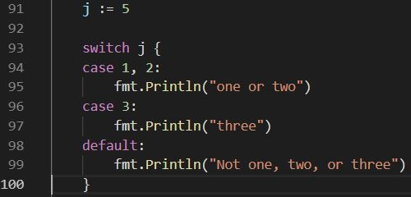
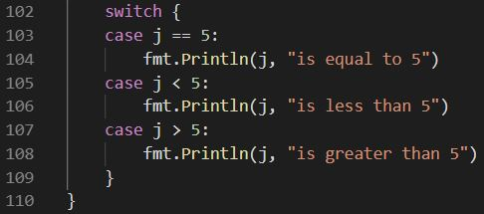
Syntax 3
Notes:
Interesting: right-hand switch-case : several numbers as one case-condition
+ switch case below → one is able to set greater than or smaller than values!

Slide 14
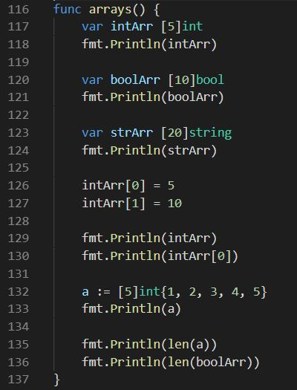
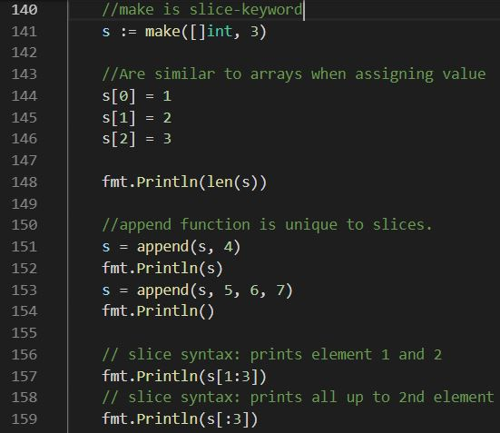
Arrays vs. Slices
Notes:
Arrays: beginning you have to give specified amount of items, not so in slices,
Also no append function possible in arrays!
On right-hand side: what do line 157 and 159 remind you of? Yes, a little bit of Python, isn‘t it?

Slide 15
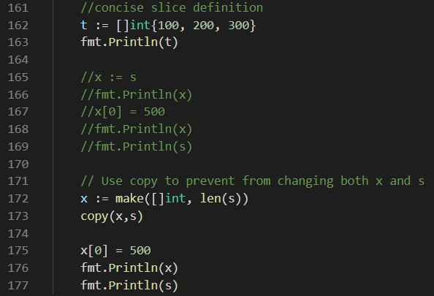
More Slices
Notes:
In the comments from line 165 to 169 is the cumbersome way to go
From line 172 on is the easiest way to go

Slide 16
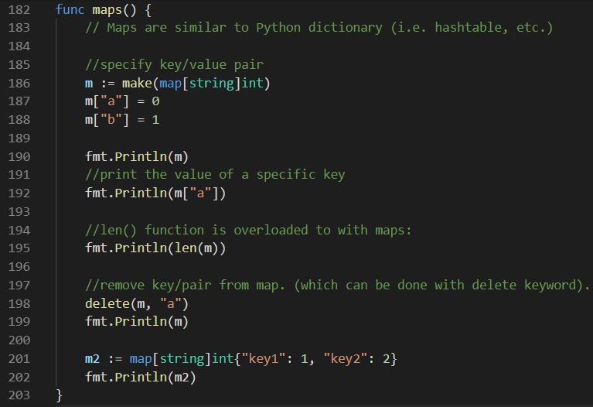
Maps
Notes:
Like HashMaps in Java or Python
What do you think is line 192 gonna print?
If the requested key doesn't exist, we get the value type's zero value. In this case the value type is int, so the zero value is 0:
M2: you already know a few initial values ahead

Slide 17
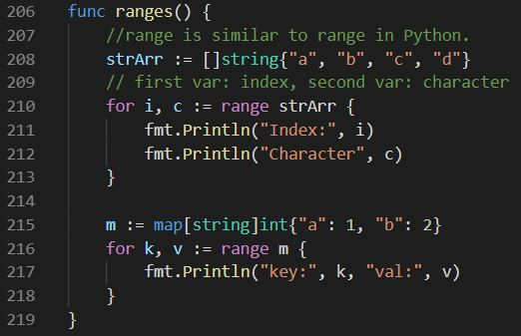
Range
Notes:
In the range, you can declare to variables for each iteration at top: for instance i and c, i is index-number, c is character!

Slide 18
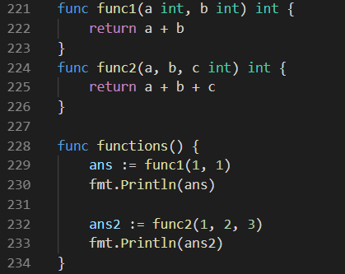
Function with a single return value

Slide 19
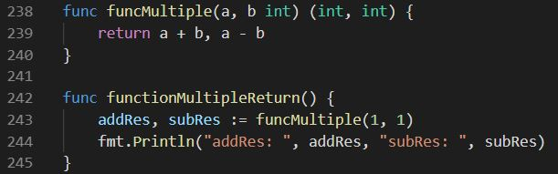
Function with multiple return values

Slide 20
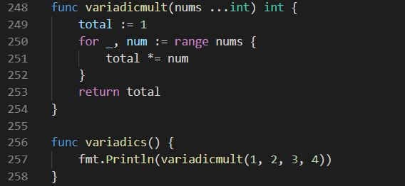
Variadic parameters

Slide 21
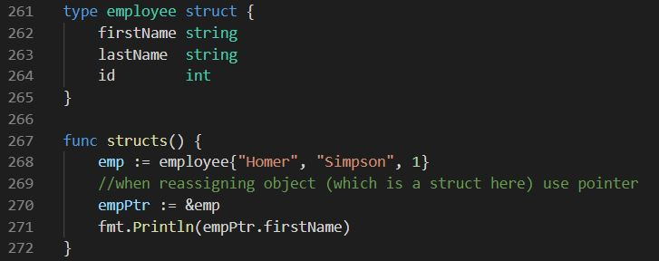
Go‘s structs are collection of fields. They can be instantiated.
https://gobyexample.com/structs

Slide 22
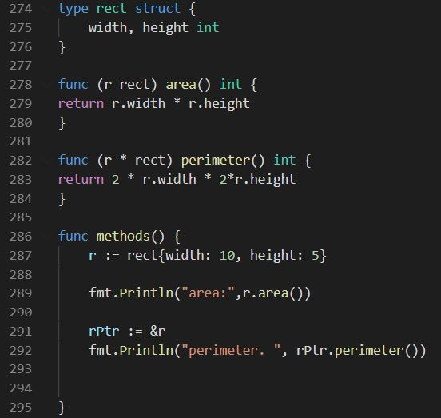
methods in structs
Notes:
These methods are not called functions because they can be instantiated from the reference r or rPtr

Slide 23
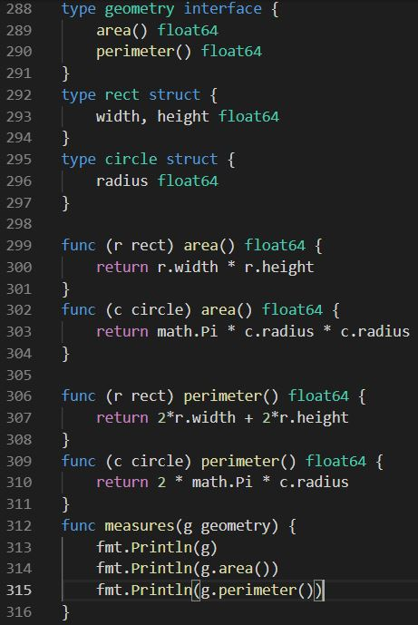
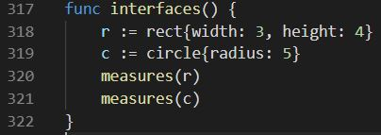
Interfaces
Notes:
In the upper part we define the interface:
Any struct that uses the geometry interface has to use the methods required (which are area() and perimeter()) → so every element defined in interface has to be used in „sub“-struct
The way you define them as „sub“-structs is by putting the interfaces into the parameter (like below)
Not until the measures-method until geometry is used, but
if taking a look at interfaces: you see measures are used taking the r and c into account

Slide 24
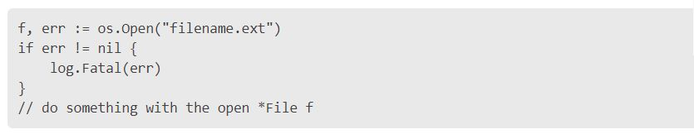
Substitute for exception handling
a conditional if-clause
If an error occurs it calls log.Fatal to print the error message and stops
Notes:
The following code uses os.Open to open a file. If an error occurs it calls log.Fatal to print the error message and stop.

Slide 25
Packages
Quite similar to Java or Node.js
In one package only use one main function
Notes:
One main function

Slide 26
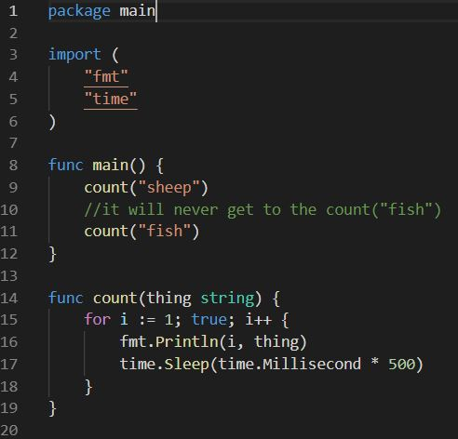
Concurrency – but first a synchronized example
Notes:
This is certainly no multithreaded system. Why? Who knows?

Slide 27
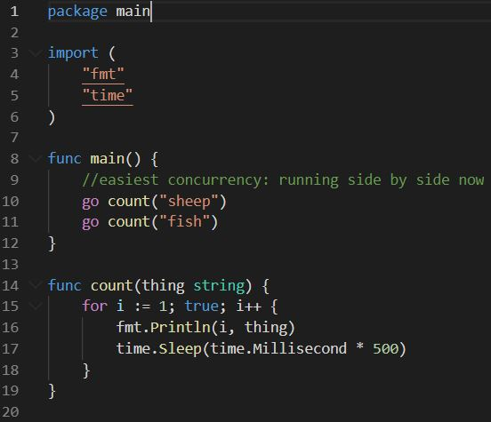
Concurrency 1 - easy

Slide 28
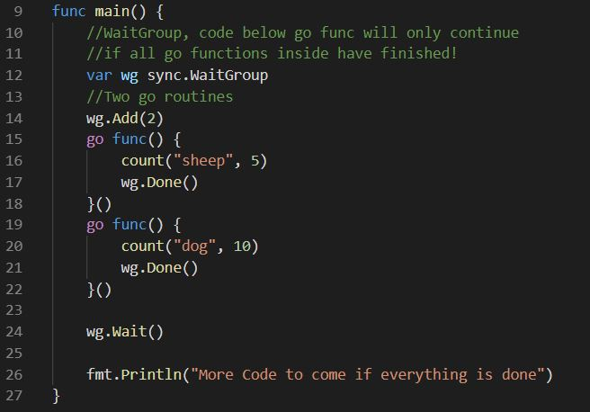
Concurrency 2 - waitGroup
Notes:
If any go routines haven‘t finished until count(„sheep“) has finished it will wait until that happens!
That‘s the reason for the WaitGroup, in the slide presented to you priorly

Slide 29
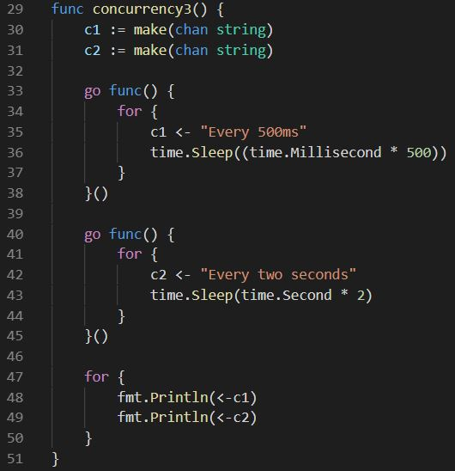
Concurrency 3 - channels
Notes:
With channels you need to know: One thread waits until the other thread has returned the channel value! It‘s only then that it is going to continue!

Slide 30
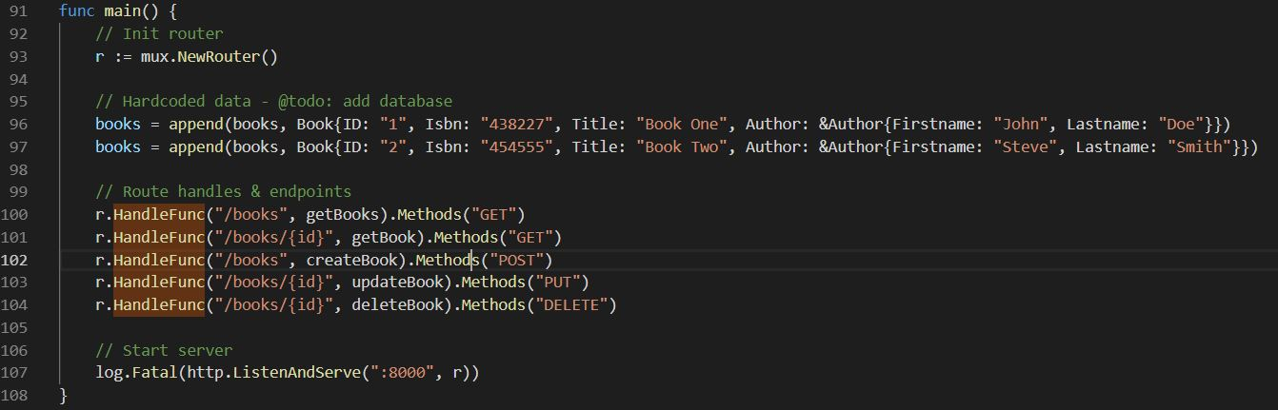
Back-End (Model, Controller) 1 with Mux source: https://github.com/bradtraversy/go_restapi
Don’t forget to import "net/http“ and "github.com/gorilla/mux"
Notes:
That‘s what go is used for, if at all → still most people work on the back-end with it on

Slide 31
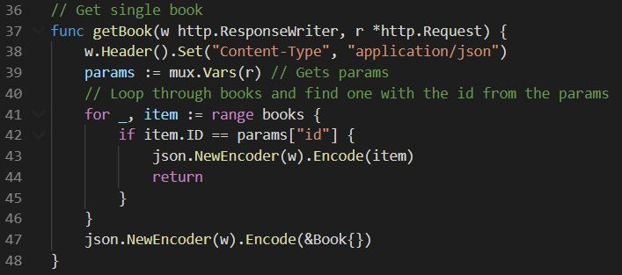
Back-End (Model, Controller) 2 – Get-Function source: https://github.com/bradtraversy/go_restapi
HandleFunc registers a new route with a matcher for the URL path.
func (*mux.Router).HandleFunc(path string, f func(http.ResponseWriter, *http.Request)) *mux.Route
Notes:
Just create a ResponseWriter with the following content
1. create the Header and put the Set-Function into it!
2.

Slide 32
Webengineering
For Front-End-WebApps
GopherJS:
GopherJS transpiles (like translates) Go code (golang.org) to pure JavaScript code
Notes:
GopherJS is a source-to-source compiler (S2S compiler), transcompiler or transpiler is a type of compiler that takes the source code of a program written in a programming language as its input and produces the equivalent source code in the same or a different programming language.
Its main purpose is to give you the opportunity to write front-end code in Go which will still run in all browsers.
https://github.com/gopherjs/gopherjs

Slide 33
Front-End (View)
https://medium.com/@kentquirk/how-to-use-gopherjs-to-turn-go-code-into-a-javascript-library-1e947703db7a

Slide 34
Sources
Pictures
https://de.wikipedia.org/wiki/Rob_Pike#/media/Datei:Rob-pike.jpg
https://en.chessbase.com/portals/4/files/news/2011/thompson09.jpg
https://upload.wikimedia.org/wikipedia/commons/c/ce/Robert_Griesemer.jpg
Content
https://www.slideshare.net/ssuser9ebf46/golang-101
https://github.com/golang/go/wiki/GoUsers
https://github.com/golang/go/wiki/GoForCPPProgrammers
https://medium.com/@kentquirk/how-to-use-gopherjs-to-turn-go-code-into-a-javascript-library-1e947703db7a
https://github.com/bradtraversy/go_restapi

