Slide 1
Stats-Screening Pitch
Team: Georg Hertzsch, Rama Abou Saleh

Slide 2
Content
Vision
Use Case
SRS
Non-Functionals
Scope
Project Methodology
Project Management
RUP

Slide 3
Vision
Create tool for screening financial instruments and opt for best asset
Retrieving prices
With those prices compute statistical performance and risk figures
Each user can have several portfolios
Charts
Export portfolio
Notes:
Project-idea: Create tool for screening financial instruments and opt for best asset
Main idea: type in a stock and through an API like Google Finance/Yahoo Finance/Bloomberg retrieving the stock prices. Those stock prices can then be computed with a statistics library. Those computed results then get displayed in a table on the User-Front-End. All the stocks can be added into a list on the User-Front. On the left-hand side there is going to be all the names or ISINs of the stock, on the right-hand side there is going to be a listing of all calculated ratios/figures.
This table will be persisted into a database per each user. Each user will have its own session and can register themself. In addition to that there will be a sample template with a few stocks to start with - this is provided to each and every user by default.
Peer Review:
Since you persisted all the stock-ISINs in a table this table can be considered a portfolio. The portfolio can then be compared in a fashion of a peer review.
Also each stock's figure can be peer reviewed.
Charts:
The portfolios figures can be displayed as a Candle-Chart/Bar-Chart and anything else there is availble.
Export Options:
The table can then be exported as an Excel-spreadsheet, Csv-File or Pdf-table with static values.
Additional ideas:
These ideas are only to be implemented if there is enough time left:
+ Manipulation/Creation of own formula. The Python Pandas equation of each figure/stats can be edited and costum adjusted. Those costum adjusted equations are persisted in yet another list (database)
+desktop app written in C++ using the Rest-API of our Controller
+dynamic Excel-Spreadsheet. There is plug-in provided to Excel to be able to use our computations and load them into an excel spreadsheet. They are updated automatically.
+ including charts into exported Excel/Pdf-file (CSV obviously doesn't work)
Specific stats/figures for screening:
drawn from book "Practical Risk-Adjusted Performance Measurement" by Carl R. Bacon as published by Wiley
Descriptive stuff:+ annualised return+ continuously compounded returns (or log returns)+ mean absolute deviation + skewness+ kurtosis+ correlation (other Benchmarks for instance)
Risk (but drawdown, see below):+ sharpe ratio+ revised sharpe ratio+ adjusted sharpe ratio+ skewness-kurtosis ratio
Regression+ Jensen's Alpha (no diff. to "normal" regression alpha)+ Beta (systematic risk or vol) of Capital Asset Pricing Model (no diff. to "normal" regression alpha)
Drawdown+Max Drawdown
Goal
Our goal is it to have a tool that brings up the best stocks to choose from in your portfolio. Those are the ones you want to invest in.

Slide 4
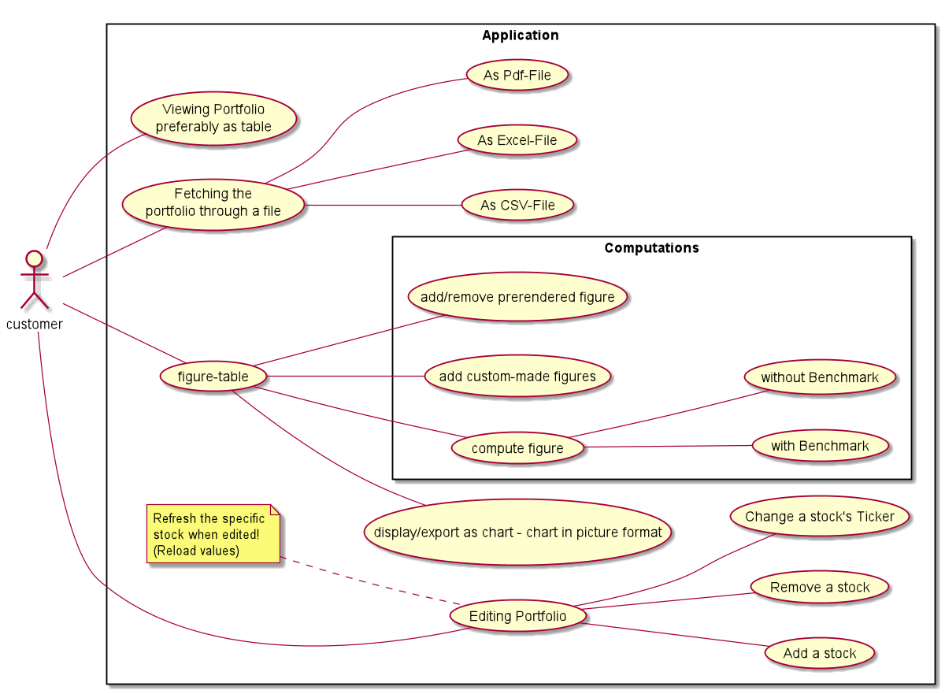
Notes:
Use Case Diagram

Slide 5
SRS – Purpose
select stocks that seem suited to the investor’s objectives in the long term
This includes risk stats as well as performance stats among others
particularily valuable for investors favoring the 3/5-Factor-Fama-French model or broadly speeking factor investing
Notes:
This SRS is meant to give specific details about the Stats-Screener we are about to develop. Stats-Screening is a piece of software supporting to select stocks that seem suited to the investor’s objectives in the long term. This includes risk stats as well as performance stats among others. It is particularily valuable for investors favoring the 3/5-Factor-Fama-French model or broadly speeking factor investing.

Slide 6
SRS - Scope
Actors: users
Subsystems:
Registration
Portfolio
Exporting Portfolio
Toolbox
Opening&Saving Operations
Stats-Screening Controller
Stats-Screening Model
Notes:
Actors: There can be several users. Those create their own portfolio and then add figures per table.
Registration: all users can log in or sign up on the first time
Portfolio: The actual portfolio containing all of it’s stocks and figures
Exporting Portfolio: to export as pdf, csv, excel
Toolbox: contains all figures and charts
Opening&Saving Operations: saving only the TYPE of figures that have been added to the portfolio (all columns)
Registration: account can be created, removed and settings can be changed, all portfolios in DB are saved dependendant on the account
Stats-Screening Controller: When sending correct user credentials, data in form of JSON-Ojects can be fetched through Get or Put-methods
Stats-Screening Model: This is the "Computation-Core". The database-API are also situated here.

Slide 7
SRS - Functionality
Registration
Using a Portfolio
Changing a Portfolio
Exporting a Portofolio
Toolbox/figures:
Performance
Risk
Opening&Savings Operations
Notes:
Performance:
annualised return
continuously compounded returns
mean absolute deviation
Skewness
Kurtosis
Correlation
Risk:
Sharpe ratio
revised sharpe ratio
adjusted sharpe ratio
skewness-kurtosis ratio
Opening& Savings Operations: Saving Portfolio in a file is possible: contains ISIN and columns

