Slide 1
Bioeconomy modelling framework: bringing it all together
Several models (within and outside of H3) could contribute to modelling the forest-based component of the bioeconomy
With Dario’s help, we would like
To make our models more user-friendly (e.g. interface so domain experts can focus on their domain of expertise, and not on IT issues)
To bridge the gap between the models
For now we can concentrate on GFTM and EFDM/CBM

Slide 2
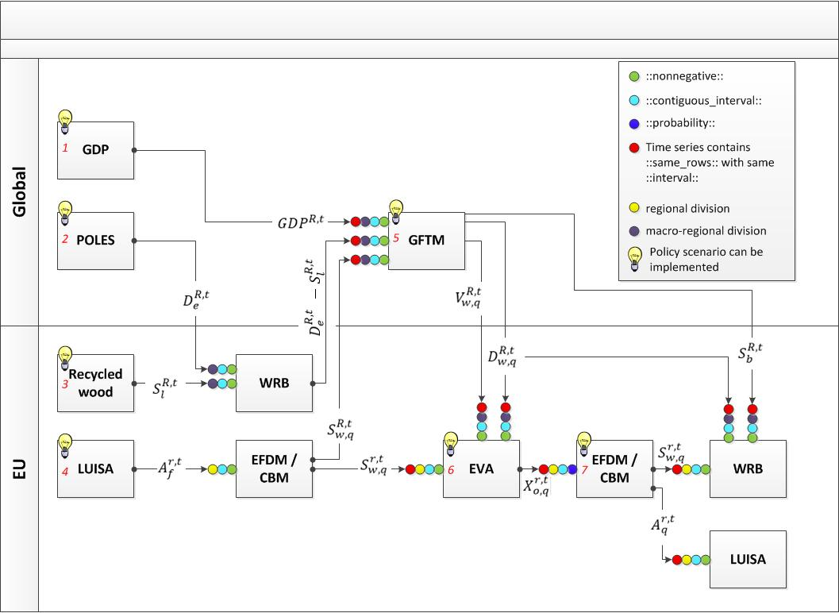

Slide 3
GFTM<->EFDM/CBM
What has been done so far?
Any issues with data exchange?
Any need for automatized iterations?

Slide 4
EFDM
\\ies.jrc.it\H03\forest\EFDM\SRS_EFDM_v1.docx
or https://webgate.ec.europa.eu/CITnet/stash/projects/FISE/repos/efdm/browse/documents

Slide 5
