Slide 1
Study Tutorial
Thank you for being here today
Georg Link glink@unomaha.edu
Vinod Ahuja vahuja@unomaha.edu
Matt Germonprez mgermonprez@unomaha.edu

Slide 2
Scenario
Work
Questions
Gift Card
Login

Slide 3
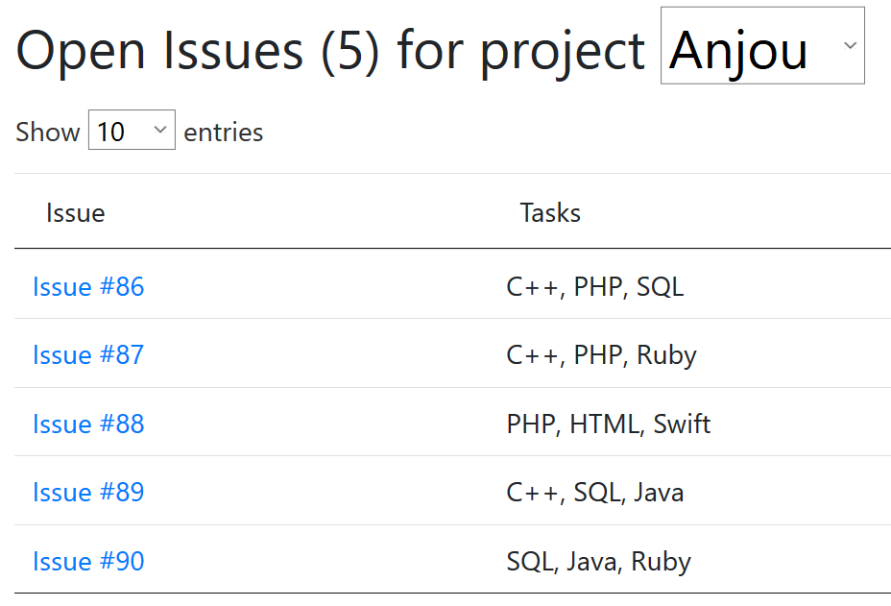


Scenario
You are a software developer
Working in Open Source
You find work through issue trackers

Slide 4

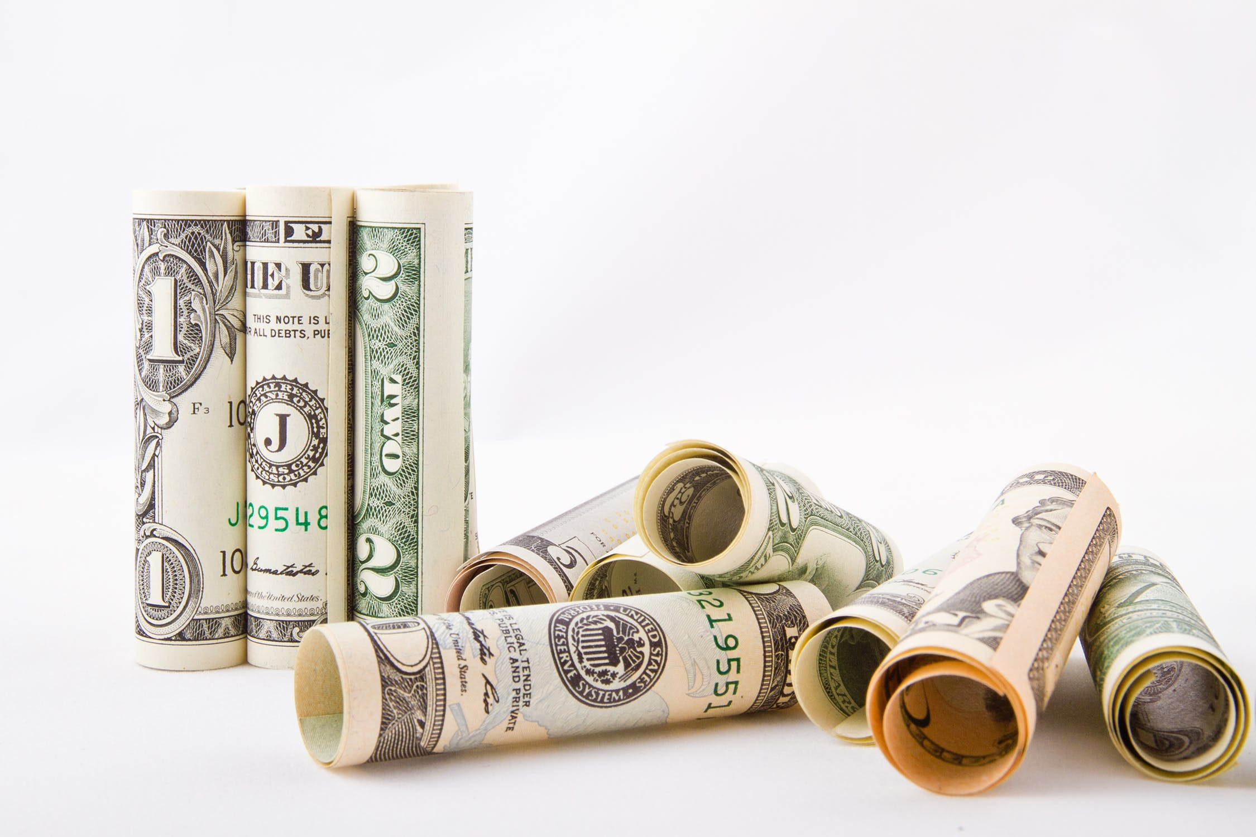
Scenario
We simulate 30 days
You have 24 hours per day to work
And you want to earn a lot of money
24h

Slide 5
Scenario
You use Bugmark to earn money
Bugmark is a futures market
You pay a price now for the right to receive money in the future, if a condition is met
The condition is that an open source issue is closed
Contract
Price: $20
Date: March 1st
Payout: $100
Issue must be closed!

Slide 6
Scenario
This is where your skills as a developer come in, because you can do the work yourself

Slide 7

Scenario
But some things you are not so good at
You can ask others for help

Slide 8
Scenario
By the way, if you don’t work on an issue
but the issue is closed on maturation, you still get paid for a contract
(someone else still needs to do the work)
Market pays out on issue status alone
Contract
Price: $20
Date: March 1st
Payout: $100
Issue must be closed!

Slide 9
Any questions so far?
PAUSE

Slide 10
Login
Work
Questions
Gift Card
Scenario

Slide 11
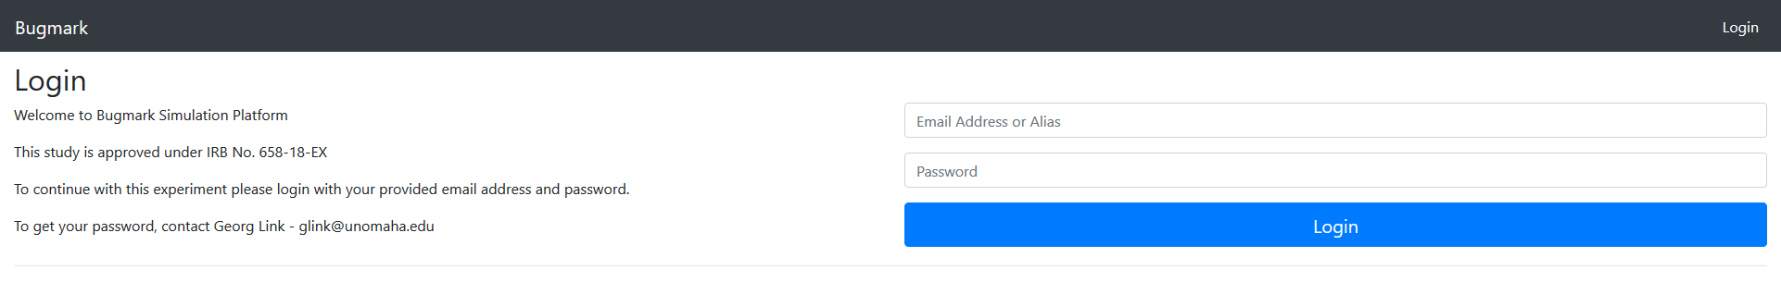
http://join.bugmark.net

Slide 12
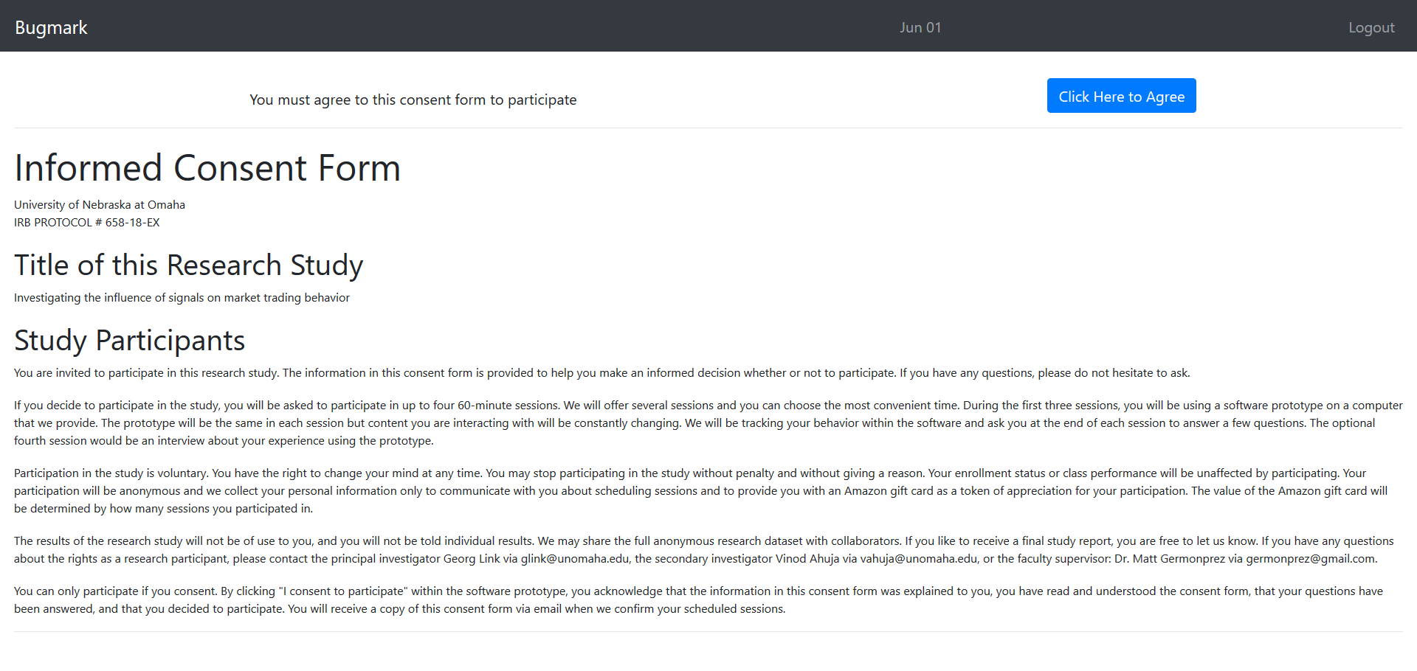

Slide 13
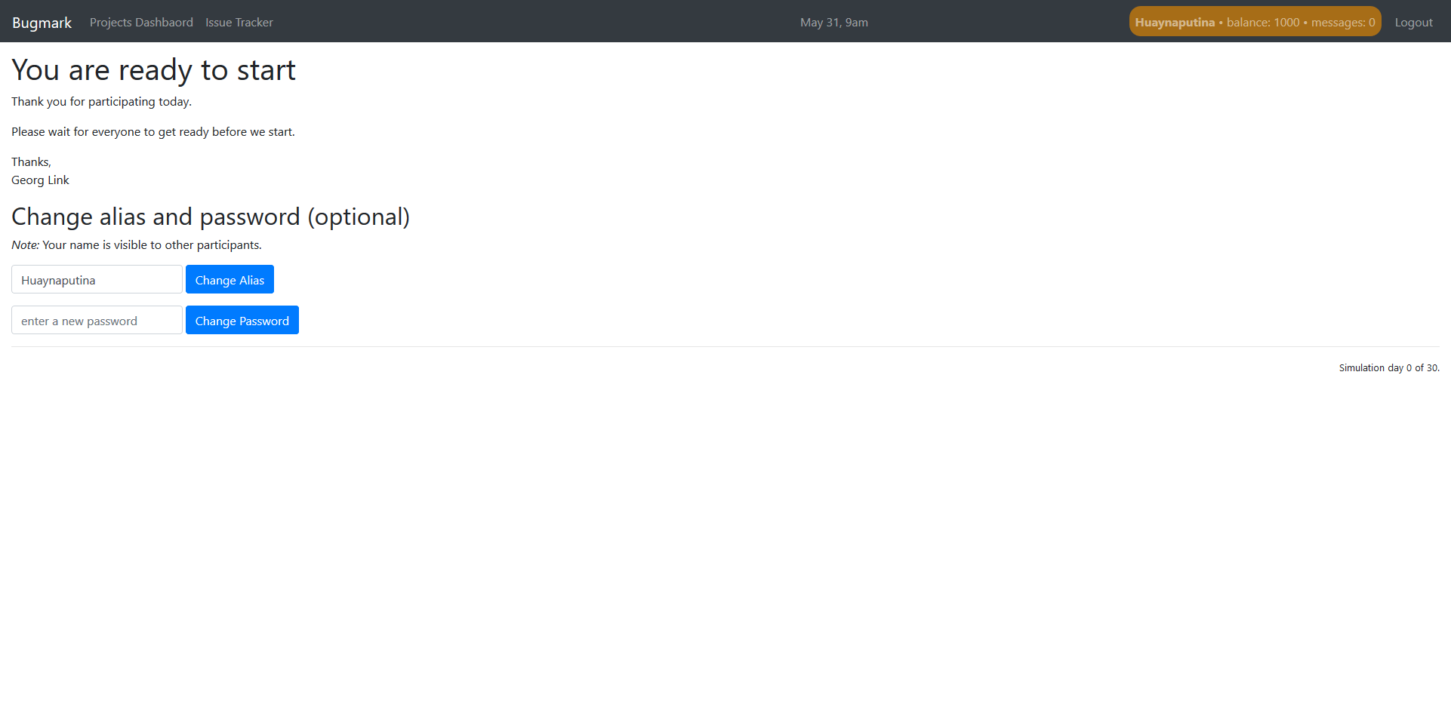

Slide 20
Login
Work
Questions
Gift Card
Scenario

Slide 22
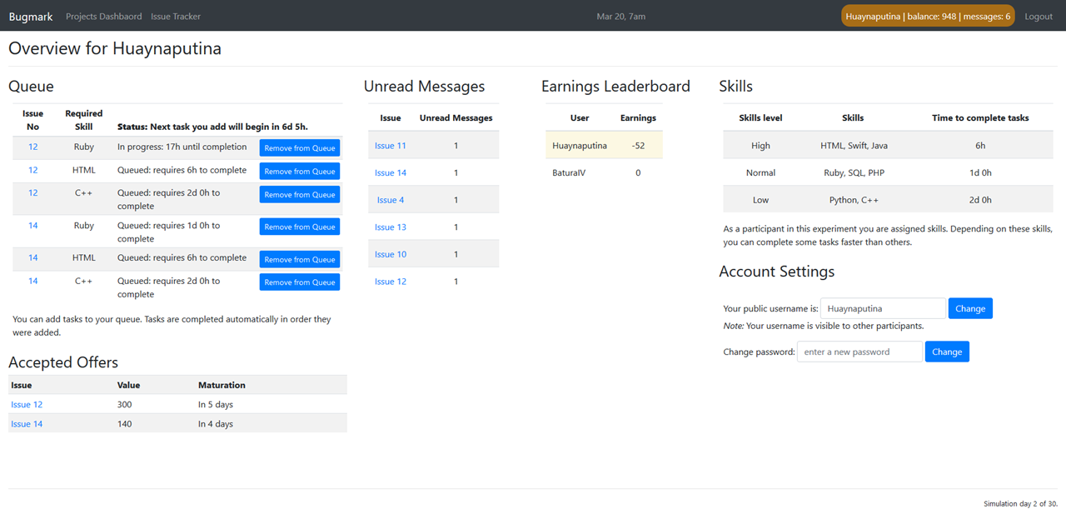

Slide 23
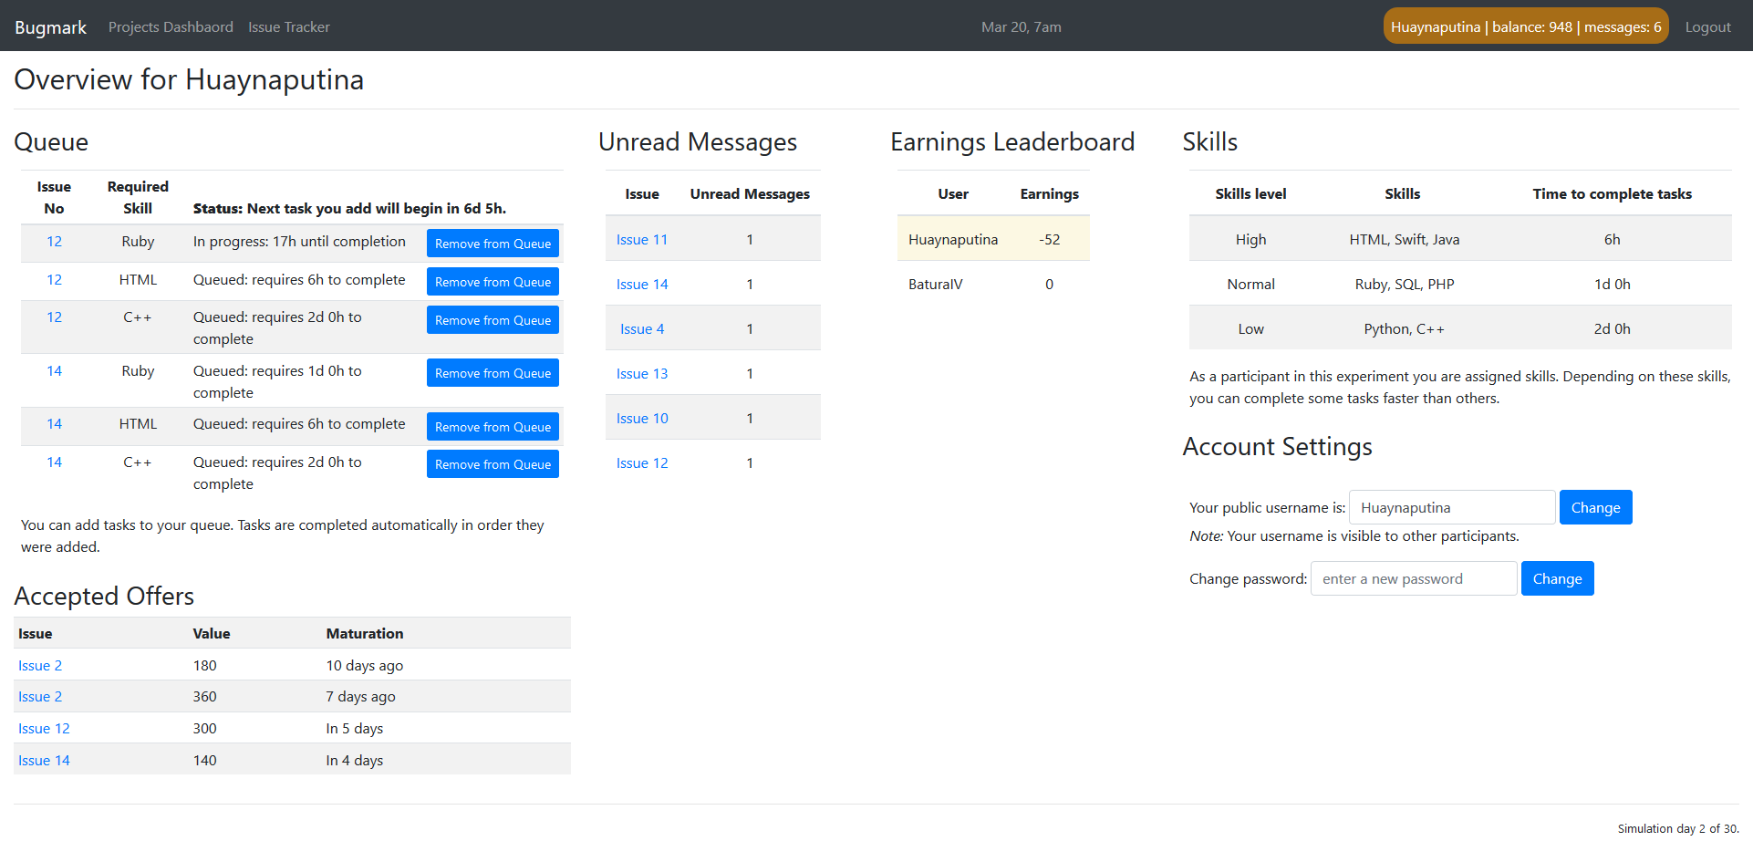

Slide 29
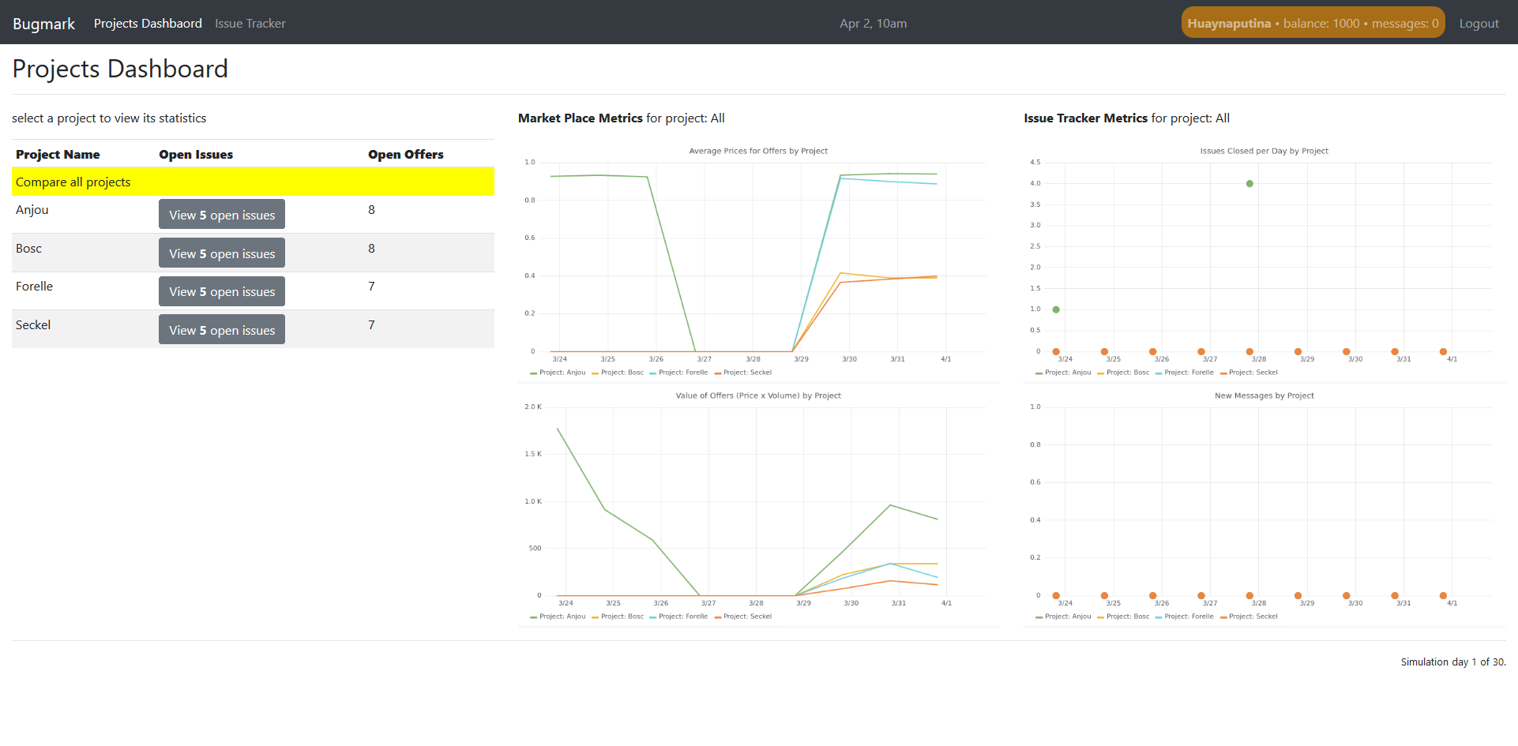

Slide 35
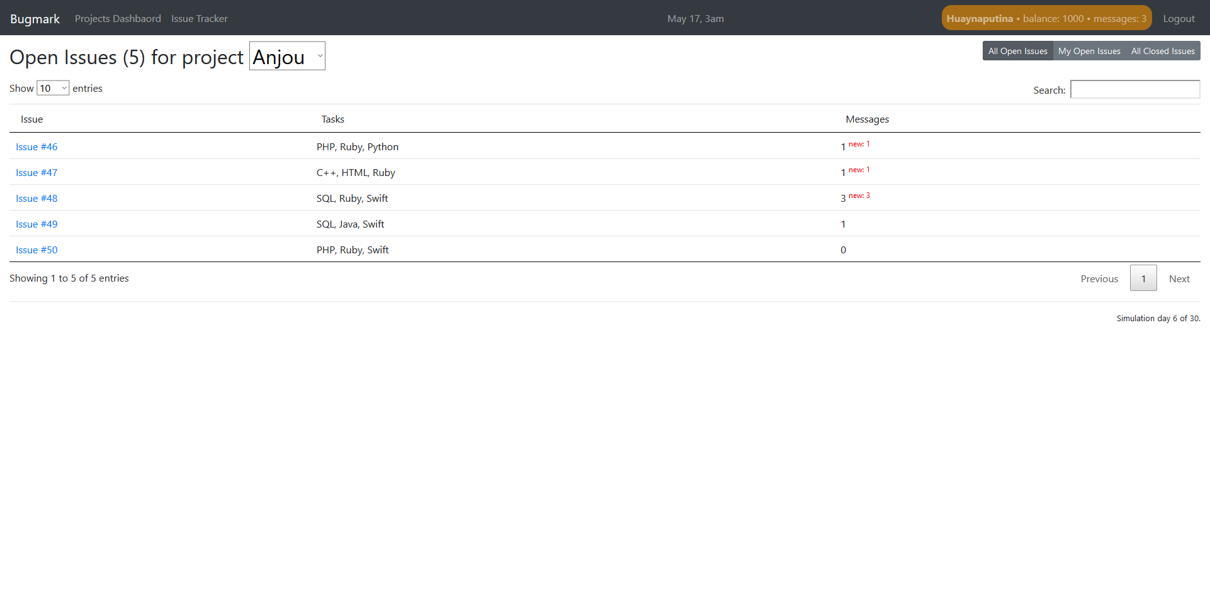

Slide 37
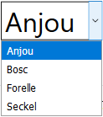

Slide 44
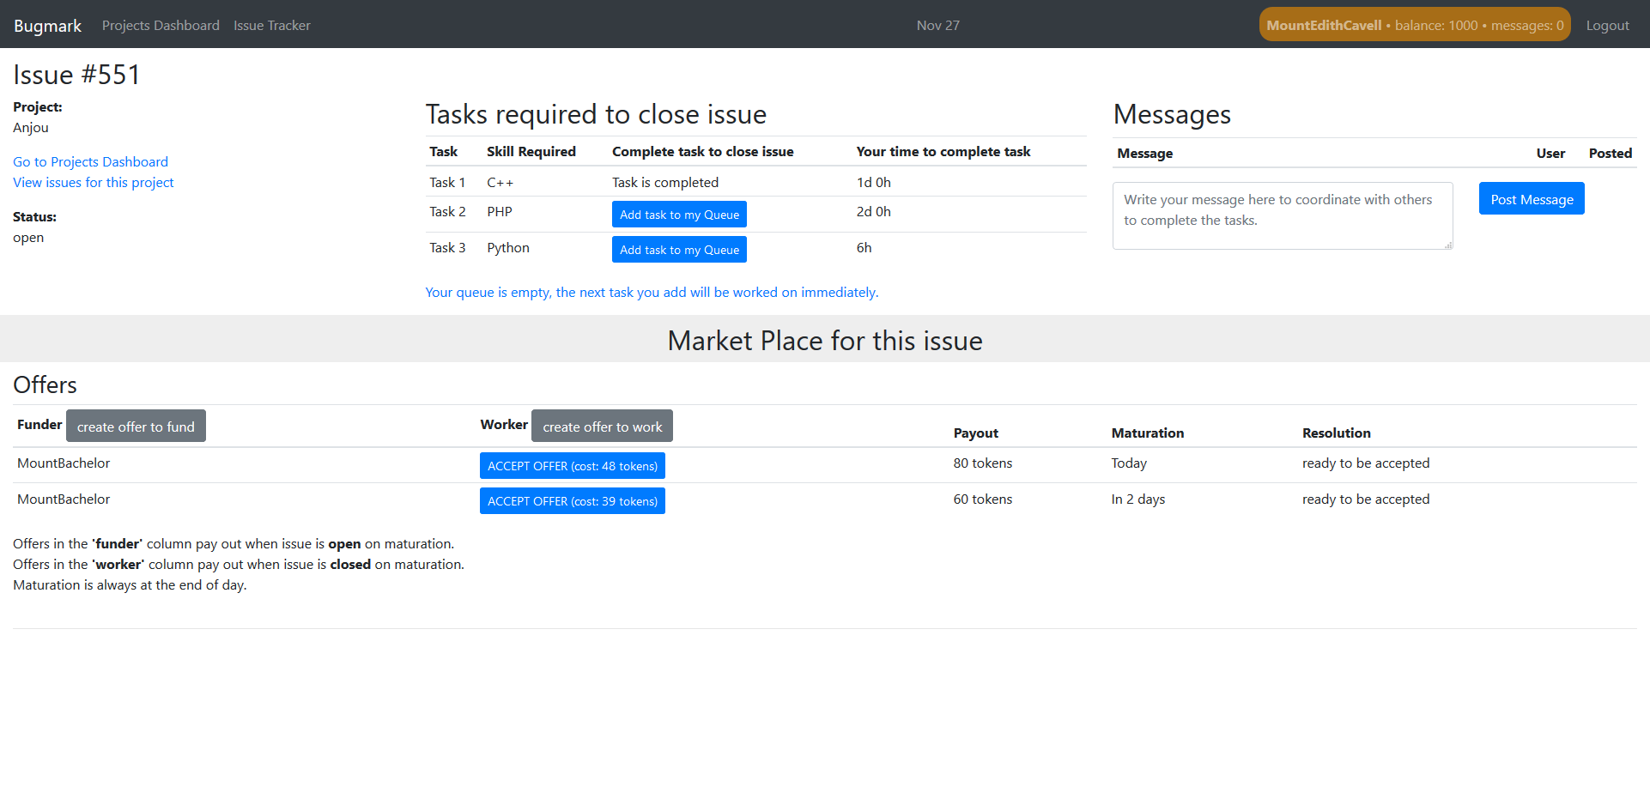

Slide 50
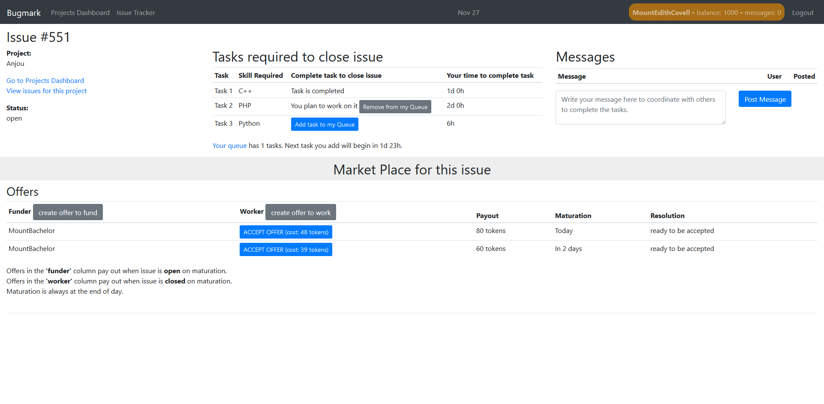

Slide 51
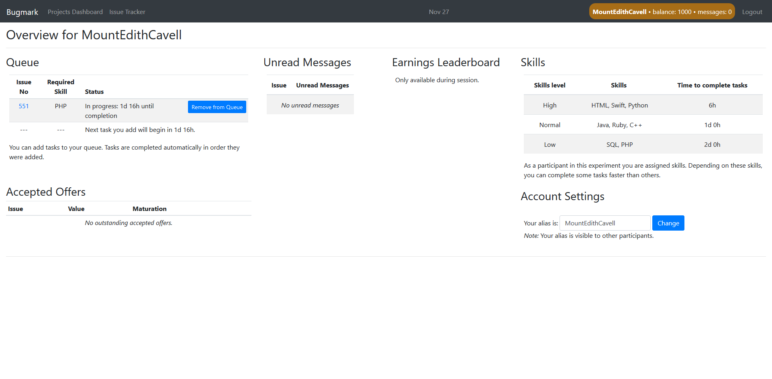

Slide 52
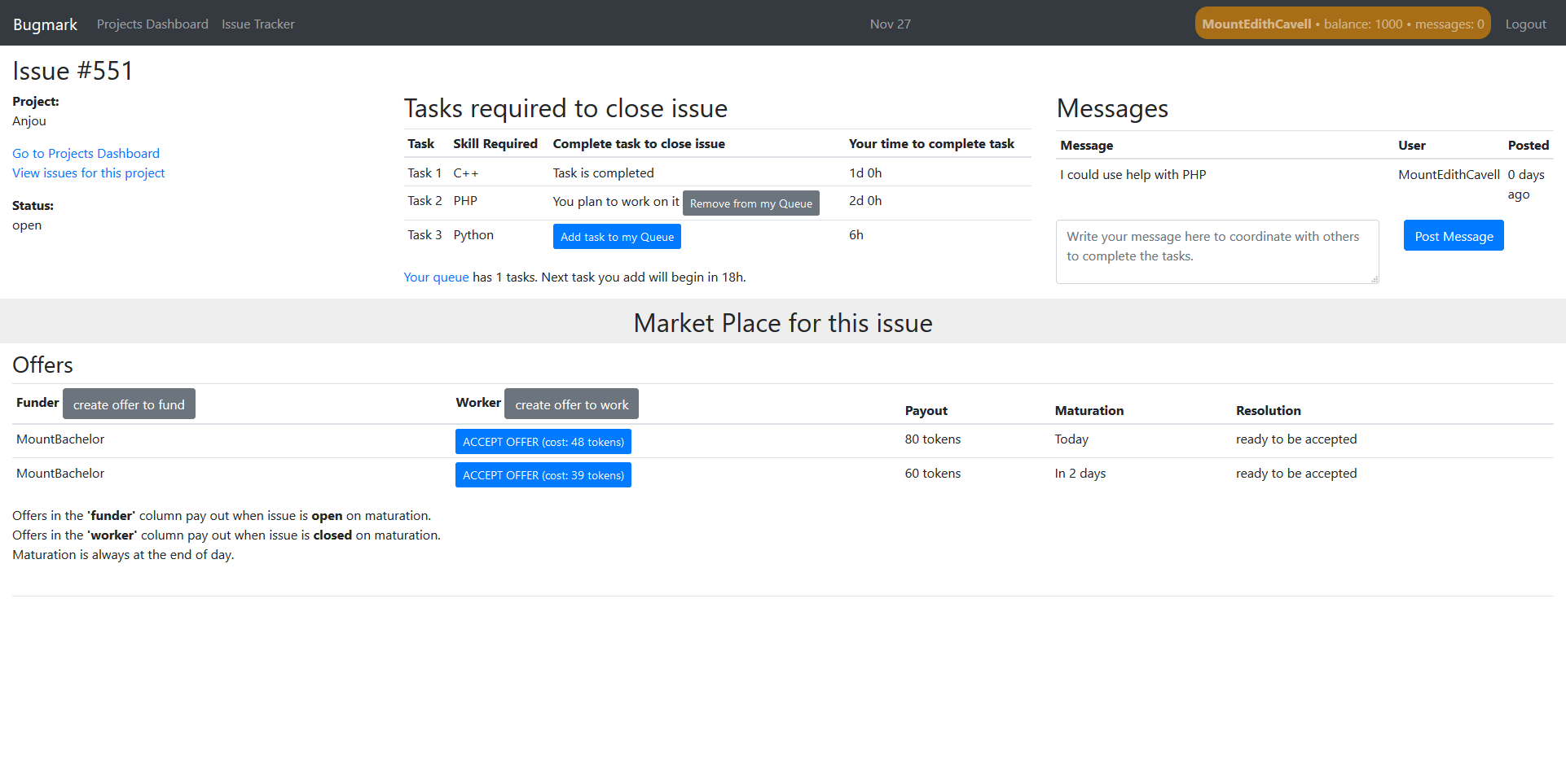

Slide 54
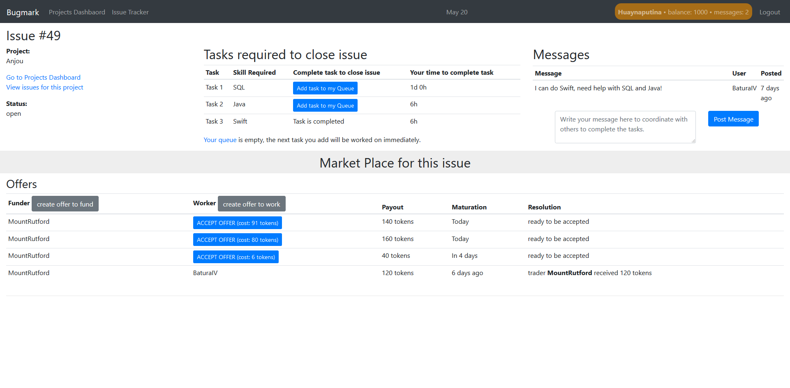

Slide 56

Offer / Contract
Price to accept
Funder

Slide 57

Offer / Contract
Price to accept
Price to accept
Funder
Worker

Slide 58
Offer / Contract
On Maturation:
Price to accept
Price to accept
Funder
Worker
Issue is open ← Payout → issue is closed

Slide 59
Offer / Contract
On Maturation:
Price to accept
Price to accept
Funder
Worker
Issue is open ← Payout → issue is closed

Slide 62
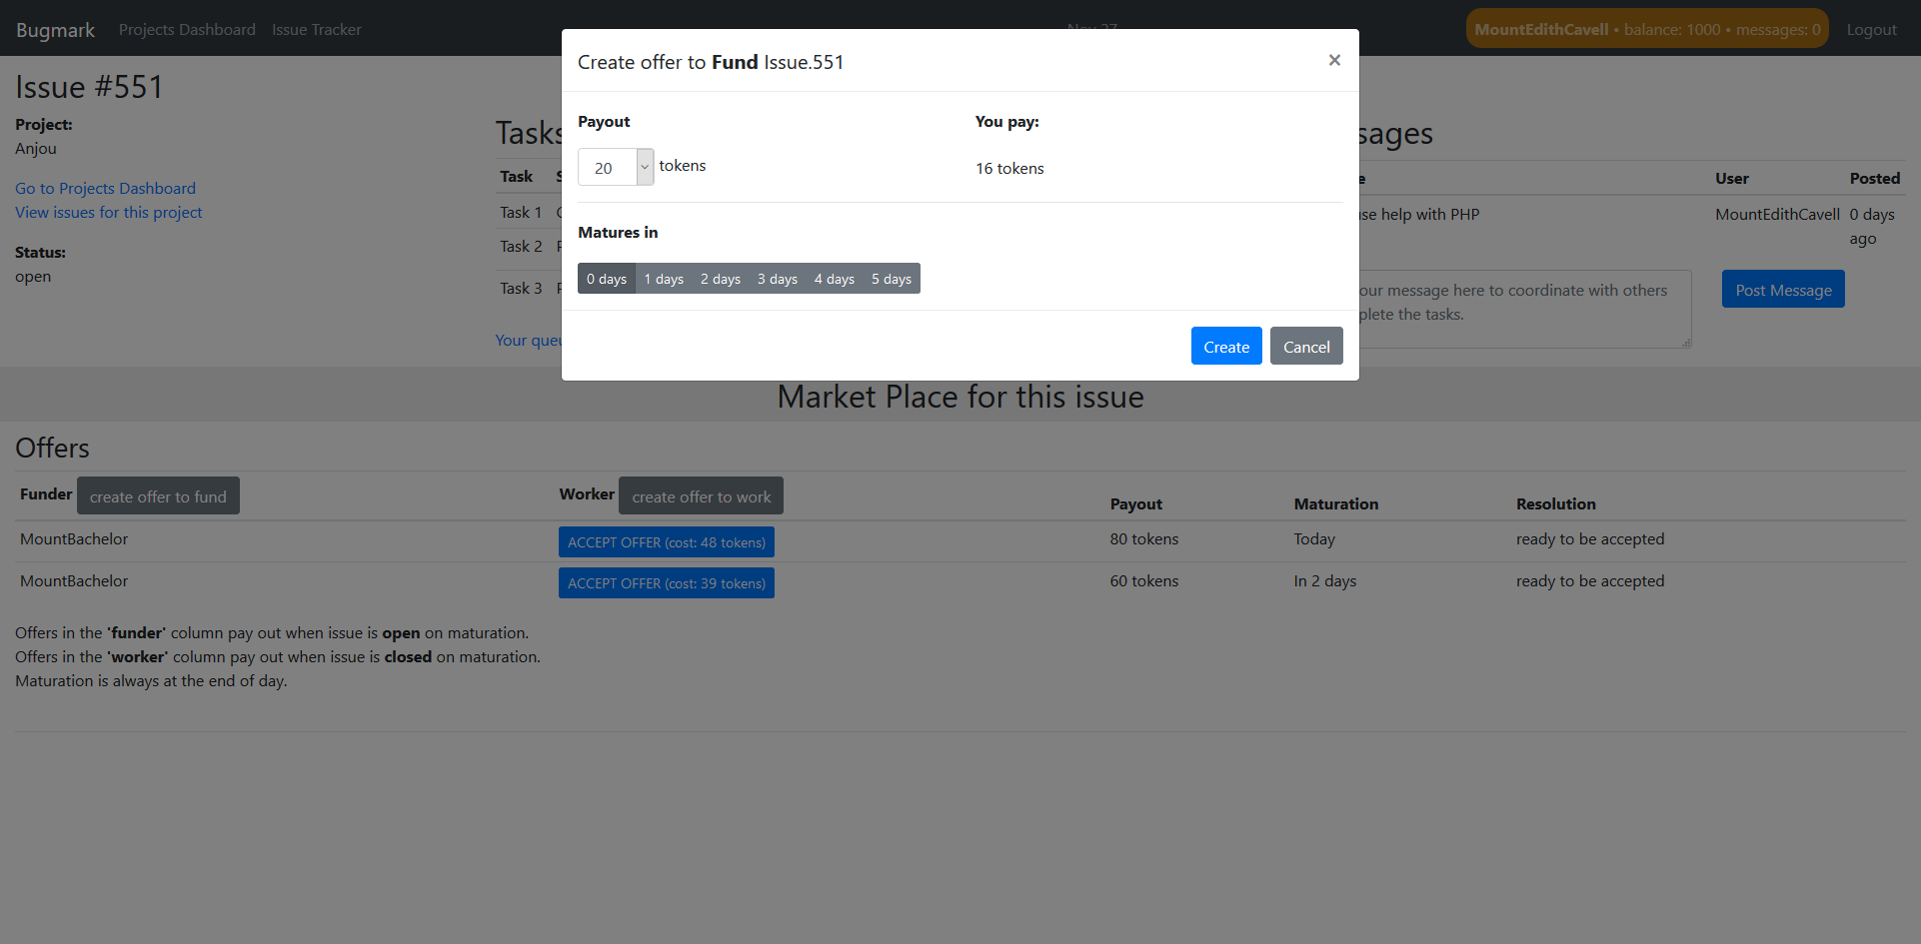

Slide 63
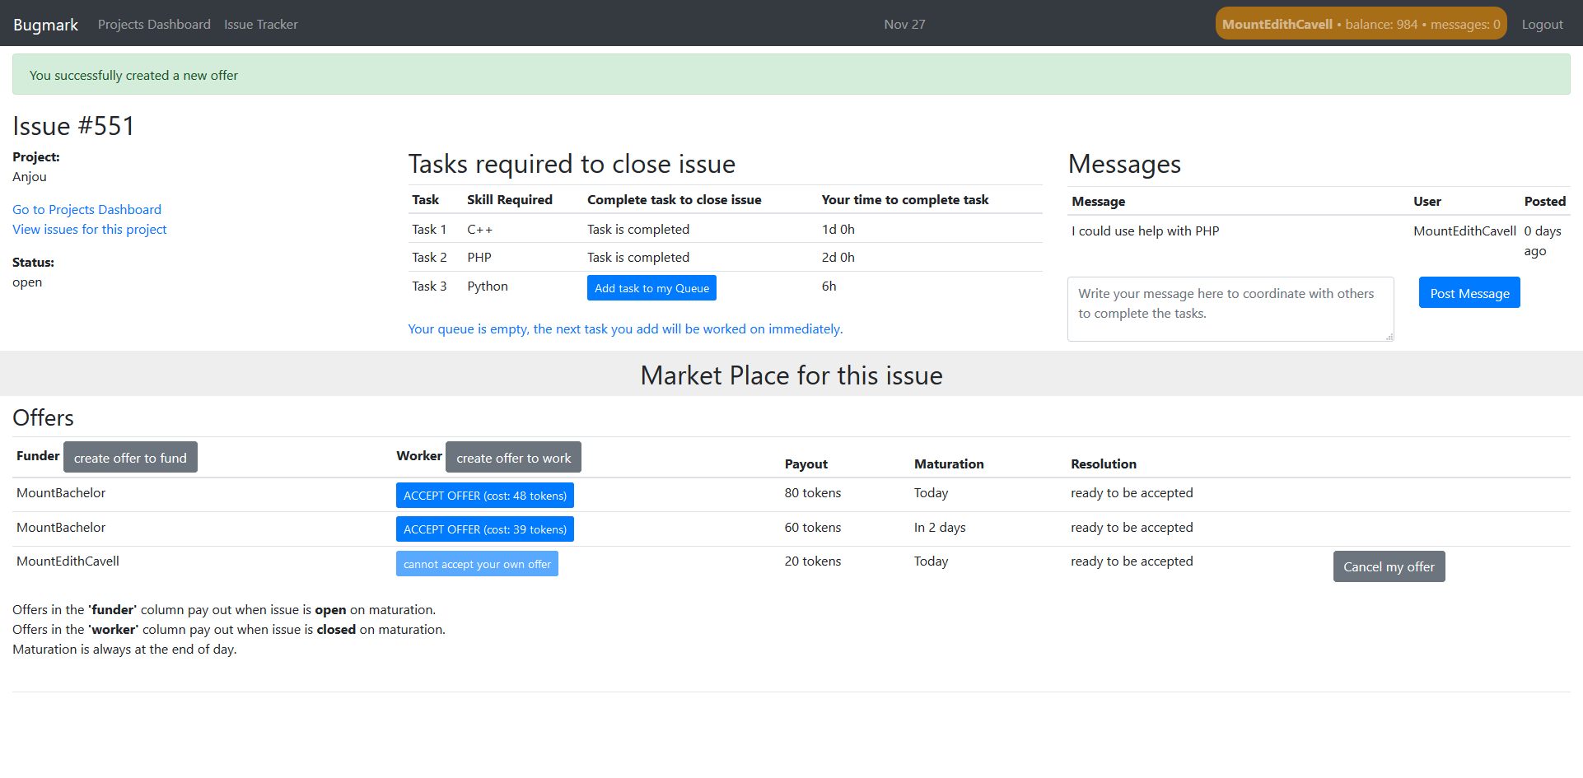
you

Slide 65
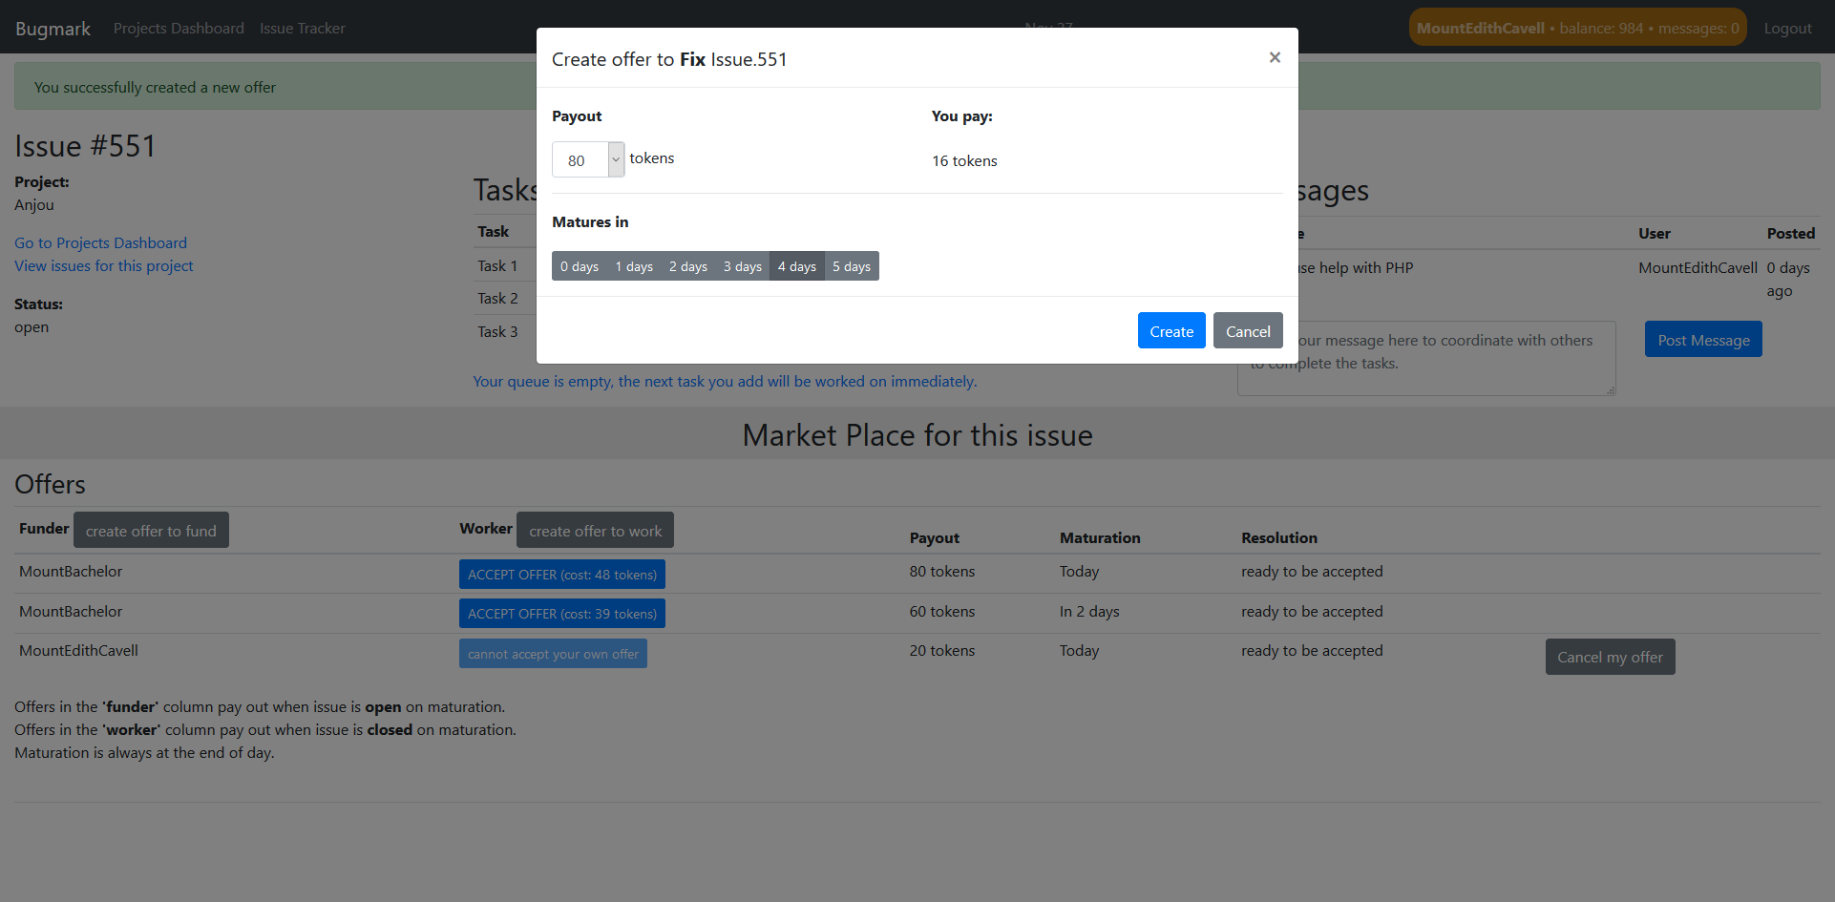

Slide 67
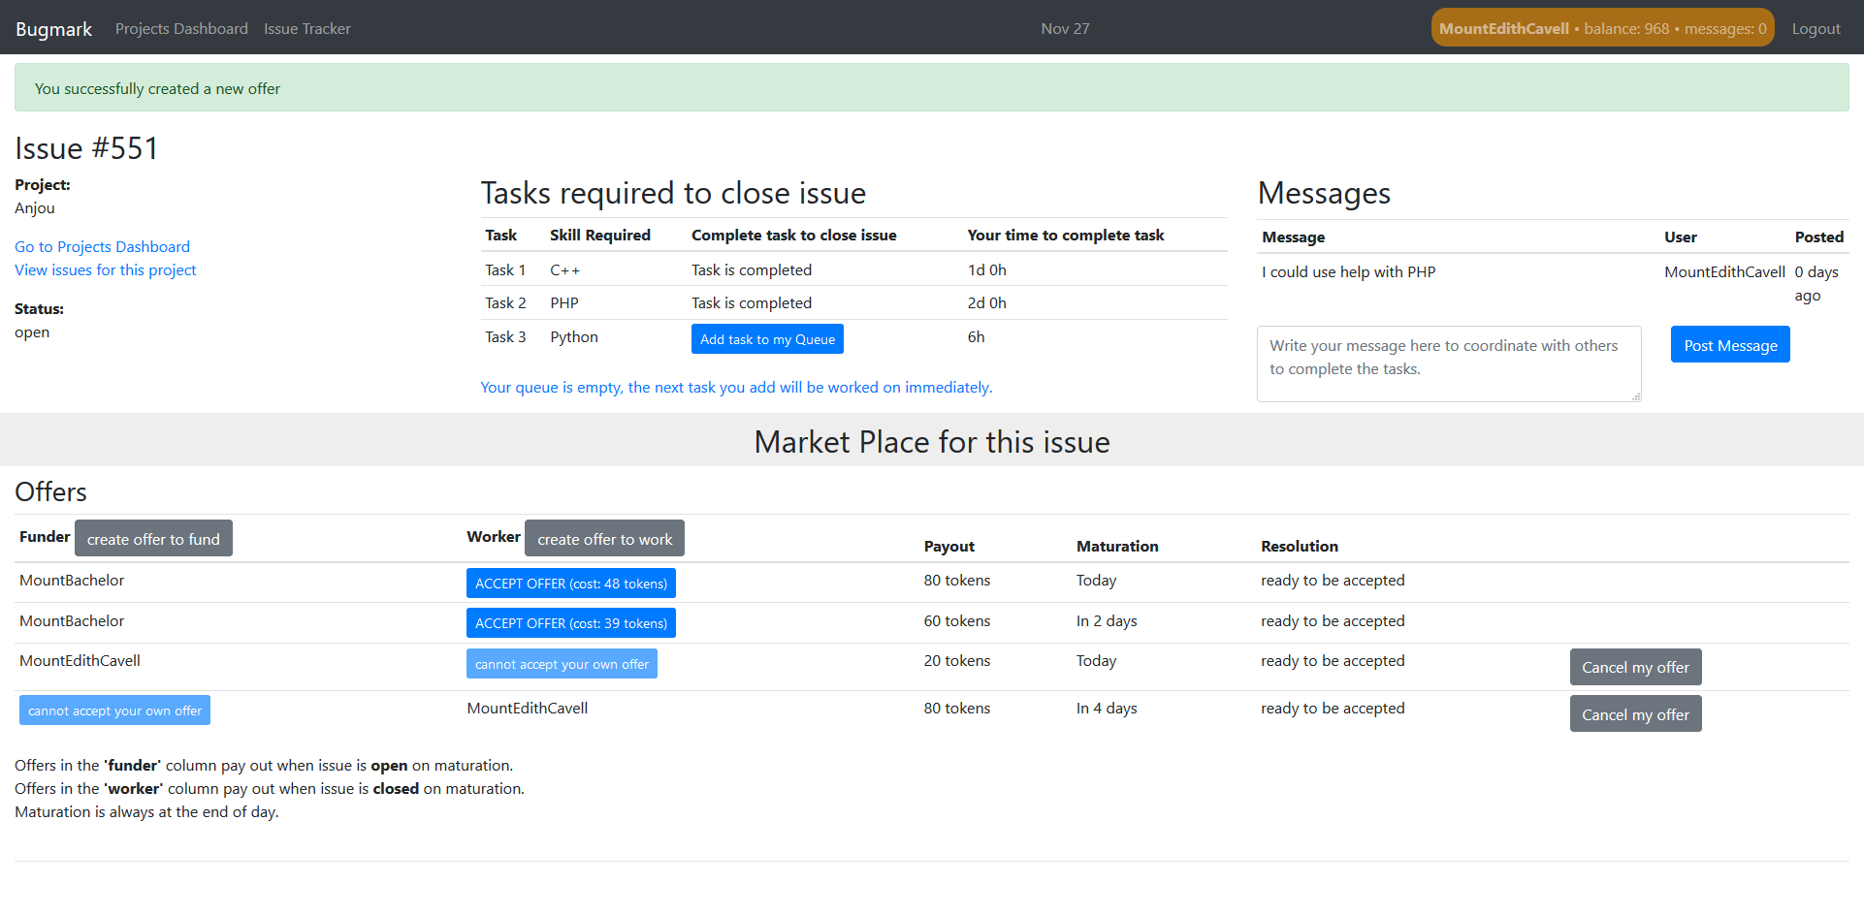
you

Slide 68
Login
Work
Questions
Gift Card
Scenario

Slide 69
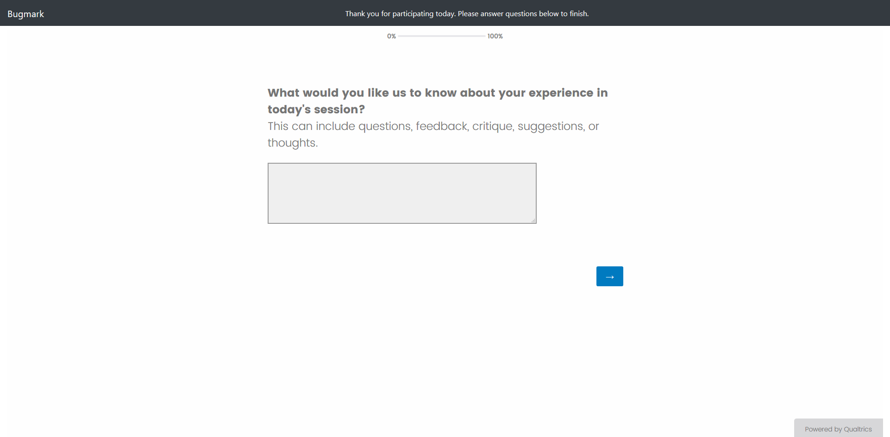

Slide 70
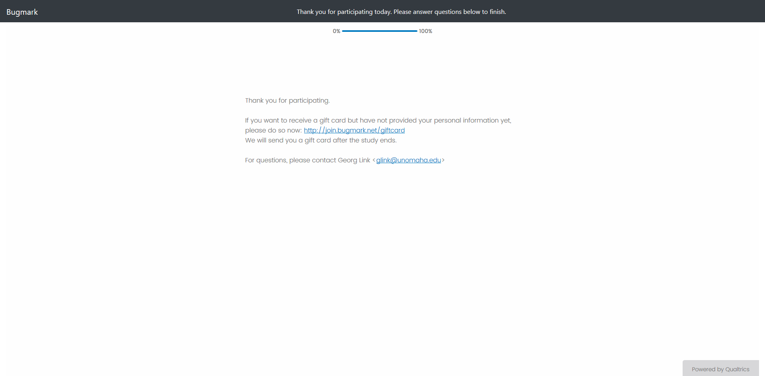

Slide 71
Login
Work
Questions
Gift Card

Slide 72
Gift Card Appreciation
+10
First Session
+10
Second Session
Third Session
+10
Performance: Best earners
+50
Chance: Raffle x7 – each session is an entry
+15
$10 – $95

