Slide 1

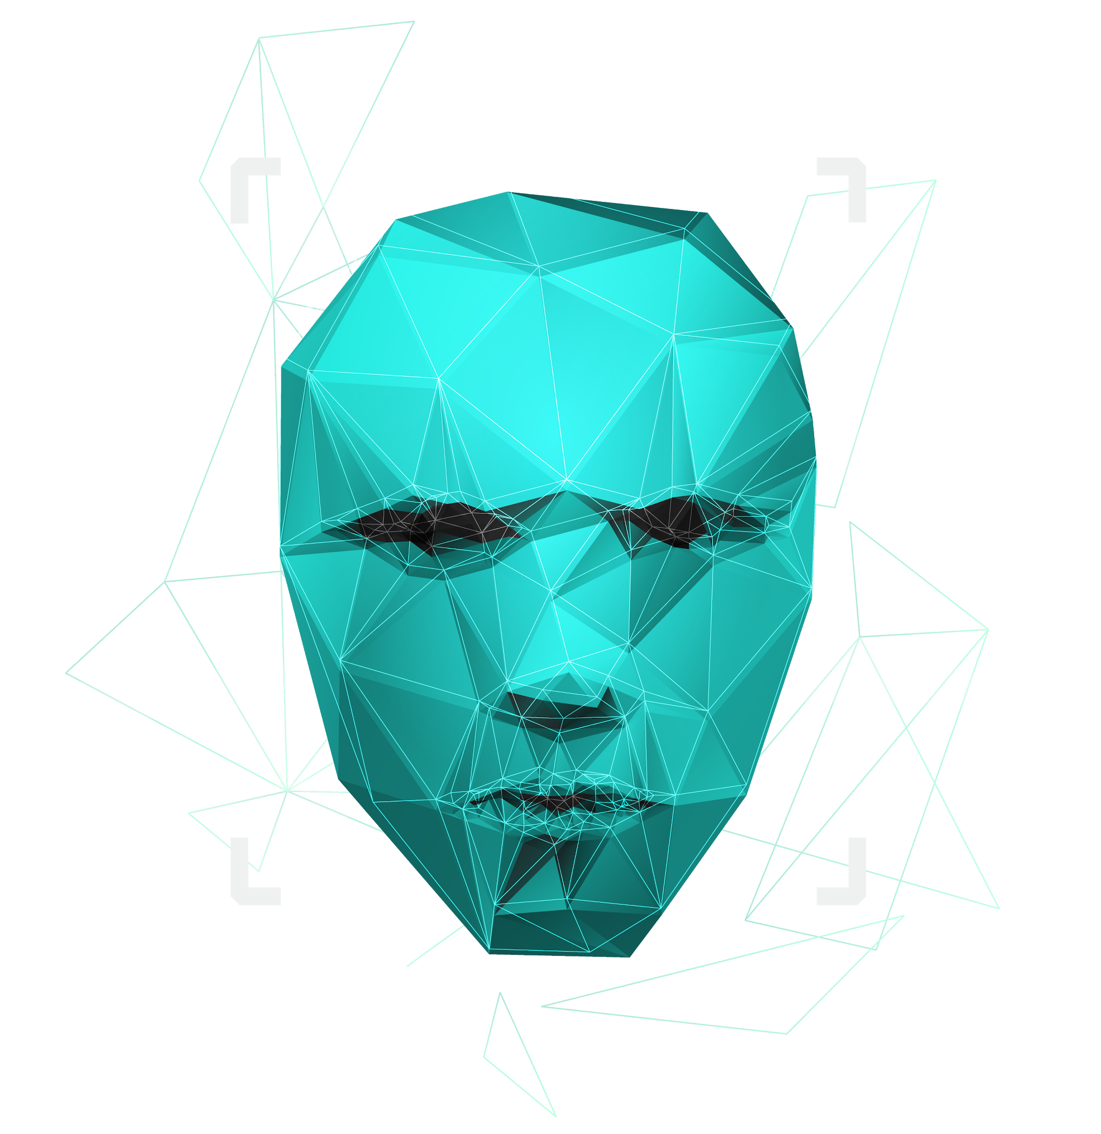
Fraud Detection
Data Exploration Project WWI18SB
Bjarne Gerdes, Georg Schieck, Anabel Lilja, Raphael Schmidt

Slide 2

INTRODUCTION
ECONOMIC PERSPECTIVE
01
02
RELATED WORK
DATASET
03
04
What is Mobile Fraud?
Why is it relevant?
What has been done so far?
Where is the data from?
OUR WORK
Demo
05
06
How does our model work?
Seeing our model in action.

Slide 3
What is Mobile Fraud?
01
Introduction

Slide 4


Mobile Fraud
Fraudulent transaction made by an unauthorized person on someone else’s account while the accountholder and its provider are not aware of it at the time of its realization
Notes:
Beispiele nennen

Slide 5
Why is it relevant?
02
Economic Perspective

Slide 6
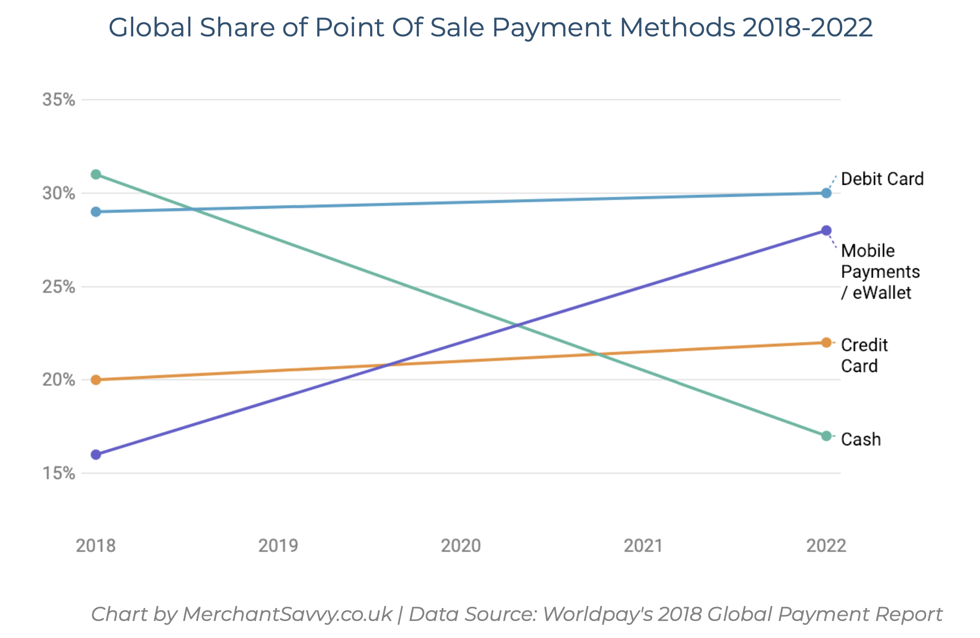
WHY IS IT RELEVANT?
New technologies and consumer behavior result in millions of payment transaction every day
Mobile payment is the one of the most predominate payment methods
Notes:
79% of smartphone owners have used their device for an online purchase in 2019

Slide 7
Annual Transaction Volume in Billion USD

Slide 8
THE STATS
Mobile apps source of only 5% of fraudulent online transactions
2015
2018
Mobile apps source of 39% of fraudulent online transactions
Total Value of mobile payments reaches one trillion USD
2020
2021
Number of mobile user will reach 7 Billion worldwide

Slide 9
Related Work
03
What has been done so far?

Slide 10

Related Work
Classification using a Random Forest Algorithm
Classification using a Random Forest Algorithm
M. Suresh Kumar (2019)
D. Meenakshi et al. (2019)
Husojinovic (2020)
Bharati Vidyapeeth’s College of Eng. (2018)
Combined approach of Naïve Bayes and a C4.5 Decision Tree
Combined approach on Naïve Bayes and KNN

Slide 11
The Dataset
04
Where is the data from?

Slide 12
Where is the data from?
The Company
Based in Africa
Operates internationally in over 14 countries
Customers can make mobile payment tansactions

Slide 13
What data do we have?
Synthetic Data
Simulating real payment transactions
6.362.620
payment transactions in a CSV file
11 Entities
Used to uniquely identify a transaction

Slide 14
The Entities
Step
nameOrig
nameDest
Unit of time in the real world
Customer making the transaction
Recipient ID
Type
oldbalanceOrg
oldbalanceDest
Type of Transaction
Customer balance before transaction
Recipient balance before transaction
Amount
newbalanceOrg
newbalanceDest
Amount of transaction in local currency
Customer balance after transaction
Recipient balance after transaction
isFraud
isFlaggedFraud
Identifies a fraudulent transaction
Flags illegal attempts to transfer too much money

Slide 15
Our Work
05
How does our model work?

Slide 16
What did we do?
Build Initial Model
Evaluation of the trained Model
Feature Engineering
Train the model
Final implementation

Slide 17
Feature Engineering
Percentage change of the customers account balance
Shows the proportion of transactions to the recipient
PctChangeOrg
relativePctTxToDest
HourOfTheDay
Type
Time of day in hours – derived from the entity step
represented transaction types - was coded with its characteristics to dummy variables

Slide 18
What algorithm did we use?
RANDOM FOREST
LOGISTIC REGRESSION
SUPPORT VECTOR MACHINES
Ensemble of a large number of individual decision trees
Standard model for binary classification that models a probability outcome for a class
Binary Classifier that is used to find the best separating hyperplane

Slide 19
Training and Validation
20% of the data used for testing the model
Data was NOT split randomly
Grid Search and Cross-Validation where used to find the optimal parameter settings
80% of the data used for training the model

Slide 20
Evaluation of the models
 | F1-Score | Average Precision | AUC Score
Random Forest | 0.99976 | 0.99953 | 0.99999
Logisitc Regression | 0.65353 | 0.45305 | 0.96342
Support Vector Machine | 0.88205 | 0.78382 | -

Slide 21
6,684 Mrd. USD
worth of fraudulent transactions were correctly blocked by our model during testing

Slide 22
The final architecture

Slide 23
Demo
06
This is how it works.

Slide 24
Sources
https://www.statista.com/statistics/226530/mobile-payment-transaction-volume-forecast/
https://dataprot.net/statistics/mobile-banking-statistics/

