Slide 1

Quality-Diversity Algorithms
Ιntelligent Control
Quality-Diversity for Control Policy Repertoires
ECE upatras
George Saliaris
Exploring Concepts and Applications

Slide 2
Introduction to QD
Intro to QD
Quality-Diversity optimizes for both performance and diversity
Popular methods include MAP-Elites and Novelty Search
Applications: robotics, game design, and design optimization
-Discover many solutions that are both good and different, not one “winner”
-Separate genotype from a human-chosen behaviour descriptor space, so exploration is guided by what the robot actually does
-Keep an archive that stores the single best individual per niche, preserving diversity automatically
-Produce a “heat-map” of the design space that illuminates trade-offs at a glance
Fgfdfgd

Slide 3
Agenda
Intro to QD
-Robust on deceptive landscapes because each niche protects its elite from being overwritten
Introduction to QD Algorithms
Key Techniques
Real-World Applications
Future Directions
-Proven in robotics, airflow design, game-content generation, rocket shapes, and more
-Progress measured with coverage (%) and QD-score (sum of fitness across all filled cells)
-New variants add gradients, curiosity, or learned descriptors to speed up map filling

Slide 4
Map Elites
-Discretises behaviour space into a fixed grid of cells
-Loop: pick an elite, mutate/crossover, evaluate, insert if better for that cell
-Pure evolutionary search → needs lots of evaluations (no surrogate)
-Grid size (e.g. 25 × 25) trades visual detail against compute cost

Slide 5
Map Elites
-Output is easy to visualise and query during runtime
Intro to QD
-CVT-MAP-Elites replaces the grid with Voronoi cells for high-D descriptor spaces
-Used for robot damage recovery: archive built in sim, queried on the broken robot
-Weak point: random mutation often re-explores already-filled areas

Slide 6
Sail Algorithm
-Augments MAP-Elites with a Gaussian-Process surrogate to slash eval cost
-Starts with a random Design-of-Experiment to train the first GP
-Samples hundreds of new genotypes and predicts μ (mean) & σ (uncertainty)
-Ranks candidates via UCB = μ + βσ; evaluates only the top few per niche

Slide 7
Sail Algorithm
-Matérn 5/2 kernel captures smooth yet rugged fitness landscapes
-Matches MAP-Elites coverage with 100–1000× fewer expensive sims in airfoils and robots
-WhiteNoise kernel term models sensor/sim jitter, avoiding over-confidence
-Main bottleneck is cubic GP scaling; sparse or local GPs are active research

Slide 8
Implementation on a robot
-Uses the open-source Minitaur URDF (8 direct-drive joints) in PyBullet
-Alternate fast path: analytic proxy computes speed & effort without physics
-Joint command: θᵢ(t) = Aᵢ sin(2πt/T); PyBullet’s built-in PD controller tracks it
-Physics timestep = 1/500 s; each evaluation simulates 1.5 s of motion

Slide 9
Implementation on a robot
-Forward velocity = (x_final − x_start)/1.5 s; effort = 2·mean(A²)
-Analytic model injects Gaussian noise to mimic real sensor scatter

Slide 10
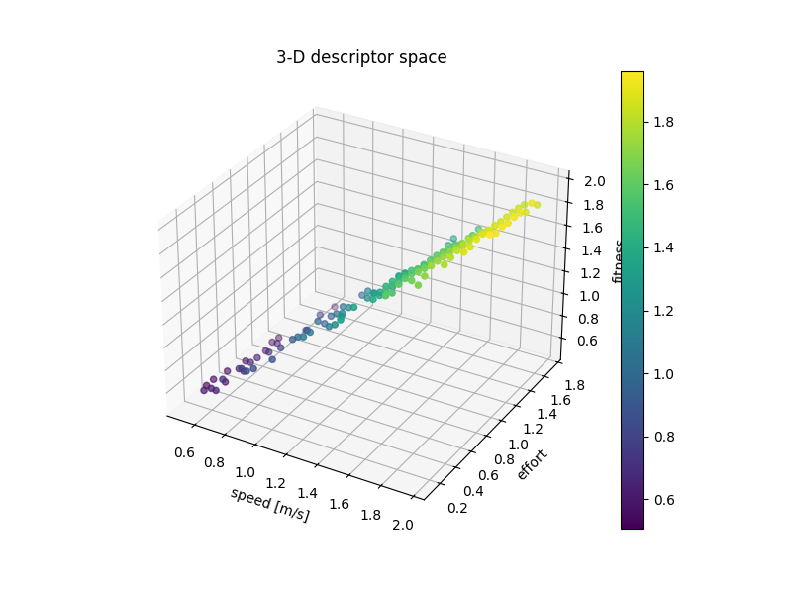
Results
Results

Slide 11
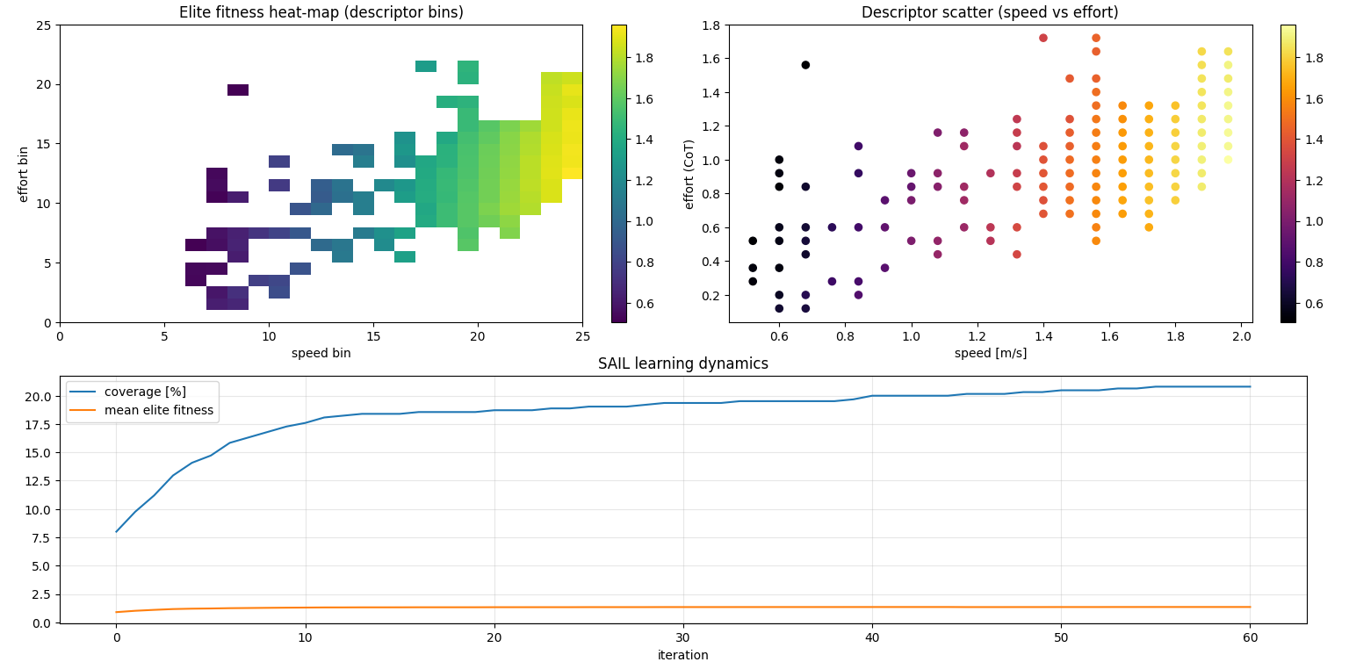
Results

Slide 12
Conclusions
-SAIL reframes optimisation as treasure-map building: many good answers in one run
-GP surrogate cuts simulation cost by orders of magnitude while preserving coverage
-Matérn 5/2 + UCB turn predictive variance into a smart search compass
-The archive doubles as an on-board lookup table for instant gait switching

Slide 13
What could be futher improved?
-Switch to sparse/inducing-point GPs for linear-ish training time on >10 k samples
-Use an adaptive β schedule: high early for exploration, lower later for exploitation
-Replace fixed grid with CVT or dynamic quad-tree cells to handle ≥3D descriptors
-Train Central Pattern Generators (CPGs) instead of raw sine amplitudes for smoother gaits

Slide 14
Some bibliography
Tutorial on Quality-Diversity Optimisation
ALIFE2023: Efficient Exploration using Model-Based Quality-Diversity with Gradients
List of papers | Quality-Diversity optimisation algorithms
Gaier, A., Asteroth, A., & Mouret, J.-B. (2018). Data-Efficient Design Exploration through Surrogate-Assisted Illumination. arXiv:1806.05865
Mouret, J.-B., & Clune, J. (2015). MAP-Elites: Illuminating Search Spaces by Mapping Elites. arXiv:1504.04909
Vassiliades, V., Chatzilygeroudis, K., & Mouret, J.-B. (2016). Using Centroidal Voronoi Tessellations to Scale Up MAP-Elites.

Slide 15
End of Presentation-Any questions??

