Slide 1

George Saliaris - AM 1092584
ECE upatras
Linear & Combinatorial Optimazation
Final Project
Optimization in fitness programs
Academic year - 2024-2025
Course Instructor - Daskalaki Sofia

Slide 2
What is this project about? (1)
-Optimal workout plan
-2 versions
-Model the 2 problems and then try to solve the using the Simplex method

Slide 3
What is this project about? (2)
-We then proceed to print the SAG and solve the dual problem (for one of the two versions)
-Finally space and time metrics are computed for the code per se.

Slide 4
Problem #1 (1)
What? -> Maximization of fitness score
What is a fitness score and how do we build it?

Slide 5
Problem #1 (2)
Decision variables x1…x9
-What does each variable represent?
-How do we incorporate them into the objective function?

Slide 6
Problem #1 (3)
Objective function:

Slide 7
Problem #1 (4)
Types of constraints
-Time budget
-Minimum guidelines
-Maximum guidelines
-Do not focus excessively or on one type of exercise instead of another; maintain a balance
-Time for recovery

Slide 8
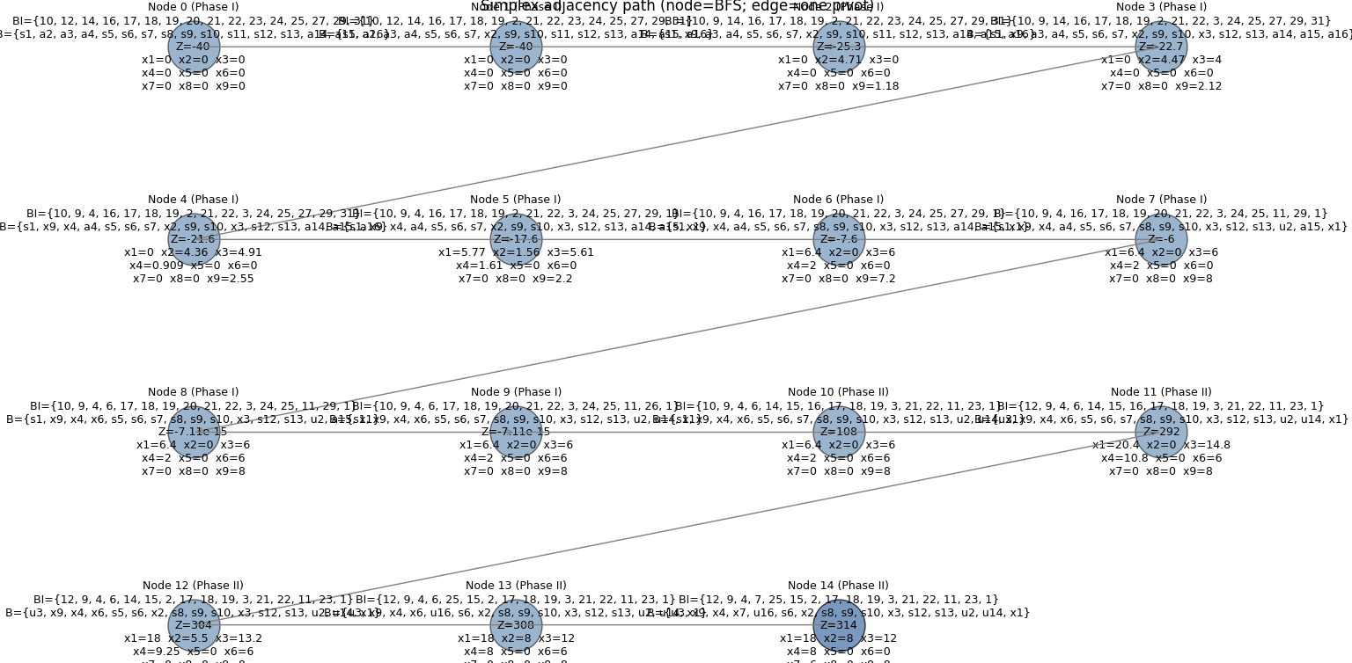
Problem #1 (5) (Code demo)

Slide 9
Problem #2 (1)
-More advanced (>700 decision variables + user-defined parameters!!!)
- >5000constraints!!
-Fully stated at An Optimization Model for Exercise Scheduling by Vardges Melkonian

Slide 10

Problem #2 (2)
-Objective function
-Parameters (not decision variables – di, tij, M (muscle groups, E (types of exercises), wim, uim, MET(i), TMET
-Decision variables xi exercise exists or not in the program), fij (exercise comes after exercise j), si (position of exercise i)

Slide 11
Problem #2 (3)
-Constraints about a)how many exercises are selected
b) consecutive exercises/arcs
c) no cycles in the program
d) keeping the program balanced enough and not focus too much/too little on one specific muscle group

Slide 12
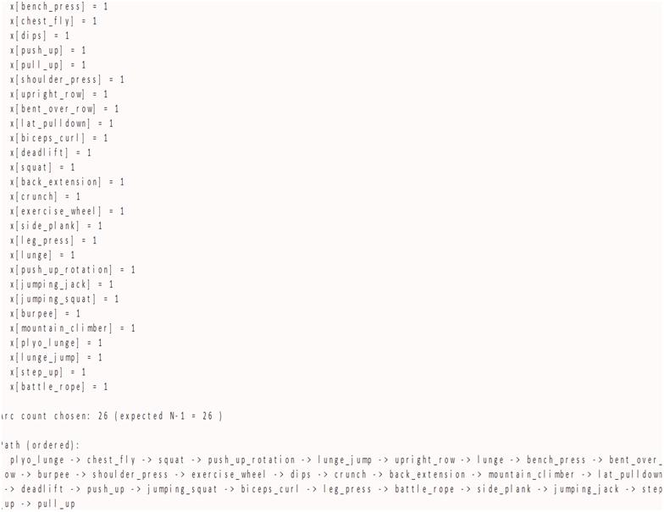
Problem #2 (4)-Code demo

Slide 13
Comparison between the two types of problems
-Nature
-What we do in one and we do in the other
-Memory and time needed

Slide 14
Conclusions
-Comments concerning both of the problems
-What could we do better? (more realistic models, different algorithms, etc)

Slide 15
Some bibliography
High-Intensity Interval Training: For Fitness, for Health or Both?
Plyometric Training
Search Results for “MET” – Compendium of Physical Activities
https://pmc.ncbi.nlm.nih.gov/articles/PMC11197041/
How to Measure Physical Activity Intensity | Physical Activity Basics | CDC
An Optimization Model for Exercise Scheduling

Slide 16
Thank you for your attention
Any questions?

