Slide 1

Adaptive Control & Reinforcement Learning
Final Project
George Saliaris 1092584
Undergraduate Student – ECE Upatras
Academic year 2025-2026

Slide 2
What is this project about?
Design an adaptive controller so as a rocket with a thrust/weight ratio = 2, can land safely inside a zone, with a speed of < 5 m/s
2 adaptive control schemes
Adaptive Backsteppish (a variation of Adaptive backstepping)
Adaotive controller using the MIT rule

Slide 3
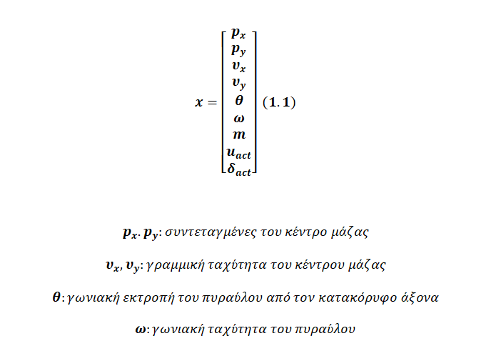
Dynamics of the system (1) –most important equations

Slide 4
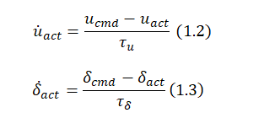
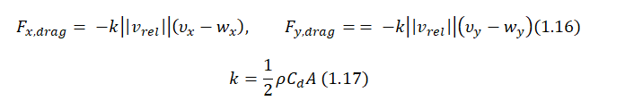

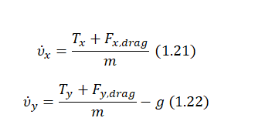
Dynamics of the system (2)

Slide 5

Dynamics of the system (3)

Slide 6
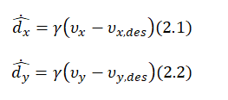
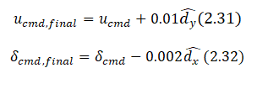
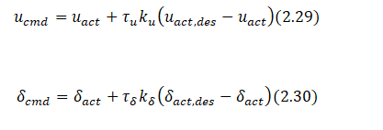
Controller Design – Adaptive Backstepping (1)
Core equations:

Slide 7


Controller Design – Adaptive Backstepping (2)
-Q: hy is this called adaptive Backstepping?
-A: Ee first pick virtual targets (e.g., desired velocities/accelerations), then “step back” and convert them into the real inputs (throttle + gimbal). That layered/virtual-input idea is exactly what backstepping is about. It’s adaptive because the controller updates an estimate online.

Slide 8




Controller Design – MIT Rule

Slide 9
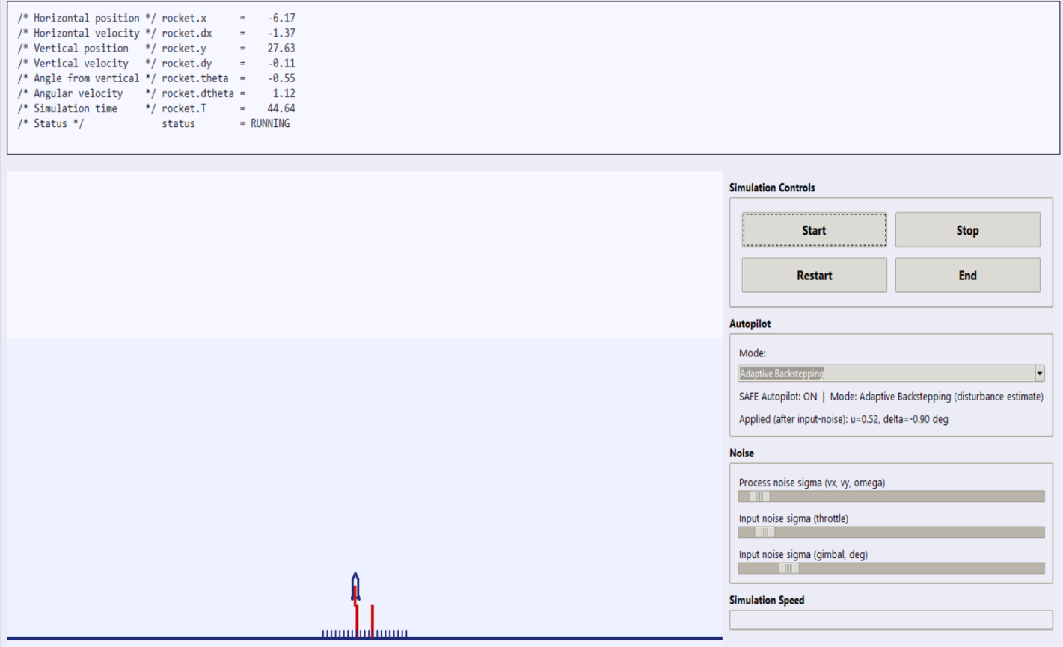
Simulation / Code demonstration

Slide 10
Some comments / discussion
Controller architecture (big picture): We generate safe velocity targets, track them with PD to get desired accelerations, convert that to a desired thrust vector + throttle, and stabilize attitude with an inner loop—while saturations/clamps enforce real actuator limits.
MIT controllers succeeds whereas AB controller does not (possible filxes?)
We can combine both of these controllers
Other types of controllers?
Limitations & next steps: Better contact/landing dynamics, improved estimation (filters for accel/vel), systematic gain tuning via Monte-Carlo noise/wind, and (if needed) more advanced guidance/optimal control for fuel/time efficiency.
-

Slide 11
Bibliography
Guided Tours
https://ntrs.nasa.gov/api/citations/19960003439/downloads/19960003439.pdf
Adaptive Backstepping Control for Flight Simulator | IEEE Conference Publication | IEEE Xplore
lewisgroup.uta.edu/ee5323/notes/Slotine and Li applied nonlinear control- bad quality.pdf
Robust and Adaptive Control: With Aerospace Applications | Springer Nature Link

