Slide 1

Data Science & Analytics Project
2025
Valentine's Dataset Analysis
A comprehensive exploration of Valentine's Day sales patterns, customer behavior, and revenue optimization strategies in 2023

Slide 2
Presentation Roadmap
01
02
03
Project Overview
Problem Statement
Dataset Overview
Understanding the scope and objectives of our Valentine's Day sales analysis
Identifying critical business challenges and knowledge gaps
Exploring the comprehensive sales data from Kaggle
04
05
Data Cleaning & Preprocessing
Dashboard & Insights
Ensuring data quality through rigorous preprocessing
Visualizing patterns and deriving actionable recommendations

Slide 3
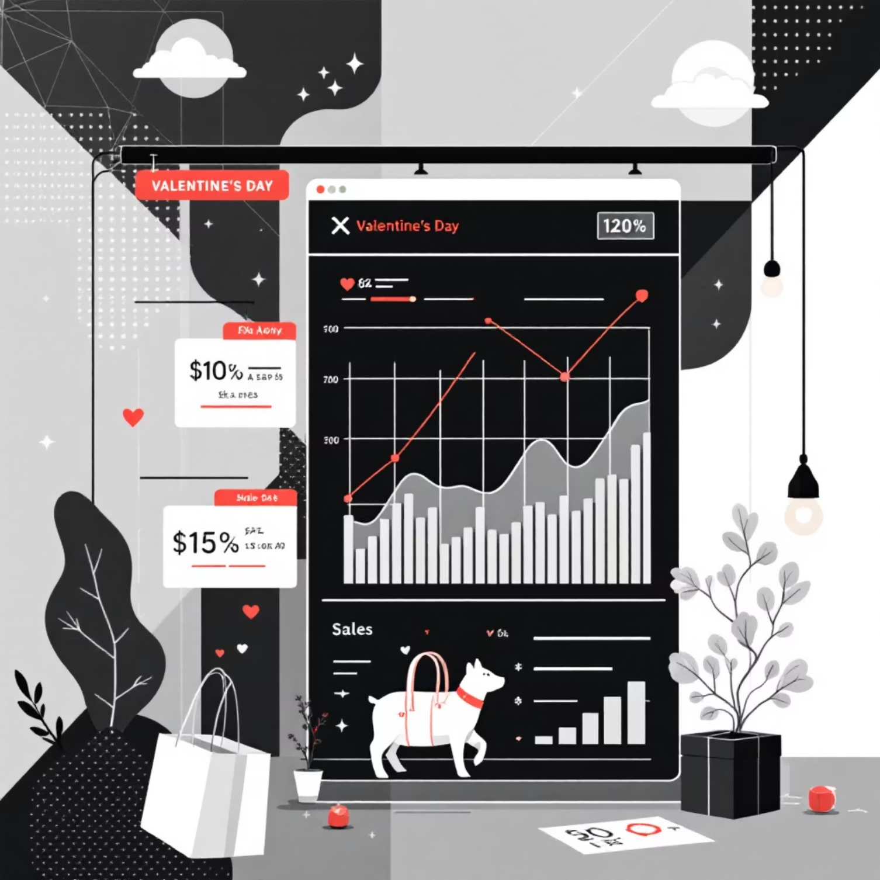
Project Overview
This project provides a comprehensive analysis of Valentine's Day sales activities, revealing the underlying factors behind customer purchasing decisions and product performance. Our investigation spans multiple dimensions of consumer behavior, from demographic patterns to temporal purchasing trends.
Key Focus Areas:
  Customer purchasing behavior and segmentation
  Top-selling product identification and analysis
  Revenue measurement and optimization opportunities
  Peak buying hours and sales trend patterns
  Payment method preferences across customer segments
The final deliverable offers strategic insights and data-driven recommendations aimed at enhancing future Valentine's Day sales strategies, optimizing inventory management, and maximizing profitability.

Slide 4

Problem Statement
The Challenge
Despite achieving a solid Valentine's Day sales performance, the business operates without clear visibility into the drivers of success. Critical questions remain unanswered about product performance, customer preferences, and purchasing behavior patterns
Knowledge Gaps
Which products delivered the strongest performance?
What payment methods do customers prefer and why?
What factors influenced buying decisions and timing?
How do customer segments differ in their behavior?
Business Impact
Without actionable insights, the business struggles to plan effective promotions, manage inventory strategically, and refine sales approaches. This project bridges these gaps by transforming raw data into clear, strategic intelligence for future Valentine's Day campaigns.

Slide 5
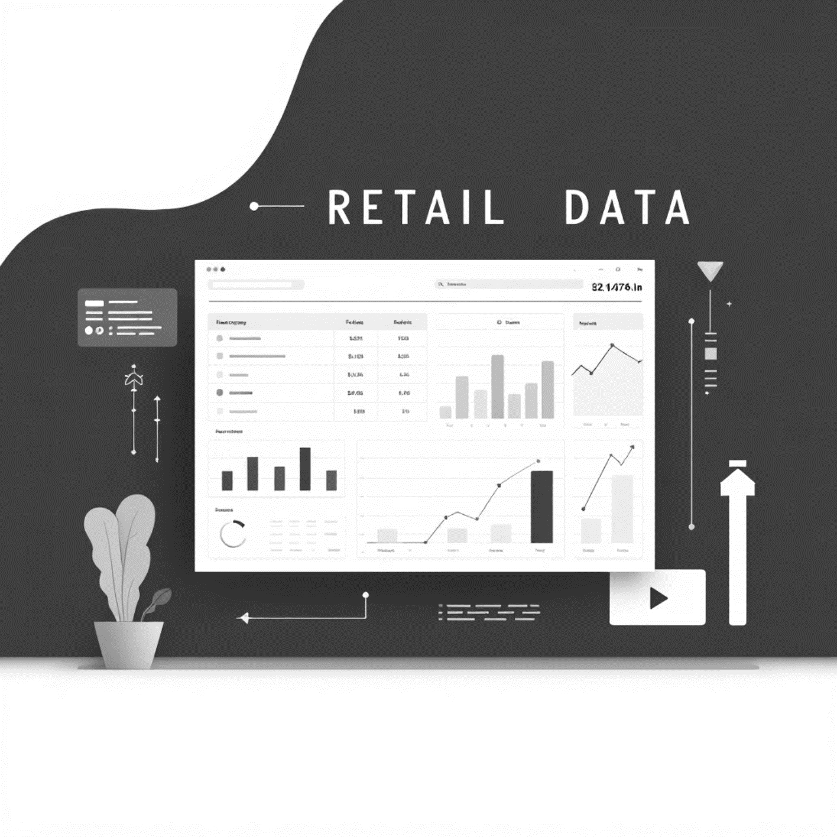
Dataset Overview
Comprehensive Valentine's Day Transaction Data
Our dataset, sourced from Kaggle, provides a rich, multidimensional view of customer purchasing behavior during Valentine's Day. It captures the complete customer journey, from search patterns to final purchase decisions.
Data Dimensions Include:
  Transaction details: items, prices, and quantities
  Customer demographics: gender and age groups
  Membership tiers and loyalty patterns
  Search behavior and product discovery
  Geographic distribution and location data
  Payment methods and transaction times
  This real-world-inspired dataset enables businesses to decode consumer preferences, optimize marketing strategies, and make data-driven decisions for future Valentine's Day events.

Slide 6



Analytical Toolkit
Microsoft Excel
Power BI
Microsoft PowerPoint
Data cleaning powerhouse: Systematic removal of errors, duplicates, and incomplete records ensuring data integrity
Visualization engine: Creating dynamic, interactive charts and graphs that bring data stories to life
Communication platform: Crafting professional reports that translate complex data findings into clear narratives
Transformation capabilities: Sorting and categorizing products, summarizing payment methods, and calculating revenue metrics to identify top performers
Dashboard development: Building comprehensive analytical dashboards that enable stakeholders to explore insights intuitively and make informed decisions
Presentation design: Delivering compelling visual presentations that engage stakeholders and drive actionable business outcomes

Slide 7
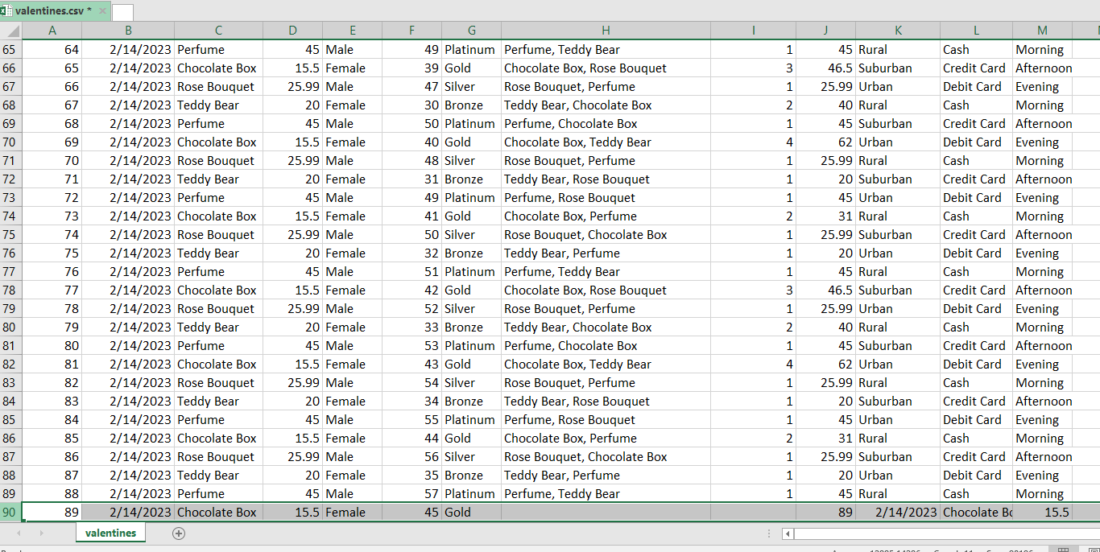
Data Cleaning & Preprocessing
Our rigorous data preprocessing workflow ensures the highest quality analytical foundation. Through systematic identification and resolution of data quality issues, we transformed raw transactional data into a clean, reliable dataset ready for deep analysis and insight generation.

Slide 8
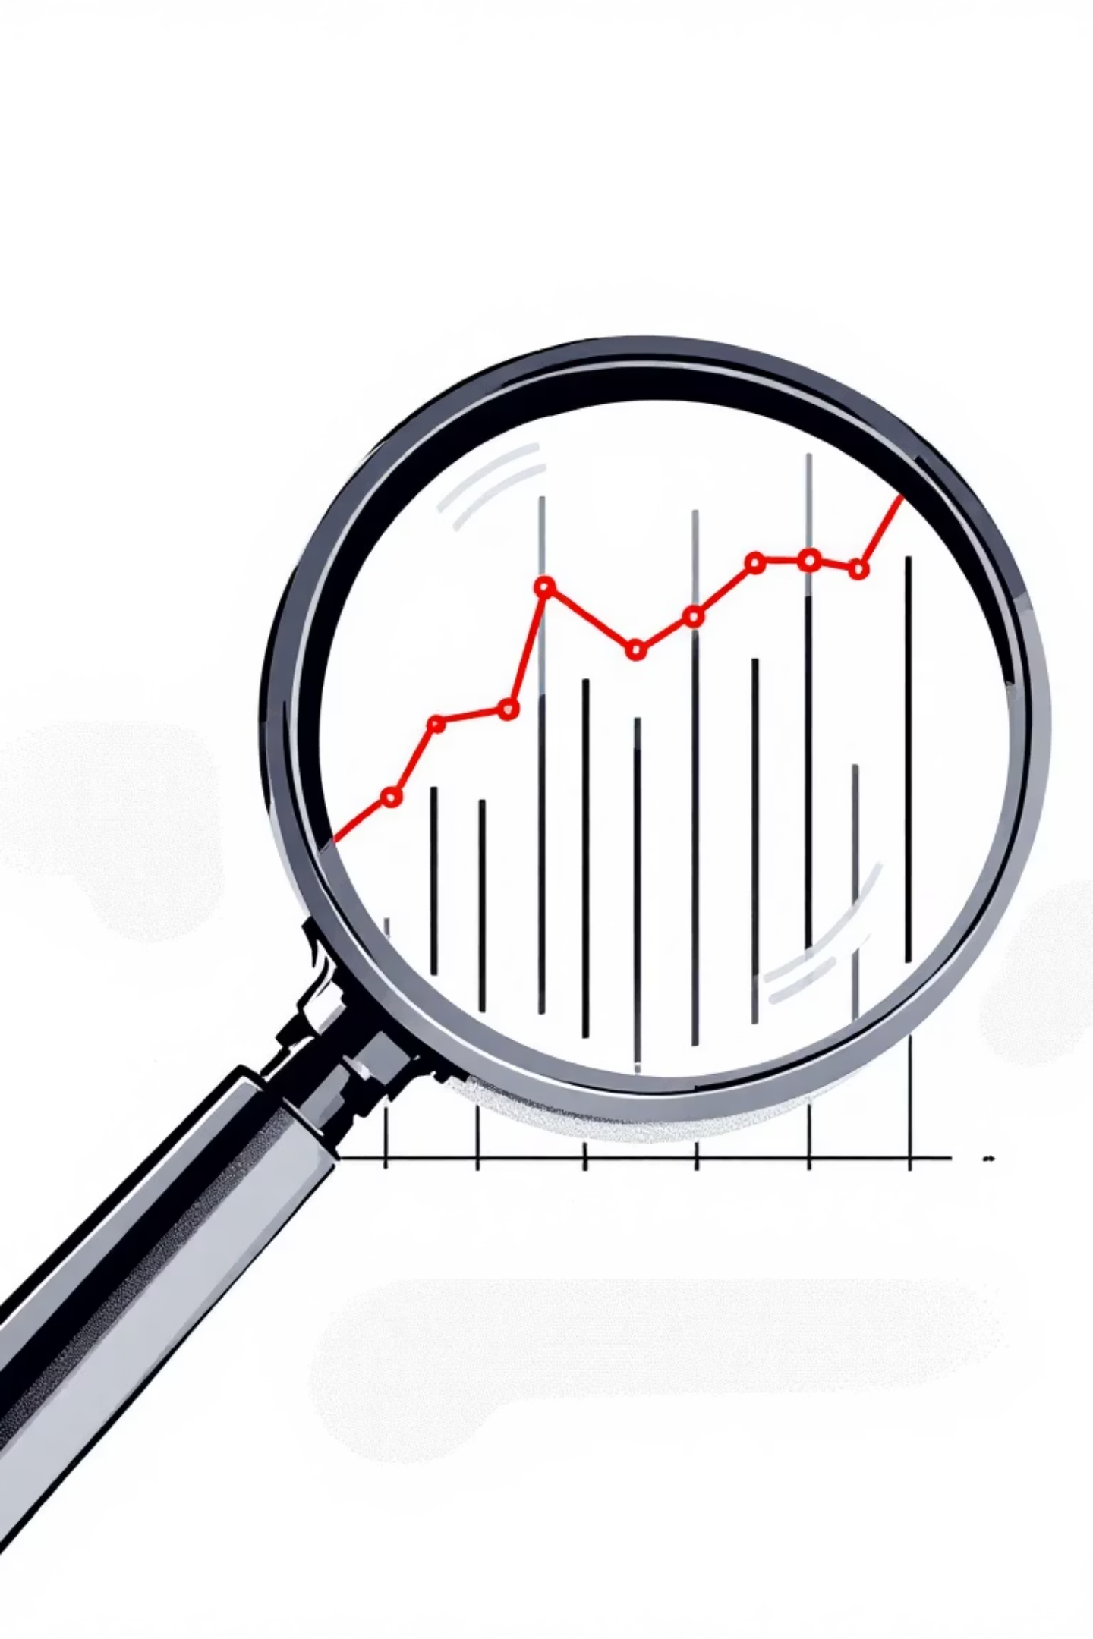
Data Quality Issues Identified
1
2
1
Null Cell Detection
Outlier Identification
Location: Cells H90 and I90 contained missing values that required strategic imputation to maintain data integrity and analytical accuracy
Cell J90: The value 89 represented a statistical anomaly, falling significantly outside the normal distribution range observed throughout the column
3
Datatype Inconsistencies
Cells K90, L90, M90: Mismatched datatypes disrupted pattern consistency and required standardization to align with established column formats
Row 90 Analysis: Comprehensive review revealed multiple data quality challenges requiring systematic resolution through pattern analysis and statistical methods

Slide 9
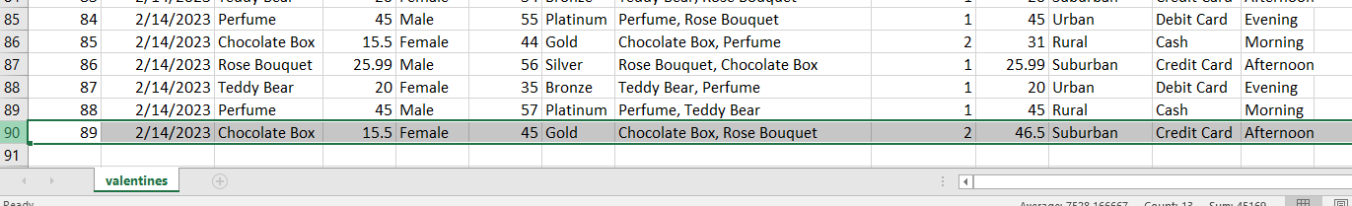
Data Cleaning Solutions
Null Cell Resolution
H90: Applied pattern recognition methodology, analyzing adjacent rows to identify "Chocolate Box, Rose Bouquet" as the appropriate value
I90: Implemented statistical imputation using rounded average: =ROUNDUP(AVERAGE(I2:I89),0)
Outlier Correction
J90: Recalculated revenue using price-quantity multiplication: =D90*I90, ensuring accurate financial metrics aligned with business logic
Datatype Standardization
K90: Corrected to "Suburban" following geographic classification patterns
L90: Standardized to "Credit Card" matching payment method taxonomy
M90: Aligned to "Afternoon" consistent with temporal categorization

Slide 10
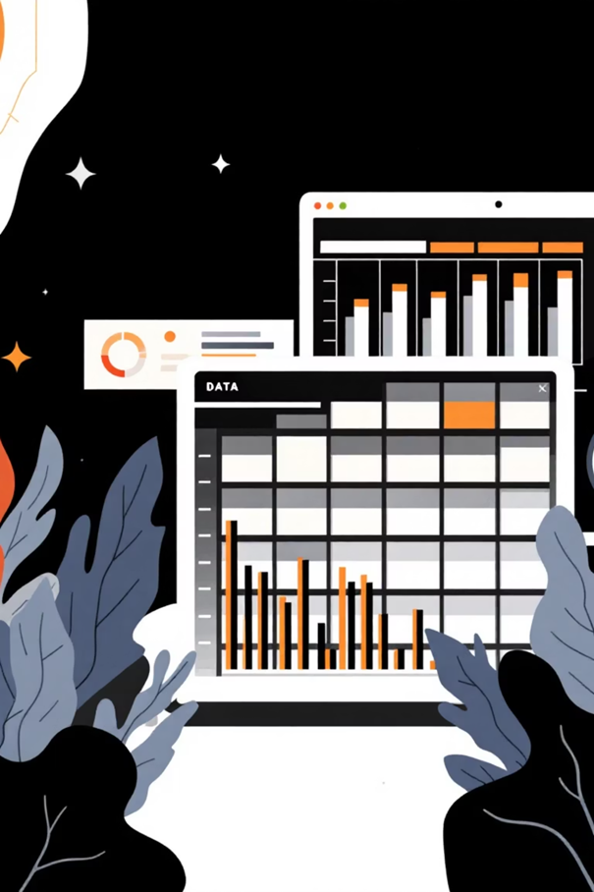
Limitations
The analysis covers only one day(Valentine's day), so it may not fully represent overall customer behaviour.
External factors like weather, promotions and competitions cannot be fully measured.
The project depends on the accuracy of the data obtained.

Slide 11
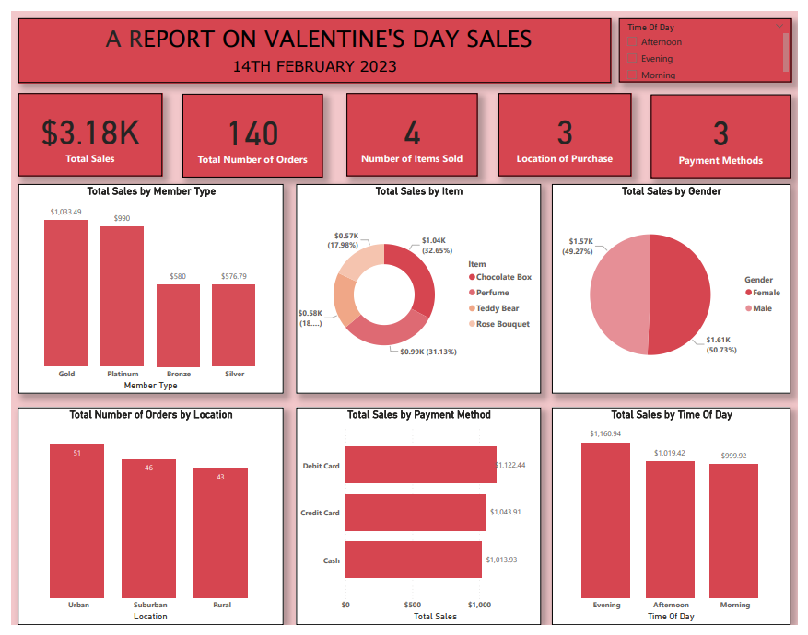
Valentine’s Dataset Dashboard
(18.24%)

Slide 12

Analysis and Insights
Overview of Valentine’s Day Sales Dashboard
  Total Sales: $3.18K.
  Total Orders: 140 units.
  We notice strong customer engagement during the Valentine’s season.
Customer Analysis
  Gold and Platinum members made most sales.
  Equal buying from men and women.
Product Performance
  Perfume and chocolate boxes made up over 60% of sales.
  Teddy bears and roses had moderate sales.
  Top products match Valentine’s gift trends.

Slide 13

Analysis and Insights contd.
Location
  Most orders from urban areas
  Suburban next; rural lowest
  Sales drop linked to accessibility to the customer
Payment Methods
  Debit and credit cards are used most
  Cash least used
  Shows a preference for digital payments
Time-of-Day Sales
  Evening sales highest
  Afternoon moderate
  Morning sales lowest
  Most customers likely shop after work hours

Slide 14

Recommendations
Offer loyalty perks to gold members, e.g., priority delivery, gifts
Focus stock and advertisements on perfume and chocolates during Valentine’s season
Improve rural sales with delivery offers and advertisements
Run evening flash sales or promotions to boost peak sales time
Encourage digital payments with incentives like discounts
Improve digital payment speed
Encourage contactless checkout
Introduce bundles like Teddy Bear & Chocolate combo, Rose & Chocolate combo.

