Slide 1
Student Attendance System

Slide 2
System Requirements
DATA BASE:
For all Students information.
For all courses in the semester.
Admin:
control student information.
has authority to modify on student data-base server.
manage student attendance & attendance marks.
Student:
Sign up to the system.
Submit required data.
Log in Attendance.

Slide 3
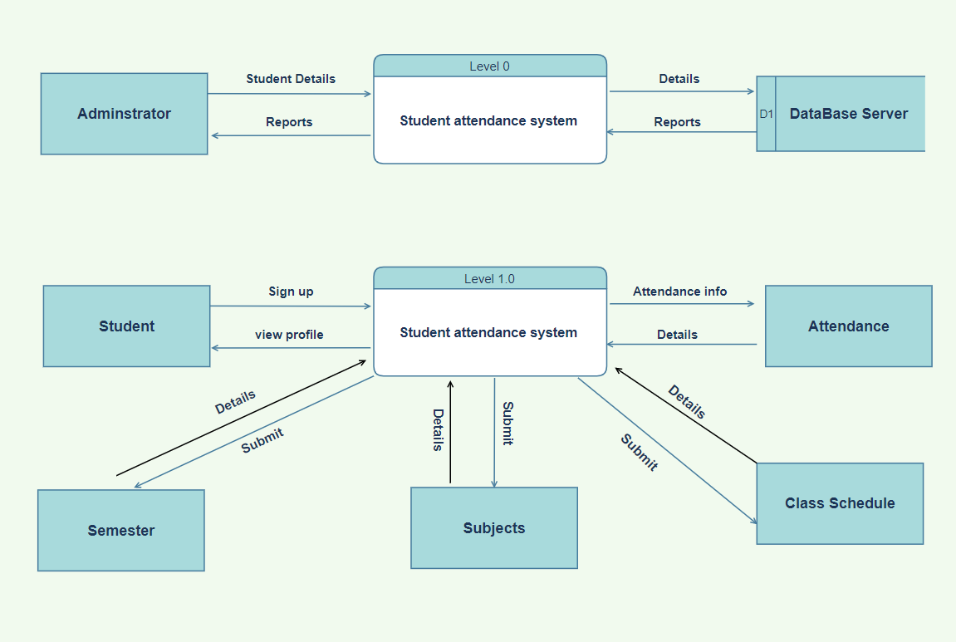
Data Flow Diagram

Slide 4
Use Case Diagram

Slide 5
First Actor (Student):-
Sign Up: Student should sign up to join into the system.
Submit: Student should submit to (Semester – Subjects - Schedule).
Log in Attendance: Student should submit his Attendance.
View Attendance: Student should be able to know his Attendance.
Attendance Report: If a student face any problem he can report it.

Slide 6
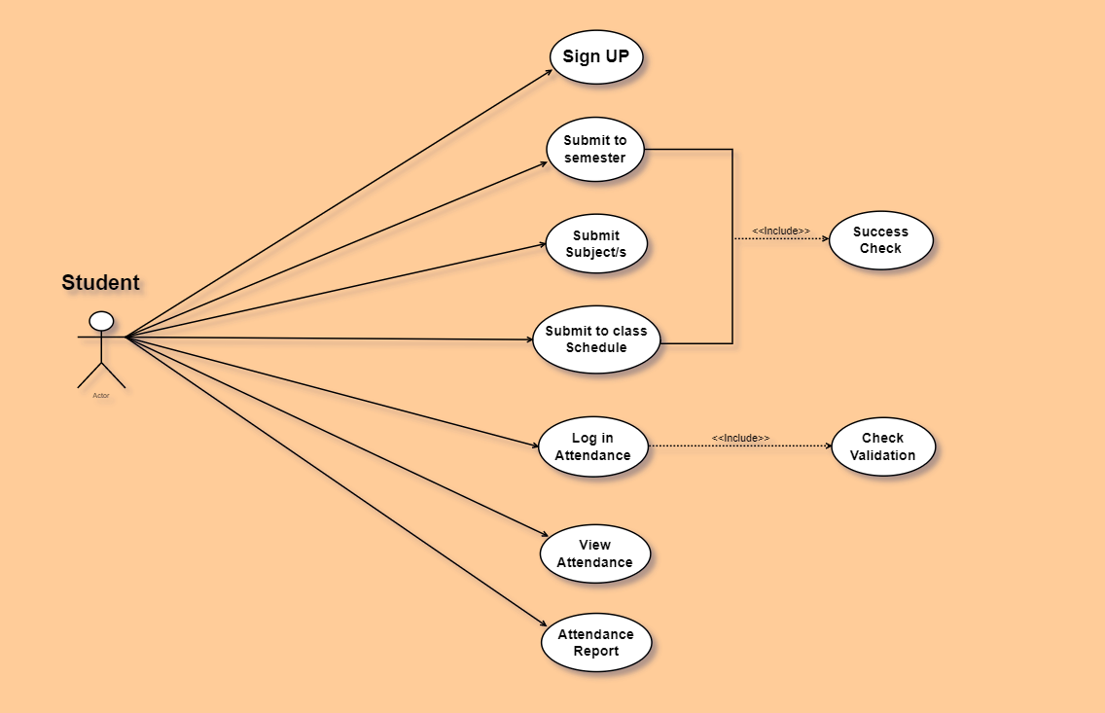

Slide 7
Second actor (Admin)
Update student profile/s: Admin has the authority to change student information at any time.
Manage profiles: Admin has access to all student information at any time.
Mark Attendance: Admin is responsible for all student’s attendance marks.
Manage Attendance: Admin has access to all student’s attendance marks.
Search about student: Admin can find any student easily ase he has access to student’s Data-base.

Slide 8
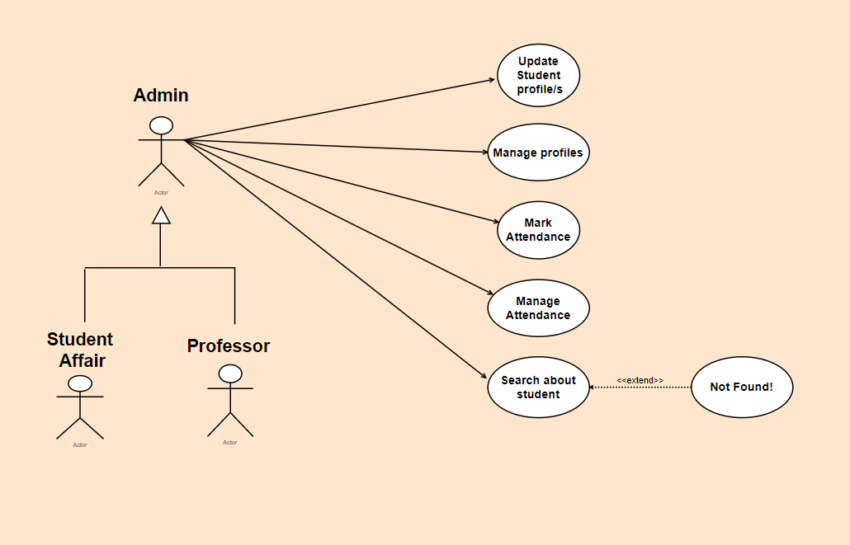

Slide 9
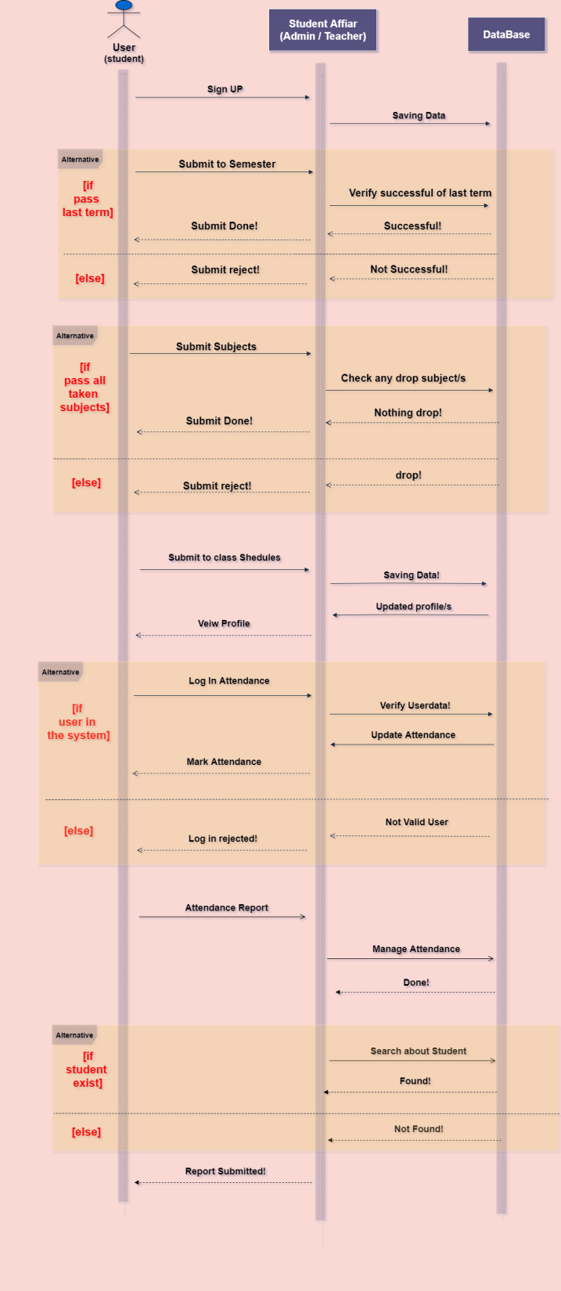
Sequence Diagram

Slide 10
System sequence Diagram

Slide 11
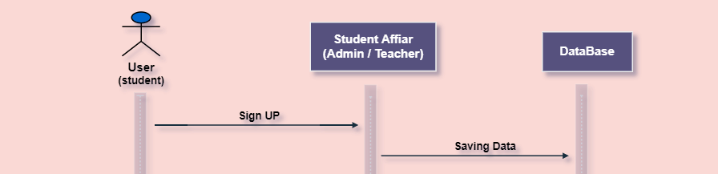
First Stage
Student sign up to join the system, then Admin save his data into the data-base server.

Slide 12
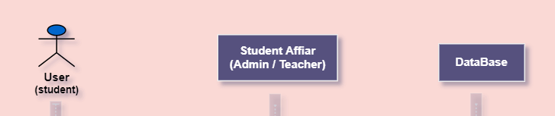
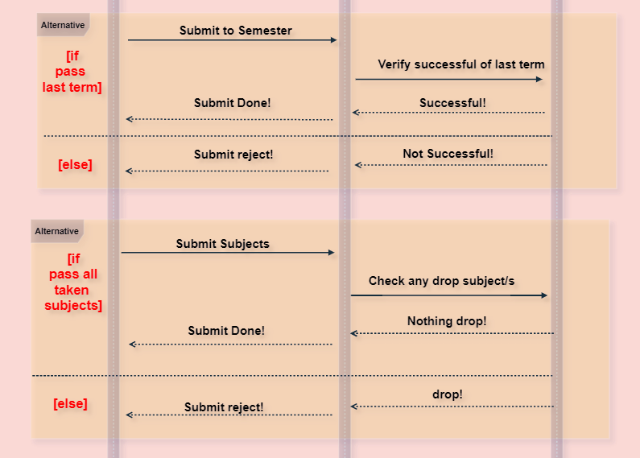
Second Stage
Student submit to semester only if he pass last semester.
After that he could submit to semester’ subjects only if he didn’t have any drop subjects from last years.

Slide 13
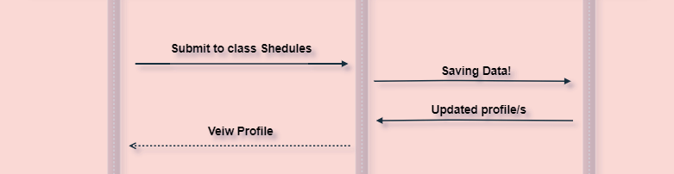
Third Stage
Student finally make last submit for class schedule.
After completing submit processing, his profile will be updated and he will be able to se his profile.

Slide 14
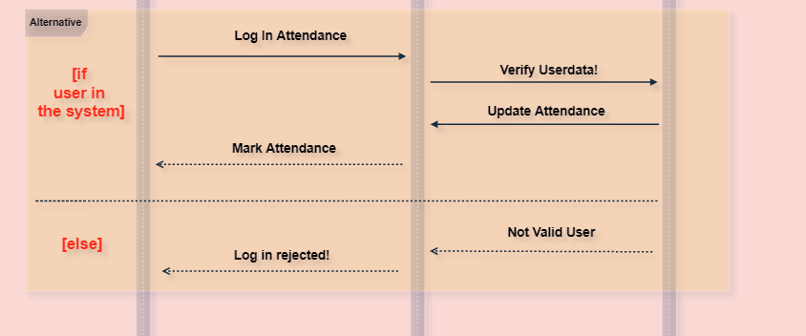
Last Stage
Finally Student Log in his attendance class, and after checking his data in data-base his attendance’s data will be updated and he will have his attendance’s marks.

Slide 15
Activity diagram

Slide 16
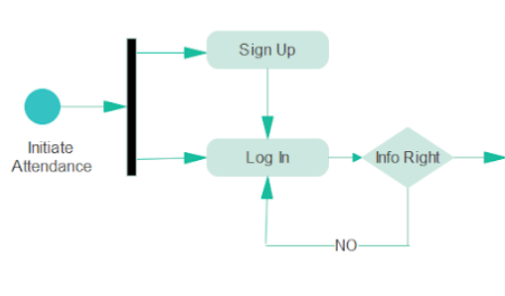
First stage: (1) The person enters the system through two stages, either sign up or log in (2) If the login is correct, it will enter the system, but if the registration is incorrect, it will be registered again.

Slide 17
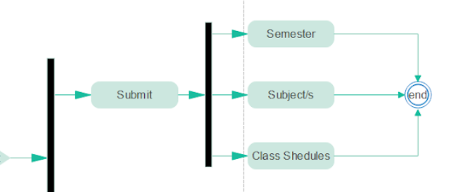
Second stage: (1) The person makes a submission and chooses from 3 options, either registering the term, subjects, or class schedules (2) After the registration process, it reaches the end.

Slide 18
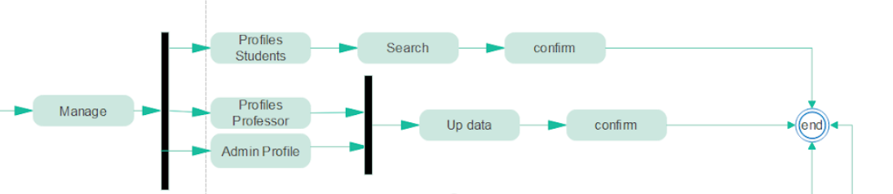
third stage: (1) A person edits his account, whether he is a student, professor or admin. (2) If he is a student, he will search for his name and he will make a confirmation. If he is a professor or an admin, he will make an amendment to the data, and they will confirm and reaches the end.

Slide 19
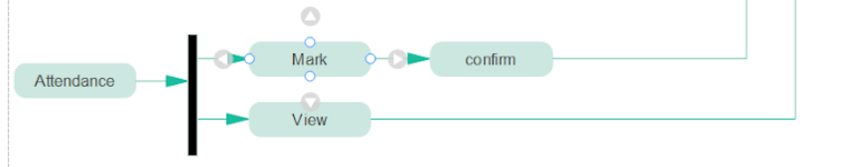
fourth stage: (1) The student can sign the attendance or the professor and the admin can view the attendance. (2) after that reaches the end.

Slide 20
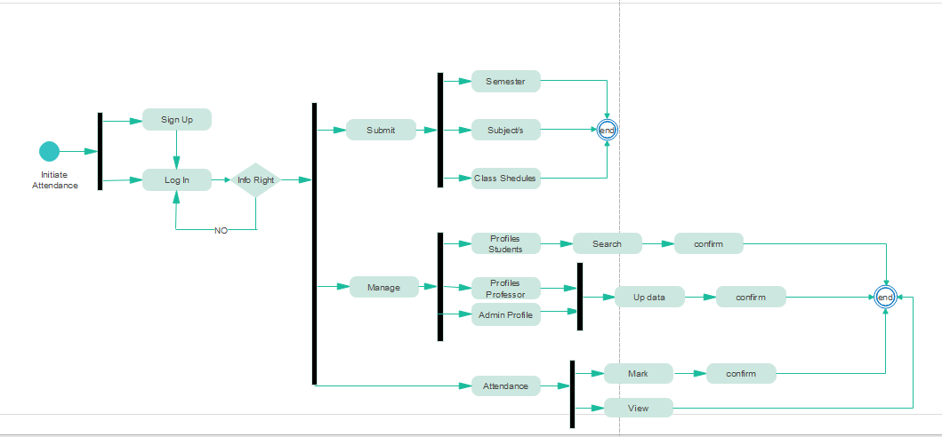
Activity diagram:

Slide 21
Class diagram

Slide 22
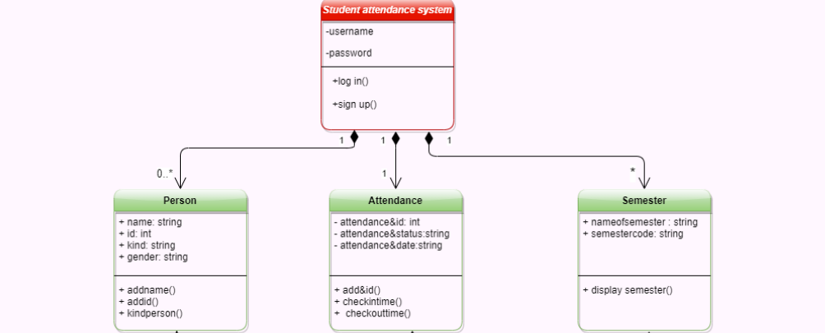
First stage: (1) person enters to system through two stages, username and password. (2) The system is related to 3 things person ,attendance and semester

Slide 23
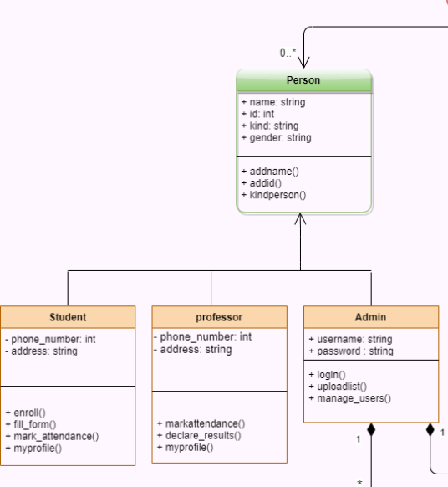
second stage: (1) person is father to 3 children students, professor and admin. (2) The user chooses any one of them and the entry is made according to the operations he does not want to perform

Slide 24
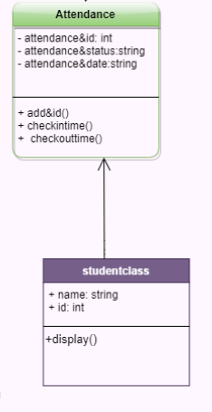
third stage: (1) Entry is made to attend and sign the status, date and time of attendance and exit (2) There is a class with all the previous specifications, with the addition of an attendance display

Slide 25
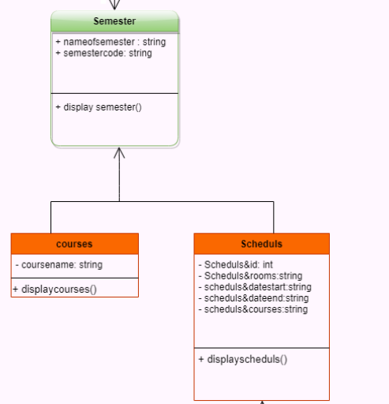
fourth stage: (1) Entry to semester and sign the name of semester, display all or one semester (2) There are 2 class courses and schedules with all details

Slide 26
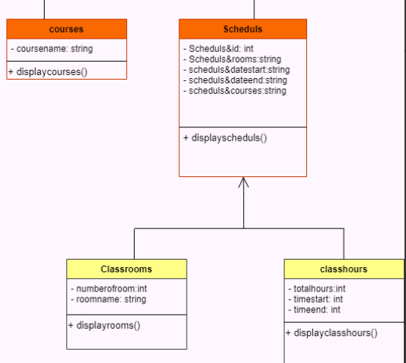
fifth stage: (1) schedules contain of rooms ,date start, date end, courses. (2) There are 2 class, class rooms and class hours with all details

Slide 27
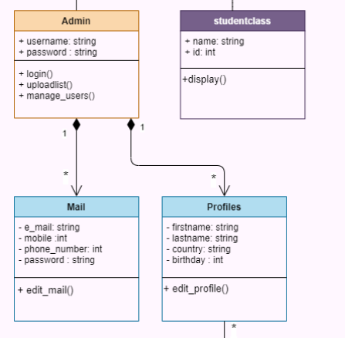
Sixth stage : (1) admin is responsible for controlling users and for modifications. (2) There are 2 class mail and profiles with all details

Slide 28
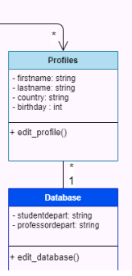
Seventh stage : (1) admin is responsible for profiles users and edit its. (2) There is class data base to check or save every thing

Slide 29
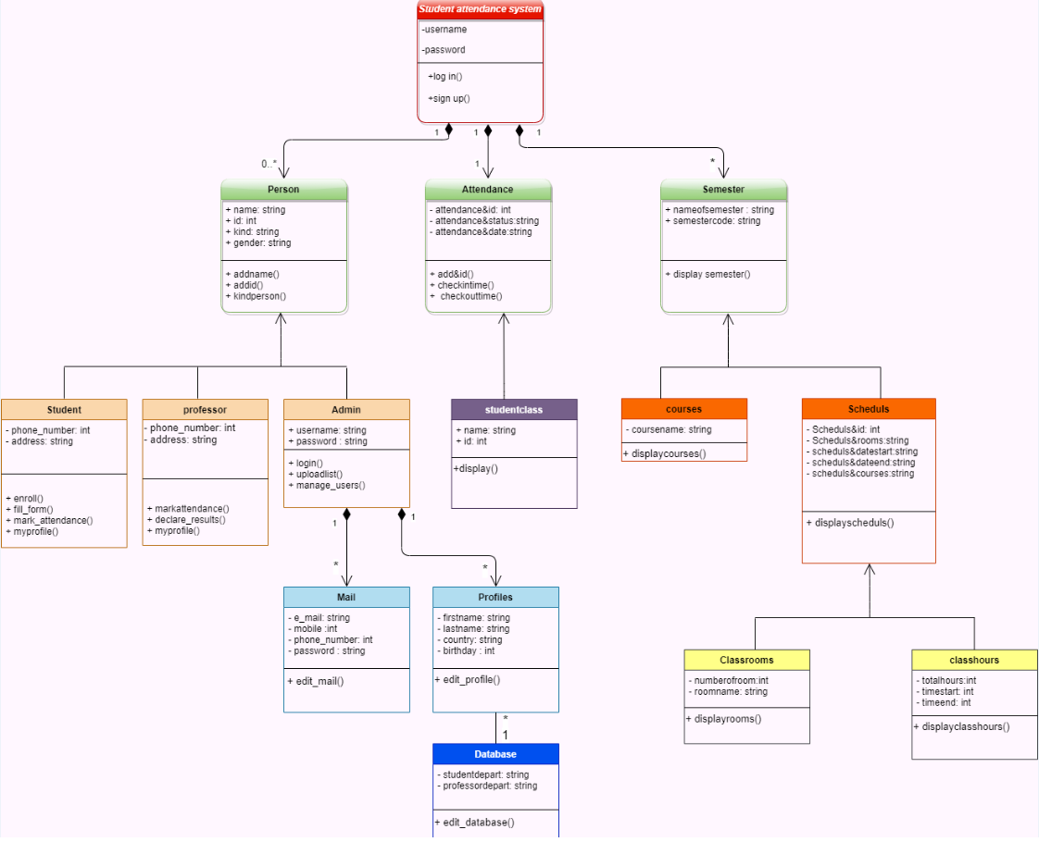
Class diagram:

