Slide 1
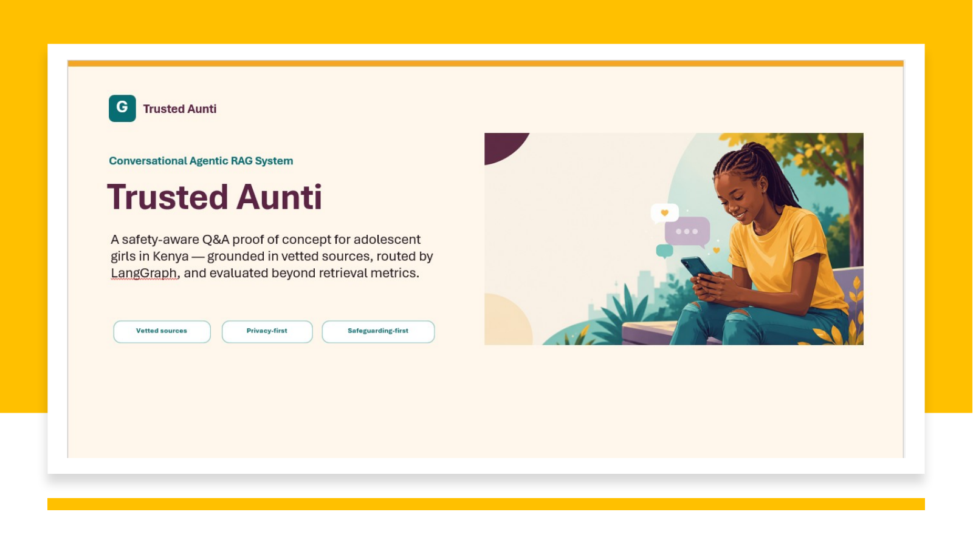

Slide 2

FINAL INTERVIEW · REFINED BUILD
Trusted Aunti, refined around the outcome that matters
From a technically broad prototype to a simpler product focused on safe, grounded service access.
THE PRODUCT QUESTION
Alex Fulcher
Can a trusted conversation help a girl move from uncertainty to a safe next action
Senior Director, Tech & Product
Girl Effect
Grounded
Private
Safeguarded
Useful
“The biggest impact for me is seeing a solution increase girls’ access to contraception in Ethopia, helping them stay in education and have more control over their future.”
Paraphrased from our first interview conversation.
Framing: interview feedback + refined project scope. The downstream impact is the goal, not a claim established by this PoC.
Trusted Aunti · Girl Effect Data Scientist Practical Assignment
01

Slide 3
WHAT CHANGED
I treated the feedback as a product experiment
The question was not “how do I make it smaller?” but “which parts actually earn their place?”
“The solution was overengineered in places. Show us a more refined version focused on delivery of the use case.”
PREVIOUS SHIPPED SYSTEM C
REFINED BUILD
Broad, multi-model control graph
Minimum justified complexity
5 model roles
classification, evidence, generation, judging
1 hosted model
generation only
2 LLM judges
evidence + output
Rules first
routing, safeguarding, validation
4 content tracks
broader health/life-skills scope
8 governed docs
contraception + sexual health + service access
12 / 51
unhelpful actions in the old benchmark
3 / 52
deterministic unusable outcomes in the current run
What did not change: a universal safety floor · grounded factual answers · verified services · youth-facing conversation.
Note: the old and refined “unhelpful/unusable” instruments differ; the comparison is directional, not a precise percentage reduction.
Trusted Aunti · Girl Effect Data Scientist Practical Assignment
02

Slide 4
THEORY OF CHANGE IN PRODUCT
A girl worried after unprotected sex, reaching HIV testing
Girl Effect’s behavioural journey translated into one conversation — from trusted discussion to a stated next action.
RAPPORT
KNOWLEDGE
SELF-EFFICACY
INTENT · CONVERSION TURN
SERVICE ACCESS
BEHAVIOUR CHANGE SIGNAL*
“niaje aunti”
“Can you tell if someone has HIV just by looking at them?”
“I think I should get tested, but I am scared of what they will say about me.”
“Okay, tell me what actually happens when you go for an HIV test.”
“Where can I actually go for one?”
“Asante sana aunti, I will text them tomorrow.”
→
→
→
→
→
WHAT TRUSTED AUNTI DOES
WHAT TRUSTED AUNTI DOES
WHAT TRUSTED AUNTI DOES
WHAT TRUSTED AUNTI DOES
WHAT TRUSTED AUNTI DOES
WHAT TRUSTED AUNTI DOES
Create a private, non-judgmental space where she is willing to keep talking.
Correct the myth with grounded evidence and explain that testing is the only way to know.
Acknowledge the fear of judgement and help her name the barrier without pushing her.
Explain the testing process clearly and surface verified contacts while she is weighing up going.
Move from information to practical access: where to go, what options exist, and how to reach help.
End with agency: the next step is hers, and the system does not pressure or overclaim the outcome.
Marie Stopes · One2One
The product does not push her through stages. It removes the barrier in front of her and makes the next safe action easier.
* Self-reported next action, not verified HIV-test uptake. The PoC measures the conversation and service-access pathway, not downstream behaviour.
Journey: refined project README · Theory of Change framing: Girl Effect AI/ML whitepaper.
Trusted Aunti · Girl Effect Data Scientist Practical Assignment
03

Slide 5
ARCHITECTURE
Refined architecture: complexity only where it earns its place
Safeguarding is a gate, not a route. Only generation uses a hosted LLM.
1
VALIDATE
2
SAFEGUARD
3
ROUTE
4
RESOLVE
input + scope checks
→
screen for harm, coercion or urgent risk
→
choose action: factual · access · support · chat
→
link a short follow-up to recent context
↓
8
CHECK
7
GENERATE
6
RETRIEVE
5
PREPARE
enforce citations + safety rules
←
one hosted LLM writes the response
←
local BGE-M3 finds governed evidence
←
focus what retrieval should search for
If safeguarding fires, the pipeline stops.
Only Generate calls the hosted model.
Approved safety response + verified contacts · no retrieval · no hosted LLM
Everything else is deterministic or local · BGE-M3 encodes locally
Resolve = understand the follow-up · Prepare = focus retrieval. Both are conditional.
Trusted Aunti · Girl Effect Data Scientist Practical Assignment
04

Slide 6
EVALUATION APPROACH
Five tests, one product
Different failure modes need different tests — not one flattering chatbot score.
1
DECISION
2
RETRIEVAL
3
MULTI-TURN
4
MIXED INTENT
5
CONVERSATION
Right action (52)?
Answerable evidence (31 )?
Follow-ups stay safe (23)?
Feelings + facts separated (15)?
Usable final reply (38)?
route · safeguarding · contrast pairs
Adequate@5 · MRR · ToC drivers
path accuracy · forbidden passages
wanted vs unwanted evidence
grounding · continuation · calls
Together, the five tests cover:
Safeguarded
Accurate
Reliable
Resonant*
* Resonance here uses deterministic proxies. Warmth, trust and cultural authenticity still need human / youth review.
Trusted Aunti · Girl Effect Data Scientist Practical Assignment
06

Slide 7
EVALUATION RESULTS
Previous System C vs refined build
A directional comparison of safety, usefulness, decision quality and model dependence.
WHAT WE MEASURED
PREVIOUS SYSTEM C
REFINED BUILD
WHAT CHANGED
Safety
0 unsafe actions
12/12 recall
Safety retained
51-case benchmark
12/12 precision
Usefulness
12 / 51
3 / 52
Fewer dead ends*
unhelpful actions
unusable outcomes
Decision quality
0.745
52 / 52
Rules replaced planner
action accuracy
route accuracy
Model dependence
3.53
0.69–1.03
≈3.4–5.1× fewer
LLM calls / turn
LLM calls / turn
REFINED BUILD — ADDITIONAL QUALITY CHECKS
RETRIEVAL
GROUNDING
MULTI-TURN
CONVERSATION
Adequate@5 .960
24 / 24 cited
forbidden 1 → 0
38 / 38 usable
* Old = LLM-judged “unhelpful actions”; refined = deterministic blocked / no-evidence / provider-error outcomes. Instruments and datasets differ, so read this directionally.
Refined 3/52 = 1 validator block + 2 no-evidence + 0 provider errors; 8 correct out-of-scope declines are excluded.
Trusted Aunti · Girl Effect Data Scientist Practical Assignment
07

Slide 8

WHAT NEXT
The next proof comes from girls, clinicians and services
The prototype is ready. The next step is to validate it with the people and institutions around it.
1
Test with real girls
Run youth testing in Kenya to check trust, clarity, warmth and whether the conversation feels natural and useful.
2
Verify with health & safeguarding
SRH clinicians and safeguarding/policy reviewers validate HIV, contraception and referral content before wider use.
3
Measure real service access
The goal is not another model node — it is safer conversations, stronger agency and real access to care.
Work with service partners to confirm contacts and measure whether intent leads to safe HIV testing or other SRH service uptake.
Beyond the prototype: validate trust, validate content, validate that girls actually reach services.
Trusted Aunti · Girl Effect Data Scientist Practical Assignment
08

