Slide 1



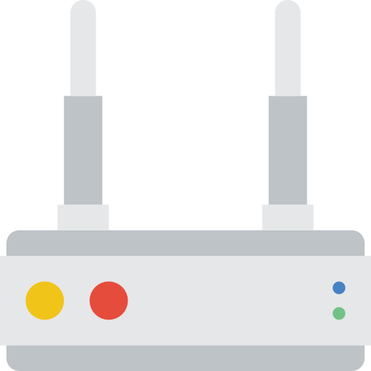
Onos
Sender
MANE
Receiver
a

